Slide 1
Structure of IR Systems
INST 734
Module 1
Doug Oard
Notes:
1

Slide 2
Segments
The nature of Information Retrieval (IR)
What IR systems do
The structure of interactive IR systems
Notes:
2

Slide 3
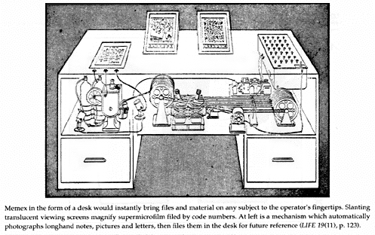
Systems: The Memex

Slide 4
Types of Information Needs
Retrospective (“Retrieval”)
  “Searching the past”
  Different queries posed against a static collection
Prospective (“Recommendation”)
  “Searching the future”
  Static query posed against a dynamic collection
Notes:
When we’re talking about information retrieval, we’re talking mainly about searching.

Slide 5
Two Ways of Searching
Controlled
Vocabulary
Searcher
Free-Text
Searcher
Author
Indexer
Construct query from
terms that may
appear in documents
Write the document
using terms to
convey meaning
Choose appropriate
concept descriptors
Construct query from
available concept
descriptors
Content-Based
Query-Document
Matching
Metadata-Based
Query-Document
Matching
Query Terms
Document Terms
Document Descriptors
Query Descriptors
Retrieval Status Value

Slide 6
The IR Black Box
Documents
Query
Hits

Slide 7
Inside the IR Black Box
Documents
Query
Representation
Function
Representation
Function
Query Representation
Document Representation
Index
Comparison
Function
Hits

Slide 8
Utility
Human Judgment
Information Need
Document
Query Formulation
Query Processing
Query
Document Processing
Representation Function
Representation Function
Query Representation
Document Representation
Comparison Function
Retrieval Status Value
Notes:
6
Start 1:20

Slide 9
Relevance
Relevance relates a topic and a document
  Duplicates are equally relevant, by definition
  Constant over time and across users
Pertinence relates a task and a document
  Accounts for quality, complexity, language, …
Utility relates a user and a document
  Accounts for prior knowledge

Slide 10
Comparing Databases and IR
Databases
IR
What we’re retrieving
Structured data. Clear semantics based on a formal model.
Mostly unstructured. Free text with some metadata.
Queries we’re posing
Unambiguous formally (mathematically) defined queries.
Vague, imprecise queries (and information needs)
Results we get
Exact. Always correct in a formal sense.
Sometimes relevant, often not.
Interaction with system
Single query produces a complete answer.
Interaction sequence can help resolve vagueness.
Nature of the content
Able to handle real-time updates.
Updates can often be processed offline.

Slide 11
Segments
The nature of Information Retrieval (IR)
What IR systems do
The structure of interactive IR systems
Notes:
2

