Slide 1
Web Search
Module 6
INST 734
Doug Oard

Slide 2
Agenda
The Web
Crawling
Web search

Slide 3
Crawling the Web

Slide 4
(Over-)Simplified Crawling Algorithm
Put a set of known pages on a queue
Repeat the until the queue is empty:
Take the first page off of the queue
Check to see if this page has been processed
If this page has not yet been processed:
Add this page to the index
Add each link on the current page to the queue
Record that this page has been processed

Slide 5
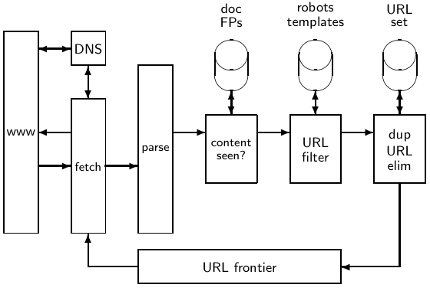
Basic crawl architecture

Slide 6
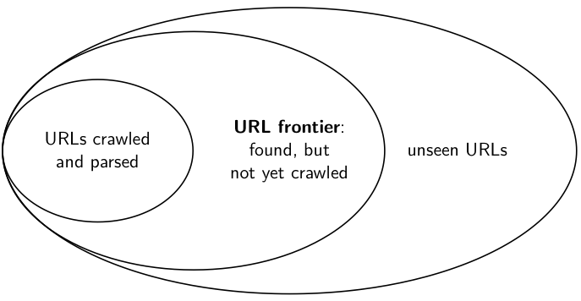
URL frontier

Slide 7
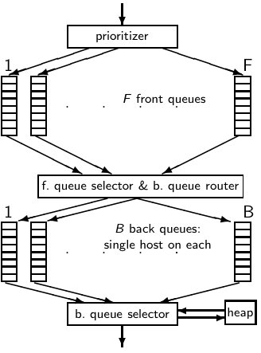
Mercator URL Frontier
URLs are obtained from new pages
Front FIFO queues for prioritization
Back FIFO queues enforce politeness

Slide 8
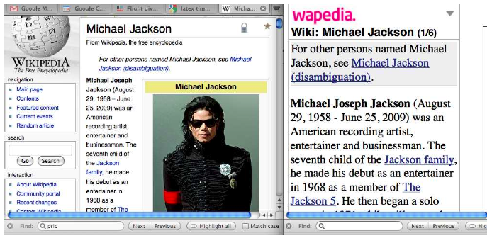
Near-Duplicates: Example

Slide 9
Shingling for Near-Dupe Detection
Create all unique word n-gram “shingles”
Compute Jaccard similarity of shingle sets
|A∩B| / |AUB|
If most are identical, call it a near-duplicate
Use locality-sensitive hashing for efficiency

Slide 10
Robots Exclusion Protocol
Exclusion by site
Create a robots.txt file at the server’s top level
Indicate which directories not to crawl
Exclusion by document (in HTML head)
Not implemented by all crawlers
<meta name="robots“ content="noindex,nofollow">
Both depend on voluntary compliance by crawlers
Servers can also refuse to serve a page to some clients

Slide 11
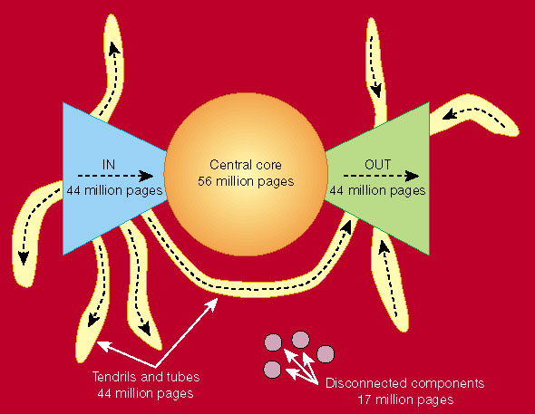
Link Structure of the Web
Nature 405, 113 (11 May 2000) | doi:10.1038/35012155

Slide 12
Web Crawl Challenges
Indexing “in”, “in tendril” and “island” pages
Managing server and network load (“politeness”)
Temporary server and network interruptions
Adversarial behavior (e.g., “spider traps”)
Near-duplicate detection (30-40% of total content)
Link rot (~1% per week)
Dynamic content generation

Slide 13
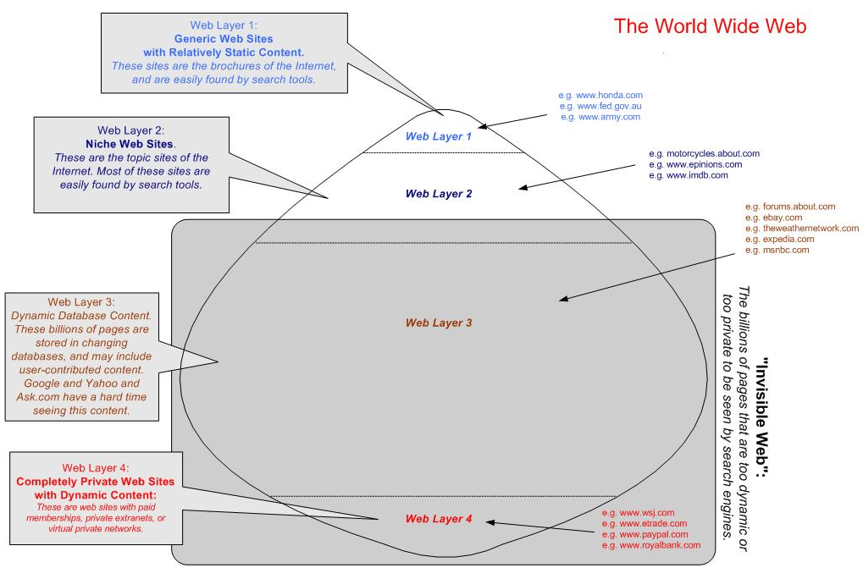

Slide 14
The “Deep Web”
Dynamic pages, generated from databases
Not easily discovered using crawling
Some content owners expose content for indexing
Far larger than the crawlable “Surface Web”
Image content, sensor data, data, restricted access, …

Slide 15
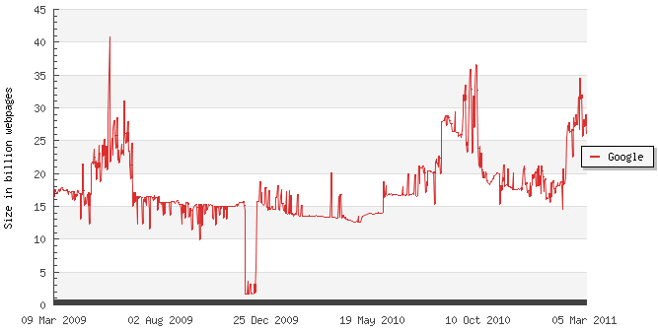
Estimated Size of the Indexed Web

Slide 16
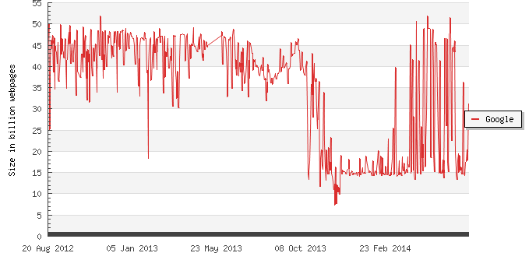
Estimated Size of the Indexed Web
Based on daily 50-word samples
http://www.worldwidewebsize.com

Slide 17
Agenda
The Web
Crawling
Web search

