Slide 1
ClueWeb09 Corpus Information Retrieval using Hadoop MapReduce

Slide 2
Research Problem
Used MapReduce algorithms to process a corpus of web pages and develop required index files
Inverted Index evaluated using TREC measures
Used Hadoop and Ivory

Slide 3
Dataset
ClueWeb09 Collection – 25 TB of uncompressed documents.
Project focusses on first 50 million English documents
For data verification, Document Record counters and Checksum values are present

Slide 4
System Designed
Inverted Index created using MapReduce
BM25 and Waterloo spam scores used to classify documents as spam or ham
14 node Hadoop cluster
Inverted Index was created using 112 cores and 336GB of RAM
Creation of Inverted Index took 2 hours 24 minutes and 228.7 GB space

Slide 5
Batch Evaluation
50 topics given by TREC
Graded relevance judgments given by TREC
The evaluation plan had the following features:
- Affordable
- Repeatable
- Insightful
- Understandable

Slide 6
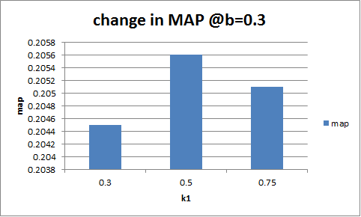
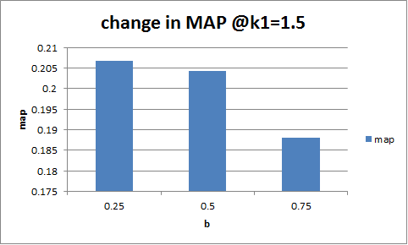
BM25 Parameters

Slide 7
Results and Conclusions
k1= 1.5 and b=0.3
Measures for BM25 | Spam-filtered | Spam-unfiltered | p-value (Paired T-test)
NDCG | 0.4685 | 0.4661 | 0.5364
P_30 | 0.3613 | 0.3540 | 0.1612
AP | 0.2109 | 0.2067 | 0.0231

Slide 8
Future Work
PageRank model can also be included with Waterloo spam scores
BM25F retrieval model would perform better as it takes into account the web page features like headings, anchor text etc.

