Slide 1
Rule 26(f)
MICHAEL D. BERMAN
mberman@rlls.com
410-206-5049
March 12, 2012
Conference of the Parties
a/k/a
“Meet and Confer”
This presentation does not contain or constitute legal advice.
No attorney-client relationship is created.
The views expressed are solely those of the author.

Slide 2
OLD VIEW OF LITIGATION
The vector of two damn lies is the truth.
  Anon.

Slide 3
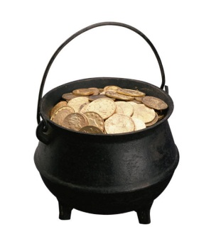
GOLD STANDARD & GAMING THE SYSTEM
Gold Standard:
  Human Review of Every Document
  Document Review Teams of Lawyers and Assistants
Gaming the System:
  Give Me Everything – Cookbook Discovery
  You Get Nothing
    You did not ask the correct question
    Boilerplate litany -
      Unduly vague, overly broad, and to the extent it seeks privileged documents, object. . . .
  Motion Practice – End of the Civil Trial

Slide 4
LITIGATION BY AMBUSH
When the federal discovery rules were adopted in 1938, civil litigation abandoned trial by ambush
Our system is an honor system in which information is exchanged upon request

Slide 5
UNDERLYING PHILOSOPHY - CHANGING
Original Intent:
  Lawyers handle discovery & Judges rarely become involved
Led to studies and loud complaints of “discovery abuse”:
  Courts became more involved
December 2006 ESI Amendments:
  G. Paul & J. Baron, “Information Inflation”
  Information has changed
    Litigation culture must change
    Early (1st?)call for cooperation

Slide 6

RESULT? SATELLITE LITIGATION
Decline in civility
Careers have been ruined – “marquee” sanctions
Forensic experts have been sued by the law firms that hired them
Courts complain – 100’s of hours to resolve fights
“Marquee” was coined by D. Willoughby, et al., 60 Duke L.J. 789 (2010).

Slide 7
UNDERLYING PHILOSOPHY
Discovery is too important to be left to the lawyers
  Apologies to Geo. Clemenceau (“war is too important to be left to the generals”)
    M. Berman, C. Barton, and The Hon. P. Grimm, eds., “Managing E-Discovery and ESI: From Pre-Litigation Through Trial” (ABA Jul. 2011), 422.
Judges take an early and active role
According to 60 Duke Law Journal 789,
Imposition of sanctions was at an
all-time high in 2010.

Slide 8

ANTITDOTE
Rule 26(f) provides a road map

Slide 9

ANTITDOTE
Previously, DISCOVERY was the path
DISCUSSION is the path compelled by the Rules

Slide 10
ORDERING PEOPLE TO “COMMUNICATE”
Courts are now in the “business” of ordering people to communicate
This is not new – for over 30 years, before filing a discovery motion, attorneys were required to confer and provide a certificate that, despite good faith efforts they were unable to resolve the discovery dispute
Cynics might say it wasn’t effective then and it is not effective now
But Rule 16 changes the game with sanctions!

Slide 11
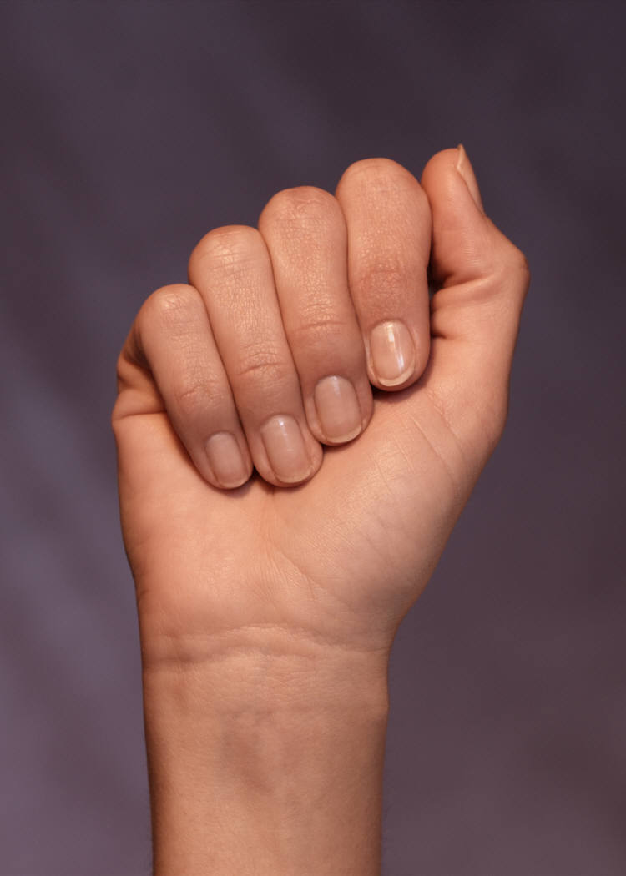
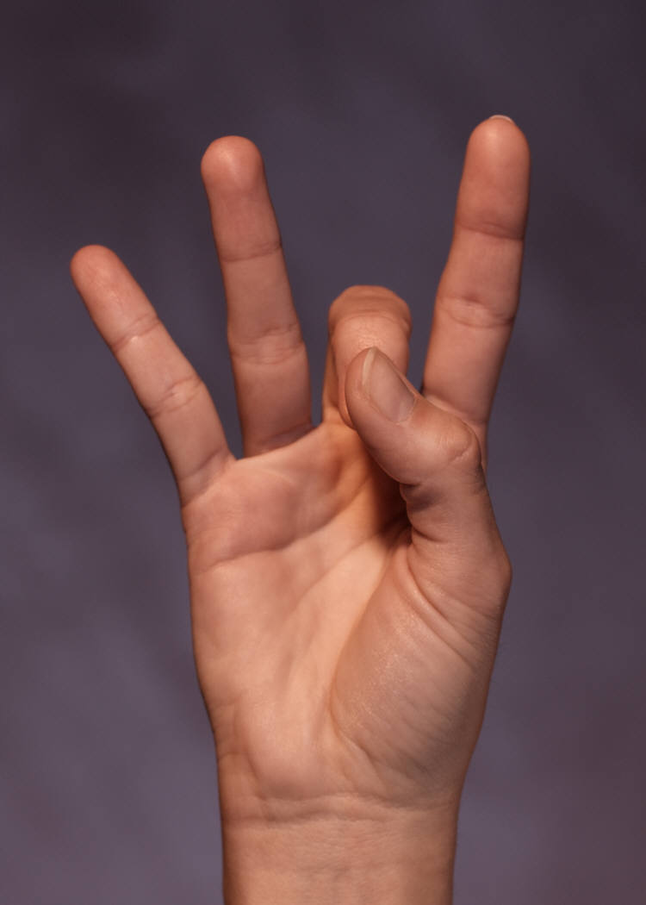
HOW DO YOU DO THIS?
iSchool people don’t speak legalese
Law students don’t understand networks and searching
You talk exabytes and we want res judicata!
Business people just look at the bottom line

Slide 12
HOW DO YOU DO THIS?:
Crossing the Great Divide
But the meter is “ticking”
And the stakes are high

Slide 13


BERMAN’S FIVE-STEP 26(f) PROGRAM
It is free; and,
Worth every penny you paid for it

Slide 14
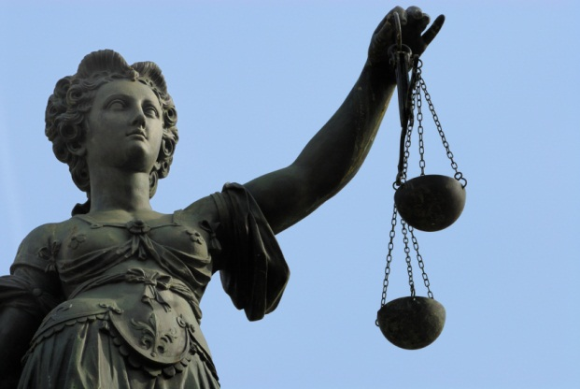
STEP 1: BE REASONABLE
Consider how every position you take will “play” before a neutral person
Patrick Henry could say: “Give me liberty or give me death,” but you can’t
“Trading” is part of the game:
  If your opponent wants something badly, maybe he/she will give something else up
UNDERSTAND the LEGAL & I.T. Landscape

Slide 15

STEP 1: BE REASONABLE
UNDERSTAND the LEGAL & I.T. Landscape
What do you think will happen if you ask a big company to preserve all email or all backup media?
If you wouldn’t allow the opponent to access your system, should you ask them to allow you to access theirs?
How can you avoid costly steps, e.g., backup media, by looking at other sources?
Have you mapped your data?
  Will you voluntarily offer to share your map?

Slide 16
STEP 1: BE REASONABLE
For ABC – Gladys has duplicated paper records and Jane has been converting slowly to computer.
  Can XYZ ask for both?
XYZ has “Supermax” – can ABC ask for a license?
Can XYZ demand preservation of son and daughter’s ESI at the law and accounting firms?

Slide 17

STEP 2
PROPORTIONALITY
PROPORTIONALITY
PROPORTIONALITY
proportionality
PROPORTIONALITY

Slide 18

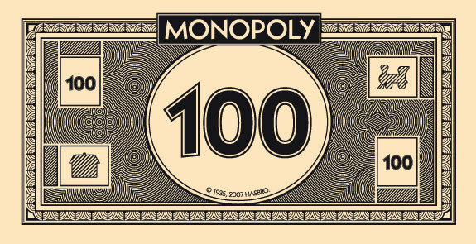
STEP 2 PROPORTIONALITY
Marens v. Carraba’s Italian Grill, Inc., 196 F.R.D. 35 (D. Md. 2000) (limiting the number of hours for document discovery).
Mancia v. Mayflower Textile Servs. Co., 2008 U.S.Dist.Lexis 83740 (D. Md. 2008).
RALPH LOSEY,
“ADVENTURES IN ELECTRONIC DISCOVERY” (West 2011), 24.
38%

Slide 19
ABC v. XYZ
What are the costs of each step?
  Can you use the prices given to estimate them?
  What about the three RAID Supermax servers?
  Can/should XYZ ask ABC to image all 50 workstations?
    If so, what is a likely response?

Slide 20

STEP 3: TRANSPARENCY
For two centuries, litigation has been played by holding your cards tight and springing a “Perry Mason” moment at trial
ESI requires disclosure
Rule 26(a)(1) mandates disclosure
Rule 26(f) compels disclosure
Rule 26(b)(2)(C) requires cost-benefit analysis
Rule 1 calls for the just, speedy, and inexpensive resolution of disputes
You need to show SOME of your cards
  Even some “bad” ones!

Slide 21
ABC v. XYZ
Is Bill a “poster child” for transparency?
What about ABC’s 45-day email deletion policy.

Slide 22
STEP 4: PERFECTION
Do not demand perfection
Do not expect perfection
Courts have said that they will tolerate mistakes
  Pension Committee (2010)
  For more detailed discussion, see http://www.esi-mediation.com/2011/07/15/what-does-%e2%80%9cthe-making-of-a-surgeon%e2%80%9d-have-to-do-with-esi-and-software-glitches/
Ralph Losey has written that the word “all” is obsolete

Slide 23

STEP 5
COOPERATION

Slide 24
STEP 5: COOPERATION
Sedona Conference Cooperation Proclamation
Over 100 Judges have endorsed it
Advocacy need not, and should not, be adversarial
You can zealously represent your client, while you cooperate
Absent cooperation, the system cannot function and litigants will be bankrupted
Electronic litigation cannot be a war of attrition
  World War I trench warfare bankrupted generations

Slide 25
THE RULE 26(f) CONFERENCE
The goal is to develop a discovery plan & propose it to the Court
  What will be preserved?
  How will it be preserved?
  What will be produced?
  How will it be produced?
Often there will be more than one conference
Two are generally ideal
  Research by Prof. D. Oard & Jason Baron, Esq.

Slide 26
END PRODUCT
TELL THE COURT
  Areas of Agreement:
    We will produce TIFFs except for spreadsheets
    We agree on the following search methodology
    Here is how we will handle privilege
  Areas of Disagreement
    We won’t preserve cell phones – they want us to
    We won’t search backup tapes – they want us to
  Areas Where Parties Agree That Court Order is Needed
    Rule 502
    Clawback

Slide 27
ABC v. XYZ
Complex facts – but realistic
Law students don’t know much about computers
iSchool students don’t know much about law
Each have knowledge in their own sphere

Slide 28
ABC v. XYZ
Complex facts – but realistic
Each side has strengths and vulnerabilities
Topics to Cover
  Privilege
  Preservation
  Form of Production
  Search

Slide 29
ABC v. XYZ
Privilege
  You have attorney-client privileged information
  You have confidential medical information
  You may have trade secrets
  How do you find it, i.e., search for it?
  How do you protect it?
  What happens if you mistakenly produce it?

Slide 30
ABC v. XYZ
  Preservation
    Do you leave it where it is?
      If so, what happens if it is lost?
    Do you make forensic copies of everything?
      If so, what is the cost?
      Can you agree to forensically copying less?
    What is key to your case?
      In your system?
      In theirs?
    What is reasonable to expect?

Slide 31
ABC v. XYZ
  Form of Production
    The Rules allow you to request the form or forms that you want
    Your opponent can object
    Once it is produced in one form, you can’t get it in another form
    Do you want TIFFs? PDFs? Native? A mix?
      Why?
      What are the advantages?
      The costs?

Slide 32

ABC v. XYZ
  Search
    What methodology?
    Keywords?
      How developed?
      How tested?
      Quality control?
    “Predictive Coding?”
      Do you trust the “black box”?
      How much will it cost?
      How much will it save?
  Different techniques for privilege and for relevance?

Slide 33

“Fear Factor - NBC©
“You either grab the reins or you get dragged by the horse.”
Liz Spayd, Washington Post

Slide 34
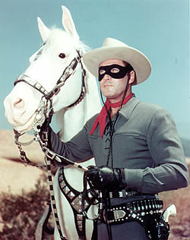
NO SILVER BULLET
“The Lone Ranger is a fictional masked Texas Ranger who. . . fights injustice in the American Old West. The character has become an enduring icon of American culture.”
PHOTO of Clayton Moore as the Lone Ranger, Wikipedia, http://www.google.com/imgres?imgurl=http://upload.wikimedia.org/wikipedia/en/c/ce/Moore-LoneRanger.jpg&imgrefurl=http://en.wikipedia.org/wiki/The_Lone_Ranger&h=317&w=250&sz=59&tbnid=Q93uAfx0iNrYcM:&tbnh=94&tbnw=74&prev=/search%3Fq%3Dlone%2Branger%26tbm%3Disch%26tbo%3Du&zoom=1&q=lone+ranger&hl=en&usg=__2X04M1OLh5ttaqy231dVYtTUj7A=&sa=X&ei=ter_TaCqEaPd0QHd_bTRDg&sqi=2&ved=0CDsQ9QEwAQ
5-STEP PLAN - A RULES-BASED APPROACH:
REASONABLENESS, PROPORTIONALITY,
TRANSPARENCY, COOPERATION, IMPERFECTIONS

Slide 35
ABC v. XYZ
What is at stake?
  Do you look at allegations of$600K + $1 million?
  Do you evaluate them?
Plaintiff has cash flow problems:
  That is relevant to what is reasonable
  But do you “bare your throat” and discuss it?
There is a ten-year course of conduct:
  Is all ESI for 10 years relevant?
  How will you handle it?

Slide 36
ABC v. XYZ
The cost to preserve .wav files is $100 per GB
  The cost of processing is TBD
  On June 1, XXX0, ABC received a voice mail order from the surgeon
  Ms. B then left a voice mail order on XYZ’s system
How do you analyze?
  Relevant?
  Preserved?
  Producable?
  Proportionate?

Slide 37
ABC v. XYZ
Why is there a mention of typewriter ribbons in an ESI class?
  Does it give one party leverage?
Jason spoke of asymmetry – where are there asymmetries here and how can you use them?
XYZ has data wiping software
  Is that OK?
  How can you use it in arguments?
What is the import of Bill, the rogue employee?
  Why is he in the problem?

Slide 38
M. Berman, “The Rule 26(f) Conference of the Parties,”
in M. Berman, C. Barton, The Hon. P. Grimm, eds.,
Managing E-Discovery and ESI
From Pre-Litigation Through Trial
(ABA 2011).

Slide 39

In Zubulake, the court wrote that the key problem was a failure to communicate:
Talk with your client;
Negotiate with your opponent.
Online Sample Mock Rule 26(f) Conference of Parties
http://www.esi-mediation.com/2011/08/07/mock-rule-26f-conference-of-parties-posted-online/
http://vimeo.com/29144124

