Slide 1
Session 7: Early Case Assessment
LBSC 708X/INFM 718X
Seminar on E-Discovery
Jason R. Baron
Adjunct Faculty
University of Maryland
March 8, 2012

Slide 2
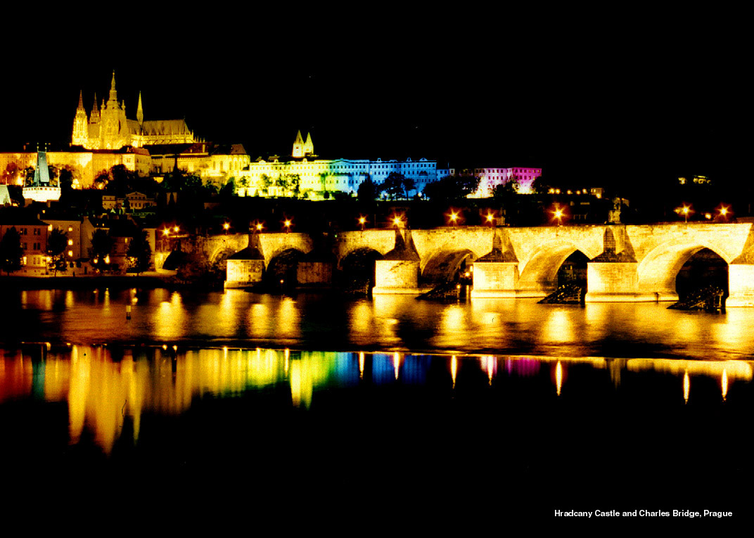

Slide 3
How much does counsel know?
About the nature and scope of the relevant evidence existing in custody and control of the opposing party?
Same question re the relevant evidence existing in one’s own client’s custody and control – how much is known?
How much is know-able?
Have the answers changed in past decade of practice?

Slide 4
Early Case Assessment
Early case assessment refers to estimating risk (cost of time and money) to prosecute or defend a legal case.
Human expertise
Technology

Slide 5
Why ECA?
--Most cases settle prior to trial
-- Exposure (likelihood of negative outcome in litigation)
--Discovery and document review in particular are costly, burdensome
--Protecting against sanctions (spoliation should preservation obligations not be carried out with due diligence)
--Speed
--Insight into case (readings this week)
--Establishing a budget

Slide 6
ECA lifecycle
Risk/benefit analysis
Putting into place legal hold
Collecting/culling info for attorney review
Processing relevant info using filtering, search terms, predictive coding, etc.
Producing info (in discovery)
Re-using info, KM, BI

Slide 7
ECA Downsides
Up front costs
False negatives (example case)

Slide 8
Software approaches to ECA
Keywords
Relevance ranking
Clustering
Predictive Coding
Sentiment detection
Social network analysis
Visual analytics

Slide 9
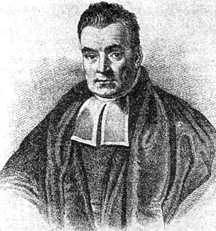
Bayesian Statistical Models
Based on mathematical models of Statistical Probability to recognize documents of similar content.
Learns passively from the document content
Position, frequency and proximity of terms (language independent) combine to create a mathematical “thumbprint” of concepts contained in documents.
Useful to “cluster” documents by content
Can “learn” to build clusters from exemplar sets
Requires re-indexing and assessment can change
Notes:
Thomas Bayes, 1702-1761, English Mathematician. General theory of statistical probability based on the concept that if you know A occurred, then B probably occurred as well based on prior knowledge.

Slide 10
Latent Semantic Indexing (LSI)
SVD (Singular Value Decomposition) assigns each record to a place creating “clusters”
z
“Query” documents are SVD analyzed and placed in the matrix
“Hits” and rankings are determined by the distance from clusters
x
Vector length = relevance ranking
y
Notes:
A statistical technique for analyzing patterns of word usage across the document collection. Initially applied for multi-language analysis in intelligence community
Uses Singular Value Decomposition (SVD) to derive clusters of terms and assigns documents to clusters
Language/vocabulary independent
Dynamic or Exemplar-based clustering
Requires re-indexing as collection changes or grows
Subject of most contemporary IR science R&D
Dates to the mid=1960s as a technique Based on Singular Value Decomposition (SVD), a mathematical approach to identifying patterns of relationships.
Initial use was academic and commercial: i.e., automatically assign articles to reviewers and grading essays.
1999 implemented in the intelligence community by SAIC . Then commercialized and uses expanded. Content Analyst.

Slide 11
Emerging New Strategies: “Predictive Analytics”
Improved review and case assessment: cluster docs thru use of software with minimal human intervention at front end to code “seeded” data set
Slide adapted from Gartner Conference
June 23, 2010 Washington, D.C.
Notes:
Key Issue: Why are search and other semantically based technologies the most-important ones in e-discovery?

Slide 13
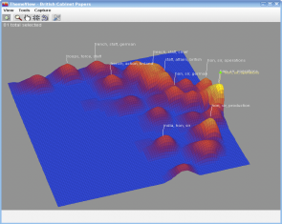

Slide 14
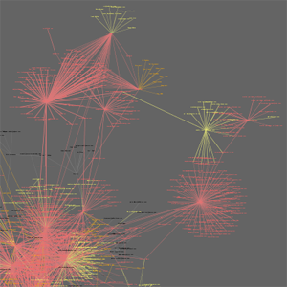
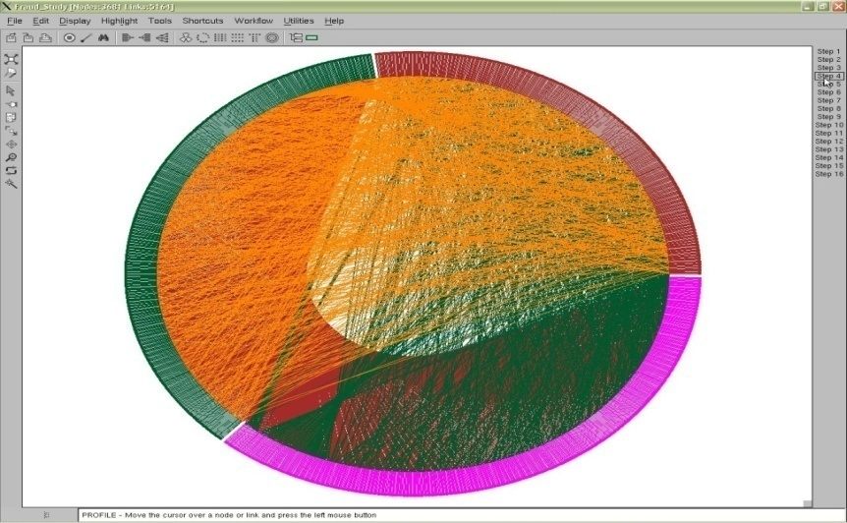
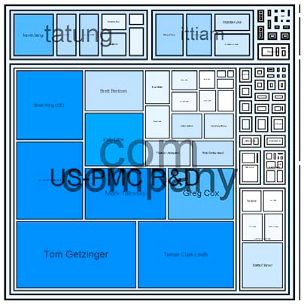
Visual Analysis Examples (Presentation by Dr. Victoria Lemieux, Univ. British Columbia, at Society of American Archivist Annual Mtg. 2010, Washington, D.C.)
With acknowledgments to Jeffrey Heer, Exploring Enron, http://hci.stanford.edu/jheer/projects/enron/,
Adam Perer, Contrasting Portraits, http://hcil.cs.umd.edu/trs/2006-08/2006-08.pdf,
and Fernanda Viegas, Email Conversations, http://fernandaviegas.com/email.html

Slide 15
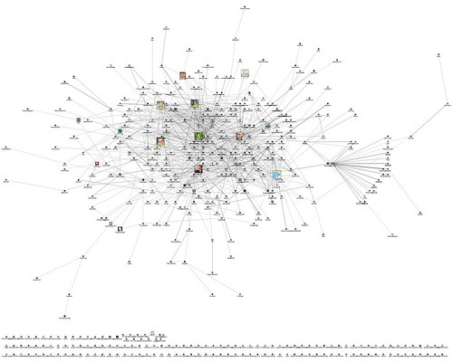
Social Networking/Links Analysis Example
From Marc Smith
Posted on Flickr
Under Creative Commons License

