Slide 1
Evaluation
INFM 718X/LBSC 718X
Session 6
Douglas W. Oard

Slide 2
Evaluation Criteria
Effectiveness
  System-only, human+system
Efficiency
  Retrieval time, indexing time, index size
Usability
  Learnability, novice use, expert use

Slide 3
IR Effectiveness Evaluation
User-centered strategy
  Given several users, and at least 2 retrieval systems
  Have each user try the same task on both systems
  Measure which system works the “best”
System-centered strategy
  Given documents, queries, and relevance judgments
  Try several variations on the retrieval system
  Measure which ranks more good docs near the top

Slide 4
Good Measures of Effectiveness
Capture some aspect of what the user wants
Have predictive value for other situations
  Different queries, different document collection
Easily replicated by other researchers
Easily compared
  Optimally, expressed as a single number

Slide 5
Comparing Alternative Approaches
Achieve a meaningful improvement
  An application-specific judgment call
Achieve reliable improvement in unseen cases
  Can be verified using statistical tests

Slide 6
Evolution of Evaluation
Evaluation by inspection of examples
Evaluation by demonstration
Evaluation by improvised demonstration
Evaluation on data using a figure of merit
Evaluation on test data
Evaluation on common test data
Evaluation on common, unseen test data

Slide 7
Automatic Evaluation Model
Query
Documents
IR Black Box
Ranked List
Evaluation
Module
Relevance Judgments
Measure of Effectiveness
These are the four things we need!

Slide 8
IR Test Collection Design
Representative document collection
  Size, sources, genre, topics, …
“Random” sample of representative queries
  Built somehow from “formalized” topic statements
Known binary relevance
  For each topic-document pair (topic, not query!)
  Assessed by humans, used only for evaluation
Measure of effectiveness
  Used to compare alternate systems

Slide 9
Defining “Relevance”
Relevance relates a topic and a document
  Duplicates are equally relevant by definition
  Constant over time and across users
Pertinence relates a task and a document
  Accounts for quality, complexity, language, …
Utility relates a user and a document
  Accounts for prior knowledge

Slide 10
Space of all documents
Relevant
Relevant +
Retrieved
Retrieved
Not Relevant + Not Retrieved

Slide 11
Set-Based Effectiveness Measures
Precision
  How much of what was found is relevant?
    Often of interest, particularly for interactive searching
Recall
  How much of what is relevant was found?
    Particularly important for law, patents, and medicine
Fallout
  How much of what was irrelevant was rejected?
    Useful when different size collections are compared

Slide 12
Effectiveness Measures
Action
Retrieved
Not Retrieved
Doc
Relevant
Relevant Retrieved
Miss
Not relevant
False Alarm
Irrelevant Rejected
User-
Oriented
System-
Oriented

Slide 13
Balanced F Measure (F₁)
Harmonic mean of recall and precision

Slide 14
Variation in Automatic Measures
System
  What we seek to measure
Topic
  Sample topic space, compute expected value
Topic+System
  Pair by topic and compute statistical significance
Collection
  Repeat the experiment using several collections

Slide 15
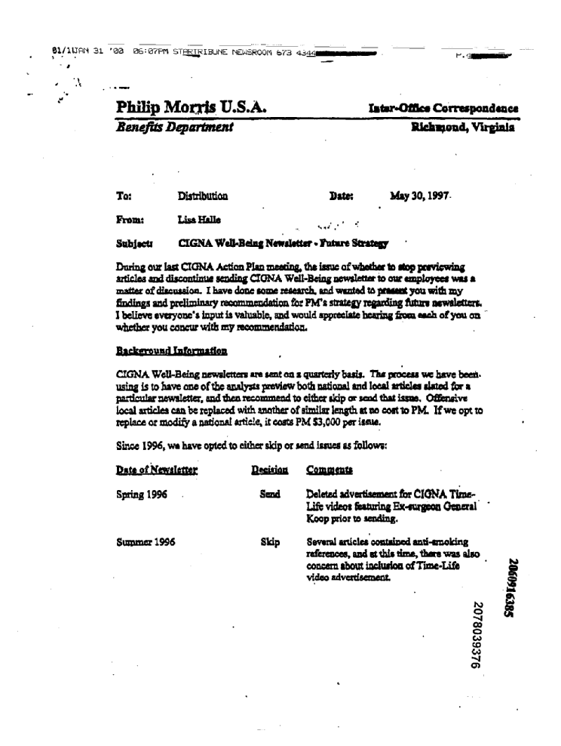
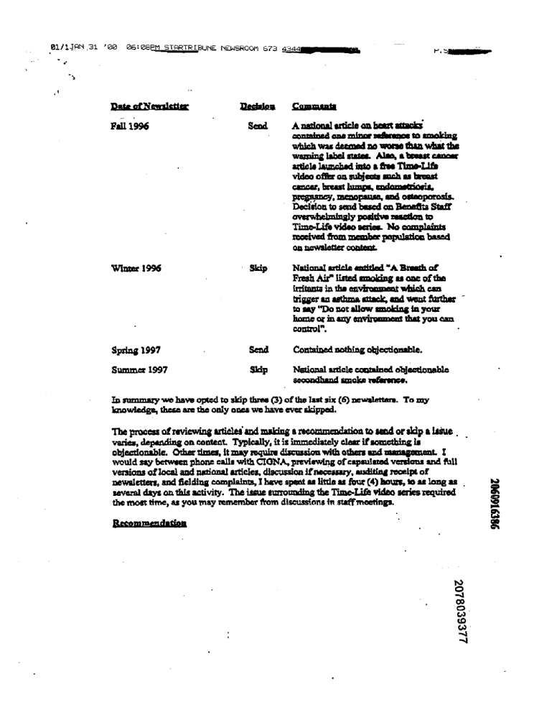
IIT CDIP v1.0 Collection
Scanned
OCR
Metadata
Philip Moxx's. U.S.A. x.dr~am~c. cvrrespoaa.aa
Benffrts Departmext Rieh>pwna, Yfe&ia
Ta: Dishlbutfon Data aday 90,1997.
From: Lisa Fislla
Sabj.csr CIGNA WeWedng Newsbttsr -Yntsre StratsU
During our last CIGNA Aatfoa Plan meadng, tlu iasuo of wLetSae to i0op per'Irw+ng
artieles aod discontinue mndia6 CIGNA Well-Being aawslener to om employees was a
msiter of disanision . I Imvm done somme reaearc>>, and wanted to pruedt you with my
Sadings and pcdiminary recwmmeadatioa for PM's atratezy Ieprding l4aas aewelattee* .
I believe .vayone'a input is valusble, and would epproolate hoarlng fmaa aaeh of you on
whetlne you concur with my reeommendatioa
…
Title: CIGNA WELL-BEING NEWSLETTER - FUTURE STRATEGY
Organization Authors: PMUSA, PHILIP MORRIS USA
Person Authors: HALLE, L
Document Date: 19970530
Document Type: MEMO, MEMORANDUM
Bates Number: 2078039376/9377
Page Count: 2
Collection: Philip Morris

Slide 16
“Complaint” and “Production Request”
…12. On January 1, 2002, Echinoderm announced record results for the prior year, primarily attributed to strong demand growth in overseas markets, particularly China, for its products. The announcement also touted the fact that Echinoderm was unique among U.S. tobacco companies in that it had seen no decline in domestic sales during the prior three years.
13. Unbeknownst to shareholders at the time of the January 1, 2002 announcement, defendants had failed to disclose the following facts which they knew at the time, or should have known:
a. The Company's success in overseas markets resulted in large part from bribes paid to foreign government officials to gain access to their respective markets;
b. The Company knew that this conduct was in violation of the Foreign Corrupt Practices Act and therefore was likely to result in enormous fines and penalties;
c. The Company intentionally misrepresented that its success in overseas markets was due to superior marketing.
d. Domestic demand for the Company's products was dependent on pervasive and ubiquitous advertising, including outdoor, transit, point of sale and counter top displays of the Company's products, in key markets. Such advertising violated the marketing and advertising restrictions to which the Company was subject as a party to the Attorneys General Master Settlement Agreement ("MSA").
e. The Company knew that it could be ordered at any time to cease and desist from advertising practices that were not in compliance with the MSA and that the inability to continue such practices would likely have a material impact on domestic demand for its products. …
  All documents which describe, refer to, report on, or mention any “in-store,” “on-counter,” “point of sale,” or other retail marketing campaigns for cigarettes.

Slide 17
An Ad Hoc “Production Request”
<ProductionRequest>
<RequestNumber>148</RequestNumber>
<RequestText>All documents concerning the Company's FMLA policies, practices and procedures.</RequestText>
<BooleanQuery>
<FinalQuery>(policy OR policies OR practice! or procedure! OR rule! OR guideline! OR standard! OR handbook! OR manual!) w/50 (FMLA OR leave OR "Family medical leave" OR absence)</FinalQuery>
<NegotiationHistory>
<ProposalByDefendant>(FMLA OR "federal medical leave act") AND (policies OR practices OR procedures)</ProposalByDefendant>
<RejoinderByPlaintiff>(FMLA OR "federal medical leave act") AND (leave w/10 polic!)</RejoinderByPlaintiff>
<Consensus1>(policy OR policies OR practice! or procedure! OR rule! OR guideline! OR standard! OR handbook! OR manual!) AND (FMLA OR leave OR "Family medical leave" OR absence)</Consensus1>
</NegotiationHistory>
</BooleanQuery>
<FinalB>40863</FinalB>
<RequestSource>2008-H-7</RequestSource>

Slide 18
Estimating Retrieval Effectiveness
Sampling rate = 6/10
Each Rel counts 10/6
Sampling rate = 3/10
Each Rel counts 10/3

Slide 19
Relevance Assessment
All volunteers
  Mostly from law schools
Web-based assessment system
  Based on document images
500-1,000 documents per assessor
  Sampling rate varies with (minimum) depth

Slide 20
2008 Est. Relevant Documents
Mean estRel = 82,403 (26 topics)
5x 2007 mean estRel (16,904)
Max estRel=658,339, Topic 131 (rejection of trade goods)
Min estRel=110 Topic 137 (intellectual property rights)
26 topics

Slide 21
2008 (cons.) Boolean Estimated Recall
Mean estR=0.33 (26 topics)
Missed 67% of relevant documents (on average)
Max estR =0.99, Topic 127 (sanitation procedures)
Min estR=0.00, Topic 142 (contingent sales)
26 topics

Slide 22
2008 ΔestR@B: wat7fuse vs. Boolean
wat7fuse Better
Final Boolean Better
26 topics

Slide 23
Evaluation Design
Scanned Docs
Interactive Task

Slide 24
Interactive Task: Key Steps
Complaint
&
Document
Requests
(Topics)
Team-TA
Interaction
&
Application
Of
Search
Methodology
First-Pass
Assessment
Of
Evaluation
Samples
Appeal
&
Adjudication
Of
First-Pass
Assessment
Analysis
&
Reporting
Coordinators &
TAs
Teams
&
TAs
Assessors
&
TAs
Teams
&
TAs
Coordinators
&
Teams

Slide 25
Interactive Task: Participation
2008
  4 Participating Teams (2 commercial, 2 academic)
  3 Topics (and 3 TAs)
  Test Collection: MSA Tobacco Collection
2009
  11 Participating Teams (8 commercial, 3 academic)
  7 Topics (and 7 TAs)
  Test Collection: Enron Collection
2010
  12 Participating Teams (6 commercial, 5 academic, 1 govt)
  4 Topics (and 4 TAs)
  Test Collection: Enron Collection (new EDRM version)

Slide 27
2008 Interactive Topics
Topic | Samples | Est Nrel Pre-adjudication | Est Nrel: Post-Adjudication | Relevance Density
102 | 4.500 |  | 562,402 ±73,000 | 8.1%
103 | 6,500 | 914,258 ±72,000 | 786,862 ±54,000 | 11.4%
104 | 2,500 |  | 45,614 ±25,000 | 0.7%

Slide 28
Pre-Adjudication Results
Topic 103

Slide 29
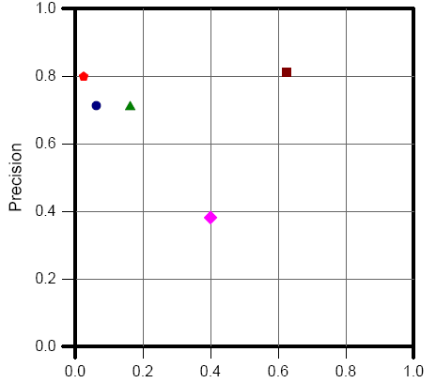
Post-Adjudication Results
Topic 103

Slide 30
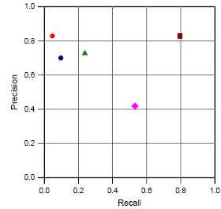
Results on Good OCR
Topic 103
High OCR-accuracy documents only
Notes:
30

Slide 31
Interactive Task - 2009
TREC Enron Email Test Collection Version 1
Enron Collection
  A collection of emails produced by Enron in response to requests from the Federal Energy Regulatory Commission (FERC)
  First year used in the Legal Track
Size of Collection (post-deduplication)
  569,034 messages
  847,791 documents
  Over 3.8 million pages
Distribution Format
  Extracted Text (in EDRM XML interchange format)
  Native .msg files

Slide 32
2009 Results (pre-adjudication)
Topic 201 (2009)
Topic 202 (2009)
Topic 203 (2009)
Topic 204 (2009)
Topic 205 (2009)
Topic 206 (2009)
Topic 207 (2009)

Slide 33
2009 Results (post-adjudication)
Topic 201 (2009)
Topic 202 (2009)
Topic 203 (2009)
Topic 204 (2009)
Topic 205 (2009)
Topic 206 (2009)
Topic 207 (2009)

Slide 34
2009 Results (pre- to post-adj)
Topic 201 (2009)
Topic 202 (2009)
Topic 203 (2009)
Topic 204 (2009)
Topic 205 (2009)
Topic 206 (2009)
Topic 207 (2009)

Slide 35
EDRM Enron V2 Dataset
Email from ~150 Enron executives
1.3M records captured by FERC
Processed to several formats by ZL/EDRM
  EDRM XML (text+native) ~100GB
  PST ~100GB
Deduped, reformatted by U. Waterloo
  455,449 messages + 230,143 attachments = 685,592 docs
  Text (1.2 GB compressed; 5.5GB uncompressed)
  Mapping from PST docs to EDRM document identifiers
Used for both Learning and Interactive tasks
  Participants submitted EDRM document identifiers
Notes:
3535

Slide 36
Topic 301 (2010)
Document Request
  All documents or communications that describe, discuss, refer to, report on, or relate to onshore or offshore oil and gas drilling or extraction activities, whether past, present or future, actual, anticipated, possible or potential, including, but not limited to, all business and other plans relating thereto, all anticipated revenues therefrom, and all risk calculations or risk management analyses in connection therewith.
Topic Authority
  Mira Edelman (Hughes Hubbard)

Slide 37
2010 Post-Adj Relevance Results

Slide 38
2010 Post-Adj Privilege Results

Slide 39
2009 Change in F1

Slide 40
2010 Change in F1

Slide 41
User Studies
Goal is to account for interface issues
  By studying the interface component
  By studying the complete system
Formative evaluation
  Provide a basis for system development
Summative evaluation
  Designed to assess performance

Slide 42
Blair and Maron (1985)
A classic study of retrieval effectiveness
  Earlier studies used unrealistically small collections
Studied an archive of documents for a lawsuit
  40,000 documents, ~350,000 pages of text
  40 different queries
  Used IBM’s STAIRS full-text system
Approach:
  Lawyers wanted at least 75% of all relevant documents
  Precision and recall evaluated only after the lawyers were satisfied with the results
David C. Blair and M. E. Maron. (1984) An Evaluation of Retrieval Effectiveness for a Full-Text Document-Retrieval System. Communications of the ACM, 28(3), 289--299.

Slide 43
Blair and Maron’s Results
Mean precision: 79%
Mean recall: 20% (!!)
Why recall was low?
  Users can’t anticipate terms used in relevant documents
  Differing technical terminology
  Slang, misspellings
Other findings:
  Searches by both lawyers had similar performance
  Lawyer’s recall was not much different from paralegal’s
“accident” might be referred to as “event”, “incident”, “situation”, “problem,” …

Slide 44
Additional Effects in User Studies
Learning
  Vary topic presentation order
Fatigue
  Vary system presentation order
Topic+User (Expertise)
  Ask about prior knowledge of each topic

Slide 45
Batch vs. User Evaluations
Do batch (black box) and user evaluations give the same results? If not, why?
Two different tasks:
  Instance recall (6 topics)
  Question answering (8 topics)
What countries import Cuban sugar?
What tropical storms, hurricanes, and typhoons have caused property damage or loss of life?
Which painting did Edvard Munch complete first, “Vampire” or “Puberty”?
Is Denmark larger or smaller in population than Norway?
Andrew Turpin and William Hersh. (2001) Why Batch and User Evaluations Do No Give the Same Results. Proceedings of SIGIR 2001.

Slide 46
Results
Compared of two systems:
  a baseline system
  an improved system that was provably better in batch evaluations
Results:
 | Instance Recall |  | Question Answering
 | Batch MAP | User recall | Batch MAP | User accuracy
Baseline | 0.2753 | 0.3230 | 0.2696 | 66%
Improved | 0.3239 | 0.3728 | 0.3544 | 60%
Change | +18% | +15% | +32% | -6%
p-value (paired t-test) | 0.24 | 0.27 | 0.06 | 0.41

Slide 47
Qualitative User Studies
Observe user behavior
  Instrumented software, eye trackers, etc.
  Face and keyboard cameras
  Think-aloud protocols
  Interviews and focus groups
Organize the data
  For example, group it into overlapping categories
Look for patterns and themes
Develop a “grounded theory”

