Slide 1
Search Technology
LBSC 708X/INFM 718X
Week 5
Doug Oard
Notes:
1

Slide 2
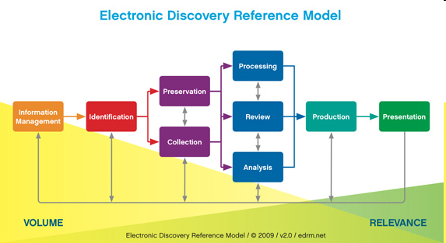
Where Search Technology Fits
T4
T3a
T1
T2
T5a
T6a
T6b
T5b
T3b

Slide 3
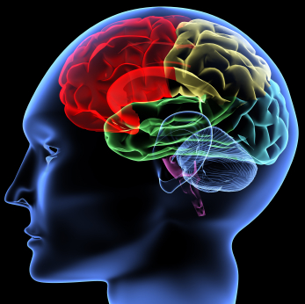
Document Review
Case Knowledge
The
Black
Box
Unprocessed
Documents
Coded
Documents

Slide 4

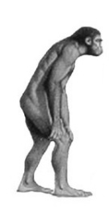
Inside Yesterday’s Black Box
Case Knowledge
Unprocessed
Documents
Coded
Documents

Slide 5
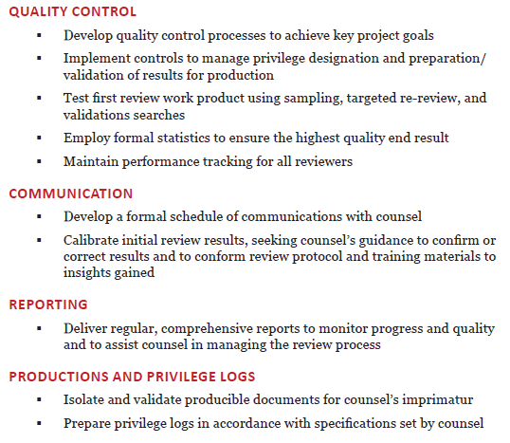
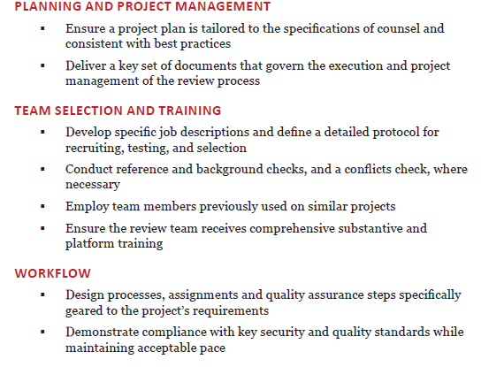
“Linear Review”

Slide 6

Is it reasonable?
Yes, if we followed a reasonable process.
  Staffing
  Training
  Quality assurance
Linear Review

Slide 7



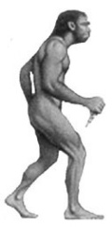
Inside Today’s Black Box
Keyword Search & Linear Review
Case Knowledge
“Reasoning”
“Representation”
“Interaction”
Unprocessed
Documents
Coded
Documents

Slide 8
Example of Boolean search string from U.S. v. Philip Morris
(((master settlement agreement OR msa) AND NOT (medical savings account OR metropolitan standard area)) OR s. 1415 OR (ets AND NOT educational testing service) OR (liggett AND NOT sharon a. liggett) OR atco OR lorillard OR (pmi AND NOT presidential management intern) OR pm usa OR rjr OR (b&w AND NOT photo*) OR phillip morris OR batco OR ftc test method OR star scientific OR vector group OR joe camel OR (marlboro AND NOT upper marlboro)) AND NOT (tobacco* OR cigarette* OR smoking OR tar OR nicotine OR smokeless OR synar amendment OR philip morris OR r.j. reynolds OR ("brown and williamson") OR ("brown & williamson") OR bat industries OR liggett group)

Slide 9

Is it reasonable?
Yes, if we followed a reasonable process.
  Indexing
  Query design
  Sampling
Keyword Search
Linear Review
Linear Review

Slide 10
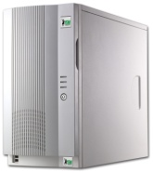

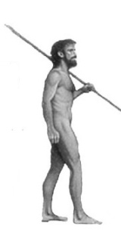
Inside Tomorrow’s Black Box
Technology Assisted Review
Case Knowledge
“Reasoning”
“Representation”
“Interaction”
Unprocessed
Documents
Coded
Documents

Slide 11
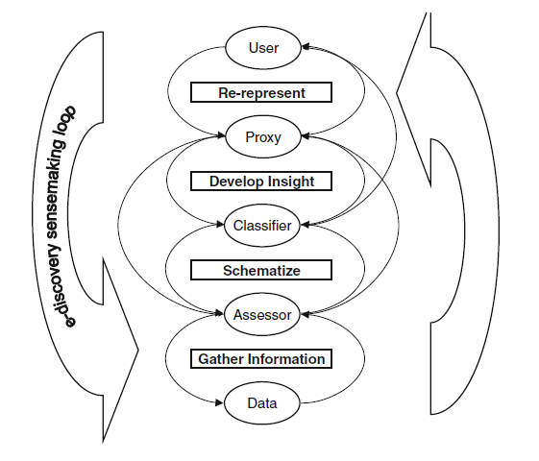
Hogan et al, AI & Law, 2010

Slide 12

Is it reasonable?
Yes, if we followed a reasonable process.
  Rich representation
  Explicit & example-based interaction
  Process quality measurement
Keyword Search
Linear Review
Technology Assisted
Review (TAR)
Linear Review

Slide 13
Agenda
Three generations of e-discovery
Design thinking
Content-based search example
Putting it all together

Slide 14
Databases vs. IR
Databases
IR
What we’re retrieving
Structured data. Clear semantics based on a formal model.
Mostly unstructured. Free text with some metadata.
Queries we’re posing
Formally (mathematically) defined queries. Unambiguous.
Vague, imprecise information needs (often expressed in natural language).
Results we get
Exact. Always correct in a formal sense.
Sometimes relevant, often not.
Interaction with system
One-shot queries.
Interaction is important.
Other issues
Concurrency, recovery, atomicity are all critical.
Issues downplayed.

Slide 15
Design Strategies
Foster human-machine synergy
  Exploit complementary strengths
  Accommodate shared weaknesses
Divide-and-conquer
  Divide task into stages with well-defined interfaces
  Continue dividing until problems are easily solved
Co-design related components
  Iterative process of joint optimization
Notes:
16

Slide 16
Human-Machine Synergy
Machines are good at:
  Doing simple things accurately and quickly
  Scaling to larger collections in sublinear time
People are better at:
  Accurately recognizing what they are looking for
  Evaluating intangibles such as “quality”
Both are pretty bad at:
  Mapping consistently between words and concepts
Notes:
17

Slide 17
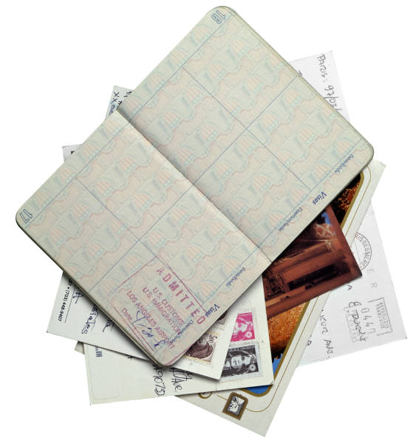
Process/System Co-Design

Slide 18
Taylor’s Model of Question Formation
Q1 Visceral Need
Q2 Conscious Need
Intermediated Search
End-user Search
Q3 Formalized Need
Q4 Compromised Need
(Query)

Slide 19
Iterative Search
Searchers often don’t clearly understand
  What actually happened
  What evidence of that might exist
  How that evidence might best be found
The query results from a clarification process
Dervin’s “sense making”:
Need
Gap
Bridge
Notes:
8

Slide 20
Divide and Conquer
Strategy: use encapsulation to limit complexity
Approach:
  Define interfaces (input and output) for each component
  Define the functions performed by each component
  Build each component (in isolation)
  See how well each component works
    Then redefine interfaces to exploit strengths / cover weakness
  See how well it all works together
    Then refine the design to account for unanticipated interactions
Result: a hierarchical decomposition
Notes:
19
Okay, I’ve presented a very complex field… how do we actually go about studying it?
Example of a decomposition that doesn’t make sense: separating engine from transmission

Slide 21
Supporting the Search Process
Source
Selection
Predict
Nominate
Choose
IR System
Query
Formulation
Query
Search
Ranked List
Selection
Query Reformulation
and
Relevance Feedback
Document
Examination
Document
Source
Reselection
Delivery

Slide 22
Supporting the Search Process
Source
Selection
IR System
Query
Formulation
Query
Search
Ranked List
Selection
Indexing
Document
Index
Examination
Document
Acquisition
Collection
Delivery

Slide 23
Inside The IR Black Box
Documents
Query
Representation
Function
Representation
Function
Query Representation
Document Representation
Index
Comparison
Function
Hits

Slide 24
McDonald's slims down spuds
Fast-food chain to reduce certain types of fat in its french fries with new cooking oil.
NEW YORK (CNN/Money) - McDonald's Corp. is cutting the amount of "bad" fat in its french fries nearly in half, the fast-food chain said Tuesday as it moves to make all its fried menu items healthier.
But does that mean the popular shoestring fries won't taste the same? The company says no. "It's a win-win for our customers because they are getting the same great french-fry taste along with an even healthier nutrition profile," said Mike Roberts, president of McDonald's USA.
But others are not so sure. McDonald's will not specifically discuss the kind of oil it plans to use, but at least one nutrition expert says playing with the formula could mean a different taste.
Shares of Oak Brook, Ill.-based McDonald's (MCD: down $0.54 to $23.22, Research, Estimates) were lower Tuesday afternoon. It was unclear Tuesday whether competitors Burger King and Wendy's International (WEN: down $0.80 to $34.91, Research, Estimates) would follow suit. Neither company could immediately be reached for comment.
…
16 × said
14 × McDonalds
12 × fat
11 × fries
8 × new
6 × company, french, nutrition
5 × food, oil, percent, reduce,
taste, Tuesday
…
“Bag of Words”

Slide 25
Agenda
Three generations of e-discovery
Design thinking
Content-based search example
Putting it all together

Slide 26
A “Term” is Whatever You Index
Token
Word
Stem
Character n-gram
Phrase
Named entity
…

Slide 27
ASCII
| 0 NUL | 32 SPACE | 64 @ | 96 ` |
| 1 SOH | 33 ! | 65 A | 97 a |
| 2 STX | 34 " | 66 B | 98 b |
| 3 ETX | 35 # | 67 C | 99 c |
| 4 EOT | 36 $ | 68 D | 100 d |
| 5 ENQ | 37 % | 69 E | 101 e |
| 6 ACK | 38 & | 70 F | 102 f |
| 7 BEL | 39 ' | 71 G | 103 g |
| 8 BS | 40 ( | 72 H | 104 h |
| 9 HT | 41 ) | 73 I | 105 i |
| 10 LF | 42 * | 74 J | 106 j |
| 11 VT | 43 + | 75 K | 107 k |
| 12 FF | 44 , | 76 L | 108 l |
| 13 CR | 45 - | 77 M | 109 m |
| 14 SO | 46 . | 78 N | 110 n |
| 15 SI | 47 / | 79 O | 111 o |
Widely used in the U.S.
  American Standard Code for Information Interchange
  ANSI X3.4-1968
| 16 DLE | 48 0 | 80 P | 112 p |
| 17 DC1 | 49 1 | 81 Q | 113 q |
| 18 DC2 | 50 2 | 82 R | 114 r |
| 19 DC3 | 51 3 | 83 S | 115 s |
| 20 DC4 | 52 4 | 84 T | 116 t |
| 21 NAK | 53 5 | 85 U | 117 u |
| 22 SYN | 54 6 | 86 V | 118 v |
| 23 ETB | 55 7 | 87 W | 119 w |
| 24 CAN | 56 8 | 88 X | 120 x |
| 25 EM | 57 9 | 89 Y | 121 y |
| 26 SUB | 58 : | 90 Z | 122 z |
| 27 ESC | 59 ; | 91 [ | 123 { |
| 28 FS | 60 < | 92 \ | 124 | |
| 29 GS | 61 = | 93 ] | 125 } |
| 30 RS | 62 > | 94 ^ | 126 ~ |
| 31 US | 64 ? | 95 _ | 127 DEL |
Notes:
7

Slide 28
Unicode
Single code for all the world’s characters
  ISO Standard 10646
Separates “code space” from “encoding”
  Code space extends ASCII (first 128 code points)
    And Latin-1 (first 256 code points)
  UTF-7 encoding will pass through email
    Uses only the 64 printable ASCII characters
  UTF-8 encoding is designed for disk file systems
Notes:
11

Slide 29
Tokenization
Words (from linguistics):
  Morphemes are the units of meaning
  Combined to make words
    Anti (disestablishmentarian) ism
Tokens (from Computer Science)
  Doug ’s running late !

Slide 30
Stemming
Conflates words, usually preserving meaning
  Rule-based suffix-stripping helps for English
    {destroy, destroyed, destruction}: destr
  Prefix-stripping is needed in some languages
    Arabic: {alselam}: selam [Root: SLM (peace)]
Imperfect: goal is to usually be helpful
  Overstemming
    {centennial,century,center}: cent
  Underseamming:
    {acquire,acquiring,acquired}: acquir
    {acquisition}: acquis

Slide 31
“Bag of Terms” Representation
Bag = a “set” that can contain duplicates
  “The quick brown fox jumped over the lazy dog’s back” →
{back, brown, dog, fox, jump, lazy, over, quick, the, the}
Vector = values recorded in any consistent order
  {back, brown, dog, fox, jump, lazy, over, quick, the, the} →
  [1 1 1 1 1 1 1 1 2]
Notes:
8
Start 1:30

Slide 32
Bag of Terms Example
Document 1
Term
Document 1
Stopword
List
Document 2
The quick brown
fox jumped over
the lazy dog’s
back.
aid
0
1
for
all
0
1
is
back
1
0
of
brown
1
0
the
come
0
1
to
dog
1
0
fox
1
0
Document 2
good
0
1
jump
1
0
lazy
1
0
Now is the time
for all good men
to come to the
aid of their party.
men
0
1
now
0
1
over
1
0
party
0
1
quick
1
0
their
0
1
time
0
1
Notes:
9
Start: 1:35
Questions:
What is the consistent order in this case?
Why is a consistent order needed?
How are the terms chosen in this case?
Stopword lists eliminate terms that only convey meaning through word order
Observations:
No need to keep a position for terms that never occur

Slide 33
Boolean “Free Text” Retrieval
Limit the bag of words to “absent” and “present”
  “Boolean” values, represented as 0 and 1
Represent terms as a “bag of documents”
  Same representation, but rows rather than columns
Combine the rows using “Boolean operators”
  AND, OR, NOT
Result set: every document with a 1 remaining
Notes:
10
Start 1:40

Slide 34
AND/OR/NOT
All documents
A
B
C

Slide 35
Boolean Operators
B
0
1
B
0
1
A
0
0
1
NOT B
1
0
A OR B
1
1
1
B
0
1
B
0
1
A
A
0
0
0
0
0
0
A AND B
A NOT B
1
0
1
1
1
0
(= A AND NOT B)
Notes:
11
Start 1:45

Slide 36
Why Boolean Retrieval Works
Boolean operators approximate natural language
  Find documents about a good party that is not over
AND can discover relationships between concepts
  good party
OR can discover alternate terminology
  excellent party
NOT can discover alternate meanings
  Democratic party
Notes:
13
Start 1:55

Slide 37
Proximity Operators
More precise versions of AND
  “NEAR n” allows at most n-1 intervening terms
  “WITH” requires terms to be adjacent and in order
Easy to implement, but less efficient
  Store a list of positions for each word in each doc
    Warning: stopwords become important!
  Perform normal Boolean computations
    Treat WITH and NEAR like AND with an extra constraint
Notes:
16
Start 2:30 after the break

Slide 38
Other Extensions
Ability to search on fields
  Leverage document structure: title, headings, etc.
Wildcards
  lov* = love, loving, loves, loved, etc.
Special treatment of dates, names, companies, etc.

Slide 39
Ranked Retrieval
Terms tell us about documents
  If “rabbit” appears a lot, it may be about rabbits
Documents tell us about terms
  “the” is in every document -- not discriminating
Documents are most likely described well by rare terms that occur in them frequently
  Higher “term frequency” is stronger evidence
  Low “document frequency” makes it stronger still
Notes:
18
Contrast this with Boolean retrieval
1) TF was always 1 or zero
2) Searchers mad to consider collection frequency

Slide 40
Ranking with BM-25 Term Weights
term frequency
document frequency
document length

Slide 41
“Blind” Relevance Feedback
Perform an initial search
Identify new terms strongly associated with top results
  Chi-squared
  IDF
Expand (and possibly reweight) the query

Slide 42
Visualizing Relevance Feedback
Initial query
x
x
x
x
o
x
x
x
x
Δ
x
x
x
o
x
o
x
Δ
x
o
x
o
o
x
x
x
x
Revised query
x non-relevant documents
o relevant documents

Slide 43
Problems with “Free Text” Search
Homonymy
  Terms may have many unrelated meanings
  Polysemy (related meanings) is less of a problem
Synonymy
  Many ways of saying (nearly) the same thing
Anaphora
  Alternate ways of referring to the same thing

Slide 44
Machine-Assisted Indexing
Goal: Automatically suggest descriptors
  Better consistency with lower cost
Approach: Rule-based expert system
  Design thesaurus by hand in the usual way
  Design an expert system to process text
    String matching, proximity operators, …
  Write rules for each thesaurus/collection/language
  Try it out and fine tune the rules by hand
Notes:
25
Start 3:10

Slide 45
Machine-Assisted Indexing Example
Access Innovations system:
//TEXT: science
IF (all caps)
USE research policy
USE community program
ENDIF
IF (near “Technology” AND with “Development”)
USE community development
USE development aid
ENDIF
near: within 250 words
with: in the same sentence
Notes:
26
Start 3:15

Slide 46
Machine Learning: kNN Classifier

Slide 47
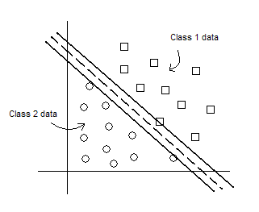
Support Vector Machine (SVM)

Slide 48
“Named Entity” Tagging
Machine learning techniques can find:
  Location
  Extent
  Type
Two types of features are useful
  Orthography
    e.g., Paired or non-initial capitalization
  Trigger words
    e.g., Mr., Professor, said, …

Slide 49
Normalization
Variant forms of names (“name authority”)
  Pseudonyms, partial names, citation styles
Acronyms and abbreviations
Co-reference resolution
  References to roles, objects, names
  Anaphoric pronouns
Entity Linking

Slide 50
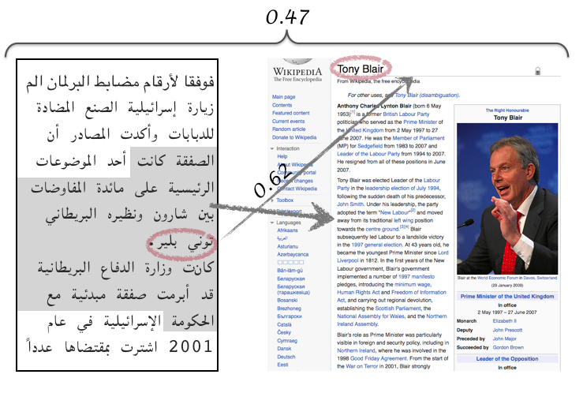
Entity Linking

Slide 51
Desirable Index Characteristics
Very rapid search
  Less than ~100ms is typically impercievable
Reasonable hardware requirements
  Processor speed, disk size, main memory size
“Fast enough” creation

Slide 52
An “Inverted Index”
Term Index
Term
Doc 1
Doc 3
Postings
Doc 2
Doc 4
Doc 5
Doc 6
Doc 7
Doc 8
AI
aid
0
0
0
1
0
0
0
1
4, 8
A
AL
all
0
1
0
1
0
1
0
0
2, 4, 6
BA
back
1
0
1
0
0
0
1
0
1, 3, 7
B
BR
brown
1
0
1
0
1
0
1
0
1, 3, 5, 7
C
come
0
1
0
1
0
1
0
1
2, 4, 6, 8
D
dog
0
0
1
0
1
0
0
0
3, 5
F
fox
0
0
1
0
1
0
1
0
3, 5, 7
G
good
0
1
0
1
0
1
0
1
2, 4, 6, 8
J
jump
0
0
1
0
0
0
0
0
3
L
lazy
1
0
1
0
1
0
1
0
1, 3, 5, 7
M
men
0
1
0
1
0
0
0
1
2, 4, 8
N
now
0
1
0
0
0
1
0
1
2, 6, 8
O
over
1
0
1
0
1
0
1
1
1, 3, 5, 7, 8
P
party
0
0
0
0
0
1
0
1
6, 8
Q
quick
1
0
1
0
0
0
0
0
1, 3
TH
their
1
0
0
0
1
0
1
0
1, 5, 7
T
TI
time
0
1
0
1
0
1
0
0
2, 4, 6
Notes:
15

Slide 53
Word Frequency in English
Frequency of 50 most common words in English
(sample of 19 million words)

Slide 54
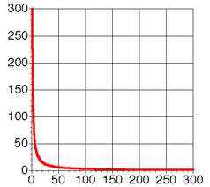
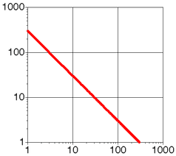
Zipfian Distribution: The “Long Tail”
A few elements occur very frequently
Many elements occur very infrequently

Slide 55
Index Compression
CPU’s are much faster than disks
  A disk can transfer 1,000 bytes in ~20 ms
  The CPU can do ~10 million instructions in that time
Compressing the postings file is a big win
  Trade decompression time for fewer disk reads
Key idea: reduce redundancy
  Trick 1: store relative offsets (some will be the same)
  Trick 2: use an optimal coding scheme
Notes:
23

Slide 56
MapReduce Indexing
(a) Map
(b) Shuffle
(c) Reduce
Shuffling
group values by: terms
doc
tokenize
combine
posting list
doc
tokenize
combine
posting list
doc
tokenize
combine
posting list
doc
tokenize
Notes:
Let me show u an example of using mapreduce
It turns out that this what we need ….
U have to compute
indexing
If u have to do this on disk, then there are 3 things to do
Compute partial products/results (the product stage pf the inner prod) We can do that efficiently on disk by working with this data structure (standard IR inverted index) that tells me for a term where it appears
And here is how to do that for ………. Example
and store them on disk,
2) On disk, we must sort the partial products/results so that we can now access them by pairs of document
3) then we do the final computation which is very simple: summation
We have taken the problem and reduced it to 3 steps:
1) Initial processing: Partial prod
2) Sort on disk
3) Produce our results: summation
This is the general framework of MapReduce
A real problem that maps to MapReduce
Morph it
Requires that I define these 4 steps
Setup: Structure of i/p
Processing/ computation
Structure of intermediate
Processing
Mapreduce handle everything: balance the date across macahines/ sorting done for me
So I save time by not having to spend time on thinking about handling those details

Slide 57
Agenda
Three generations of e-discovery
Design thinking
Content-based search example
Putting it all together

Slide 58
Indexable Features
Content
  Stems, named entities, …
Context
  Sender, time, …
Description
  Subject line, anchor text, …
Behavior
  Most recent access time, incoming links, …

Slide 59
Technology-Assisted Review
Understand the task
  Analyze and clarify the production request
Find a sufficient set of seed documents
  Adequate diversity, adequate specificity
Iteratively improve the classifier
  Judge samples for training and for evaluation
Stop when benefit exceeds cost

Slide 60
What Does “Better” Mean?
“Better” Technique
D
INCREASING
SUCCESS
(finding
relevant documents)
“Baseline” Technique
A
C
y
B
x
INCREASING EFFORT
(time, resources expended, etc.)

Slide 61
Hogan et al, AI & Law, 2010

Slide 62
Responsiveness vs. Privilege
Very large review set
Topical
False positive risks harmful disclosure
Much smaller review set
Non-topical
False negative risks harmful disclosure
Last chance to catch errors!

