Slide 1
Session 4: Civil Discovery
LBSC 708X/INFM 718X
Seminar on E-Discovery
Jason R. Baron
Adjunct Faculty
University of Maryland
February 16, 2012

Slide 2
Preservation Order
"Documents, data, and tangible things" is to be interpreted broadly to include writings; records; files; correspondence; reports; memoranda; calendars; diaries; minutes; electronic messages; voicemail; E-mail; telephone message records or logs; computer and network activity logs; hard drives; backup data; removable computer storage media such as tapes, disks, and cards; printouts; document image files; Web pages; databases; spreadsheets; software; books; ledgers; journals; orders; invoices; bills; vouchers; checks; statements; worksheets; summaries; compilations; computations; charts; diagrams; graphic presentations; drawings; films; charts; digital or chemical process photographs; video; phonographic tape; or digital recordings or transcripts thereof; drafts; jottings; and notes. Information that serves to identify, locate, or link such material, such as file inventories, file folders, indices, and metadata, is also included in this definition. --Pueblo of Laguna v. U.S. 60 Fed. Cl. 133 (Fed. Cir. 2004).

Slide 3
Attack on the Citadel: Questioning The Opposing Party’s Chosen Method of Responding To Discovery

Slide 4
The Sedona Principles (2d ed. 2008), Principle 6
Responding parties are best situated to evaluate the procedures, methodologies, and technologies appropriate for preserving and producing their own electronically stored information.

Slide 5
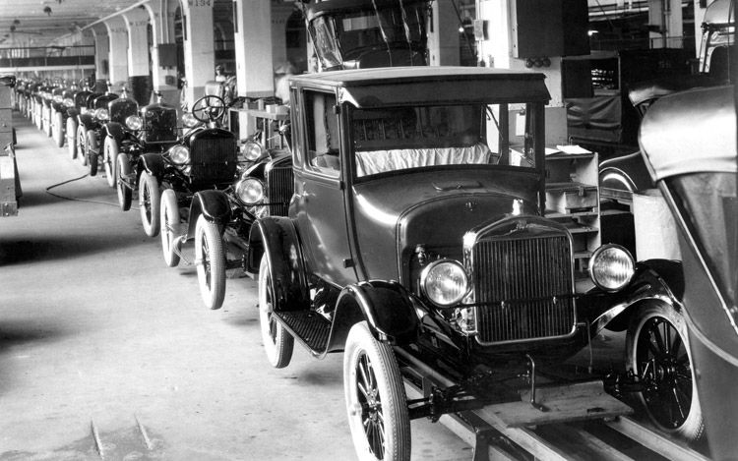
In the face of allegations of missing evidence, the Court upheld a manual collection process used by Ford Motor, acknowledging that “manual collection is sometimes even disfavored” [citing to The Sedona Conference Commentary on Search and Retrieval], but going on to note that “absent an agreement or timely objection, the choice is clearly within the producing party’s sound discretion.”
Ford Motor Co. v. Edgewood Properties Inc., 257 F.R.D. 418, 427 (D. N.J. 2009).
Notes:
In Ford Motor Co. v. Edgewood Properties Inc., 257 F.R.D. 418, 427 (D. N.J. 2009), in the face of allegations of missing evidence, the Court upheld a manual collection process used by Ford Motor, acknowledging that “manual collection is sometimes even disfavored [citing to The Sedona Conference Commentary on Search and Retrieval], but going on to note that “absent an agreement or timely objection, the choice is clearly within the producing party’s sound discretion.”

Slide 6
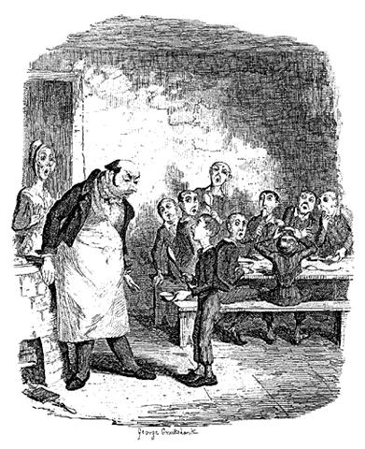
Please your Honor, may I have some more (ESI, that is)?
In the face of a protest of “inexplicable deficiencies” in a party’s production, "vague notions that there should have been more than what was produced are speculative and are an insufficient premise to compel judicial action."
Judge Facciola,
U.S. v. O’Keefe, 537 F.
Supp. 2d 14, 22 (D.D.C. 2008).

Slide 7
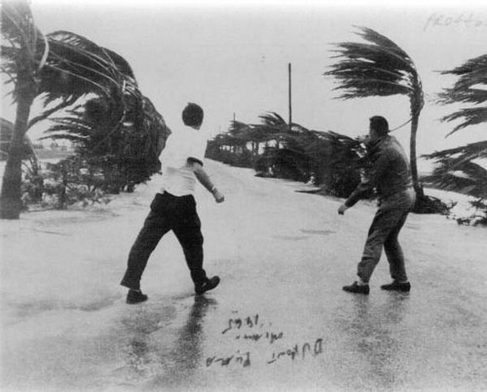
But there are gale force winds in the case law…

Slide 8
Judge Scheindlin, Pension Committee of the University of Montreal Pension Plan v. Banc of America Securities, et al.
685 F.Supp.2d 456, 473 (S.D.N.Y. 2010) (as amended May 28, 2010).
Plaintiffs’ litigation hold policy is defective…
Judge Scheindlin’s Opinion in Pension Committee goes on to say @ 685 F.Supp.2d at 473 n.68:
attorney oversight of the process … is important.
Citing to:
Adams v. Dell, 621 F.Supp.2d 1173, 1194 (D. Utah 2009). (holding that defendant had violated its duty to preserve information, in part because the defendant's preservation practices “place operations-level employees in the position of deciding what information is relevant”)

Slide 9
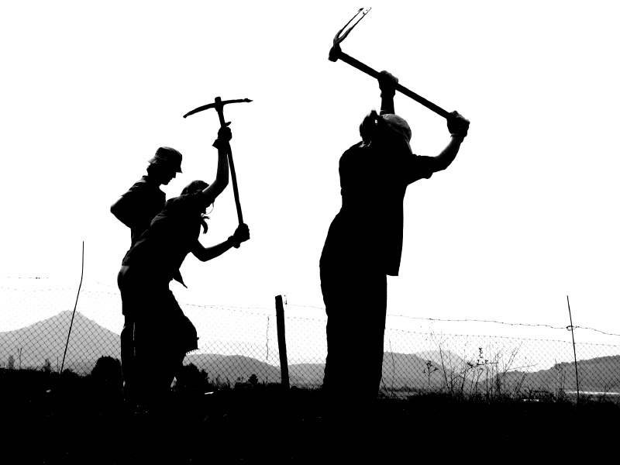
Issues & Challenges With Manual Collection

Slide 10
Issues and Challenges with Manual, Custodian Based Collection
Under-collection
Inconsistent, idiosyncratic searching for purpose of collection
Late identification of key evidence
Metadata spoliation
Self-interest, bias
End user’s absence of legal knowledge (e.g., relevancy)
Failure of attorney supervision (being out of loop)
Burdens, costs, and the risk of a do-over

Slide 11
Hot topic: Judicial second guessing of failure to use e-search capabilities: Capitol Records v. MP3 Tunes, 261 F.R.D. 44 (S.D.N.Y. 2009)
“In [a prior case] the Court notes its dismay that the party opposing discovery of its ESI had organized its files in a manner which seemed to serve no purpose other than ‘to discourage audits. . .’ Similarly, in this case, [the party] host[ed] no ediscovery software on their servers and apparently are unable to conduct centralized email searches of groups of users without downloading them to a separate file and relying on the services of an outside vendor.”

Slide 12
Judicial second guessing of failure to use e-search capabilities: Capitol Records v. MP3 Tunes (con’t)
Court went on to add:
“The day will undoubtedly will come when burden arguments based on a large organization’s lack of internal ediscovery software will be received about as well as the contention that a party should be spared from retrieving paper documents because it had filed them sequentially, but in no apparent groupings, in an effort to avoid the added expense of file folders or indices.”

Slide 13
Judge Facciola writing for the U.S. District Court for the District of Columbia
“Whether search terms or ‘keywords’ will yield the information sought is a complicated question involving the interplay, at least, of the sciences of computer technology, statistics and linguistics. See George L. Paul & Jason R. Baron, Information Inflation: Can the Legal System Adapt?', 13 RICH. J.L. & TECH.. 10 (2007) * * * Given this complexity, for lawyers and judges to dare opine that a certain search term or terms would be more likely to produce information than the terms that were used is truly to go where angels fear to tread.”
-- U.S. v. O'Keefe, 537 F.Supp.2d 14, 24 D.D.C. 2008).

Slide 14
Search Protocols: Two paths
One approach: the judiciary choosing to decide between competing methods and protocols
A second approach: requiring the parties to negotiate and come to agreement.

Slide 15
Judge Grimm writing for the U.S. District Court for the District of Maryland
“[W]hile it is universally acknowledged that keyword searches are useful tools for search and retrieval of ESI, all keyword searches are not created equal; and there is a growing body of literature that highlights the risks associated with conducting an unreliable or inadequate keyword search or relying on such searches for privilege review.” Victor Stanley, Inc. v. Creative Pipe, Inc., 250 F.R.D. 251 (D. Md. 2008); see id., text accompanying nn. 9 & 10 (citing to Sedona Search Commentary & TREC Legal Track research project)

Slide 16
Victor Stanley v Creative Pipe, 250 FRD 251 (D Md 2008) (Victor Stanley I)
o What was new and different about the opinion?
o Is there a distinction to be made between searching for responsiveness and searching for privilege?
o How does Mt Hawley Ins. Co. v. Felmen Production (S.D. W. Va 2010) deal with issue of quality control in e-discovery?
o How does the reasoning of Mt Hawley line up with Victor Stanley?

Slide 17
Hot topic: Metadata
What is it?
Email header information (possibly hidden)
Proprietary features of word processing (e.g. summary fields)
Embedded & shadow data
Deleted keystrokes
Tracking info
Spreadsheet formulas
Format issues and metadata
Metadata ethics: inadvertent production

Slide 18
Recent Cautionary Tales
1) In re Fannie Mae Litigation, 552 F.3d 814 (D.C. Cir. 2009) (backup tapes)
2) Aguilar v. ICE Division of US Dept of Homeland Security, 2008 WL 5062700 (S.D.N.Y. Nov. 21, 2008) (metadata)

