Slide 1
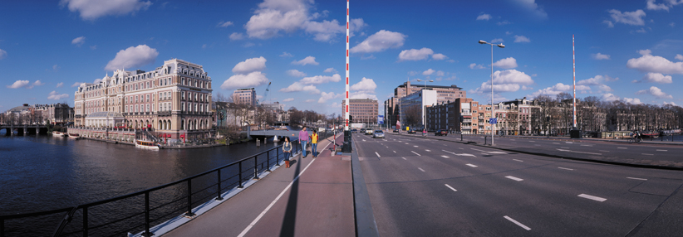
Identification and Collection
Seminar on E-Discovery, February 9th, 2012,
College of Information Studies, University of Maryland
Dr. Hans Henseler
Amsterdam University of Applied Sciences, The Netherlands

Slide 2
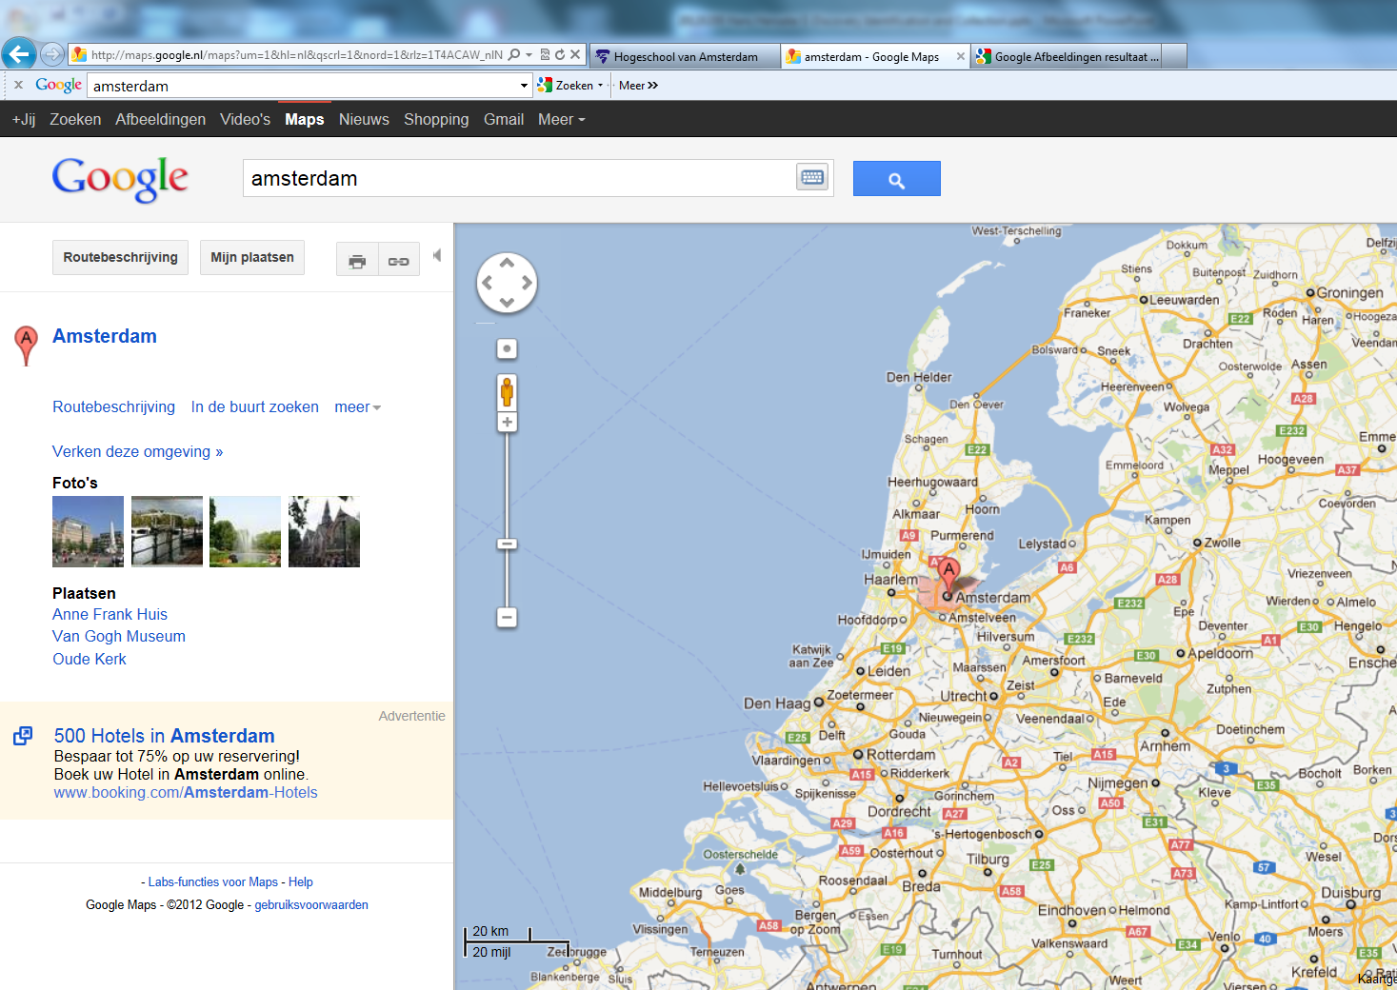
HvA
Kaart van Nederland

Slide 3
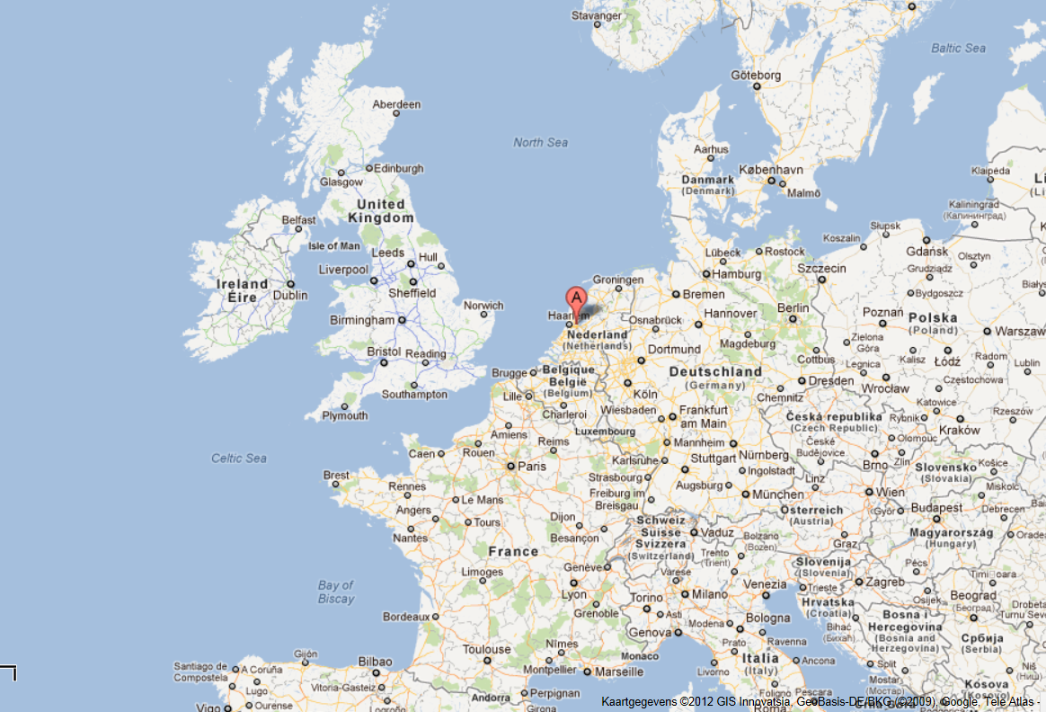
HvA
Kaart van Nederland

Slide 4

Dr. Hans Henseler
Ph.D. computer science (1993)
Netherlands Forensic Institute (1992-1998)
Netherland Institute of Applied Research (1998-2000)
CTO at ZyLAB (2000-2006)
Director at Pricewaterhouse Coopers (2006-2010)
Adjunct Professor HvA (2009-)
Partner at Fox-IT (2011-)

Slide 5
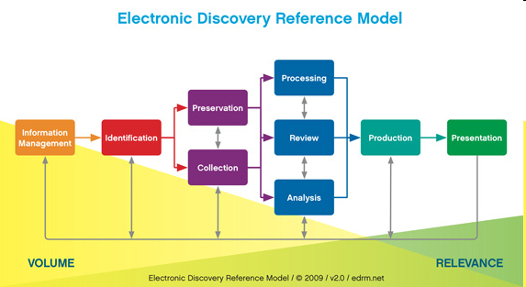
1. Recap: EDRM
Incident
T4
T3a
T1
T2
T5a
T6a
T6b
T5b
T3b

Slide 6
1. Recap: Track 1: Information Management
GOAL:
Develop defensible retention policies and e-discovery processes
HOW:
By managing all information sources:
- Complete information lifecycle: From creation, through using to archival and destruction.

Slide 7
Track 2: Identification
GOAL:
Determine what should be preserved and collected
HOW:
By identifying and localising potential sources of information:
- what kind of information is required?
- relevant time period?

Slide 8
Track 3a: Preservation
GOAL:
Preserve data to avoid spoliation claims/sanction
HOW:
By securing information that may potentially be relevant
- By ensuring that information can not be altered or destroyed.

Slide 9
Track 3b: Collection
GOAL:
Retrieve forensically sound copies of critical data
HOW:
By making digitale copies of electronic stored information and related meta data (information context)
- In such a way that the integrity and authenticity of the information can be verified

Slide 10
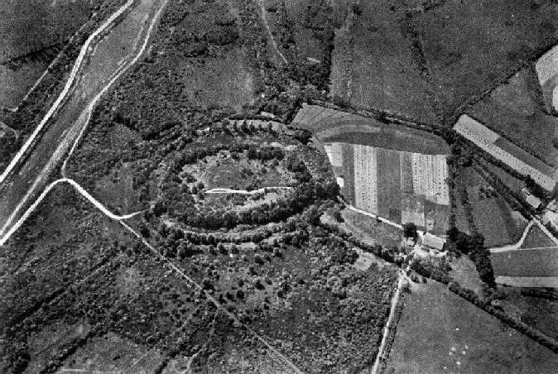
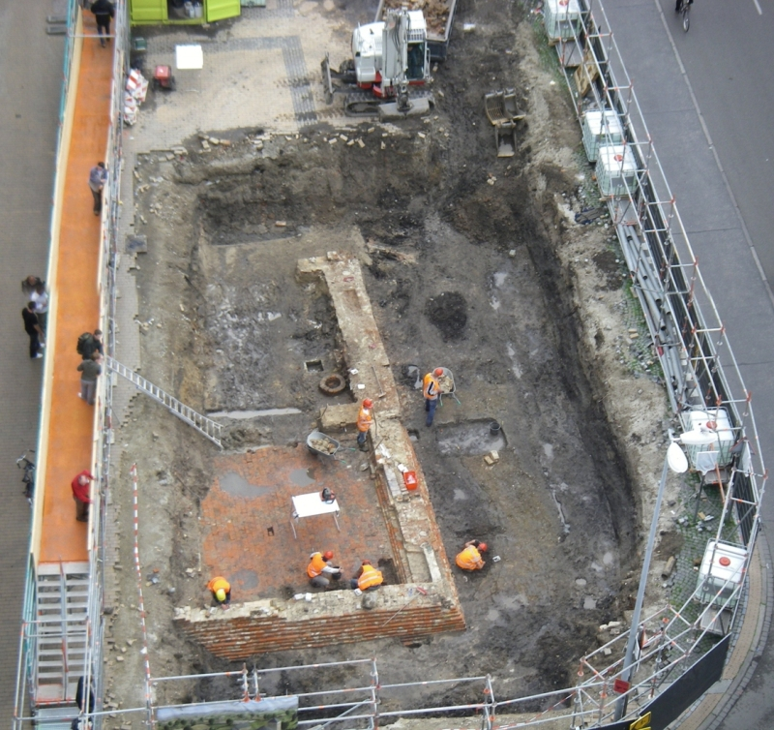
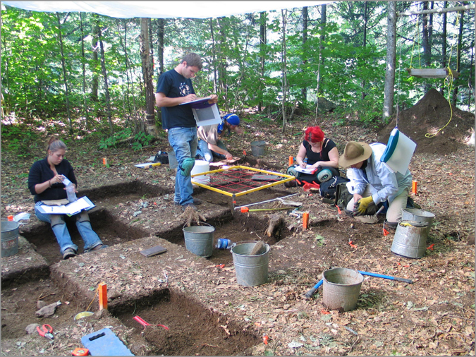
E-Discovery and Archeology

Slide 11
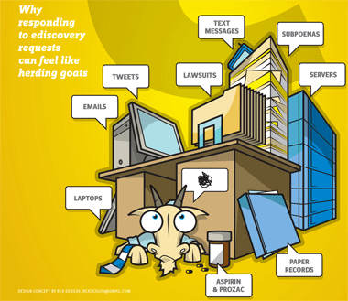
Identification
Identification is the first reactive step in response to an E-Discovery request.
Identification involves:
    Localisation of potential sources of electronic information.
    Determine the scope of the investigation
      Which data (i.e. projects, employees,
      departments)
      Which periods
Forensic Technology:
    Mapping the information
    landscape
    Identifying relevant sources

Slide 12
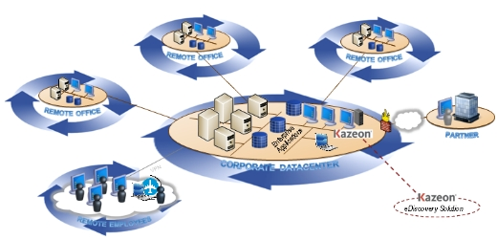
IT Infrastructure: Example 1

Slide 13
IT Infrastructure: Example 2

Slide 14
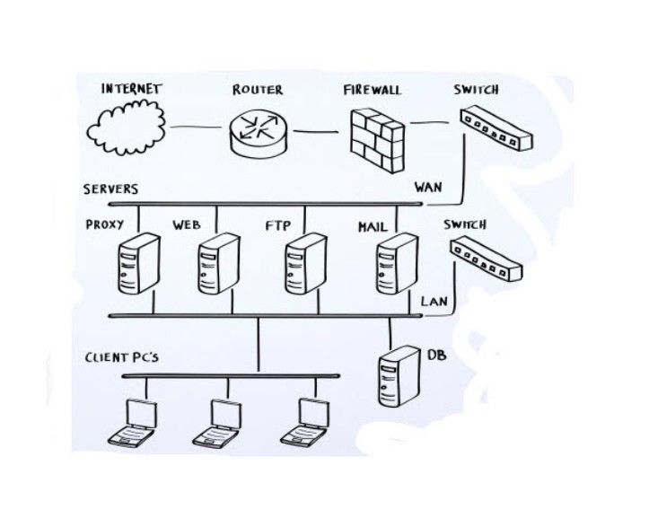
IT Infrastructure: Example 3

Slide 15
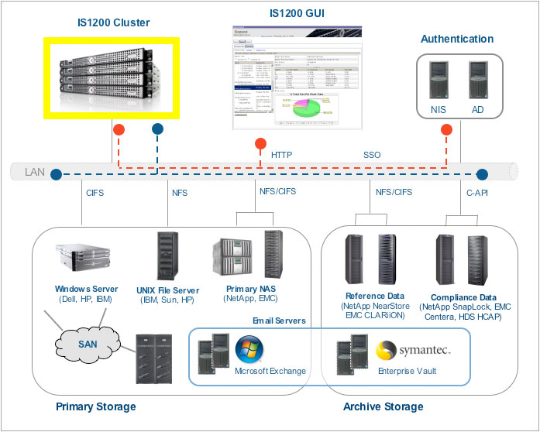
IT Infrastructure: Example 4

Slide 16
Systems: Accounting

Slide 17
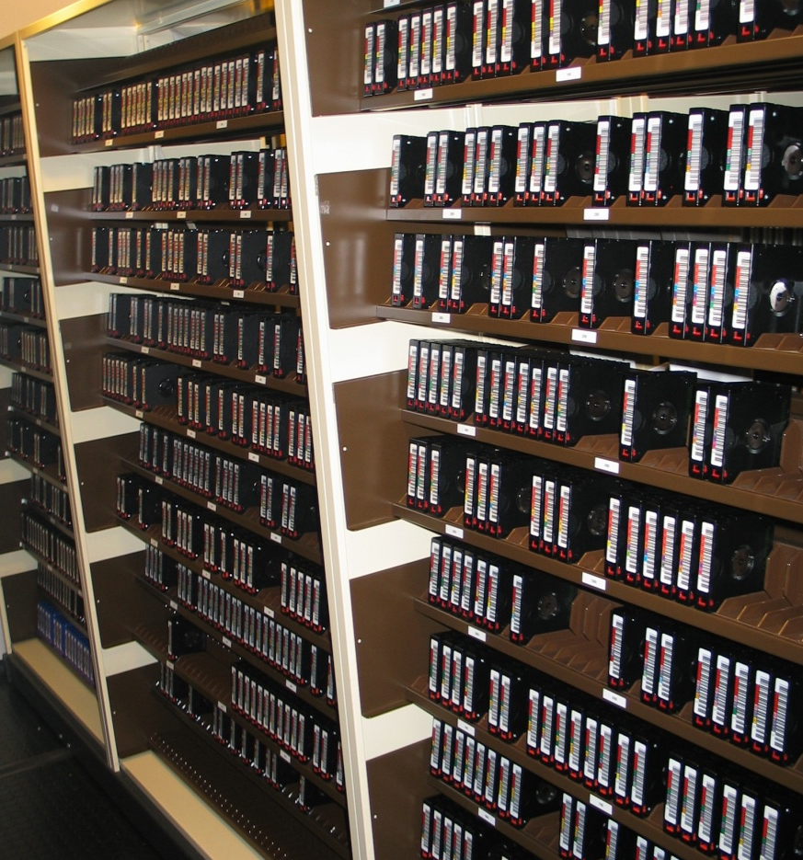
Identifications of backups
Typical company (1800 employees) had the following backups available in July 2007:
12x Backup July 2006 /June 2007
1x Backup Friday 29/12/2006
1x Backup Friday 30/12/2005
1x Backup Friday 31/12/2004
Total 15 backups per custodian!

Slide 18
Data preservation
Goal:
  Preserve data to avoid spoliation claims/sanction
Measures:
  Issue a legal hold by sending out an internal company memo
  Secure data to prevent it from being changed or destroyed (avoid data spoliation), for instance stop backup tapes from being recycled
  Freeze records so they can not be destroyed

Slide 19
Collection
Relevant electronicalle stored information is copied in a forensically sound way.
Forensic technology:
    Maintain original meta data of electronic information (i.e. filename, path, dates etc)
    Forensic computer image versus logical file copy
    Maintaining chain of custody
    Calculate secure hash values of collected data

Slide 20

Collection: File Servers
  What to expect:
    Files
    Personal email archives (pst, nsf etc.)
    Long and deep file paths
  Forensic tools:
    Encase (Guidance Software)
    Forensic Toolkit - FTK (AccessData)
    Evidence Mover (Micro Forensics)
    Robocopy (Microsoft)

Slide 21
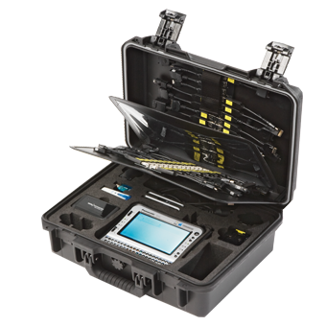
Collection: Mobile Phones
  What to expect:
    Mobile/Smart phones
    Android Tablets, iPad
  Forensic Tools:
    XRY (MicroSystemation) →
    Device Seizure (Paraben)
    UFED (Cellebrite)
    FTK Mobile Phone Examiner (AccessData)
    Encase Smartphone Examiner (Guidance Software)

Slide 22

Collection: Databases
  What to expect:
    Financial databases (SAP, Oracle Financials etc)
    Firewall databases
    SQL databases (MsSQL, Oracle, MySQL, Progress etc)
  Best practices
    Use SQL queries
    Exports vs. Dumps
    SAP abap scripts vs. Oracle database dumps
      (depends on size and available time)

Slide 23
Collection: Email Servers
  What to expect:
    Lotus Notes (nsf)
    Microsoft Exchange (edb)
    Groupware
  Connect to life server (why?)
    Exchange Server (2010 has
    interesting E-Discovery capabilities)
    Encase Enterprise
  Process message store
    Network Email Examiner (Paraben),
    PowerControls (Kroll Ontrack)

Slide 24
Secure Hash: MD5 and SHA1
Message m
(long)
Message digest, y
(Shorter fixed length)
Cryptographic hash
Function, h
Shrinks data, so 2 messages can
have the same digest: m₁ != m₂, but
h(m₁) = h(m₂)
Goal: to provide a unique “fingerprint” of the message.
How? Must demonstrate 3 properties:
  Fast to compute y from m.
  One-way: given y = h(m), can’t find any m’ satisfying h(m’) = y easily.
  Secure Hash: Strongly collision-free, i.e. can’t find any m₁ != m₂ such that h(m₁)=h(m₂) easily

Slide 25
Procedures, Forms and Logs
Data freeze directive
Data request
Letter of consent
IT inventory template
Encase acquisition form
Chain of custody form
Evidence log for tracking collected electronic data
Physical document collection sheets and scanning log
Standard Operation Procedure for Data Collection

Slide 26
