Slide 1
Identification and Collection
INFM 718X/LBSC 708X
Douglas W. Oard

Slide 2
“Data” Mapping
Organizational
Application-al
Logical
Physical
Geographic

Slide 3
Levels of Analysis

Slide 4
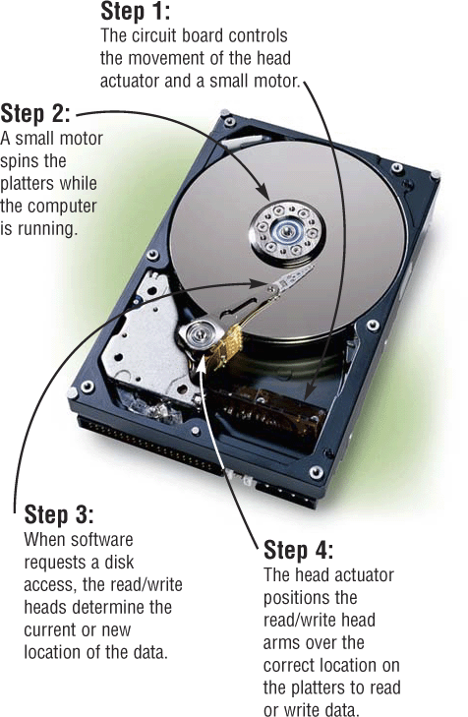
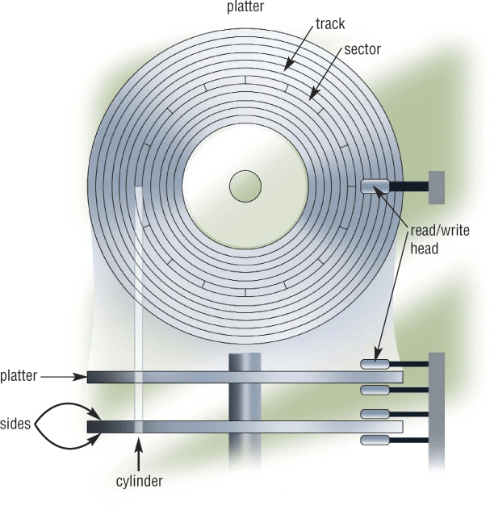
How Disks Work
Extracted From Shelly Cashman Vermatt’s Discovering Computers 2004

Slide 5
Windows “NTFS” File Metadata
Time file created (or copied)
Most recent one; optionally “journaled”
Time file content changed (or made changeable)
Most recent one; optionally “journaled”
Time file renamed (or moved)
Most recent one
Time file metadata created or changed
Most recent one
Time file accessed (content or metadata)
Most recent one; optionally disabled

Slide 6
Microsoft Word Metadata
Author
Title
Dates (may not agree with NTFS!)
Created
Modified
Accessed
Printed
Each tracked change

Slide 7
EXIF Image Metadata
Time
Location
Camera manufacturer and model
Camera orientation
Exposure information (shutter speed, f stop)
Thumbnail versions
Altering the image may not change the thumbnail!

Slide 8
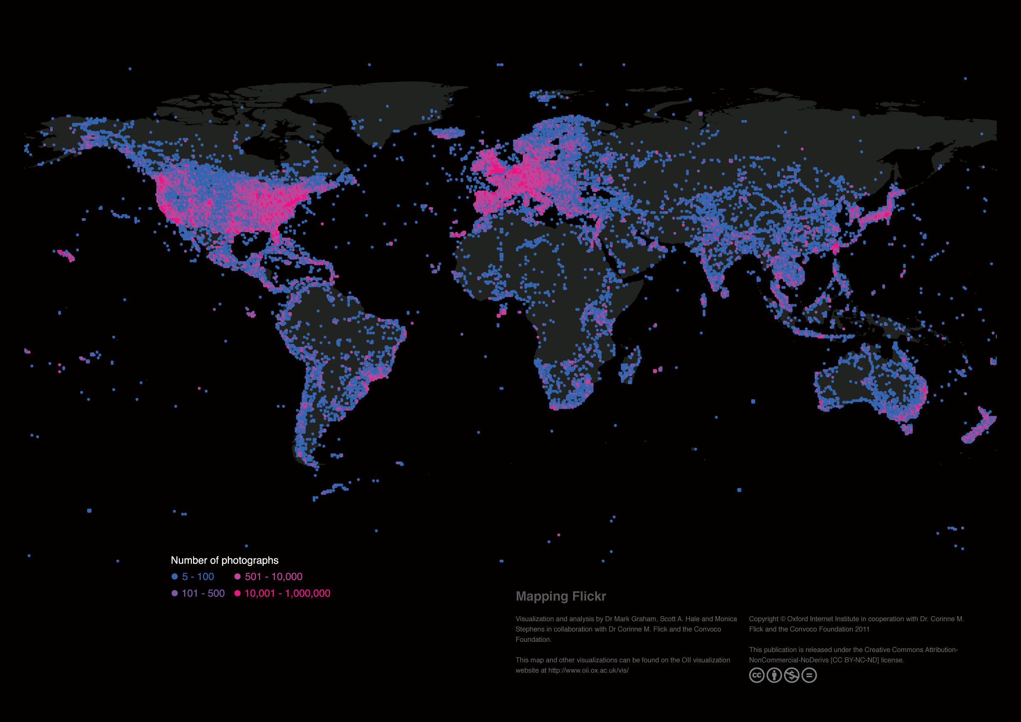

Slide 9
Email Metadata
Message metadata
Times
Sent
Resent
Received
Route
In-reply-to
Attachment file type
System metadata
Folder

Slide 10
File Types
Extensions
MyDocument.xls
MIME type
Magic bytes
Supervised machine learning

Slide 12
Capture
Imaging
Tape copy
Disk image
Active file capture
Hardware write block
Software write blocking
File system copy

Slide 13
Culling
Custodian
De-NISTing
Based on NIST list of known program hashes
Date range

Slide 14
Preservation
Future accessibility
Replication
Service copies
Authenticity
Documented traceable process
Separately stored hashes

