Slide 1
Information and Records Management
INFM 718X/LBSC 708X
Seminar on E-Discovery

Slide 2
Agenda
Information management
Records management
Discussant

Slide 3
The EDI Trinity
Data
Information
Records

Slide 4
Sources of ESI
Enterprise databases
Web sites
File systems
Organized
Shared
Personal
Email
Backup tapes
Voicemail
Instant messaging
File systems
Metadata
Deleted files
Security badge access logs
Personally owned systems
Files
Email
Cloud services
Gmail/Hotmail/…
Dropbox/Google Docs/…
Facebook
Twitter
SMS

Slide 5
Formal and Informal Social Networks

Slide 6
The Activity Trinity
Use
Retain
Proactive (records management)
Reactive (legal hold)
Destroy
Reasonable (cost, business risk, …)
“Bad faith” (litigation risk)

Slide 7
Internal Stakeholders
Business functions
Operations
Sales
Management (audit, …)
Support functions (purchasing, human resources, …)
Information technology staff
Records management staff
Legal staff

Slide 8
Who to Believe?

Slide 9
Replication
Business continuity
Disaster recovery
Parallel access
Latency mitigation
Leakage
Convenience
Unauthorized disclosure
Theft
Disposal

Slide 10
IT Support Functions
Management (CIO, CTO, projects, audit, …)
Acquisition (systems, services, outsourcing, …)
Development (software, Web, migration, …)
Operations (servers, network, backups, …)
Security (network, data, …)
Support (training, help desk, …)

Slide 11
Management Structures
Execution
Centralized
Distributed
Control
Centralized
Distributed
Network architectures
Workstations
Cloud
Peer-to-peer
Centralized Functions
Relational database
Servers
Mail
Web
Backups

Slide 12
Critical Events
Hardware refresh
Migration, concurrent operations
System upgrade
Backward compatibility
Change of outsourcing contractor
Service Level Agreement (SLA) continuation
Termination of employment
ESI, tacit knowledge, file encryption passwords

Slide 13
Risk Management
Awareness
Training
Detection
Red team
Mitigation
Proactive
Technology
Policy
Process
Reactive

Slide 14
Information Management Policies
Access control (systems, FERPA, classified, …)
Change control (Content, authorization, …)
Acceptable use (personal use, malicious use , …)
Dissemination control (Web sites, blogs, …)
System integrity (wireless devices, media, …)
Privacy (rights, assurances, …)
Backup management (periodicity, restoration, …)
Legal holds

Slide 15
Sedona Guidelines
Information and records management is important in the electronic age
An organization’s information and records management policies and procedures should be realistic, practical, and tailored to the circumstances of the organization
An organization need not retain all electronic information ever generated or received

Slide 16
Sedona Guidelines (cont.)
An organization adopting an information and records management policy should also develop procedures that address the creation, identification, retention, retrieval and ultimate disposition or destruction of information and records
An organizations policies and procedures must mandate the suspension of ordinary destruction practices and procedures as necessary to comply with preservation obligations related to actual or reasonably anticipated litigation, government investigation or audit

Slide 17
Defining “Records”
ISO 15489-1:2001: Information created, received and maintained as evidence and information by an organization or person in pursuance of legal obligations or in the transactions of business”
ICA Committee on Electronic Records: A recorded information produced or received in the initiation, conduct or completion of an institutional or individual activity and that comprises content, content and structure sufficient to provide evidence of the activity.

Slide 18
Records Management
“Schedules”
What
How long
(Why)
Classification
Specialized staff (e.g., executive assistant)
End-user (e.g., for email)
Embedded rules (hand-written or learned)

Slide 19
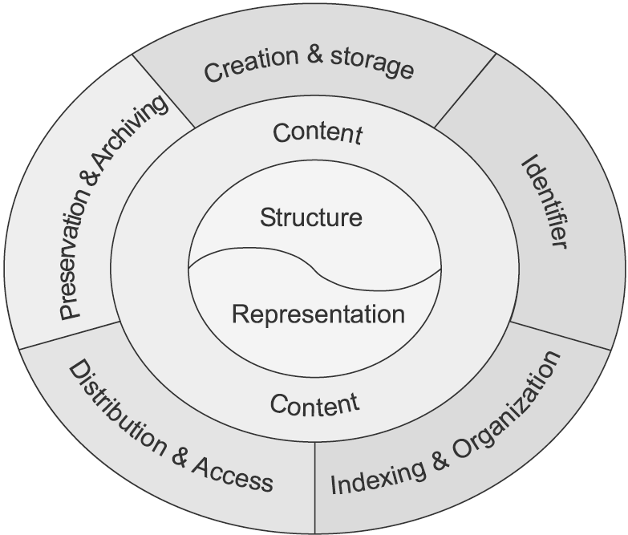
Information Life Cycle

Slide 20
Famous Last Words
Word of the day: spoliation
Destruction or altering of evidence
“There are some communications that should not be put in written form”
(hmmm … how is it that we know this was said?)

