Slide 1
Session 11: Cloud Computing
LBSC 708X/INFM 718X
Seminar on E-Discovery
Jason R. Baron
Adjunct Faculty
University of Maryland
April 12, 2012

Slide 2
Cloud Computing Definition
From Wikipedia: “Cloud computing is a style of computing in which dynamically scalable and often virtualized resources are provided as a service over the Internet. Users need not have knowledge of, expertise in, or control over the technology infrastructure in the "cloud" that supports them.
* * *
The term cloud is used as a metaphor for the Internet, based on how the Internet is depicted in computer network diagrams and is an abstraction for the complex infrastructure it conceals.”

Slide 3
Cloud computing: NIST (partial) definition
Cloud computing is a model for enabling ubiquitous, convenient, on-demand network access to a shared pool of configurable computing resources (e.g., networks, servers, storage, applications and services) that can be rapidly provisioned and released with minimal management effort or service provider interaction.
From NIST Definition of Cloud Computing

Slide 4
Cloud Service Models
Software as a Service (SaaS) – Cloud provider makes applications accessible through a thin client interface, e.g., web browser
Platform as a Service (PaaS) – Cloud provider manages infrastructure but user can customize/configure applications
Infrastructure as a Service (IaaS) – Cloud user controls apps plus capability to modify/manage operating systems and resources

Slide 5
Cloud Deployment Models
Public Cloud – access available to general public; data segregated by user groups
Private Cloud – access solely to specific organization
Hybrid Cloud – combination of both. E.g., organization might use public cloud for email and private cloud for other types of apps

Slide 6
Cloud Questions
What, if anything, makes cloud computing different than what has come before?
From a technological perspective
From a legal/policy perspective
How are the subjects of cloud computing and social media related/distinct?
From a technological perspective
From a legal/policy perspective

Slide 7
More Cloud Questions
What are the advantages of cloud computing?
What are the risks?
What constitute best practices?

Slide 8
Hypothetical
The CIO of a large federal agency considers herself to be under a mandate from the Administration to move 100,000 email accounts to the cloud by the end of the current fiscal year. What technological and policy choices does the organization face, and what legal issues might arise?

Slide 9
Federal Cloud Computing Strategy Document Vivek Kundra, Feb. 8, 2011
“Storing information in the cloud will require a technical mechanism to achieve compliance with records management laws, policies and regulations promulgated by both the National Archives and Records Administration (NARA) and the General Services Administration (GSA). The cloud solution has to support relevant record safeguards and retrieval functions, even in the context of a provider termination.” (page 14)

Slide 10
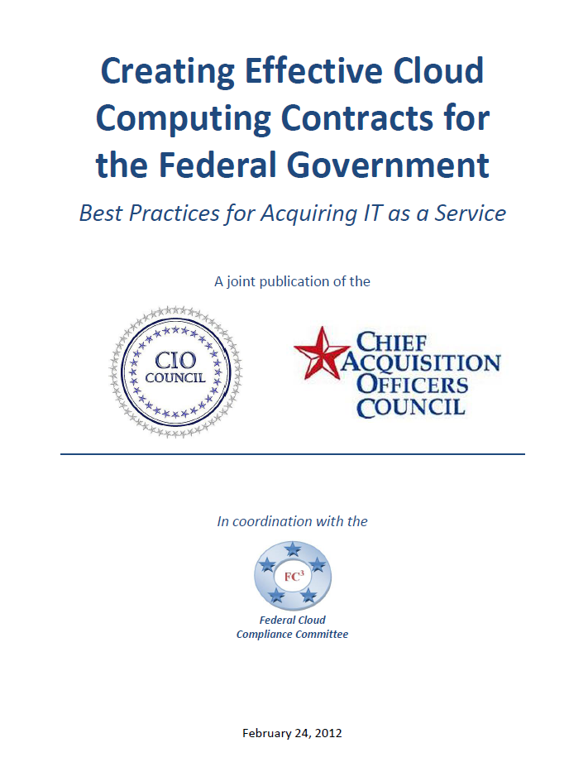
Cloud Procurement White Paper
Overview
Top 10 areas Federal agencies need to address when procuring cloud
Gives description of issues along with ways to address issues within contracts
Provides tactical guidance through a questionnaire checklist
Source: www.cio.gov
Notes:
Allison

Slide 11
FOIA and Federal Recordkeeping in the Cloud
FOIA Access
Federal Recordkeeping
Ability to conduct a reasonable search to meet FOIA obligations
Ensure the processing of information is pursuant to FOIA requirements
Allow for the tracking and reporting of information pursuant to FOIA
Agencies should have proactive records planning before using a cloud service
Ensure the ability to have timely and actual destruction of records in accordance with mandated records schedules
How to deal with permanent records
Process for transitioning to a new Cloud Service Provider (CSP)

Slide 12
NARA on Cloud Computing NARA Bulletin 2010-05
+ Defines cloud models in accordance with NIST definitions
+ Discusses records mgmt challenges
+ Details how agencies can meet records mgmt responsibilities

Slide 13
NARA on Cloud Computing: RM Challenges NARA Bulletin 2010-05
+ Lacking the capability to implement records disposition schedules, including the ability to transfer permanent records to archives and/or delete temporary records
--are records maintained in a way that preserves functionality and integrity throughout the records’ life cycle?
--are links maintained between records and metadata?

Slide 14
NARA on Cloud Computing: More Challenges NARA Bulletin 2010-05
+ Agencies need to be able to control proposed deletion of records, wherever they be located
+ Agencies must ensure records are accessible for all purposes of access (e-discovery, FOIA, etc.)

Slide 15
NARA on Cloud Computing: Still More Challenges NARA Bulletin 2010-05
+ Cloud architecture may lack formal technical standards governing storage and manipulation of data, threatening long-term trustworthiness and sustainability of data

Slide 16
NARA on Cloud Computing: Still More Challenges NARA Bulletin 2010-05
+ Lack of portability complicating transferring/exporting permanent records to archival environment
+ Agencies should anticipate how continued preservation and access issues will be resolved where cloud provider business operations materially change

Slide 17
NARA on Cloud Computing: How can agencies meet their RM responsibilities? NARA Bulletin 2010-05
1) Include records officer in planning & deployment of cloud computing solutions
2) Declare which copy of records will be the official record copy (value of cloud version may be greater).
3) Determine if cloud data covered under existing records schedules
4) Include instructions on how records will be captured, managed, retained, made available to users

Slide 18
NARA on Cloud Computing: How can agencies meet their RM responsibilities? NARA Bulletin 2010-05
5) Instructions on conducting a records analysis, including on system documentation & metadata
6) Instructions to periodically test transfers of Federal records to other environments, including agency servers, to ensure portability
7) Instructions on how data will be migrated to new formats, so records are readable thru their life cycle
8) Resolve portability and accessibility thru good RM policies and data governance practices (interoperability, security, access, etc.)

Slide 19
NARA on Cloud Computing: Contractors & Service Level Agreements (SLAs) NARA Bulletin 2010-05
+ Agencies maintain responsibility for managing records whether they reside in an agency’s physical custody or if maintained by a 3rd party contractor.
+ When dealing with 3rd parties, include RM clause to ensure that contractor must manage records in accordance with Federal Records Act, 44 USC Chapters 21, 29, 31, 33, and NARA Regs, 36 CFR Chapter XII Subchapter B.

Slide 20
Sample RFQ Language
The Quoter shall provide common Application Program Interfaces (APIs) allowing integration with third party tools such as email archiving solutions, E-Discovery solutions, and Electronic Records Management Software Applications.
The Quoter shall support an immutable email management solution integrated with the messaging system in accordance with the requirement for Federal agencies to manage their email messages and attachments as electronic records in accordance with 36 CFR § 1236.22 , including capabilities such as those identified in: DoD STD-5015.2 V3 , Electronic Records Management Software Applications Design Criteria Standard, NARA Bulletin 2008-05, July 31, 2008, Guidance concerning the use of e-mail archiving applications to store e-mail, and NARA Bulletin 2010-05 September 8, 2010, Guidance on Managing Records in Cloud Computing Environments.

Slide 21
Leading case precedent
Flagg v. City of Detroit, 252 F.R.D. 346 (E.D. Mich. 2008) (where City of Detroit, as defendant, entered into contract for text messaging services with non-party service provider, held, City exercised sufficient control over ESI in form of text messages so as to require production to plaintiff under FRCP 34 standards; additionally, court ordered plaintiff to make its request under FRCP 34, in lieu of Court adjudicating dispute over the propriety of plaintiff’s pending 3rd party subpoena for same material).

