Slide 1
Beyond Text
INFM 718X/LBSC 708X
Session 10
Douglas W. Oard

Slide 2
Agenda
Beyond Text, but still language
  Scanned documents
  Speech
Beyond Text, but still information
  Images
  Video
Beyond text to data

Slide 3
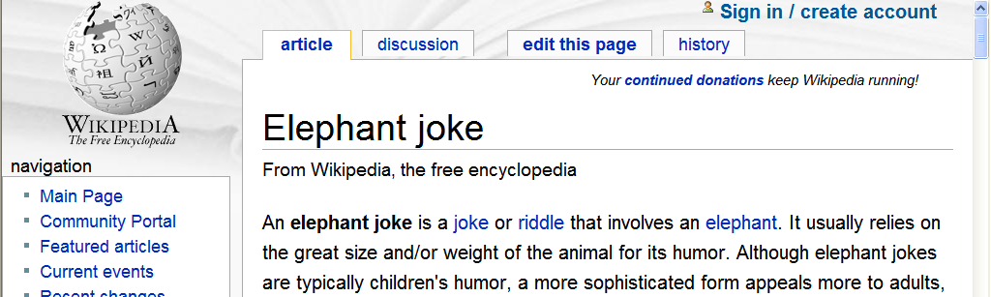
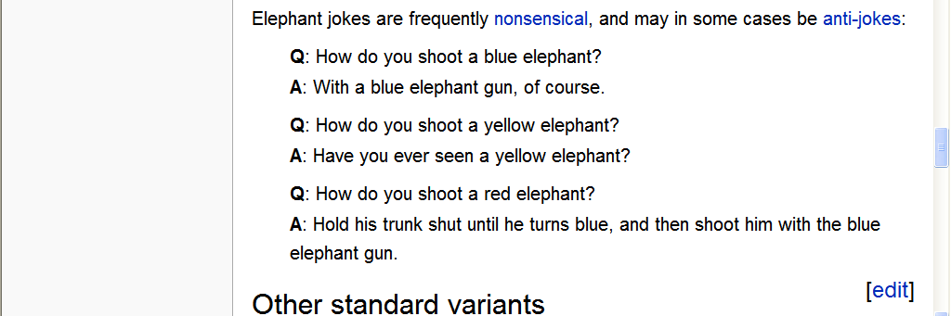

Slide 4
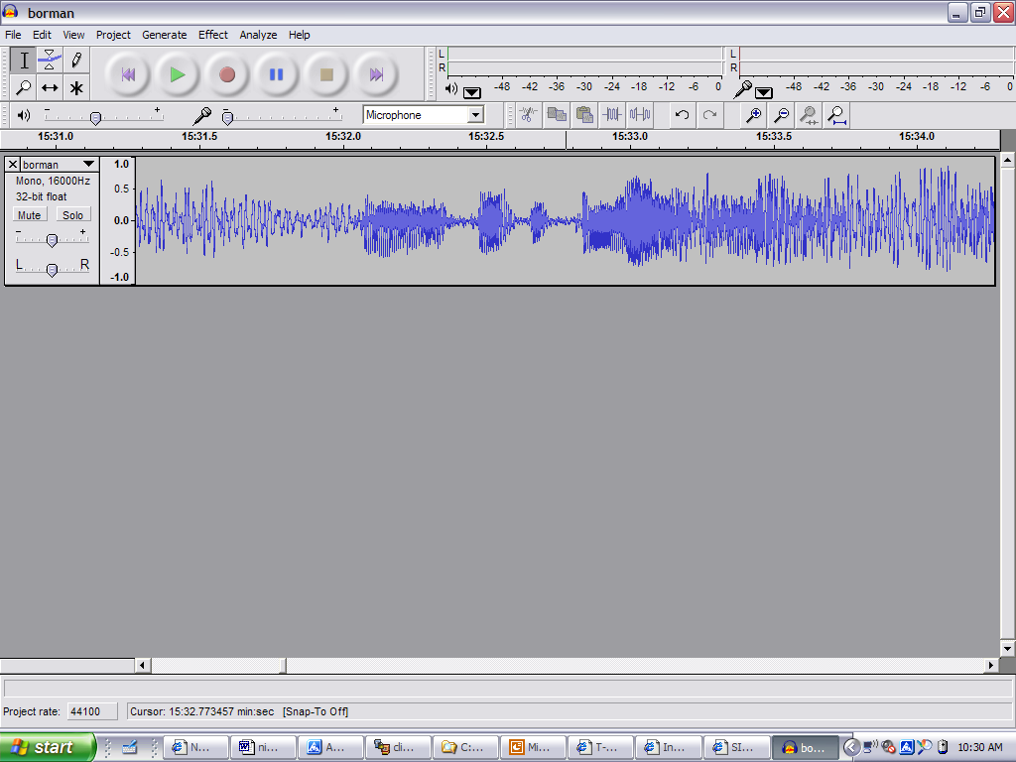
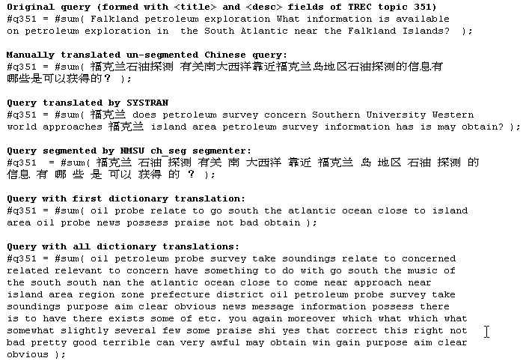
Expanding the Search Space
Scanned Docs
Identity: Harriet
“… Later, I learned that
John had not heard …”

Slide 5
Language Conversion
MT
OCR
Searchable
Fraction
Handwriting
Speech
Transducer Capabilities

Slide 6
Supporting Information Access
Source
Selection
Search System
Query
Formulation
Query
Search
Ranked List
Selection
Query Reformulation
and
Relevance Feedback
Recording
Examination
Recording
Source
Reselection
Delivery

Slide 7
Indexing and Retrieving
Images of Documents
LBSC 796/INFM 718R
David Doermann, UMIACS
Notes:
1

Slide 8
Sources
Existing digitized collections
Networked digital copiers
High-volume digitization

Slide 9
Document
DOCUMENT
DATABASE
IMAGE
Basic Medium for Recording Information
Transient
  Space
  Time
Multiple Forms
  Hardcopy (paper, stone, ..) / Electronic (CDROM, Internet, …)
  Written/Auditory/Visual (symbolic, scenic)
Access Requirements
  Search
  Browse
  “Read”
Notes:
For transience in space and time, consider Web crawls, which copy documents to different locations, and consider the Internet Archive, which maintains snapshots of Web pages through time.

Slide 10

Images
DOCUMENT
DATABASE
IMAGE
Pixel representation of intensity map
No explicit “content”, only relations
Image analysis
  Attempts to mimic human visual behavior
  Draw conclusions, hypothesize and verify
Image databases
Use primitive image analysis to represent content
Transform semantic queries into “image features”
  color, shape, texture …
  spatial relations
10
27
33
29
27
34
33
54
54
47
89
60
25
35
43
9

Slide 11
Document Images
DOCUMENT
DATABASE
IMAGE
A collection of dots called “pixels”
  Arranged in a grid and called a “bitmap”
Pixels often binary-valued (black, white)
  But greyscale or color is sometimes needed
300 dots per inch (dpi) gives the best results
  But images are quite large (1 MB per page)
  Faxes are normally 72 dpi
Usually stored in TIFF or PDF format
Yet we want to be able to process them like text files!

Slide 12
Document Image
“Database”
DOCUMENT
DATABASE
IMAGE
Collection of scanned images
Need to be available for indexing and retrieval, abstracting, routing, editing, dissemination, interpretation …

Slide 13
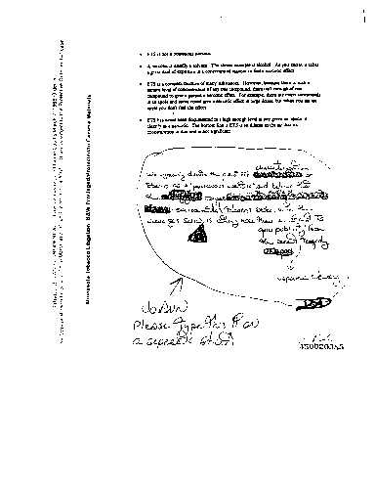
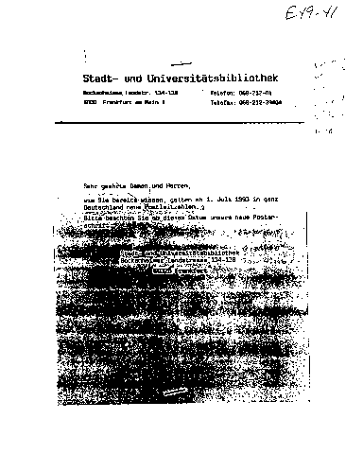
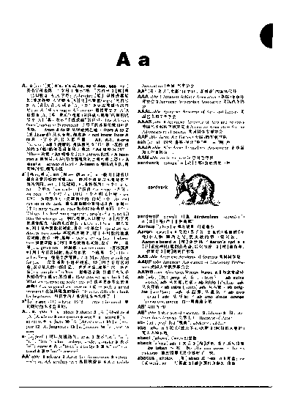
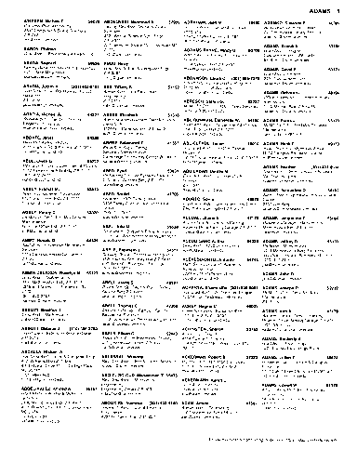
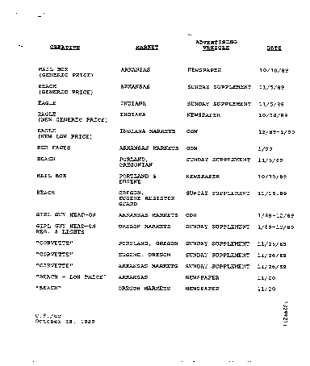
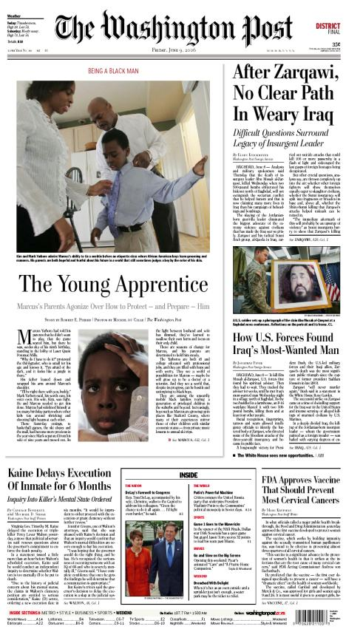
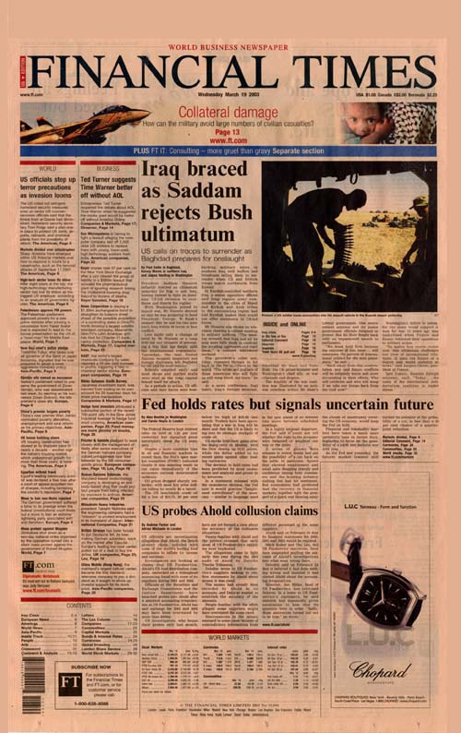
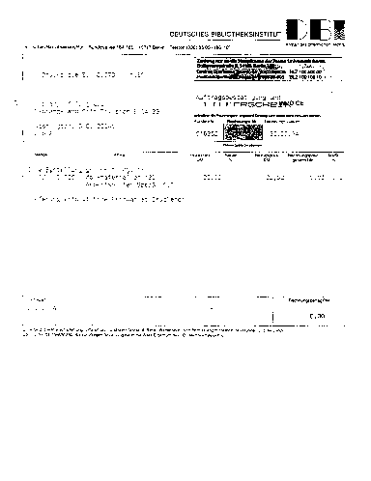
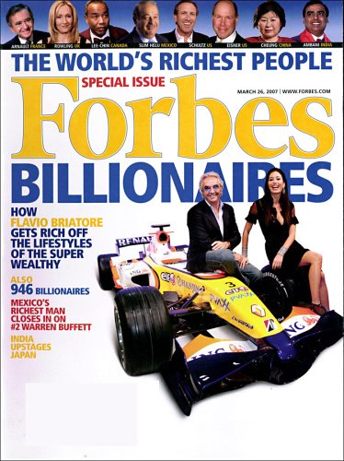
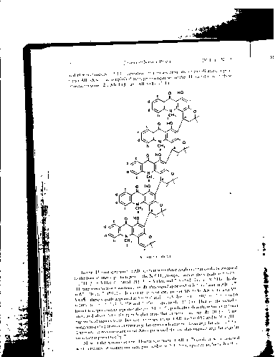

Slide 14
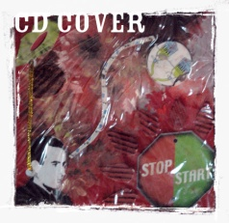
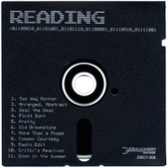






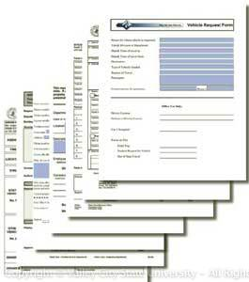



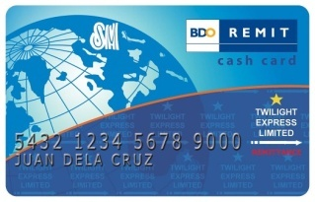
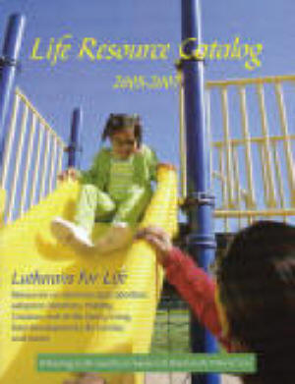

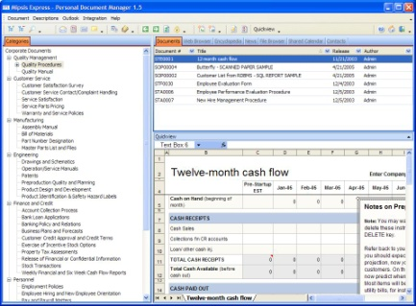
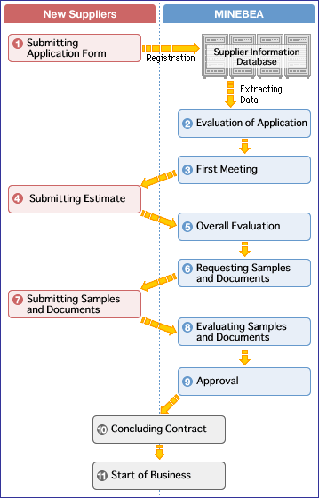
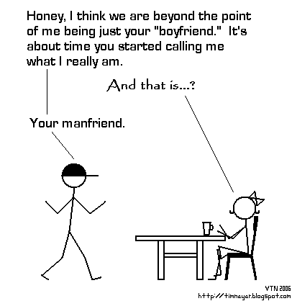
Other “Documents”

Slide 15
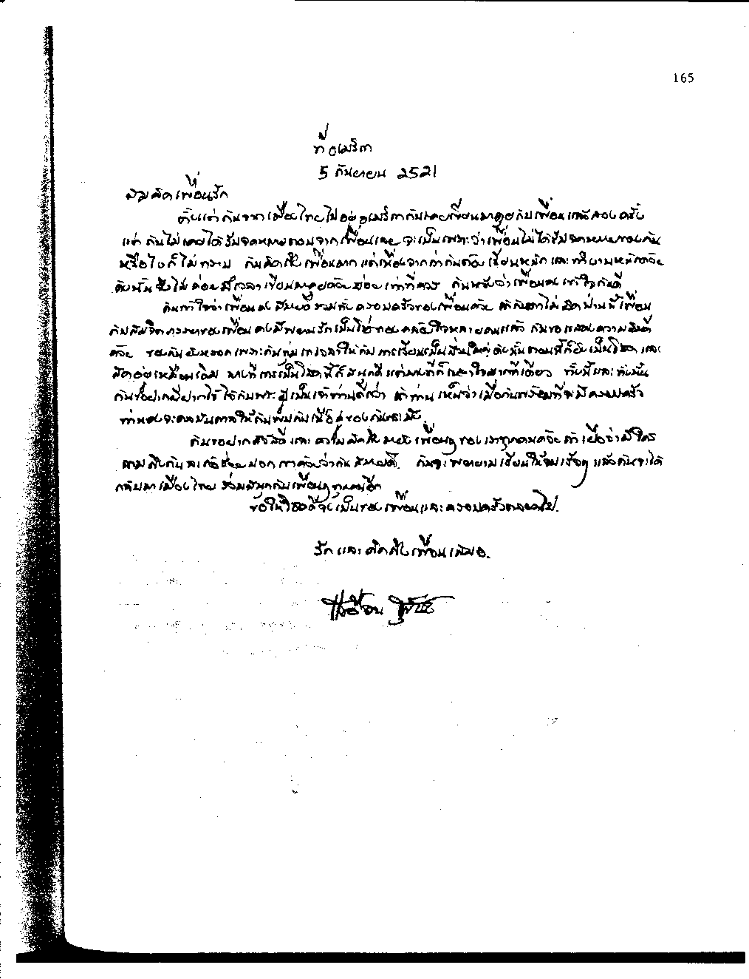
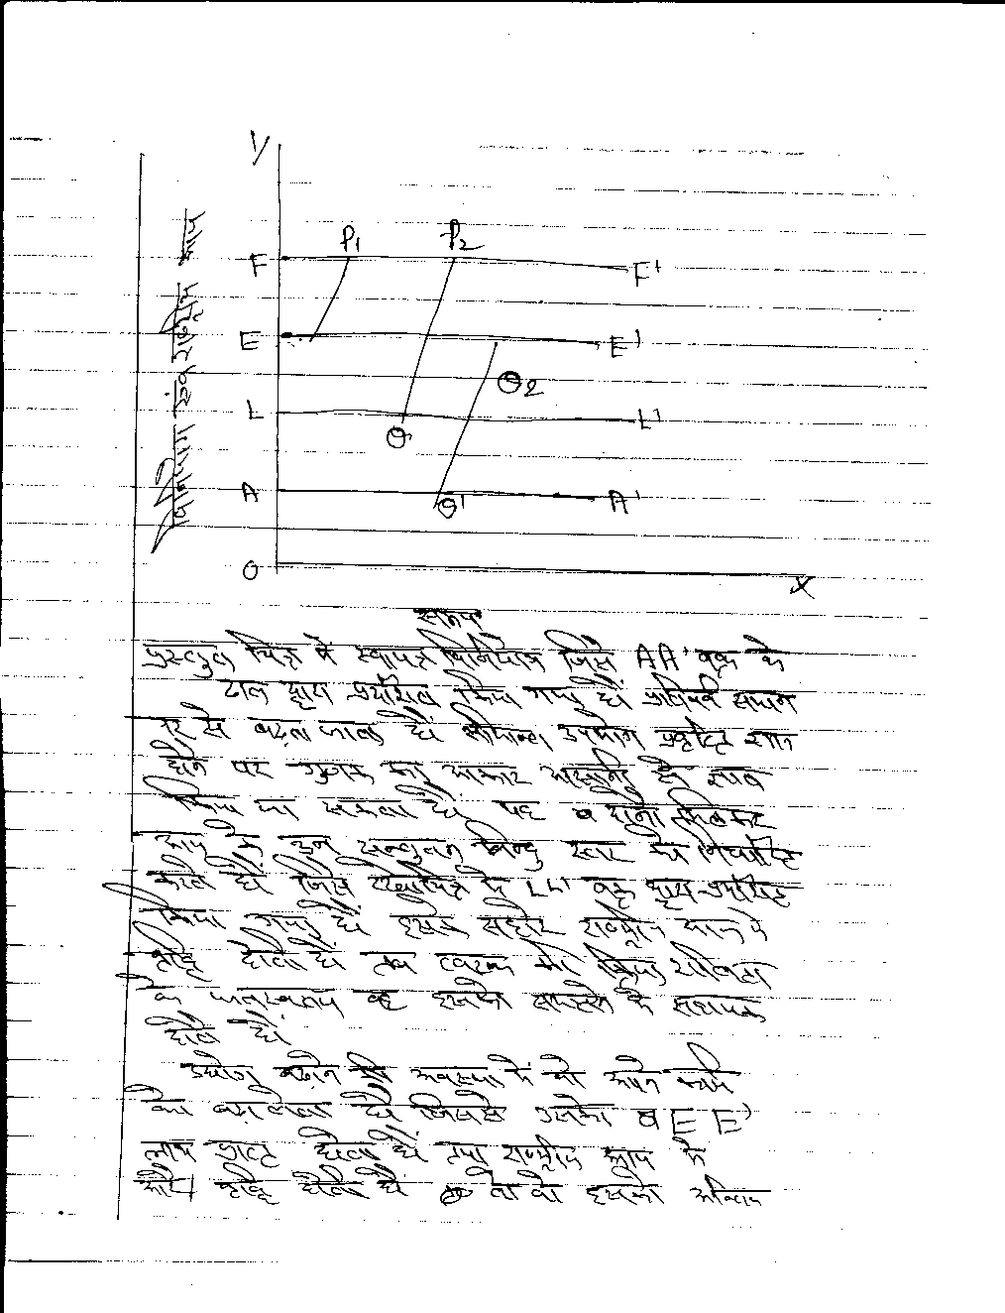

Slide 16
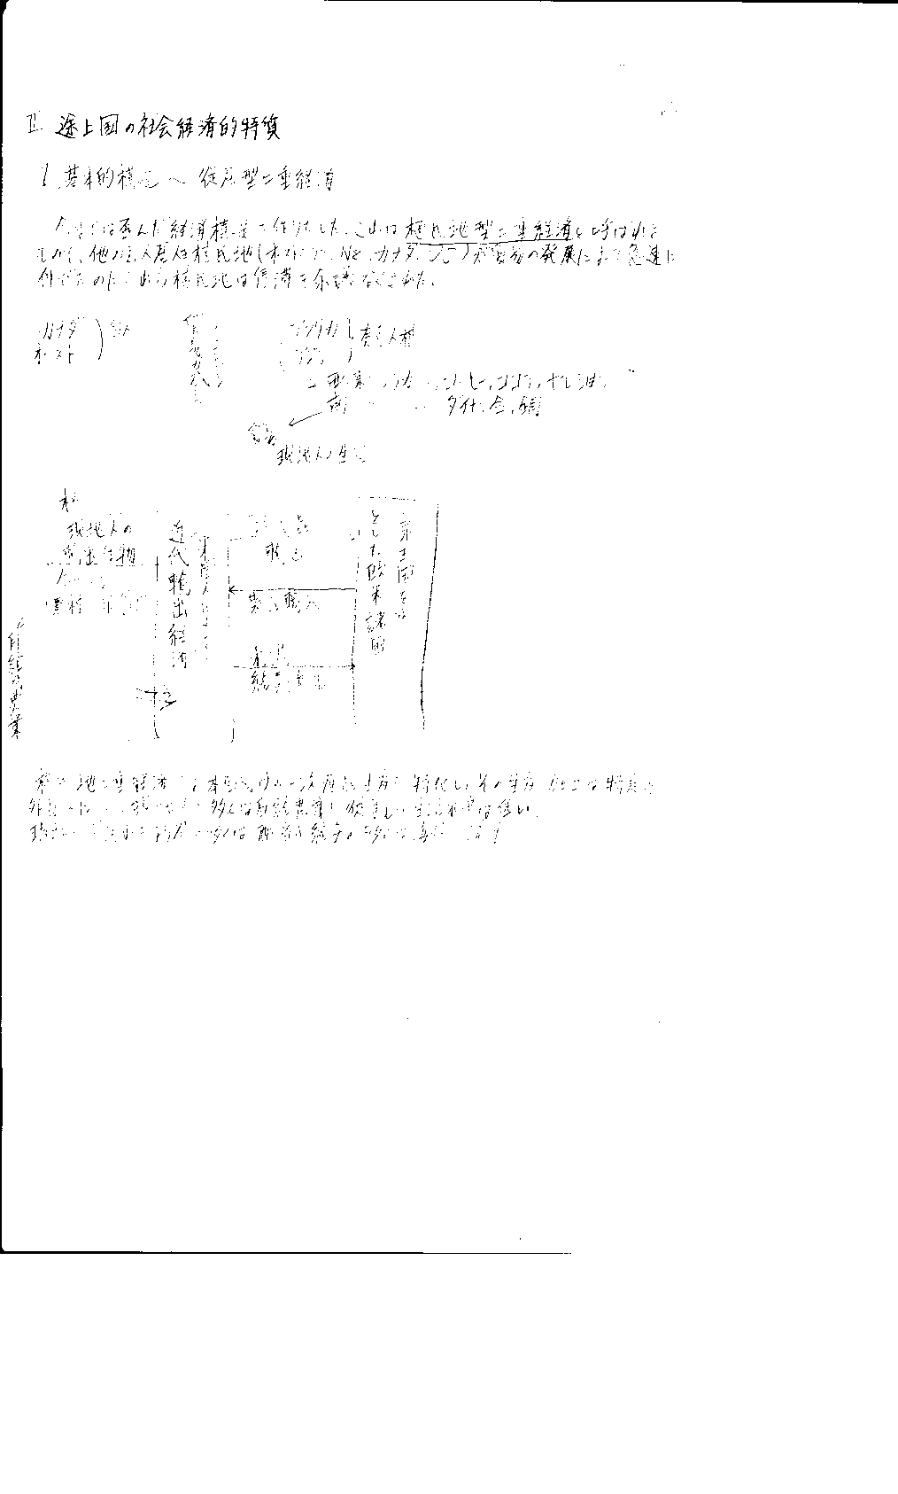
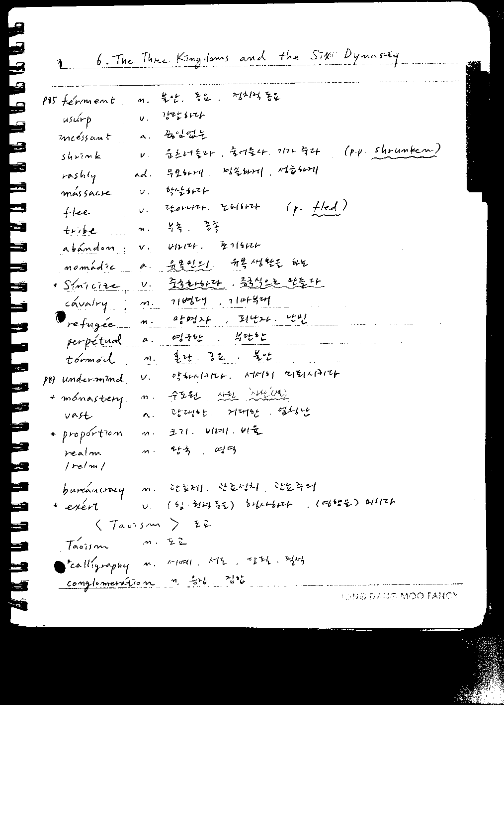

Slide 17
Indexing Page Images
Page
Image
Structure
Representation
Document
Scanner
Page
Decomposition
Text
Regions
Character or
Shape Codes
Optical Character
Recognition
Notes:
13

Slide 18
Document Image Analysis
General Flow:
  Obtain Image - Digitize
  Preprocessing
  Feature Extraction
  Classification
General Tasks
  Logical and Physical Page Structure Analysis
  Zone Classification
  Language ID
  Zone Specific Processing
    Recognition
    Vectorization

Slide 20
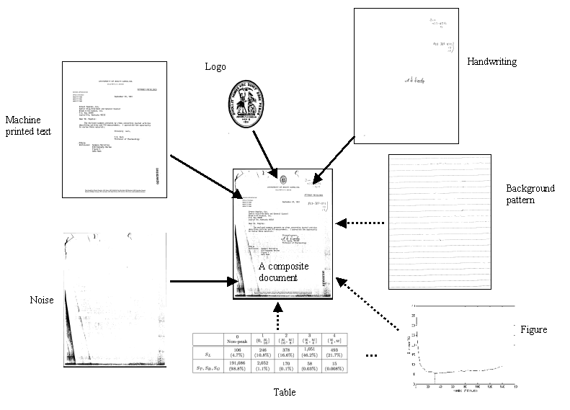
Page Layer Segmentation
Document image generation model
  A document consists many layers, such as handwriting, machine printed text, background patterns, tables, figures, noise, etc.

Slide 21
Page Analysis
Skew correction
  Based on finding the primary orientation of lines
Image and text region detection
  Based on texture and dominant orientation
Structural classification
  Infer logical structure from physical layout
Text region classification
  Title, author, letterhead, signature block, etc.

Slide 22
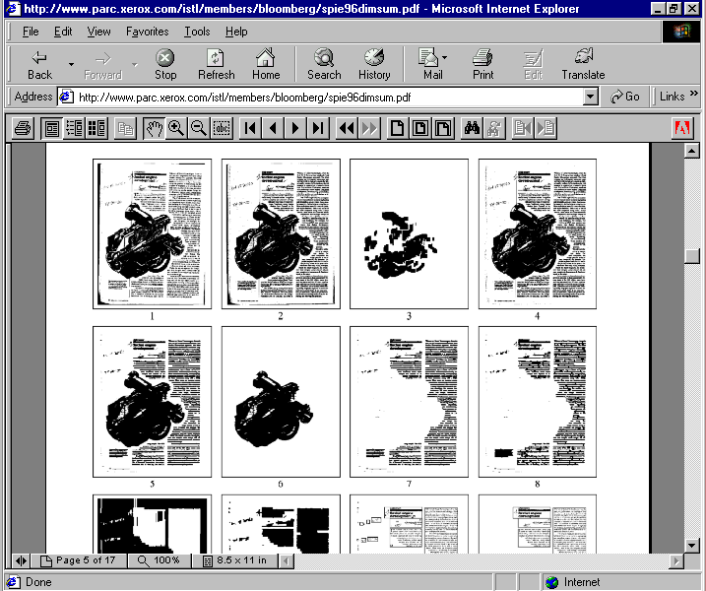
Image Detection

Slide 23
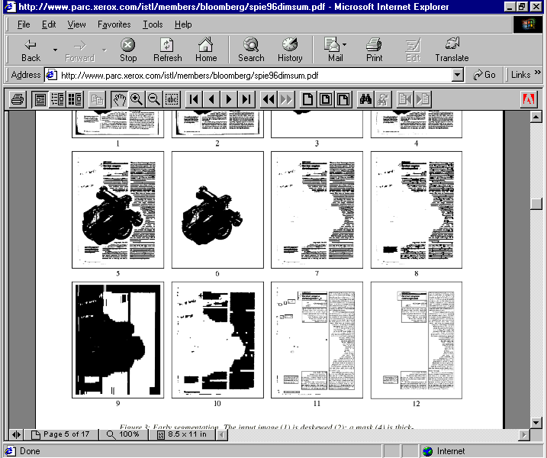
Text Region Detection

Slide 24
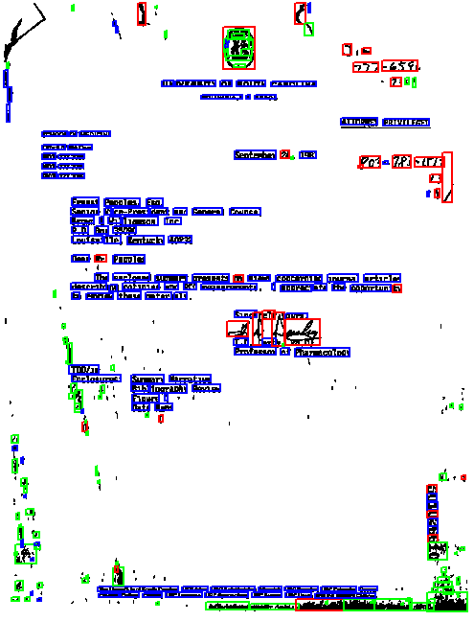
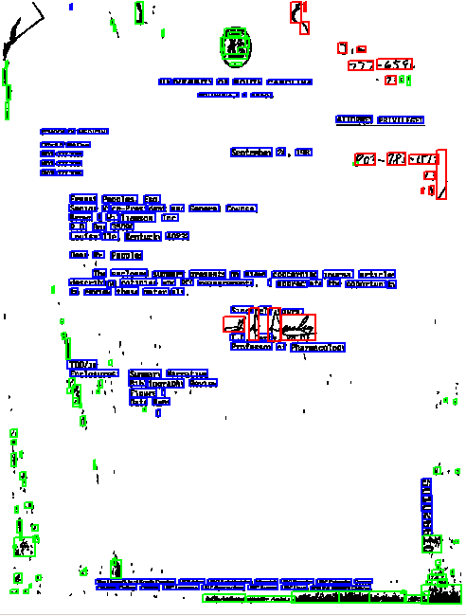
More Complex Example
Printed text
Handwriting
Noise
Before MRF-based postprocessing
After MRF-based postprocessing

Slide 25
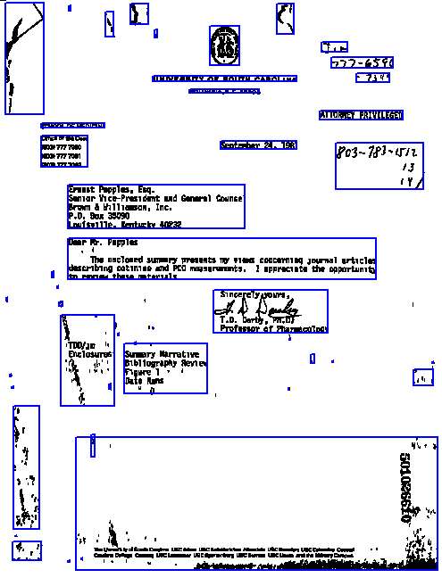
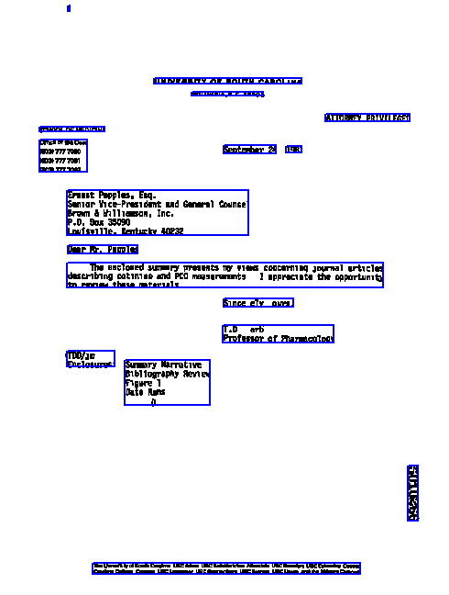
Application to Page Segmentation
Before enhancement
After enhancement

Slide 26
Language Identification
Language-independent skew detection
  Accommodate horizontal and vertical writing
Script class recognition
  Asian scripts have blocky characters
  Connected scripts can’t be segmented easily
Language identification
  Shape statistics work well for western languages
  Competing classifiers work for Asian languages
What about handwriting?

Slide 27
Optical Character Recognition
Pattern-matching approach
  Standard approach in commercial systems
  Segment individual characters
  Recognize using a neural network classifier
Hidden Markov model approach
  Experimental approach developed at BBN
  Segment into sub-character slices
  Limited lookahead to find best character choice
  Useful for connected scripts (e.g., Arabic)

Slide 28
OCR Accuracy Problems
Character segmentation errors
  In English, segmentation often changes “m” to “rn”
Character confusion
  Characters with similar shapes often confounded
OCR on copies is much worse than on originals
  Pixel bloom, character splitting, binding bend
Uncommon fonts can cause problems
  If not used to train a neural network

Slide 29
Improving OCR Accuracy
Image preprocessing
  Mathematical morphology for bloom and splitting
  Particularly important for degraded images
“Voting” between several OCR engines helps
  Individual systems depend on specific training data
Linguistic analysis can correct some errors
  Use confusion statistics, word lists, syntax, …
  But more harmful errors might be introduced

Slide 30
OCR Speed
Neural networks take about 10 seconds a page
  Hidden Markov models are slower
Voting can improve accuracy
  But at a substantial speed penalty
Easy to speed things up with several machines
  For example, by batch processing - using desktop computers at night

Slide 31
Problem: Logical Page Analysis
(Reading Order)
Can be hard to guess in some cases
  Newspaper columns, figure captions, appendices, …
Sometimes there are explicit guides
  “Continued on page 4” (but page 4 may be big!)
Structural cues can help
  Column 1 might continue to column 2
Content analysis is also useful
  Word co-occurrence statistics, syntax analysis

Slide 32
Information Retrieval on OCR
Requires robust ways of indexing
Statistical methods with large documents work best
Key Evaluations
  Success for high quality OCR (Croft et al 1994, Taghva 1994)
  Limited success for poor quality OCR (1996 TREC, UNLV)

Slide 33
N-Grams
Powerful, Inexpensive statistical method for characterizing populations
Approach
  Split up document into n-character pairs fails
  Use traditional indexing representations to perform analysis
  “DOCUMENT” -> DOC, OCU, CUM, UME, MEN, ENT
Advantages
  Statistically robust to small numbers of errors
  Rapid indexing and retrieval
  Works from 70%-85% character accuracy where traditional IR fails

Slide 34
Matching with OCR Errors
Above 80% character accuracy, use words
  With linguistic correction
Between 75% and 80%, use n-grams
  With n somewhat shorter than usual
  And perhaps with character confusion statistics
Below 75%, use word-length shape codes

Slide 35
Handwriting Recognition
With stroke information, can be automated
  Basis for input pads
Simple things can be read without strokes
  Postal addresses, filled-in forms
Free text requires human interpretation
  But repeated recognition is then possible

Slide 36
Additional Reading
A. Balasubramanian, et al. Retrieval from Document Image Collections, Document Analysis Systems VII, pages 1-12, 2006.
D. Doermann. The Indexing and Retrieval of Document Images: A Survey. Computer Vision and Image Understanding, 70(3), pages 287-298, 1998.

Slide 37
Some Applications
Legacy Tobacco Documents Library
  http://legacy.library.ucsf.edu/
Google Books
  http://books.google.com/
George Washington’s Papers
  http://ciir.cs.umass.edu/irdemo/hw-demo/

Slide 38
Agenda
Beyond Text, but still language
  Scanned documents
  Speech
Beyond Text, but still information
  Images
  Video
Beyond text to data

Slide 39
Encoding Audio
Nyquist theorem: sampling rate
Channel characteristics
  Bandpass
  Amplitude resolution
Compression
  Lossless
  Perceptually-based lossy (e.g., .mp3)

Slide 40
Description Strategies
Transcription
  Manual transcription (with optional post-editing)
Annotation
  Manually assign descriptors to points in a recording
  Recommender systems (ratings, link analysis, …)
Associated materials
  Interviewer’s notes, speech scripts, producer’s logs
Automatic
  Create access points with automatic speech processing

Slide 41
Detectable Speech Features
Content
  Phonemes, one-best word recognition, n-best
Identity
  Speaker identification, speaker segmentation
Language
  Language, dialect, accent
Other measurable parameters
  Time, duration, channel, environment

Slide 42
How Speech Recognition Works
Three stages
  What sounds were made?
    Convert from waveform to subword units (phonemes)
  How could the sounds be grouped into words?
    Identify the most probable word segmentation points
  Which of the possible words were spoken?
    Based on likelihood of possible multiword sequences
These can be learned from “training data”
  Hill-climbing sequence models
    (a “Hidden Markov Model”)

Slide 43
Using Speech Recognition
Phone
n-grams
Phone
Detection
Phone
lattice
Word
Construction
Transcription
dictionary
Word
lattice
Word
Selection
One-best
transcript
Language
model
Words

Slide 44
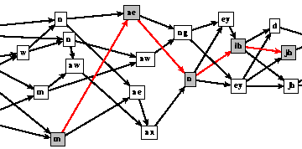
Phone Lattice

Slide 45
Phoneme Trigrams
Manage -> m ae n ih jh
  Dictionaries provide accurate transcriptions
    But valid only for a single accent and dialect
  Rule-base transcription handles unknown words
Index every overlapping 3-phoneme sequence
  m ae n
  ae n ih
  n ih jh

Slide 46
Speech Retrieval Evaluations
1996-1998: TREC SDR
  EN broadcast news / EN queries
1997-2004: TDT
  EN+CN+AR broadcast news / Query by example
2003-2004: CLEF CL-SDR
  EN broadcast news / Many query languages
2005-2007: CLEF CL-SR
  EN+CZ interviews / Many query languages

Slide 47
Key Results from TREC/TDT
Recognition and retrieval can be decomposed
  Word recognition/retrieval works well in English
Retrieval is robust with recognition errors
  Up to 40% word error rate is tolerable
Retrieval is robust with segmentation errors
  Vocabulary shift/pauses provide strong cues

Slide 48
A Richer View of Speech
Speaker identification
  Known speaker and “more like this” searches
  Gender detection for search and browsing
Topic segmentation
  Vocabulary shift, cue words
  More natural breakpoints for browsing
Speaker segmentation
  Visualize turn-taking behavior for browsing
  Classify turn-taking patterns for searching

Slide 49
Speaker Identification
Gender
  Classify speakers as male or female
Identity
  Detect speech samples from same speaker
  To assign a name, need a known training sample
Speaker segmentation
  Identify speaker changes
  Count number of speakers

Slide 50
Competing Demands on the Interface
Query must result in a manageable set
  But users prefer simple query interfaces
Selection interface must show several segments
  Representations must be compact, but informative
Rapid examination should be possible
  But complete access to the recordings is desirable

Slide 51
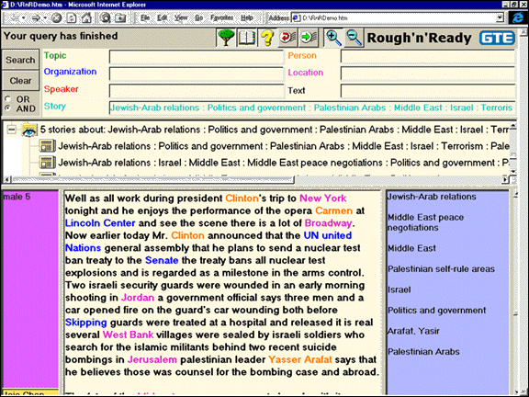
BBN Radio News Retrieval

Slide 52
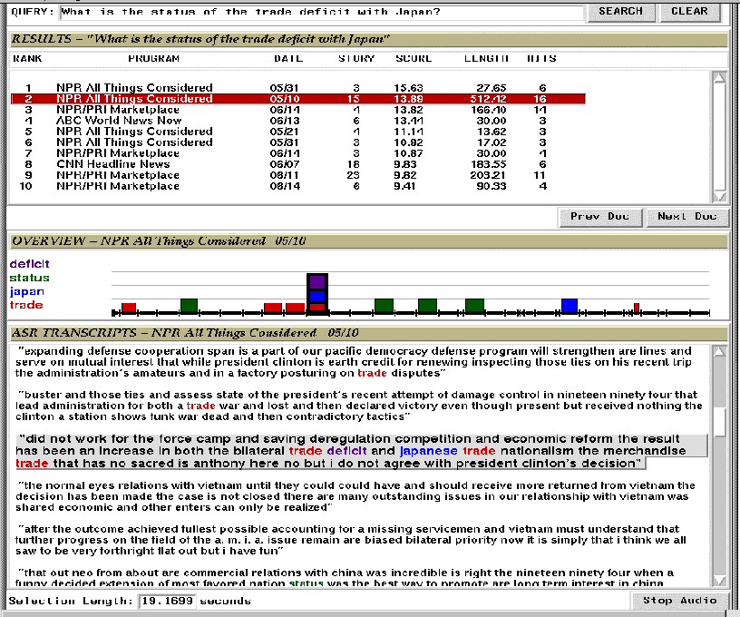
AT&T Radio News Retrieval

Slide 53
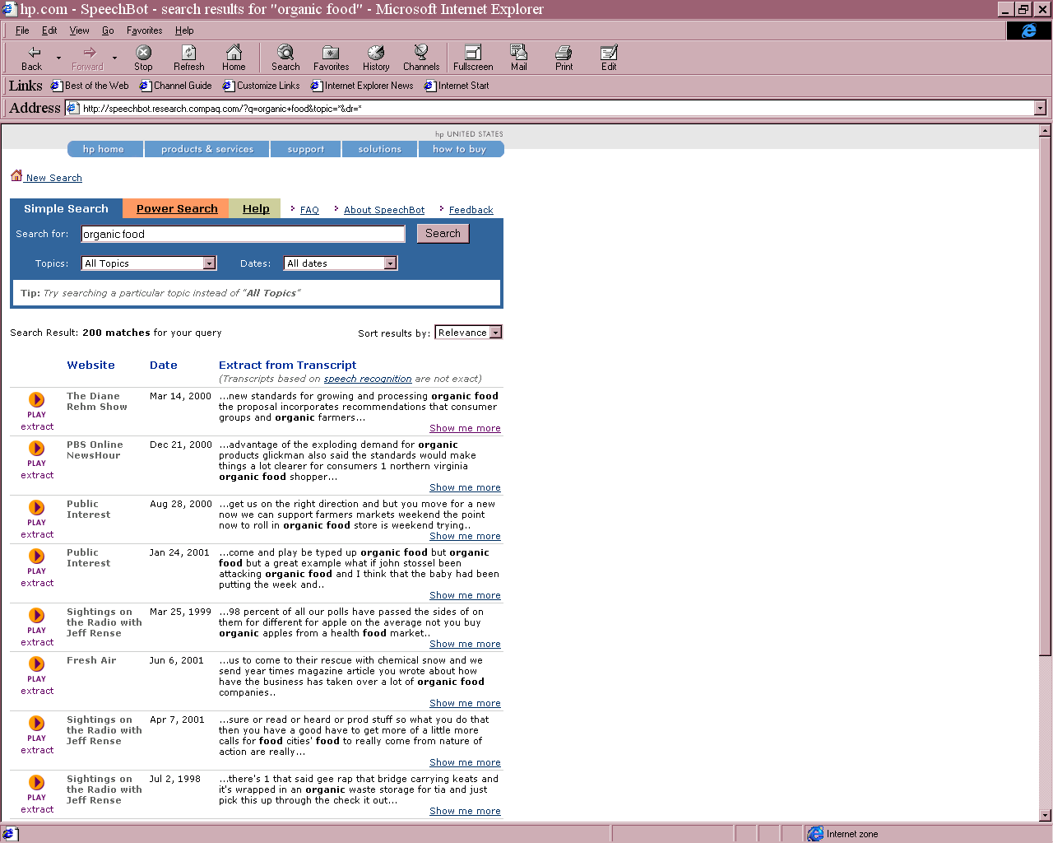
SpeechBot

Slide 54
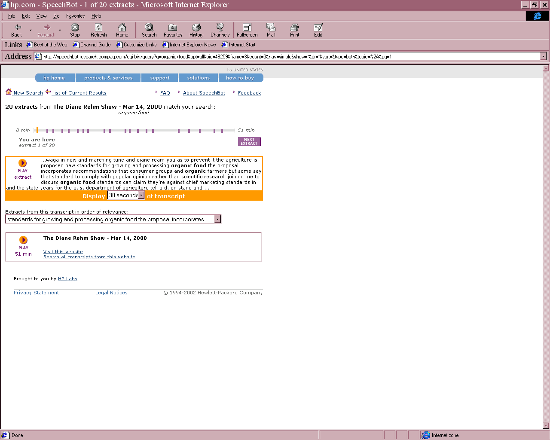

Slide 55
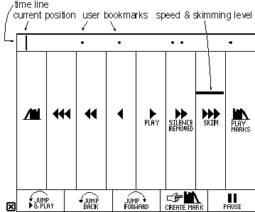
MIT “Speech Skimmer”

Slide 56
Comparison with Text Retrieval
Detection is harder
  Speech recognition errors
Selection is harder
  Date and time are not very informative
Examination is harder
  Linear medium is hard to browse
  Arbitrary segments produce unnatural breaks

Slide 57

English Transcription Accuracy
ASR2006A
ASR2004A
ASR2003A
Training: 200 hours from 800 speakers

Slide 58
English Test Collection Design
Query
Formulation
Speech
Recognition
Boundary
Detection
Automatic
Search
Content
Tagging
Interactive
Selection

Slide 59
Comparing ASR with Metadata (2005)
CLEF-2005 training + test – (metadata < 0.2), ASR2004A only, Title queries, Inquery 3.1p1

Slide 60
Error Analysis
(2005)
Somewhere in ASR | Only in Metadata
wallenberg (3/36)* rescue jews
wallenberg (3/36) | eichmann
abusive female (8/81) personnel
minsko (21/71) ghetto underground
art auschwitz
labor camps | ig farben
slave labor | telefunken | aeg
holocaust | sinti roma
sobibor (5/13) death camp
witness | eichmann
jews | volkswagen
(ASR/Metadata)
CLEF-2005 training + test – (metadata < 0.2), ASR2004A only, Title queries, Inquery 3.1p1

Slide 61
For More Information
CLEF Cross-Language Speech Retrieval track
  http://clef-clsr.umiacs.umd.edu/
The MALACH project
  http://malach.umiacs.umd.edu/
NSF/DELOS Spoken Word Access Group
  http://www.dcs.shef.ac.uk/spandh/projects/swag

Slide 62
Agenda
Beyond Text, but still language
  Scanned documents
  Speech
Beyond Text, but still information
  Images
  Video
Beyond text to data

Slide 63
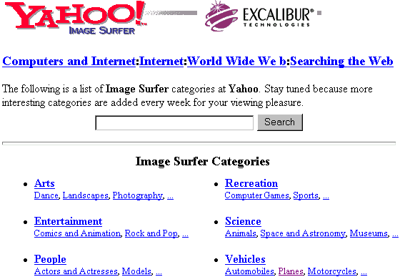
Yahoo! Image Surfer

Slide 64
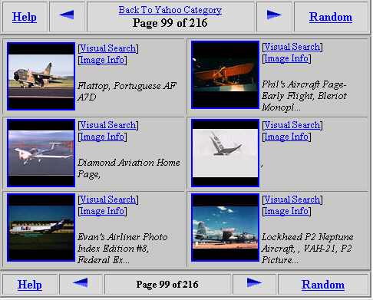

Slide 65
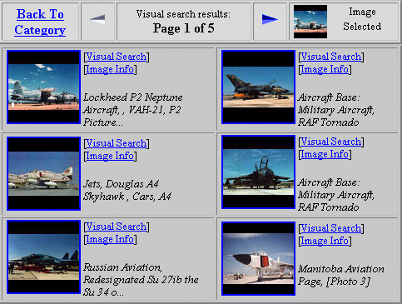

Slide 66
Color Histogram Matching
Represent image as a rectangular pixel raster
  e.g., 1024 columns and 768 rows
Represent each pixel as a quantized color
  e.g., 256 colors ranging from red through violet
Count the number of pixels in each color bin
  Produces vector representations
Compute vector similarity
  e.g., normalized inner product

Slide 67
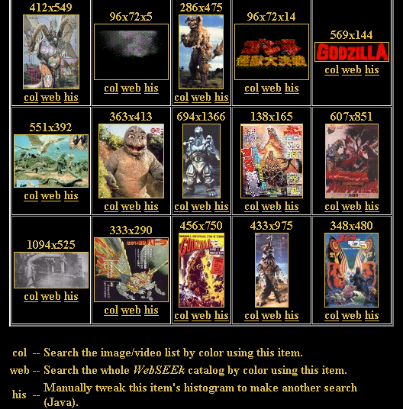
http://www.ctr.columbia.edu/webseek/

Slide 68
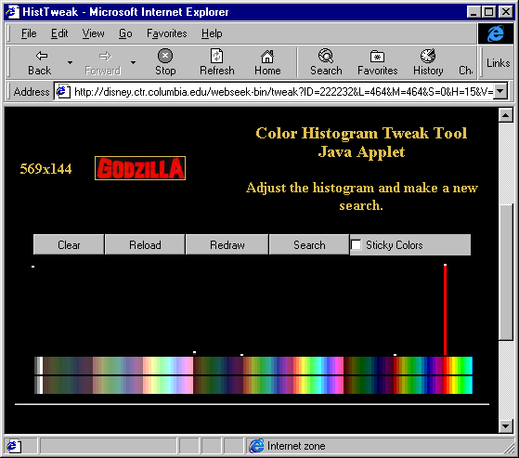
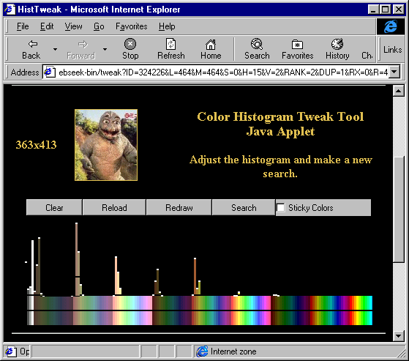
Color Histogram Example

Slide 69
Texture Matching
Texture characterizes small-scale regularity
  Color describes pixels, texture describes regions
Described by several types of features
  e.g., smoothness, periodicity, directionality
Match region size with image characteristics
  Computed using filter banks, Gabor wavelets, …
Perform weighted vector space matching
  Usually in combination with a color histogram

Slide 70
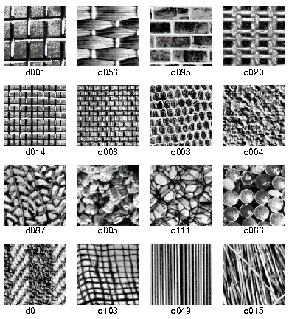
Texture Test Patterns

Slide 71
Image Segmentation
Global techniques alone yield low precision
  Color & texture characterize objects, not images
Segment at color and texture discontinuities
  Like “flood fill” in Photoshop
Represent size shape & orientation of objects
  e.g., Berkeley’s “Blobworld” uses ellipses
Represent relative positions of objects
  e.g., angles between lines joining the centers
Perform rotation- and scale-invariant matching

Slide 72
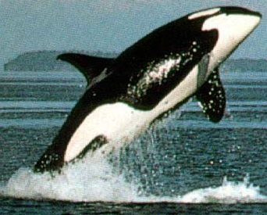
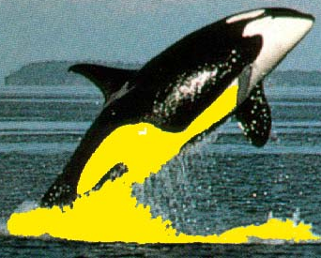
Flood Fill in Photoshop
More sophisticated techniques are needed ☺

Slide 73
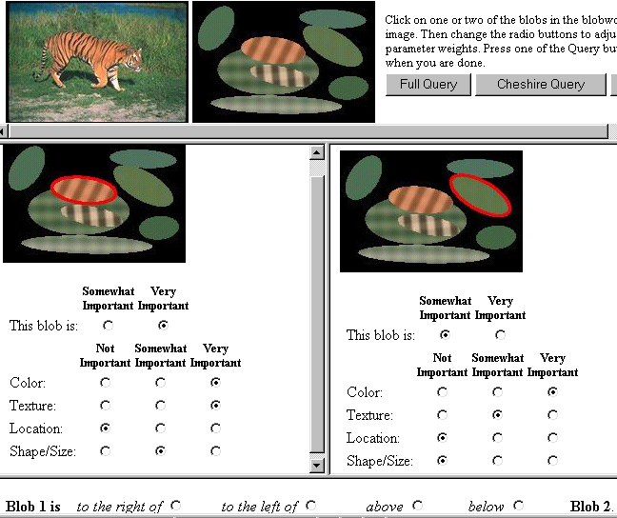
Berkeley Blobworld

Slide 74
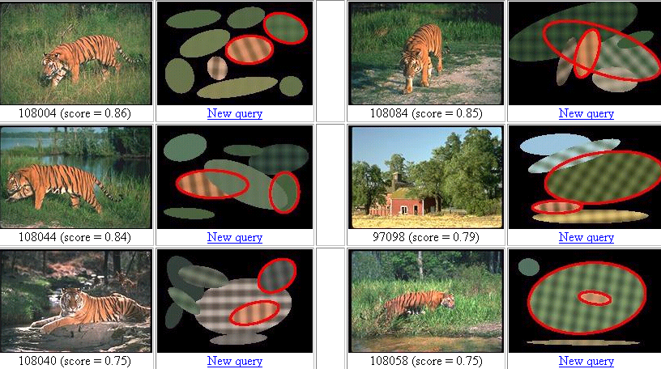
Berkeley Blobworld

Slide 75

Automated Annotation

Slide 76
Image Retrieval Summary
Query
  Keywords, example, sketch
Matching
  Caption text
  Segmentation
  Similarity (color, texture, shape)
  Spatial arrangement (orientation, position)
  Specialized techniques (e.g., face recognition)
Selection
  Thumbnails

Slide 77
Try Some Systems
Google Image Search (text)
  http://images.google.com
IBM QBIC (color, location)
  http://wwwqbic.almaden.ibm.com/, select Hermitage

Slide 78
Agenda
Beyond Text, but still language
  Scanned documents
  Speech
Beyond Text, but still information
  Images
  Video
Beyond text to data

Slide 79
Video Structures
Image structure
  Absolute positioning, relative positioning
Object motion
  Translation, rotation
Camera motion
  Pan, zoom, perspective change
Shot transitions
  Cut, fade, dissolve, …
Notes:
7

Slide 80
Object Motion Detection
Hypothesize objects as in image retrieval
  Segment based on color and texture
Examine frame-to-frame pixel changes
Classify motion
  Translation
    Linear transforms model unaccelerated motion
  Rotation
    Creation & destruction, elongation & compression
  Merge or split
Notes:
8

Slide 81
Camera Motion Detection
Do global frame-to-frame pixel analysis
Classify the resulting patterns
  Central tendency -> zoom out
  Balanced exterior destruction -> zoom in
  Selective exterior destruction -> pan
  Coupled rotation and translation -> perspective
    Coupled within objects, not necessarily across them
Notes:
9

Slide 82
Shot-to-Shot Structure Detection
Create a color histogram for each image
Segment at discontinuities (cuts)
  Cuts are easy, other transitions are also detectable
Cluster representative histograms for each shot
  Identifies cuts back to a prior shot
Build a time-labeled transition graph
Notes:
10

Slide 83
Shot Classification
Shot-to-shot structure correlates with genre
  Reflects accepted editorial conventions
Some substructures are informative
  Frequent cuts to and from announcers
  Periodic cuts between talk show participants
  Wide-narrow cuts in sports programming
Simple image features can reinforce this
  Head-and-shoulders, object size, …
Notes:
11

Slide 84
Exploiting Multiple Modalities
Video rarely appears in isolation
  Sound track, closed captions, on-screen captions
This provides synergy, not just redundancy
  Some information appears in only one modality
Image analysis complements video analysis
  Face detection, video OCR
Notes:
12

Slide 85
Story Segmentation
Video often lacks easily detected boundaries
  Between programs, news stories, etc.
Accurate segmentation improves utility
  Too large hurts effectiveness, to small is unnatural
Multiple segmentation cues are available
  Genre shift in shot-to-shot structure
  Vocabulary shift in closed captions
  Intrusive on-screen text
  Musical segues
Notes:
13

Slide 86
Closed Captions
Designed for hearing-impaired viewers
  Speech content, speaker id, non-speech audio
Weakly synchronized with the video
  Simultaneously on screen for advance production
  Significant lag for live productions
Missing text and significant errors are common
  Automatic spelling correction can produce nonsense
Notes:
14

Slide 87
Aligning Closed Captions
Speech and closed caption are redundant, but:
  Each contains different types of errors
  Each provides unique information
Merging the two can improve retrieval
  Start with a rough time alignment
  Synchronize at points of commonality
    Speech recognition provides exact timing
  Use the words from both as a basis for retrieval
    Learn which to weight more from training data
Notes:
15

Slide 88
On-Screen Captions
On-screen captions can be very useful
  Speaker names, event names, program titles, …
They can be very challenging to extract
  Low resolution, variable background
But some factors work in your favor
  Absolutely stable over multiple frames
  Standard locations and orientations
Notes:
16

Slide 89
Video OCR
Text area detection
  Look for long thin horizontal regions
    Bias towards classic text locations by genre
  Integrate detected regions across multiple frames
Enhance the extracted text
  Contrast improvement, interpolation, thinning
Optical character recognition
  Matched to the font, if known
Notes:
17

Slide 90
Face Recognition
Segment from images based on shape
  Head, shoulders, and hair provide strong cues
Track across several images
  Using optical flow techniques
Select the most directly frontal view
  Based on eye and cheek positions, for example
Construct feature vectors
  “Eigenface” produces 16-element vectors
Perform similarity matching
Notes:
18

Slide 91
Identity-Based Retrieval
Face recognition and speaker identification
  Both exploit information that is usually present
  But both require training data
On-screen captions provide useful cues
  Confounded by OCR errors and varied spelling
Closed captions and speech retrieval help too
  If genre-specific heuristics are used
    e.g., announcers usually introduce speakers before cuts
Notes:
19

Slide 92

Combined Technologies Integration
Scene Changes
Camera Motion
Face Detection
Text Detection
Word
Relevance
Audio Level

Slide 93
Key Frame Extraction
First frame of a shot is easy to select
  But it may not be the best choice
Genre-specific cues may be helpful
  Minimum optical flow for director’s emphasis
  Face detection for interviews
  Presence of on-screen captions
This may produce too many frames
  Color histogram clusters can reveal duplicates
Notes:
22

Slide 94


Slide 95
Salient Stills Abstracts
Composite images that capture several scenes
  And convey a sense of space, time, and/or motion
Exploits familiar metaphors
  Time exposures, multiple exposures, strobe, …
Two stages
  Modeling (e.g., video structure analysis)
  Rendering
    Global operators do time exposure and variable resolution
    Segmentation supports production of composite frames
Notes:
23

Slide 96
Notes:
24

Slide 97
Storyboards
Spatial arrangement of still images
  Linear arrangements depict temporal evolution
    Overlapped depictions allow denser presentations
  Graph can be used to depict video structure
    But temporal relationships are hard to capture
Naturally balances overview with detail
  Easily browsed at any level of detail
Tradeoff between detail and complexity
  Further limited by image size and resolution
Notes:
25

Slide 98

Static Filmstrip Abstraction

Slide 99
Slide Shows
Flip through still images in one spot
  At a rate selected by the user
Conserves screen space
  But it is hard to process several simultaneously
Several variations possible
  Content-sensitive dwell times
  Alternative frame transitions (cut, dissolve, …)
Notes:
26

Slide 100
Full Motion Extracts
Extracted shots, joined by cuts
  The technique used in movie advertisements
Conveys more information using motion
  Optionally aligned with extracted sound as well
Hard to build a coherent extract
  Movie ads are constructed by hand
Notes:
27

Slide 101
Agenda
Beyond Text, but still language
  Scanned documents
  Speech
Beyond Text, but still information
  Images
  Video
Beyond text to data

Slide 102
Uses of Relational Databases
Relatively static “relational” data
  Organization charts
  Phone directories
Transaction processing
  Financial
  B2B
  B2C

Slide 103
Database Implementation
DBMS
Normalized tables
  Organized to minimize implementation
Denormalized tables
  Organized to support access
SQL
File system
CSV
Programming language

Slide 104
Operational Systems
Data exchange
Forms
Views
Reports

Slide 105
Data Warehouse
Non-operational “strategic” data resource
  Organized for analysis, not operations
Data harvested from operational systems
OLAP
Data mining
  Association rules

Slide 106

Data Warehousing

Slide 107

Online Analytical Processing (OLAP)

Slide 108
Sedona Database Principles
1. Absent a specific showing of need or relevance, a requesting party is entitled only to database fields that contain relevant information, not the entire database in which the information resides or the underlying database application or database engine.
2. Due to differences in the way that information is stored or programmed into a database, not all information in a database may be equally accessible, and a party’s request for such information must be analyzed for relevance and proportionality.
3. Requesting and responding parties should use empirical information, such as that generated from test queries and pilot projects, to ascertain the burden to produce information stored in databases and to reach consensus on the scope of discovery.
4. A responding party must use reasonable measures to validate ESI collected from database systems to ensure completeness and accuracy of the data acquisition.
5. Verifying information that has been correctly exported from a larger database or repository is a separate analysis from establishing the accuracy, authenticity, or admissibility of the substantive information contained within the data.
6. The way in which a requesting party intends to use database information is an important factor in determining an appropriate format of production.

