Slide 1
Session 1: Civil Discovery
LBSC 708X/INFM 718X
Seminar on E-Discovery
Jason R. Baron
Adjunct Faculty
University of Maryland
January 26, 2012

Slide 2
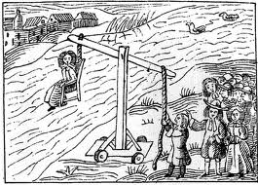
In the beginning…
Trial by Ordeal

Slide 3
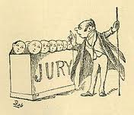
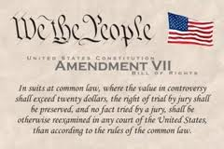
Progressing to…
In England…
And in the U.S. …

Slide 4
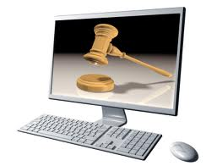

Leading to the present…
Litigation by Ordeal (a/k/a) “e-discovery”

Slide 5
Development of law and equity
English common law in the courts
Law of equity: appeals to the King
  Court of Chancery
Remedies (law=damages; equity=injunctions)
Jury trial guaranteed by 7th Amendment in suits at common law
Judge as trier of fact in equity
Merger of law and equity in US in 1938 with promulgation of Federal Rules of Civil Procedure
Remedies available today, including both damages and injunctive relief

Slide 6
Major Stages of a Lawsuit
Pre-lawsuit activity* (Question: what might that be??)
Complaint
Answer
Discovery
  Depositions
  Interrogatories
  Requests to Produce
  Requests for Admissions

Slide 7
Stages of a Lawsuit (con’t)
Summary Judgment
Trial
Post trial motions
Appeal(s)
Possible remand to lower court for further proceedings
Final Order

Slide 8
Settlement and Compromise
Questions:
--under what circumstances does it make sense to settle a lawsuit?
--when should settlement take place?

Slide 9
Comprehensive list of stages of a Lawsuit
Pleadings
  Service of process
  Complaint
  Answer
    Affirmative defense
  Counterclaim
  Crossclaim
  Joinder
  Indispensable party
  Intervention
  Other Motions
Pre-trial procedure
  Discovery
  Initial Conference
  Interrogatories
  Depositions
  Request for Admissions
  Request for production
Resolution without trial
  Default judgment
  Summary judgment
  Voluntary dismissal
  Involuntary dismissal
  Settlement
Trial
  Jury
  Judgment
    Judgment as a matter of law
    Motion to set aside judgment
    New trial
    Remedy
      Injunction
      Damages
      Attorney's fees
      Declaratory judgment
Appeal
  Mandamus
  Certiorari

Slide 10
Example of a Complaint
From TREC Legal Track 2010, Complaint K
  Hypothetical lawsuit: New Searchland Resort & Spa v. Volteron, et al. (S.D. New Searchland)

Slide 11
Fed. Rule of Civil Procedure 1
These rules govern the procedure in all civil actions and proceedings in the United States district courts . . . They should be construed and administered to secure the just, speedy and inexpensive determination of every action and proceeding.
Question: how would you propose to define “just,” “speedy,” and “inexpensive”?

Slide 12
Requests to Produce Documents
Rule 34 – A party may serve on any other party a request within the scope of Rule 26(b) . . . to produce and permit the requesting party or its representative to inspect, copy, test, or sample the following items in the responding party’s possession, custody, or control … any designated documents, or electronically stored information … stored in any medium from which information can be obtained directly or, if necessary, after translation by the responding party into a reasonably useable form.
Questions: what is ESI? What constitutes possession, custody or control?

Slide 13
Selected Changes to the Federal Rules of Civil Procedure, 2006 Amendments: Definition of ESI
A new term of art: “electronically stored information”:
  The wide variety of computer systems currently in use, and the rapidity of technological change,counsel against a limiting or precise definition of ESI…A common example [is] email … The rule … [is intended] to encompass future developments in computer technology. --Advisory Committee Notes to Rule 34(a), 2006 Amendments

Slide 14
Common Forms of ESI
Email with attachments (all kinds)
Text files, powerpoint, spreadsheets, images
Voice mail, instant and text messaging
Databases, proprietary applications
Internet, intranet, dashboards, wikis, blogs, tweets, RSS feeds, cache files, slack space data, cookies
Data on PDAs, cellphones
Videoconferencing & webcasting
Metadata

Slide 15
Common Sources of ESI
Mainframes, network servers, local drives (including network activity logs)
DVDs, CD ROMs, floppy disks
Laptops
Backup tapes
External hard drives (e.g., flash, Zip, Jazz, ipods, ipads, etc.)
Third party storage including in “the cloud”

Slide 16
Hot topic: Metadata
What is it?
  Email header information (possibly hidden)
  Proprietary features of word processing (e.g. summary fields)
  Embedded & shadow data
  Deleted keystrokes
  Tracking info
  Spreadsheet formulas
Format issues and metadata
Metadata ethics: inadvertent production

Slide 17
Kept in the Usual Course of Business
Rule 34(b)(2)(E) “Unless otherwise stipulated or ordered by the Court . . . A party must produce documents as they are kept in the usual course of business or must organize and label them to correspond to the categories of the request. . . . If a request does not specify a form for producing [ESI] a party must produce it in a form or foms in which it is ordinarily maintained or in a reasonably useable form or forms….

Slide 18
Rule 26(g) Certifications
Every disclosure . . . and every discovery request, response, or objection must be signed . . . By signing, an attorney or party certifies that to the best of the person’s knowledge, information and belief formed after a reasonable inquiry – with respect to a disclosure, it is complete and correct as of the time it is made.
Query: what constitutes “a reasonable inquiry”? What is meant by “complete and correct”?

Slide 19
Selected Changes to the Federal Rules of Civil Procedure, 2006: Discussing ESI at the Rule 26(f) Initial “Meet and Confer” and at the Rule 16(b) Pre-Trial Conference
New FRCP Rule 26(f) conference obligations: parties must have early meet and confer to discuss “any issues relating to preserving discoverable information,” including “any issues relating to disclosure or discovery of ESI, including the form or forms in which it should be produced.” Thus, meet and confers will necessarily include:
+ Scope of ESI holdings
+ Preservation issues
+ Formatting issues
+ Access issues
Similarly, Rule 16(b) provides for pre-trial disclosure of ESI

Slide 20
Selected Changes to the Federal Rules of Civil Procedure, 2006: Two-Tier Rule on ESI “Accessibility”
Rule 26(b)(2)(B) – Parties need not provide discovery of ESI from sources that the party identifies as not reasonably accessible because of undue burden or cost. On motion to compel discovery or for a protective order, the party from whom discovery is sought must show that the information is not reasonably accessible because of undue burden or cost.
Question: what kinds of ESI are not reasonably accessible?

Slide 21
Selected Changes to the Federal Rules of Civil Procedure: Accommodation for Routine Deletion of ESI
Rule 37(f): Absent exceptional circumstances, a court may not impose sanctions under these rules on a party for failing to provide ESI lost as a result of the routine, good-faith operation of an electronic information system.
Advisory notes: Good faith in the routine operation of an information system may involve a party’s intervention to modify or suspend certain features of that routine operation to prevent the loss of information, if that information is subject to a preservation obligation. “Litigation hold” concept referenced.

Slide 22
Additional Selected Changes to the Federal Rules of Civil Procedure and Federal Rules of Evidence
Rule 26(b)(5) FRCP: “Claw back” procedures are available in the event of inadvertent production of privileged documents
Rule 502 FRE (see handout)

Slide 23
Selected hot topics, 2012
Scope of parties’ duty to preserve ESI in anticipation of litigation
  What constitutes adequate triggers?
  Requirement of written legal holds
Handling of social media/web 2.0 apps
Defensibility of technology-assisted review methods (in contrast to traditional linear, manual review)

Slide 24
Case Study: U.S. v. Philip Morris –
Overall Discovery
1,726 Requests to Produce propounded by tobacco companies on U.S. (30 federal agencies, including NARA) for tobacco related records
Along with paper records, email records were made subject to discovery
32 million Clinton era email records – government had burden of searching

Slide 25
Case Study: U.S. v. Philip Morris (con’t) –
Employing a limited feedback loop
Original set of 12 keywords searched unilaterally
After informal negotiations, additional terms explored
Sampling against database to find “noisy” terms generating too many false positives (Marlboro, PMI, TI, etc.)
Report back and consensus on what additional terms would be in search protocol.

Slide 26
Example of Boolean search string from U.S. v. Philip Morris
(((master settlement agreement OR msa) AND NOT (medical savings account OR metropolitan standard area)) OR s. 1415 OR (ets AND NOT educational testing service) OR (liggett AND NOT sharon a. liggett) OR atco OR lorillard OR (pmi AND NOT presidential management intern) OR pm usa OR rjr OR (b&w AND NOT photo*) OR phillip morris OR batco OR ftc test method OR star scientific OR vector group OR joe camel OR (marlboro AND NOT upper marlboro)) AND NOT (tobacco* OR cigarette* OR smoking OR tar OR nicotine OR smokeless OR synar amendment OR philip morris OR r.j. reynolds OR ("brown and williamson") OR ("brown & williamson") OR bat industries OR liggett group)

Slide 27
U.S. v. Philip Morris E-mail Winnowing Process
20 million → 200,000 → 100,000 → 80,000 → 20,000
email hits based relevant produced placed on
records on keyword emails to opposing privilege
terms used party logs
(1%)
→ A PROBLEM: only a handful entered as exhibits at trial
→ A BIGGER PROGLEM: the 1% figure does not scale

Slide 28
A Hypothetical
1 billion emails, 25% with attachments
Reviewed at 50 per hour
Would take 100 people, 10 hrs per day, 7 days a week, 52 weeks a year ….
54 YEARS TO COMPLETE
At $100/hr, $ 2 billion in cost
Even 1% (10 million docs) … 28 weeks
and $20 million in cost …..

Slide 29
Overview of the PROFS Case:
Armstrong v Executive Office of the President

Slide 30
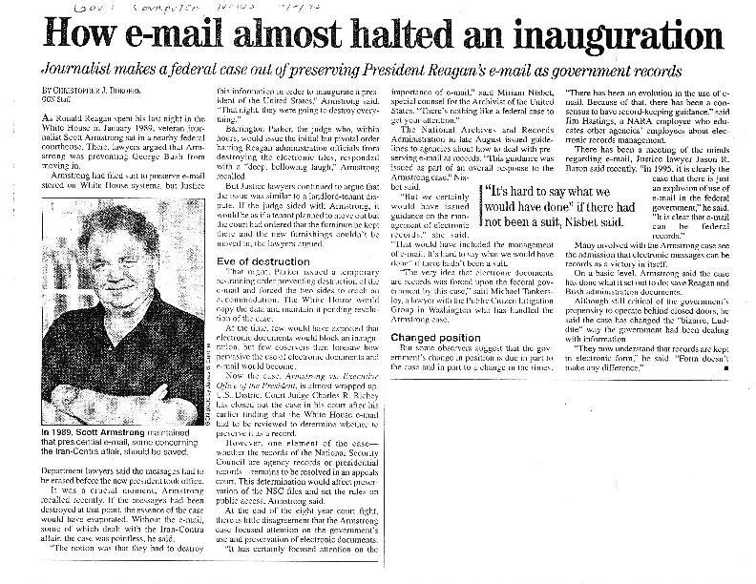
The Original Email Case…
Armstrong v. EOP, 1 F.3d 1274 (DC Cir 1993)

Slide 31
THE THREE ARMSTRONG INJUNCTIONS
The initial temporary restraining order covered Reagan Admin. PROFS tapes (1989)
The second temporary restraining order covered Reagan and Bush era PROFS and All-in-1 tapes (1992)
The district court’s permanent injunction covered all “electronic commuincations systems” and their backups (1993)

Slide 32
THE ARMSTRONG ORDER January 6, 1993
“ * * * ORDERED that Defendants are enjoined from removing, deleting, or altering information on their electronic communications systems until such time as the Archivist takes action pursuant to . . . the Federal Records Act to prevent the destruction of federal records, including those records saved on backup tapes.”

Slide 33
TYPES OF BACKUP MEDIA
CAPTURED IN THE ARMSTRONG LITIGATION
Open reel
4 mm
8 mm
DLT
3480 cartridges
Pinnacle drives
Hard drives

Slide 34
ISSUES ADDRESSED IN ARMSTRONG
E-mail messages can be federal records
Agencies must manage the unique “electronic” e-mail record, as it is only a “kissing cousin” of a hard-copy printout
Agencies must provide for some form of periodic monitoring by records managers to ensure correct application of guidance

Slide 35
To: List A
From: ON
Date: April 11, 1987
Re: Email: paper vs. electronic copies
Unless the software defaults to a
different configuration, neither the name
of the sender nor the names of the
the recipients are provided in an
intelligible form. Is this all that the
storm and furor have been about? What
other data & metadata existing on the
“live” electronic version must be
captured?
cc: John Smith, Jane Doe, Gary ….

Slide 36
ISSUES ADDRESSED IN ARMSTRONG (cont’d)
“Who Knew What When”
Transmission and receipt data must be managed along with content
  Names of senders, recipients
  Distribution Lists
  User Directories
  Receipt data, including acknowledgements of receipt, where requested

Slide 37
How the EOP Implemented
Armstrong
Issued recordkeeping guidance covering applications on existing e-mail systems
Customized existing proprietary software to perform electronic recordkeeping functions
  Introduced front-end ‘prompts’
  Built in automatic monitoring functions
Restored and reconstructed e-mail residing on backup tapes

Slide 38
In class exercise
You have been appointed Records Officer for a large cabinet Department in the Obama Administration.
A lawsuit against the Department has been pending for a few months which would affect several agencies and bureaus in the Department (but not all of them).
Tomorrow, when you walk in to work, you will find out that a federal magistrate judge (the Hon. Judge Grimmiola) issued a preservation order late yesterday requiring that all documents, records, and evidence in any form be preserved relevant to the lawsuit.
A senior lawyer in the General Counsel’s office called you just now to ask what your plan of action is for dealing with this litigation crisis. What do you tell him?

