Slide 1

Web Characterization (online)
Web Design
Week 3
LBSC 690
Information Technology

Slide 2
Today’s Goals
Be able to discuss what the Web “is”
Understand human-computer interaction principles
  What makes something well or poorly designed?
Connect that knowledge to good Web site design
Begin to think about evaluation

Slide 3
*Review
FTP
URLs

Slide 4
G1: What the Web ‘is’
Web Characterization

Slide 5
Let’s reflect

Slide 6
G2: Understand HCI
Human-computer interaction

Slide 7
Human Computer Interaction
A discipline concerned with the
of interactive computing systems for human use.
Design
Implementation
Evaluation

Slide 8
What are Computers Good At?
Sense stimuli outside human’s range
Calculate quickly and accurately
Store large quantities and recall accurately
Respond rapidly and consistently
Perform repetitive actions reliably
Work under heavy load for an extended period
Notes:
“Simple and sharply defined things” again paraphrasing George Miller

Slide 9
What are Humans Good At?
Sense low level stimuli
Recognize patterns
Reason inductively
Communicate with multiple channels
Apply multiple strategies
Adapt to changes or unexpected events
Notes:
Fuzzy and hard things

Slide 10
Individual Differences
Physical
  Anthropomorphic (height, left handed, etc.)
  Age (mobility, dexterity, etc.)
Cognitive
Perceptual
  Sight, hearing, etc.
Personality
Cultural factors

Slide 11
Where is the bottleneck?
computer
performance
human performance
1950
2000
2050
Notes:
11
Don’t let the computer run away once it crosses that performance benchmark. HCI involves harnessing the computer’s ability to perform in order to accommodate human weaknesses and optimize human strengths, and to let people accopmlish their GOALS.

Slide 12
Synergy
Humans do what they are good at
Computers do what they are good at
Strengths of one cover weakness of the other
Notes:
THIS is hci!

Slide 13
Interaction
Forming an intention
  Internal mental characterization of a goal
Selection of an action
  Review possible actions, select most appropriate
Execution of the action
  Carry out appropriate actions with the system
Evaluation of the outcome
  Compare results with expectations
Notes:
The synergy happens when humans (as they are) interact with computers (as they are, which is how they’ve been designed built to be) in order to accomplish their goals. Learning, teaching, playing, organizing, planning, communicating.

Slide 14
Stages of Interaction
Goals
Intention
Expectation
Evaluation
Selection
Interpretation
Mental Activity
Physical Activity
System
Execution
Perception

Slide 15
Mental Models
How the user thinks the machine works
  What actions can be taken?
  What results are expected from an action?
  How should system output be interpreted?
Mental models exist at many levels
  Hardware, operating system, and network
  Application programs
  Information resources

Slide 16
Mental Models
Built from:
  Affordances, causality, constraints, mapping
  Positive transfer, stereotypes / cultural transfer
  Instructions
  Interactions
Allow people to mentally simulate use of a system
  Thus developing expectations for how the system will work & respond
Can be wrong
  Especially if any of the above are misleading: Direct link between system features and user’s state of mind.

Slide 17
Modeling Interaction: Computer Peripherals & Human Sensory Perception
Human
Mental Models
Sight
Sound
Task
System
Hands
Voice
Software Models
Keyboard
Mouse
Task
User
Display
Speaker
Computer

Slide 18
Modeling Interaction
Human
Mental Models
Sight
Sound
Task
System
Hands
Voice
Software Models
Keyboard
Mouse
Task
User
Display
Speaker
Computer

Slide 19
Human Senses
Visual
  Position/motion, color/contrast, symbols
Auditory
  Position/motion, tones/volume, speech
Haptic
  Mechanical, thermal, electrical, kinesthethic
Olfactory
  Smell, taste
Vestibular

Slide 20
Human-computer communication
Human-to-computer
  Input devices
    Keyboard, mouse, touchscreen, microphone, etc.
    Hardware mechanisms that receive the kind of data that can be processed by software processes
Computer-to-human
  Output devices
    Screen, speaker, device vibration, etc.
    Hardware mechanisms that can send the kind of data that can be processed by human senses

Slide 21
G3: Connect HCI principles with good Web site design
Human-computer interaction +
Human-information interaction

Slide 22
Objects & Design:
Lessons from Donald Norman
Objects have natural actions that go with them
  Chairs are for sitting
  Knobs are for turning
  Buttons are for pushing …
Vandalizing a train
  Example from The Psychology of Everyday Things by Donald Norman.
The perceived and actual fundamental properties of an object determine how it will be used.

Slide 23
Bridging Users & Systems:
Affordances
Real or perceived action possibilities of an object
  A knob can be twisted or pushed
  A cord can be pulled, twisted, wrapped
  A link can be read, clicked, copied
  A box can be typed into
Complex things may need explaining, but simple things should not

Slide 24
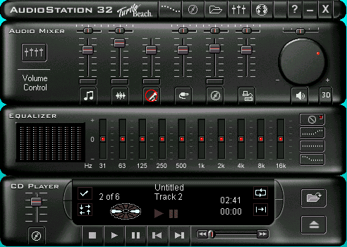
Affordances Gone Wrong
Sliders for sliding
Dials for turning
Are these buttons?
What does this button do?

Slide 25
Bridging Users & Systems:
Visible Constraints
Visible limitations on affordances
  Limitations in a good way: Reduces complexity, uncertainty of objects with many possible affordances
Push or pull?
Which side?
Can only push,
side to push clearly visible

Slide 26
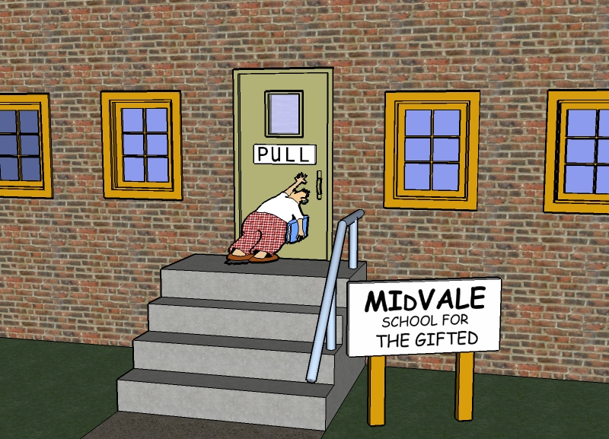
Users play a role too!
Not all visual constraints are seen, perceived, followed!

Slide 27
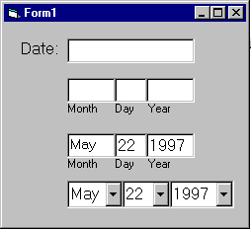
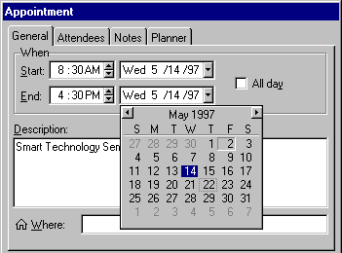
Visible Constraints: Date Entry

Slide 28
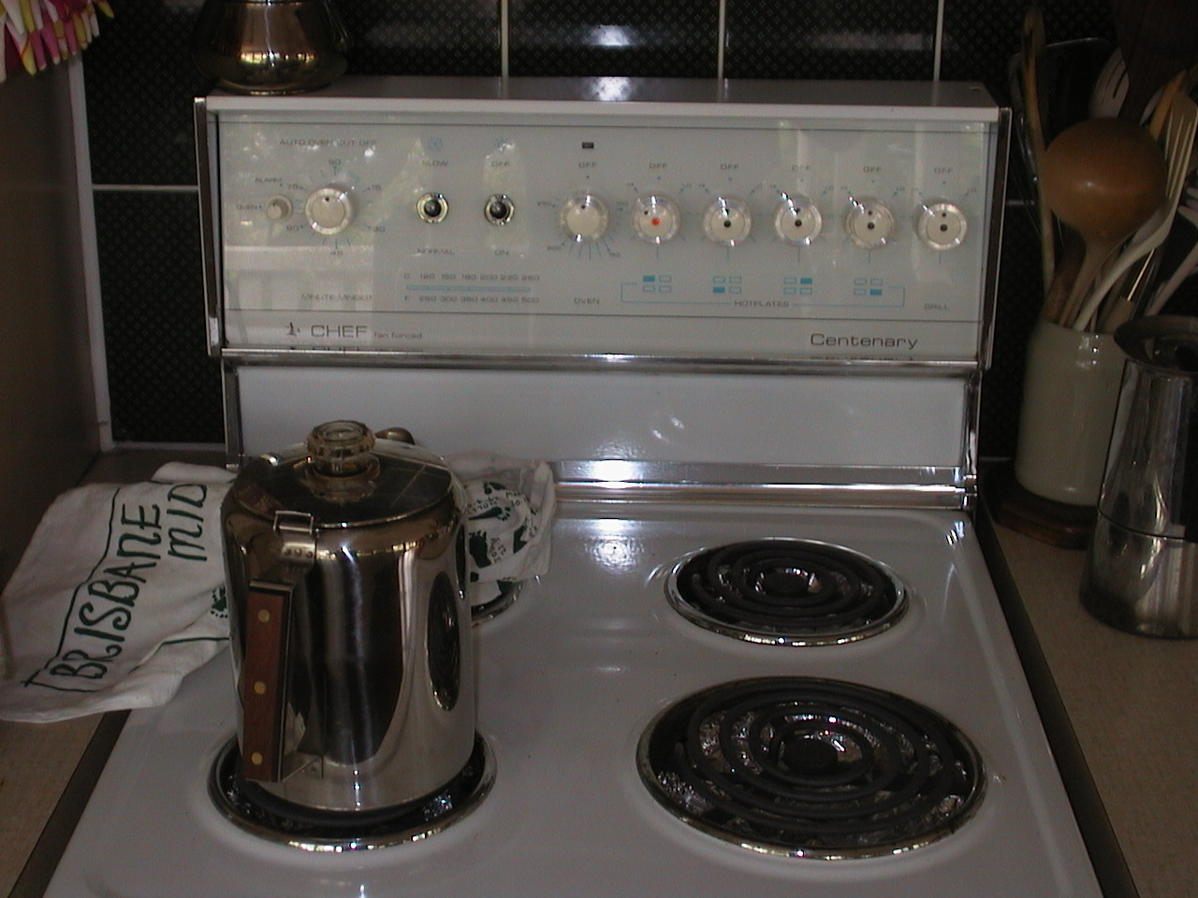

Slide 29
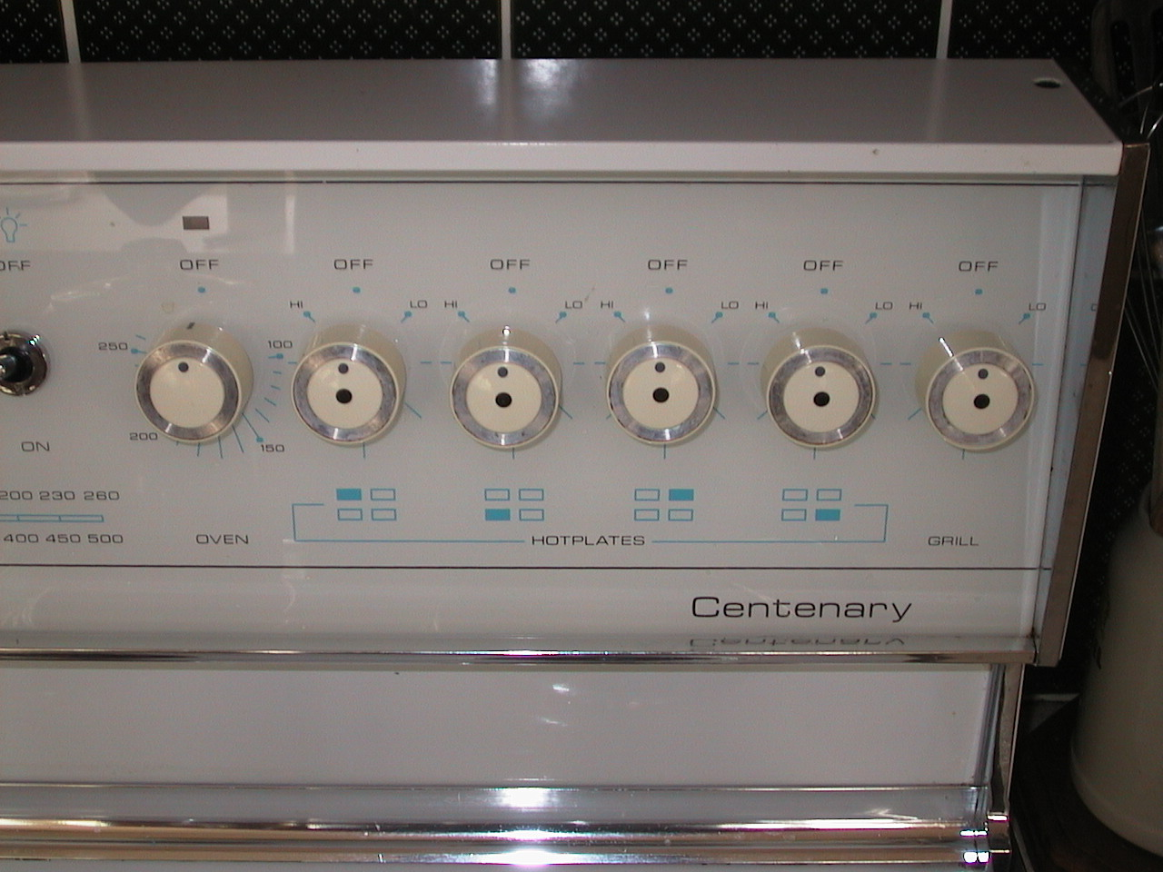

Slide 30
Bridging Users & Systems:
Mapping
Design concept
Draw clear relationships between objects and the things or behaviors they control
Should help users develop reasonable expectations of cause and effect
  What will probably happen if I click here?

Slide 31
Possible Mappings
full mapping
arbitrary
paired
back
right
front
left
back
left
front
right
back
front
front
back
24 possibilities, requires:
-visible labels + memory
2 possibilities per side
= 4 total possibilities

Slide 32
Bridging Users & Systems:
Causality
More specifically, perceived causality
  What happens immediately after an action is feedback about the consequences of the action
False causality
  Post hoc ergo propter hoc.
  Incorrect effect
    E.g., invoking unfamiliar function, then computer freezes
    Can cause ‘superstitious’ behaviors
  Invisible effect
    Command with no apparent result often re-entered repeatedly
Causality and design
  Maintain awareness that humans naturally and unavoidably ascribe causality
  Design for consequences of this kind of reasoning

Slide 33
Bridging Users & Systems:
Transfer Effects
People transfer their learning/expectations of similar objects to current objects
  Positive transfer: Previous learning applies well to new situation
  Negative transfer: Previous learning conflicts with new situation

Slide 34
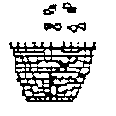

Bridging Users & Systems:
Population Stereotypes/Idioms
People learn idioms and symbols differently in different cultures:
  Red means stop or danger
  Green means go or safe
  Light switch in America versus Great Britain
  Faucets in America versus Great Britain
  Thai trash can icon
  American trash can icon

Slide 35
Lessons from
Architecture: Patterns
“[A] pattern describes a problem that occurs over and over again in our environment, and then describes the core of the solution to that problem, in such a way that you can use this solution a million times over, without ever doing it the same way twice.”
  Christopher Alexander, A Pattern Language. 1977.
A design concept that can apply to anything that gets ‘built.’
  Buildings, landscapes, software, Web sites, collections

Slide 36
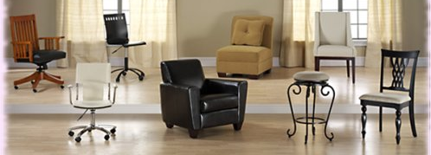
Pattern Examples
251: Different Chairs
Conflict: People are different sizes; they sit in different ways. And yet there is a tendency in modern times to make all chairs alike.
Resolution: Never furnish any place with chairs that are identically the same. Choose a variety of different chairs, some big, some small, some softer than others, some with rockers, some very old, some with arms, some wicker, some wood, some cloth.

Slide 37

Pattern Examples
112: "Entrance Transition"
Conflict: Buildings, especially houses, with a graceful transition between the street and the inside, are more tranquil than those which open directly off the street.
Resolution: Make a transition space between the street and from front door. Bring the path which connects street and entrance through this transition space, and mark it with a change of surface, a change of level, perhaps by gateways which make a change of enclosure, and above all with a change of view.

Slide 38
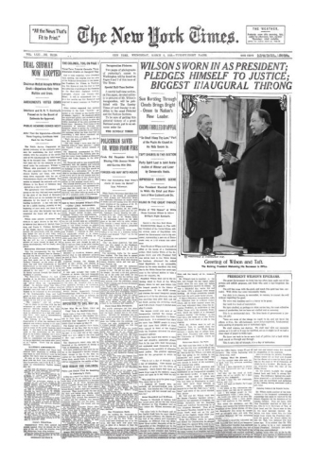
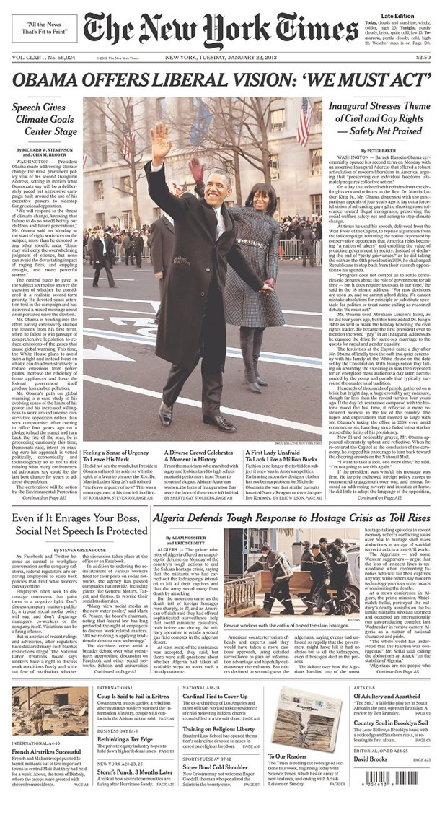
Notes:
1913 & 2013

Slide 39
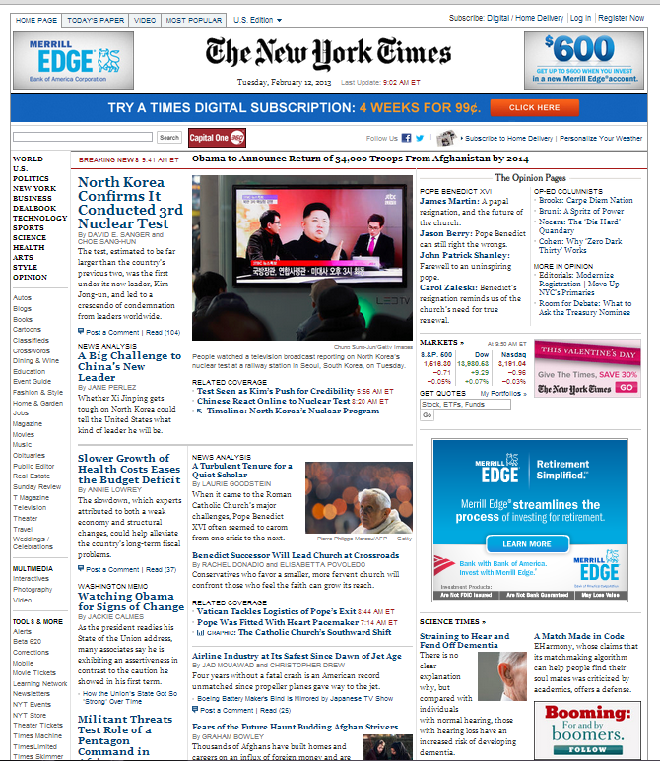
Notes:
Print & online

Slide 40
Layers of Patterns for Web Design
Posture – genre, type, purpose
  Commercial, informative, social, creative, combo
  The posture of the site it becomes clearer what kinds of experiences to design
Experience
  User tasks and goals within the realm of the posture
    High-level tasks & goals
    Primary & secondary level experiences
Task
  Specific solutions and strategies for creating experiences
  Can be drawn as wireframes or sketches
Action
  Low-level widgets & features that contribute to
  task performance
Affordances & Constraints go here

Slide 41
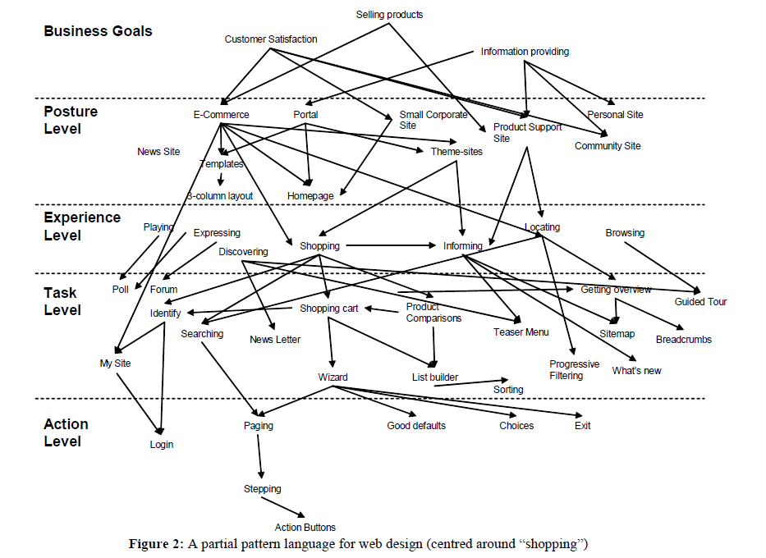
Notes:
Van Welie, Martijn, & van der Veer, Gerrit C. (2003). Pattern languages in Web design: Structure and organization. In Proceedings of Interact ‘03, 1-5 September, Zurich, Switzerland. p. 527 – 534.

Slide 42
Wire Framing
Design, brainstorming technique
  Highly conceptual
  Low-fi
  Low risk, low cost
  Rapid
Incorporates three elements of Web design:
  Information design. Which information will go where?
  Navigation design. How will users get around?
  Interface design. What kinds of elements convey functionality?

Slide 43
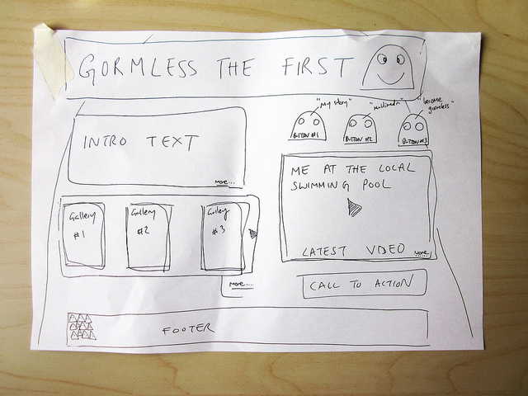
Notes:
By Flickr user Simon Collision. http://www.flickr.com/photos/collylogic/4971094116/.

Slide 44
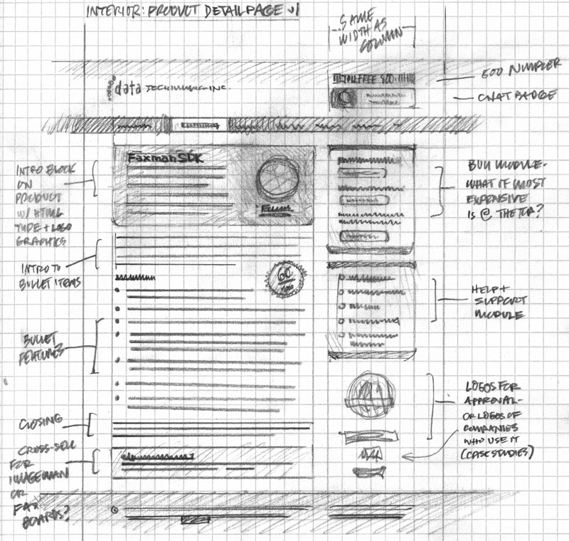
Notes:
By Flickr user Mike Rohde. http://www.flickr.com/photos/rohdesign/3307066409/.

Slide 45
G4: Begin to think about evaluation
Timing, methods, and outcomes of usability evaluation

Slide 46
Human-Computer Interaction
A discipline concerned with the
Design
Implementation
Evaluation
of interactive computing systems for human use
Notes:
46

Slide 47
Usability Evaluation Methods
Quantitative
  Numeric data
  Usually objective
Qualitative
  Narrative data
  Usually subjective
Mixed Methods
  Combine both kinds of data

Slide 48
Objective Data:
Quantitative Analysis
Response/task times
  Captured via transaction logs
  System can capture time & place of mouse clicks, text entries, etc.
  Screen capture can record any on-screen activity (movement of mouse, typing, screen loads)
Reading time/locus of attention
  Eye trackers can record a “movie” of where a person looks and for how long
Response/task accuracy
  Types of responses can be tracked and categorized, then compared with accuracy benchmarks

Slide 49
Subjective Data:
Quantitative Analysis
Numeric user survey responses
  Likert scale
  Odd (neutrality allowed) or even (forced choice) number of choices allowed
Statistics calculated for each question
  Mean, standard deviation, N-per-answer

Slide 50
Objective Data:
Qualitative Analysis
Content analysis of user’s text entries
  E.g., Query logs
Qualitative evaluation of transaction logs, screen captures, eye-trackers
  Requires some inferences, conjecture on researcher’s part, unless user corroboration is built into evaluation method
Heuristic evaluation
  Applying established design guidelines to the analysis of a site
    E.g., Homework 3 using HHS Usability Guidelines

Slide 51
Subjective Data for
Qualitative Analysis
Interviews: Researcher & One Participant
  Structured: The same pre-planned list of questions is asked of every participant, with no going off-script
  Semi-structured: The same pre-planned list of questions or talking points are touched on with every participant, although some follow-up questions or tangential discussions are expected
  Unstructured: No structured plan going in; a free form conversation between researcher and participant

Slide 52
Subjective Data for
Qualitative Analysis
Focus groups: Group of users and observation by a (perhaps invisible) researcher
  Small groups are asked to collaborate on a task, OR
  Work independently on a task, then discuss, OR
  Discuss their wants, needs, reactions to a real or proposed product
  Sometimes facilitated by researcher, sometimes the researcher stays out of the room

Slide 53
Subjective Data for
Qualitative Analysis
User reactions to system
  Think-aloud: User is asked to think out loud while using the system
    Often requires prompt from the researcher, like “What are you trying to do right now?” or “Tell me what you’re thinking about the system while you do this.”
  Stimulated recall: User is shown a transaction log, screen capture, etc. and asked to recall what was going on at the time

Slide 54
Processing Qualitative Data
Transcripts are often made of narrative data (interviews, focus groups, etc.)
Researcher uses software (e.g., Nvivo, Atlas.ti) to highlight interesting passages and code them according to evaluation benchmarks or research topics
  E.g., Researcher might highlight all passages where an interviewee discusses the menu structure, or all passages where interviewee expresses disatisfaction.

