Slide 1

Computing
Week 9
LBSC 671
Creating Information Infrastructures

Slide 2
Muddiest Points
BIBFRAME
The analog hole

Slide 3
Goals for Today
Understand what makes stupid computers seem smart
Understand how the Internet works

Slide 4
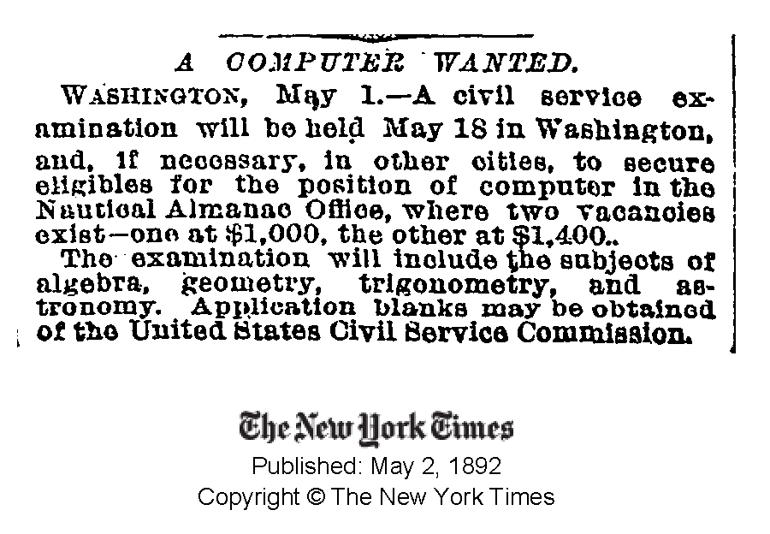

Slide 5
Commercial Developments
Mainframes (1960’s)
  IBM
Minicomputers(1970’s)
  DEC
Personal computers (1980’s)
  Apple, Microsoft
Networks (1990’s)
  Web
Convergence (2000’s)
  Cell phone/PDA, HDTV/Computer, …

Slide 6

Source: Wikipedia

Slide 7
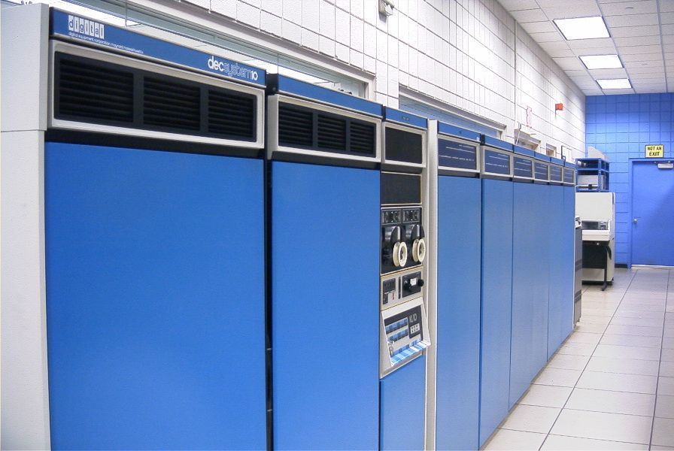
Source: Wikipedia

Slide 8
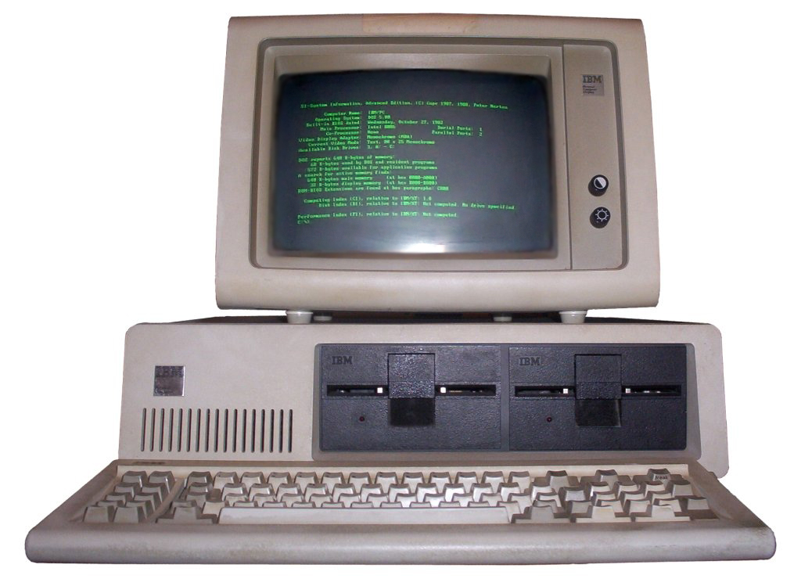
Source: Wikipedia

Slide 9
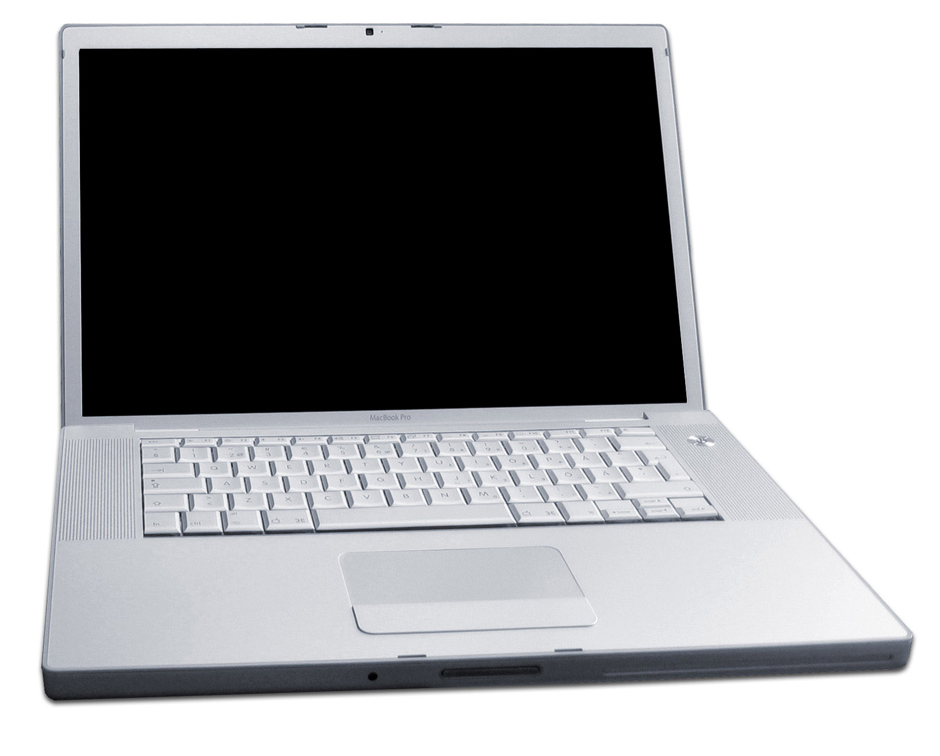
Source: Wikipedia

Slide 10
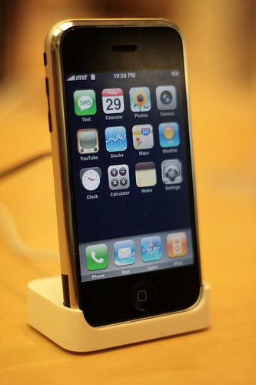
Source: Wikipedia

Slide 11
The Big Picture
Memory
Processor
Network

Slide 12
Hardware Processing Cycle
Input comes from somewhere
  Keyboard, mouse, microphone, camera, …
The system does something with it
  Processor, memory, software, network, …
Output goes somewhere
  Monitor, speaker, robot controls, …

Slide 13
Memory
Processor
Output
Input

Slide 14
System Architecture
Keyboard
Mouse
Sound
Card
Video
Card
Input
Controller
System Bus
Front Side Bus
Hard
Drive
CD/
DVD
L2
RAM
USB Port
CPU
L1
Cache
Motherboard

Slide 15
“Solid-State” Memory
ROM
  Does not require power to retain content
  Used for “Basic Input/Output System” (BIOS)
Cache (Fast, low-power)
  Level 1 (L1) cache: small, single-purpose
  Level 2 (L2) cache: larger, shared
(“Dynamic”) RAM (Slower, power hungry)
  Reached over the “Front-Side Bus” (FSB)
Flash memory (fast read, slow write)
  Reached over USB bus or SD socket
  Used in memory sticks (“non-volatile” storage)

Slide 16
The Storage Hierarchy
Type | Speed | Size | Cost
Registers | ~300 ps | 256 B | Very expensive
Cache | ~1 ns | 4 MB | Expensive
RAM | ~10 ns | 1 GB | Cheap
Hard drive | ~10 ms | 1 TB | Very cheap

Slide 17
File System
Paths specify location of files on a hard drive
Folder metaphor
  Hierarchically nested directories
  Relative paths
/afs/wam.umd.edu/home/wam/j/i/jimmylin/home
C:\Documents and Settings\Jimmy Lin\My Documents
../pub
..\Desktop
~/oard

Slide 18
Directory Tree Exercise
First, visually explore the directory tree
  PC: Windows Explorer
  Mac: Finder
Then launch a shell
  PC: type cmd in search box
  Mac: Applications->Utiities->Terminal
Then navigate around
  “tree .” plots the tree from here (PC only)
  “dir” (PC) or “ls” (Mac) lists the present directory
  “cd WINDOWS” takes you “down” in the tree
  “cd ..” takes you “up” in the tree

Slide 19
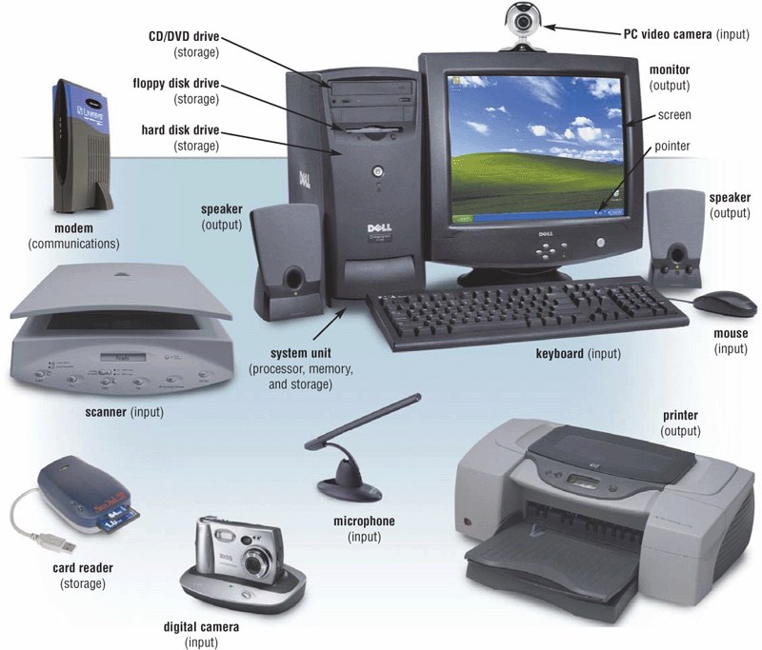
Extracted From Shelly Cashman Vermatt’s Discovering Computers 2004

Slide 20
The Internet
Global collection of public “IP” networks
  Private networks are often called “intranets”
Independent
  Each organization maintains its own network
Cooperating
  Internet Corp. for Assigned Names & Numbers (ICANN)
    Internet Protocol (IP) address blocks
    Top-level domain names
  World-Wide Web Consortium (W3C)
  Computer Emergency Response Team (CERT)

Slide 21
A Short History of the Internet
1969: Origins in government research
  Advanced Research Projects Agency (ARPAnet)
  Key standards: UDP, TCP, DNS
1983: Design adopted by other agencies
  Created a need for inter-network connections
  Key standards: IP
1991: World-Wide Web added point-and-click
  Now about 1 billion Internet “hosts” (March 2014)
  Key standards: HTTP, URL, HTML, XML
Notes:
Moore’s law make shift from large time sharing computer facilities to individual, small but powerful computer systems, and

Slide 22
What Changed in 1994?

Slide 23
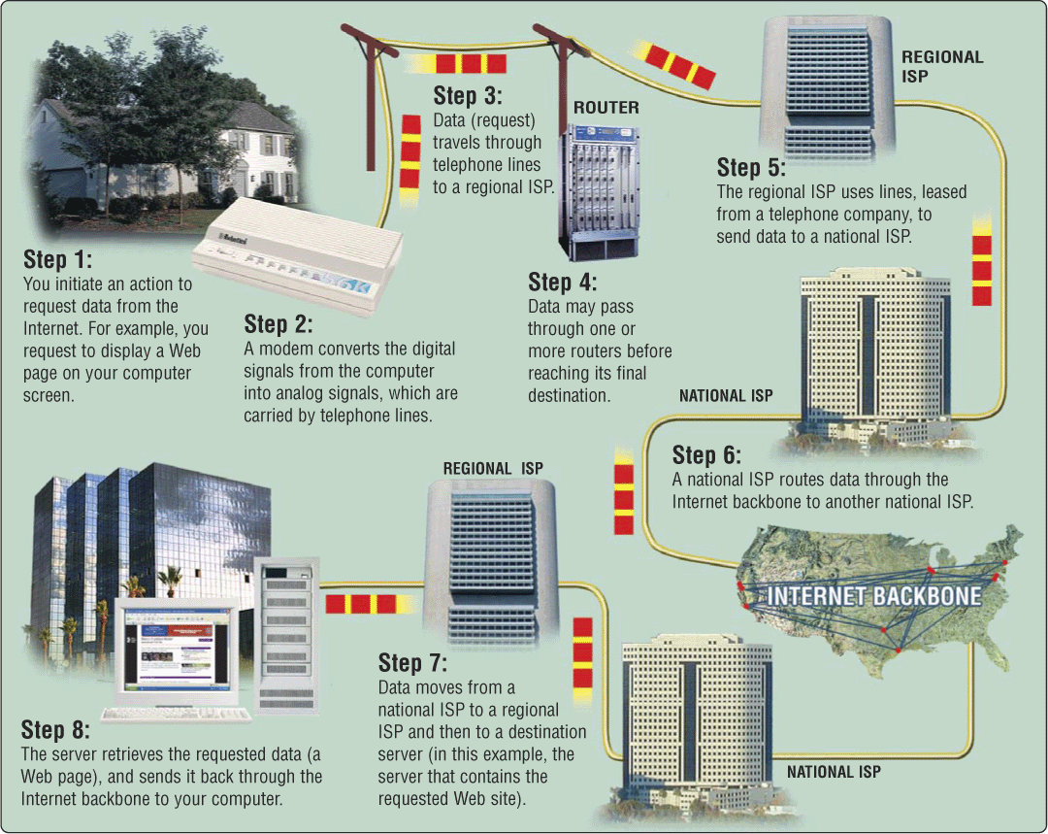
A Network of Networks

Slide 24
Types of Digital Channels
“Backbone”
  Microwave
  Satellite
  Fiber
“Last mile” wired
  ADSL
  Cable modem
  Fiber
“Last mile” wireless
  Wi-Fi (IEEE 802.11)
  GSM/4G

Slide 25
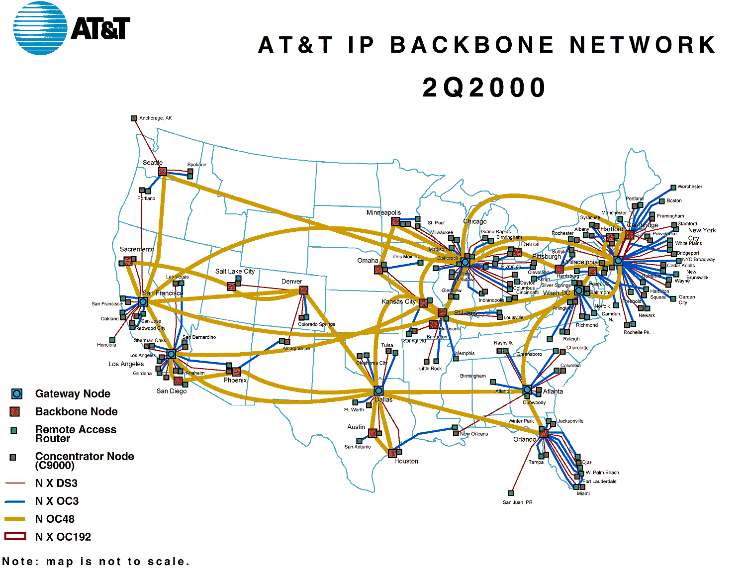
http://www.geog.ucl.ac.uk/casa/martin/atlas/isp_maps.html

Slide 26
Thinking About Speed
Two parts to latency:
  Getting the first bit there
    At the speed of light + routing delays
  Getting the rest of the bits there
    Which depends on the “bandwidth” or “data rate”
Applies to:
  Moving data from the processor to RAM
  Saving a file to disk
  Downloading music from a server in China

Slide 27
Units of Time
Unit | Abbreviation | Duration (seconds)
second | sec/s | 1
millisecond | ms | 10⁻³ = 1/1,000
microsecond | μs | 10⁻⁶ = 1/1,000,000
nanosecond | ns | 10⁻⁹ = 1/1,000,000,000
picosecond | ps | 10⁻¹² = 1/1,000,000,000,000
femtosecond | fs | 10⁻¹⁵ = 1/1,000,000,000,000,000

Slide 28
Units of Frequency
Unit | Abbreviation | Operations per second
hertz | Hz | 1
kilohertz | KHz | 10³ = 1,000
megahertz | MHz | 10⁶ = 1,000,000
gigahertz | GHz | 10⁹ = 1,000,000,000

Slide 29
Units of Size
Unit | Abbreviation | Size (bytes)
bit | b | 1/8
byte | B | 1
kilobyte | KB | 2¹⁰ = 1024
megabyte | MB | 2²⁰ = 1,048,576
gigabyte | GB | 2³⁰ = 1,073,741,824
terabyte | TB | 2⁴⁰ = 1,099,511,627,776
petabyte | PB | 2⁵⁰ = 1,125,899,906,842,624

Slide 30
Types of Internet “Nodes”
Hosts
  Computers that use the network to do something
Routers
  Specialized computers that route packets
Gateway
  Routers that connect two networks
Firewall
  Gateways that pass packets selectively

Slide 31
IP Address
Every host (and every router) is identified by an “Internet Protocol” (IP) address
32 bit number, divided into four “octets”
128.8.11.33
216.239.39.99
199.181.132.250
Example: point your browser at http://128.8.237.77/

Slide 32
An Internet Protocol (IP) Address
Identifies a LAN
IP address: 216.183.103.150
Identifies a specific computer

Slide 33
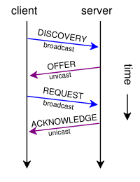
Dynamic IP Addresses
Dynamic Host Configuration Protocol (DHCP)

Slide 34
Hands-on:
Learn About Your IP Address
Find your IP address
  Windows: type “cmd” in the search box, then “ipconfig /all”
  Mac: type “ifconfig –a” in a terminal window
Use Reverse DNS to see who “owns” an address
  http://remote.12dt.com/
See where in the world it (probably) is
  http://www.geobytes.com/ipLocator.htm

Slide 35
Routing Tables
IP Prefix | Next Router | Estimated Delay
216.141.xxx.xxx | 120.0.0.0 | 18 ms
216.xxx.xxx.xxx | 121.0.0.0 | 34 ms
101.42.224.xxx | 120.0.0.0 | 21 ms
xxx.xxx.xxx.xxx | 121.0.0.0 | 250 ms
120.0.0.0
45.0.2.10
121.0.0.0

Slide 36
TraceRoute
See how packets get from South Africa to you
  http://services.truteq.com/
Look at the same data visually
  http://visualroute.visualware.com/
  Select “route test”
  Don’t download the “free 15 day trial”!

Slide 37
IP Addresses and Domain Names
IP address: 128.8.10.142
Domain Name: wam.umd.edu

Slide 38
Domain Name Service (DNS)
“Domain names” improve usability
  Easier to remember than IP addresses
  Written like a postal address: specific-to-general
Each “name server” knows one level of names
  “Top level” name servers know .edu, .com, .mil, …
  .edu name server knows umd, umbc, stanford, …
  .umd.edu name server knows terpconnect, ischool, …
  .ischool.umd.edu name server knows www, …

Slide 39
Uniform Resource Locator (URL)
Uniquely identify Web pages
Domain name
File name
http://www.glue.umd.edu:80/~oard/teaching.html
Protocol
Port
Path

Slide 40
Ports
Well-known ports
  22 Secure Shell (for SSH and SFTP)
  25 Simple Mail Transfer Protocol (SMTP)
  53 Domain Name System (DNS)
  68 Dynamic Host Configuration Protocol (DHCP)
  80 Hypertext Transfer Protocol (HTTP)
  143 Internet Message Access Protocol (IMAP)
  554 Real-Time Streaming Protolol (RTSP)
Registered Ports
  8080 HTTP server run by ordinary users
Ephemeral Ports

Slide 41
Port Mapping
Internet Service providers lease one IP address
  But home networks may contain many machines
Network Address Translation (NAT)
  Each internal machine gets a private IP address
  Ports on internal machines are mapped both ways
Port forwarding
  Permits public server to run in the local network

Slide 42
The TCP/IP “Protocol Stack”
Link layer moves bits
  Ethernet, cable modem, DSL
Network layer moves packets
  IP
Transport layer provides services to applications
  UDP, TCP
Application layer uses those services
  DNS, SFTP, SSH, …

Slide 43
TCP/IP layer architecture
Application
Application
Virtual network service
Transport
Transport
Virtual link for end to end packets
Network
Network
Network
Network
Virtual link for packets
Link
Link
Link
Link
Link
Link
Link for bits
Link for bits
Link for bits

Slide 44
Transmission Control Protocol (TCP)
Built on the network-layer version of UDP
Guarantees delivery all data
  Retransmits missing data
Guarantees data will be delivered in order
  “Buffers” subsequent packets if necessary
No guarantee of delivery time
  Long delays may occur without warning

Slide 45
User Datagram Protocol (UDP)
The Internet’s basic transport service
  Sends every packet immediately
  Passes received packets to the application
No delivery guarantee
  Collisions can result in packet loss
Example: sending clicks on web browser
Notes:
No connection establishment. As we shall discuss in Section 3.5, TCP uses a three-way handshake before it starts to transfer data. UDP just blasts away without any formal preliminaries. Thus UDP does not introduce any delay to establish a connection. This is probably the principle reason why DNS runs over UDP rather than TCP -- DNS would be much slower if it ran over TCP. HTTP uses TCP rather than UDP, since reliability is critical for Web pages with text. But, as we briefly discussed in Section 2.2, the TCP connection establishment delay in HTTP is an important contributor to the "world wide wait".
No connection state. TCP maintains connection state in the end systems. This connection state includes receive and send buffers, congestion control parameters, and sequence and acknowledgment number parameters. We will see in Section 3.5 that this state information is needed to implement TCP's reliable data transfer service and to provide congestion control. UDP, on the other hand, does not maintain connection state and does not track any of these parameters. For this reason, a server devoted to a particular application can typically support many more active clients when the application runs over UDP rather than TCP.
Small segment header overhead. The TCP segment has 20 bytes of header overhead in every segment, whereas UDP only has 8 bytes of overhead.
Unregulated send rate. TCP has a congestion control mechanism that throttles the sender when one or more links between sender and receiver becomes excessively congested. This throttling can have a severe impact on real-time applications, which can tolerate some packet loss but require a minimum send rate. On the other hand, the speed at which UDP sends data is only constrained by the rate at which the application generates data, the capabilities of the source (CPU, clock rate, etc.) and the access bandwidth to the Internet. We should keep in mind, however, that the receiving host does not necessarily receive all the data - when the network is congested, a significant fraction of the UDP-transmitted data could be lost due to router buffer overflow. Thus, the receive rate is limited by network congestion even if the sending rate is not constrained.

Slide 46
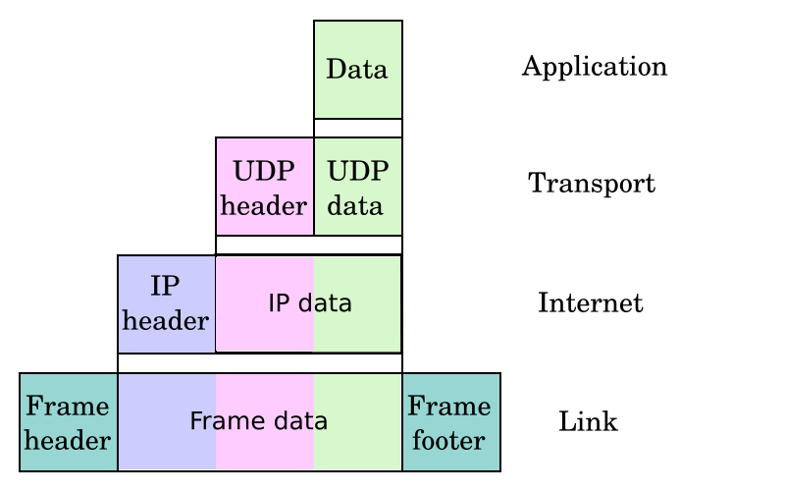
UDP/IP Protocol Stack

Slide 47
(Secure) File Transfer Program (SFTP)
Used to move files between machines
  Upload (put) moves from client to server
  Download (get) moves files from server to client
Both visual and command line interfaces available
Normally requires an account on the server
  Userid “anonymous” provides public access

Slide 48
Hands On:
Graphical Secure FTP
SFTP to “terpconnect.umd.edu”
Change directory to “/pub/USERID”
Upload or download files
You can see these files at:
http://terpconnect.umd.edu/~USERID/

Slide 49
Network Abuse
Flooding
  Excessive activity, intended to prevent valid activity
Worms
  Like a virus, but self-propagating
Sniffing
  Monitoring network traffic (e.g., for passwords)

Slide 50
Encryption
Secret-key systems (e.g., DES)
  Use the same key to encrypt and decrypt
Public-key systems (e.g., PGP)
  Public key: open, for encryption
  Private key: secret, for decryption
Digital signatures
  Encrypt with private key, decrypt with public key

Slide 51
Encrypted Standards
Secure Shell (SSH)
  Replaces Telnet
Secure FTP (SFTP)/Secure Copy (SCP)
  Replaces FTP
Secure HTTP (HTTPS)
  Used for financial and other private data
Wired Equivalent Protocol (WEP)
  Used on wireless networks
Virtual Private Network (VPN)
  Not really a “standard”

Slide 52
Virtual Private Networks
a secure private network over the public Internet
Public Internet
Intranet
virtual “leased line”
Intranet

Slide 53
Internet ≠ Web
Internet: collection of global networks
Web: way of managing information exchange
There are many other uses for the Internet
  File transfer (FTP)
  Email (SMTP, POP, IMAP)

Slide 54
The World-Wide Web
My Browser
Local copy of
Page requested
Requested Page
Proxy Server
Fetch Page
Remote Sever
Send Request
Internet
Notes:
A server that sits between a client application, such as a Web browser, and a real server. It intercepts all requests to the real server to see if it can fulfill the requests itself. If not, it forwards the request to the real server. Proxy servers have two main purposes:
Improve Performance: Proxy servers can dramatically improve performance for groups of users. This is because it saves the results of all requests for a certain amount of time. Consider the case where both user X and user Y access the World Wide Web through a proxy server. First user X requests a certain Web page, which we'll call Page 1. Sometime later, user Y requests the same page. Instead of forwarding the request to the Web server where Page 1 resides, which can be a time-consuming operation, the proxy server simply returns the Page 1 that it already fetched for user X. Since the proxy server is often on the same network as the user, this is a much faster operation. Real proxy servers support hundreds or thousands of users. The major online services such as Compuserve and America Online, for example, employ an array of proxy servers.
Filter Requests: Proxy servers can also be used to filter requests. For example, a company might use a proxy server to prevent its employees from accessing a specific set of Web sites.

Slide 55
“The Web”
HTML
HTTP
Email
FTP
RTSP
URL
URL
(e.g.,http://www.foo.org/snarf.html)
Web
Server
File System
Internet
communication
protocols
HTML
(data/display)
HTTP
(transfer)

Slide 56
Web Standards
HTML
  How to write and interpret the information
URL
  Where to find it
HTTP
  How to get it
Notes:
Link this to postal service

Slide 57
HyperText Transfer Protocol (HTTP)
Send request
  GET /path/file.html HTTP/1.0
  From: someuser@jmarshall.com
  User-Agent: HTTPTool/1.0
Server response
  HTTP/1.0 200 OK
  Date: Fri, 31 Dec 1999 23:59:59 GMT
  Content-Type: text/html
  Content-Length: 1354
  <html><body> <h1>Happy New Millennium!</h1> … </body> </html>
Notes:
The Difference Between FTP and HTTP File Transfer Protocol, or FTP, is a protocol used to upload files from a workstation to a FTP server or download files from a FTP server to a workstation. It is the way that files get transferred from one device to another in order for the files to be available on the Internet. When ftp appears in a URL it means that the user is connecting to a file server and not a Web server and that some form of file transfer is going to take place. Most FTP servers require the user to log on to the server in order to transfer files. In contrast, Hyper Text Transfer Protocol, or HTTP, is a protocol used to transfer files from a Web server onto a browser in order to view a Web page that is on the Internet. Unlike FTP, where entire files are transferred from one device to another and copied into memory, HTTP only transfers the contents of a web page into a browser for viewing. FTP is a two-way system as files are transferred back and forth between server and workstation. HTTP is a one-way system as files are transported only from the server onto the workstation's browser. When http appears in a URL it means that the user is connecting to a Web server and not a file server. The files are transferred but not downloaded, therefore not copied into the memory of the receiving device.

Slide 58
Before You Go
On a sheet of paper, answer the following (ungraded) question (no names, please):
What was the muddiest point in today’s class?

