Slide 1

Discovery and Delivery
Week 8
LBSC 671
Creating Information Infrastructures

Slide 2
Midterm Exam
Posted by 5 PM on Wednesday March 26
  Due at 5:30 PM on Monday March 31
  3 Hours, same process as the quiz (email, no talking, …)
  Note: there are also readings for that week’s class
Comprehensive, including tonight’s class
  Nature of information institutions
  Have it, find it, serve it
  Last semester’s exam is available on the course Web page
One question will be to create + represent a bibliographic description (w/authority control)
  One RDA+MODS option
  One DACS+EAD option

Slide 3
Tonight
Linked Open Data and BIBFRAME
Discovery
Delivery

Slide 4
Some Basic Rules for XML
XML declaration is the first statement
  <?xml version="1.0"?>
An XML document is a “tree”
  Must contain one root element
  Other elements must be properly nested
All start tags must have end tags
XML is case sensitive
Attribute values must have quotation marks
  <item id=“33905”>
Certain characters are “reserved”
  For example: &lt; is used to represent <

Slide 5
Resource Description Framework
XML schema for describing resources
Can integrate multiple metadata standards
  Dublin Core, P3P, PICS, vCARD, …
Dublin Core provides a XML “namespace”
  DC Elements are XML “properties
    DC Refinements are RDF “subproperties”
  Values are XML “content”

Slide 6
XML Namespaces
<?xml version="1.0"?>
<rdf:RDF
xmlns:rdf="http://www.w3.org/1999/02/22-rdf-syntax-ns#"
xmlns:rss="http://purl.org/rss/1.0/"
xmlns:dc="http://purl.org/dc/elements/1.1/">
<rss:channel rdf:about="http://www.xml.com/xml/news.rss">
<rss:title>XML.com</rss:title>
<rss:link>http://xml.com/pub</rss:link>
<dc:description>
XML.com features a rich mix of
information and services for the XML community.
</dc:description>
<dc:subject>XML, RDF, metadata, information
syndication services</dc:subject>
<dc:identifier>http://www.xml.com</dc:identifier>
<dc:publisher>O'Reilly & Associates, Inc.</dc:publisher>
<dc:rights>Copyright 2000, O'Reilly &
Associates, Inc.</dc:rights>
</rss:channel>
</rdf:RDF>
Example from http://www.xml.com/pub/a/2000/10/25/dublincore/

Slide 7
Dublin Core in RDF XML
<rdf:RDF
xmlns:rdf="http://www.w3.org/1999/02/22-rdf-syntax-ns#"
xmlns:dc="http://purl.org/dc/elements/1.1/">
<rdf:Description
rdf:about="http://media.example.com/audio/guide.ra">
<dc:creator>Rose Bush</dc:creator>
<dc:title>A Guide to Growing Roses</dc:title>
<dc:description>Describes process for planting and nurturing
different kinds of rose bushes.</dc:description>
<dc:date>2001-01-20</dc:date>
</rdf:Description>
</rdf:RDF>

Slide 8
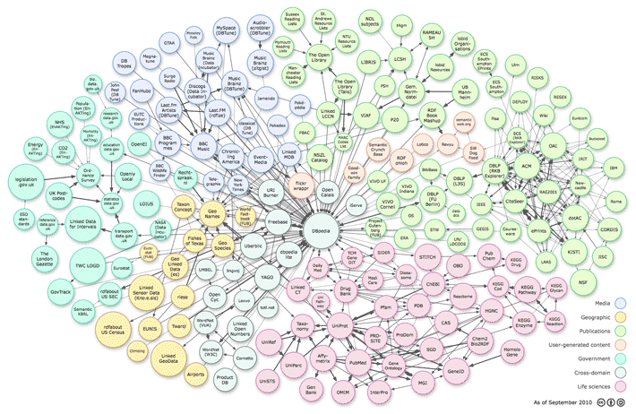
Linked Open Data

Slide 9

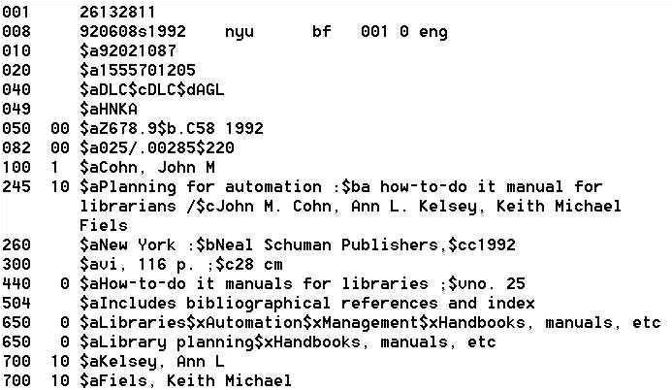



Deconstructing MARC
Sally McCallum, September, 2012

Slide 10
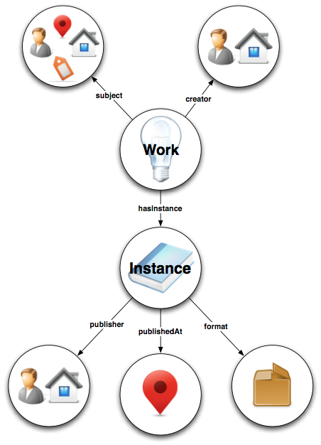
Bibliographic Framework Initiative
(BIBFRAME)
http://bibframe.org

Slide 11
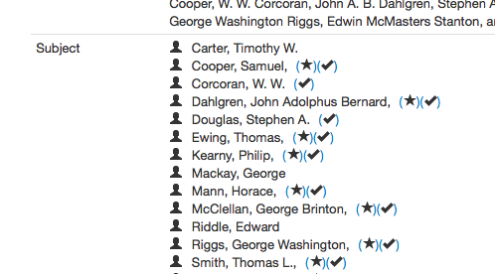
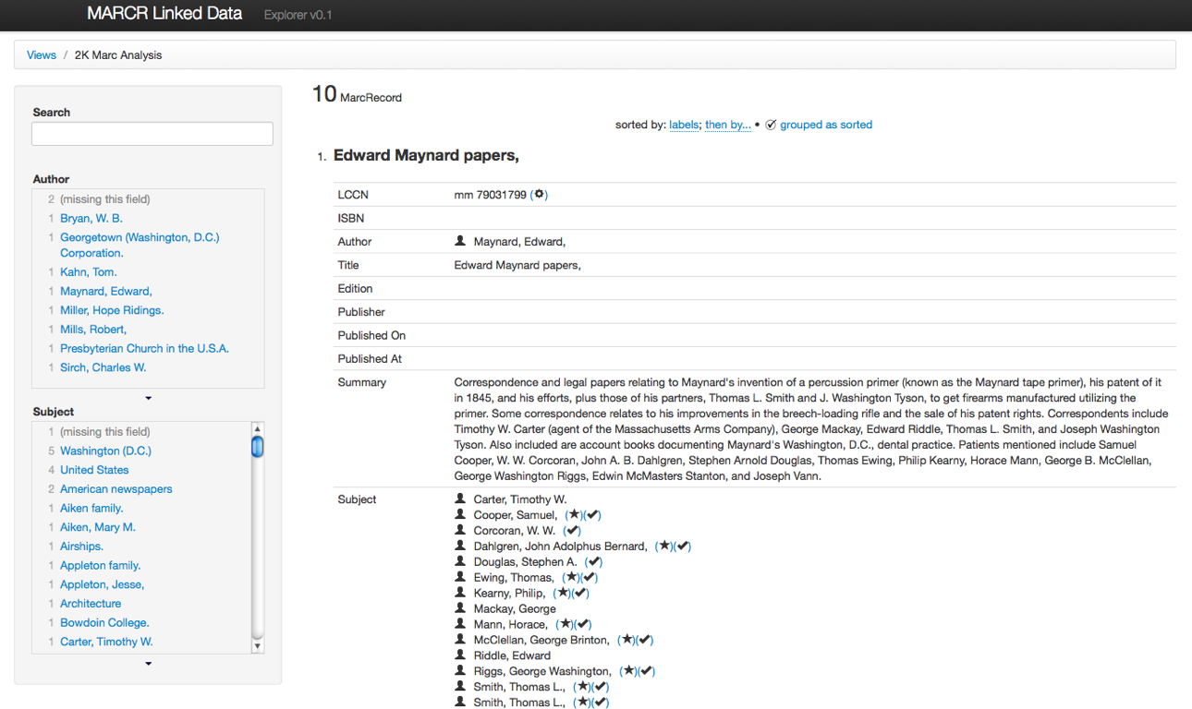

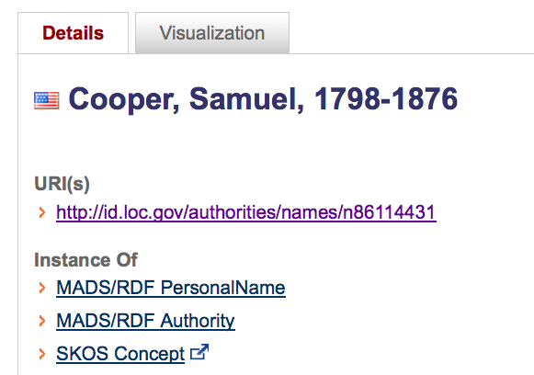
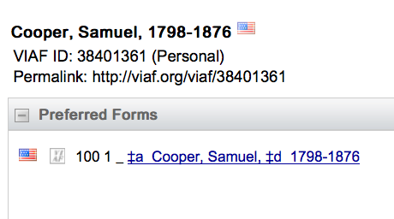

Slide 12
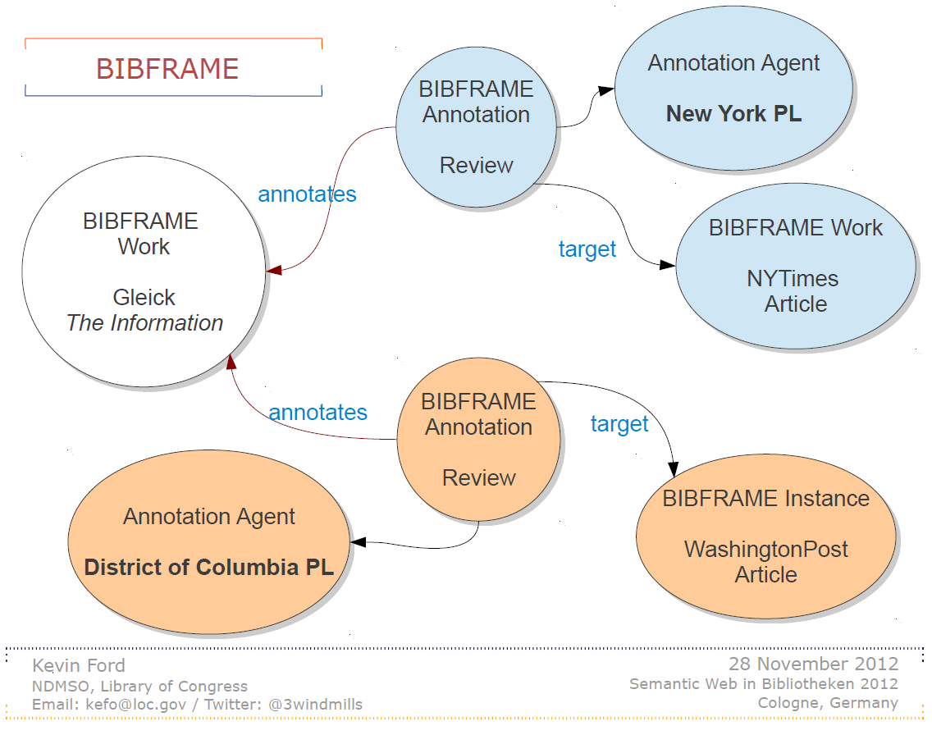

Slide 13
Tonight
Linked Open Data and BIBFRAME
Discovery
Delivery

Slide 14
Two Ways of Searching
Controlled
Vocabulary
Searcher
Free-Text
Searcher
Author
Indexer
Construct query from
terms that may
appear in documents
Write the document
using terms to
convey meaning
Choose appropriate
concept descriptors
Construct query from
available concept
descriptors
Content-Based
Query-Document
Matching
Metadata-Based
Query-Document
Matching
Query Terms
Document Terms
Document Descriptors
Query Descriptors
Retrieval Status Value

Slide 15
Supporting the Search Process
Source
Selection
IR System
Query
Formulation
Query
Search
Ranked List
Selection
Indexing
Document
Index
Examination
Document
Acquisition
Collection
Delivery

Slide 16
Online Public Access Catalog (OPAC)
Known-item search
  Author, Title
Topic search
  Title, subject headings
Result display
  Sort by publication date, “relevance,” …
Navigation
  Broader/narrower headings, other editions, …
Delivery
  Call number or (digital content) direct delivery

Slide 17
Tonight
Linked Open Data and BIBFRAME
Discovery
Delivery
  Shelf Order
  Inter-Library Loan
  Digital Rights Management

Slide 18
Delivery (“Serve It”)
Assigning a shelf order
Moving physical materials
Controlling access to digital materials

Slide 19
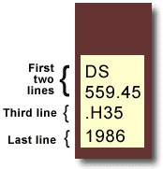
Library of Congress Classification
Book title: Uncensored War: The Media and Vietnam
Author: Daniel C. Hallin
Call Number: DS559.46 .H35 1986
The first two lines describe the subject of the book.
DS559.45 = Vietnamese Conflict
The third line often represents the author's last name.
H = Hallin
The last line represents the date of publication.
D History
DS1-937 History of Asia
DS520-560.72 Southeast Asia
DS556-559.93 Vietnam. Annam
DS557-559.9 Vietnamese Conflict
After other initial consonants for the second letter: use number: |  | a 3 | e 4 | i 5 | o 6 | r 7 | u 8 | y 9
For expansion for the letter: use number: |  | a-d 3 | e-h 4 | i-l 5 | m-o 6 | p-s 7 | t-v 8 | w-z 9
http://www.usg.edu/galileo/skills/unit03/libraries03_04.phtml

Slide 20
The World Is Flat (in LCC)
    HM846 .F74 2005
H Social sciences
HM Sociology
HM831 Social change – Causes
HM846 Technological Innovations. Technology.
.F74 Cutter number for Friedman, Thomas

Slide 21
The World Is Flat (in Dewey)
303.4833
300 Social science
300 Social sciences, sociology, & anthropology
303 Social processes
303.4 Social change
303.48 Causes of change
303.483 Development of science and technology
303.4833 Communication (Information technology)

Slide 22
Inter-Library Loan
Users search “union catalog” to find books
Remote library “ships” it to local library
  Often by scanning it, where practical
  Someone pays for this (local library or user)
Local library manages circulation
  Limited access period
  Some “return” mechanism

Slide 23
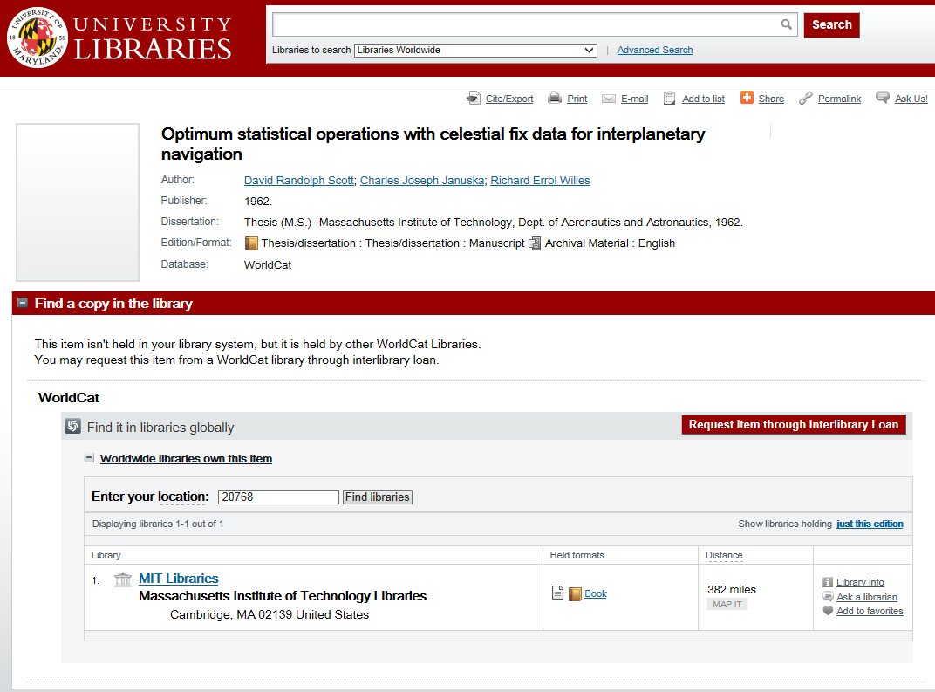

Slide 24
Inter-Library Loan Issues
Cost
Delivery time
  Satisficing
Delivery
  Online (links, PDF’s)
  Library pick up
  Mail

Slide 25
E-Book Distribution
OECD, E-Books: Development and Policy Considerations (2011)

Slide 26
Copyright
Balances two public interests
  Incentivizing production of new information
    Through owner’s interest in monetizing assets
  Fostering use of information
    First sale doctrine
    Fair use doctrine

Slide 27
First Sale Doctrine
Owner may transfer access of the owned copy
  But may not make a copy then transfer the copy
  This is what permits “lending libraries”
    Exception: no commercial lending of audio recordings
Licensing can apply more restrictive rules
  Establishes a conditional right of access
  This is what permits limited-

Slide 28
Fair Use Doctrine
Balance two desirable characteristics
  Financial incentives to produce content
  Desirable uses of existing information
Safe harbor agreement
  Book chapter, magazine article, picture, …
Developed in an era of physical documents
  Perfect copies/instant delivery alter the balance

Slide 29
Recent Copyright Laws
Copyright Term Extension Act (CTEA)
  Ruled constitutional (Jan 2003, Supreme Court)
Digital Millennium Copyright Act (DMCA)
  Prohibits circumvention of technical measures
  Implements WIPO treaty database protection

Slide 30
Digital Rights Management (DRM)
Goal: protect intellectual property rights
  Copyright relies on cost and quality of analog copies
Three interlocking strategies
  Make it difficult to produce an exact digital copy
  Encrypt the content and then control description
  Enforce policies to rebalance costs and benefits

Slide 31
Digital Rights Management
No standards, so proliferation of one-off solutions
  Many of which have caused unintended problems
Unilateral implementation can result in imbalance
  Establishing balance is a political process
The “analog hole” is technically intractable
  Unless interaction is needed

Slide 32
Before You Go!
On a sheet of paper (no names), answer the following question:
What was the muddiest point in today’s class?

