Slide 1

Description
Week 5
LBSC 671
Creating Information Infrastructures

Slide 2
Metadata Capture: User Behavior
Minimum Scope
Segment
Object
Class
Examine
View
Select
Listen
Retain
Print
Bookmark
Save
Purchase
Subscribe
Delete
Behavior Category
Reference
Copy / paste
Forward
Quote
Reply
Link
Cite
Annotate
Mark up
Tag
Organize
Publish
Create
Type
Edit

Slide 3
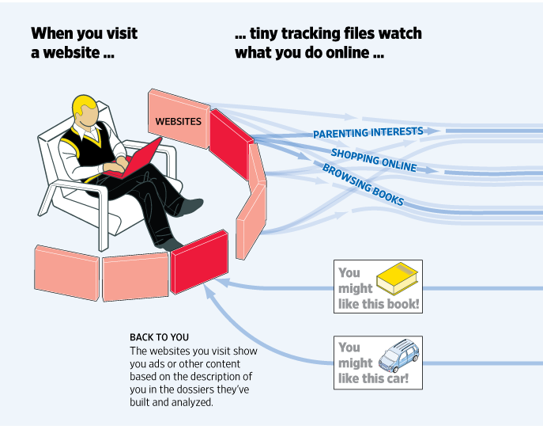
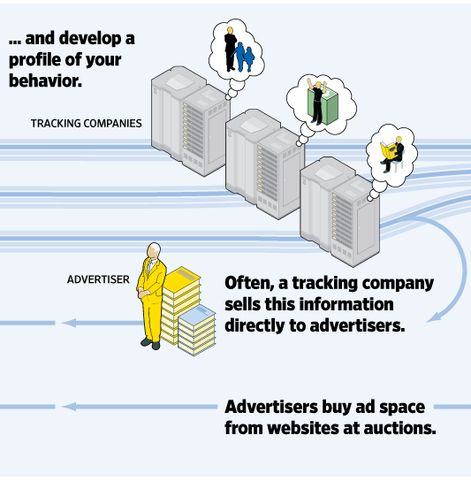
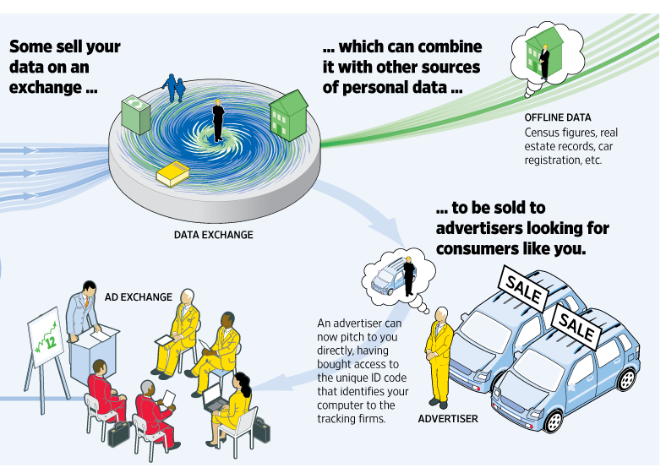
Exploiting Behavioral Metadata
http://wsj.com/wtk

Slide 4
Metadata Extraction:
Named Entity “Tagging”
Machine learning techniques can find:
  Location
  Extent
  Type
Two types of features are useful
  Orthography
    e.g., Paired or non-initial capitalization
  Trigger words
    e.g., Mr., Professor, said, …

Slide 5
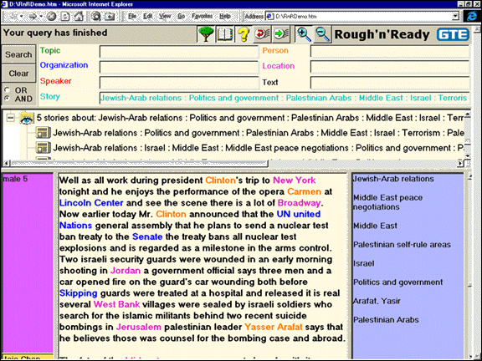

Slide 6
Metadata Sources
Automated
  Capture
  Extraction
  Classification
Manual
  Professional
  Community
  Personal

Slide 7
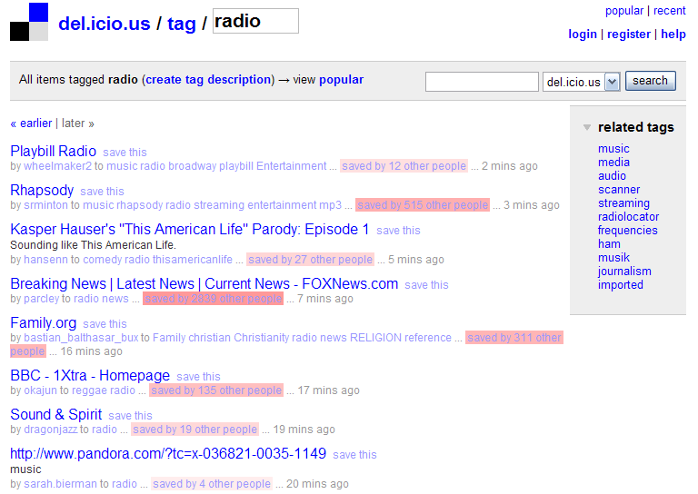
Community Metadata:
“Folksonomies”

Slide 8
Community Metadata:
Games With a Purpose
van Ahn and Dabbish, CHI 2004

Slide 9
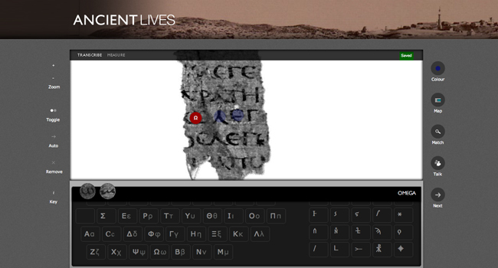
Community Metadata:
Crowdsourcing

Slide 10
Sources of File Type Metadata
Capture:
  MyDocument.xls
  Attachment MIME type
Extraction
  “Magic bytes”
Classification
  Machine learning on byte sequences
Manual
  Mechanical Turk

Slide 11
Metadata Challenges
Balancing cost and benefit
Accommodating dynamic factors
  Content
  Location
Reuse for unanticipated purposes
Remaining interpretable in the far future

Slide 12
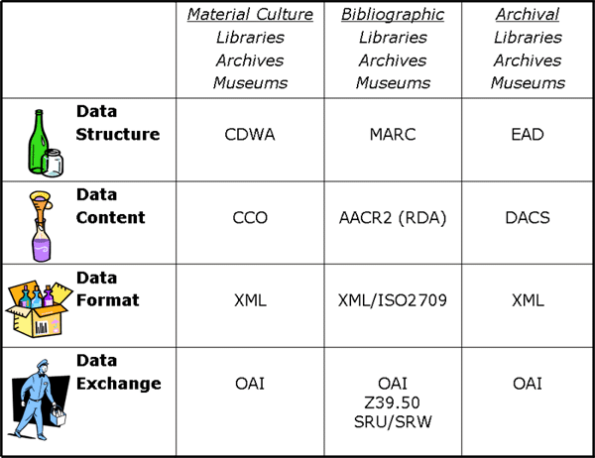
Putting It All Together
Adapted from Elings and Waibel, First Monday, (12)3, 2007

Slide 13
Some Types of “Metadata”
Descriptive
  Content, creation process, relationships
Technical
  Format, system requirements
Administrative
  Acquisition, authentication, access rights
Preservation
  Media migration
Usage
  Display, derivative works
Adapted from
Introduction to Metadata,
Getty Information Institute (2000)

Slide 14




Aspects of Metadata
Framework
  Functional Requirements for Bibliographic Records (FRBR)
Schema (“Data Fields and Structure”)
  Dublin Core
Guidelines (“Data Content and Values”)
  Resource Description and Access (RDA)
  Library of Congress Subject Headings (LCSH)
Representation (abstract “Data Format”)
  Resource Description Framework (RDF)
Serialization (“Data Format”)
  RDF in eXtensible Markup Language (RDF/XML)
Adapted from Elings and Waibel, First Monday, (12)3, 2007

Slide 15
Fostering Consistency
Content Standards
  Resource Description and Access (RDA)
  Describing Archives: a Content Standard (DACS)
Authority Control
  Subject Authority
  Name authority

Slide 16
FRBR Entity Types
Subject-Only Entities
  (abstract) Concepts
  (tangible) Objects
  (any kind of) Places
  Events
Subject or Responsibility Entities
  Persons
  (any kind of) “Corporate” Bodies
  Families (technically, only in FRAD)
Product Entities
  Works, Expressions, Manifestations, Items

Slide 17
Work
Expression
Manifestation
Item
is owned by
Person
is produced by
Family
is realized by
is created by
Corporate Body
many
Notes:
17
17
Let’s now move on to relationships for the Group 2 entities: person, family, and corporate body.
You see the relationships with the Group 1 entities in this picture:
work is created by a person, family, or corporate body
expression is realized by a person, family, or corporate body
manifestation is produced by a person, family, or corporate body
item is owned by a person, family, or corporate body.
The names of these Group 2 entities are controlled when they are used as access points in bibliographic records.
In the future we expect to see the names linked to descriptions of the resources and the links would indicate the specific type of relationship.

Slide 18
Work
The idea or impression in the mind of its creator
  Completely abstract, no physical form
What all forms, presentations, publications, or performances of a work have in common
  Romeo & Juliet
  Homer’s Odyssey
  Debussy’s Syrinx

Slide 19
Expression (Realization)
A work formulated into an ordered presentation
When a work takes a form
  Can be notational, aural, kinetic, etc.
Excludes aspects of form not integral to the work
  Font, layout, etc. (with some exceptions)
Attributes: Form, Language

Slide 20
Manifestation
Physical embodiment of an expression
  The level usually described via cataloging
Set of physical objects that bear the same:
  intellectual content (expression), and
  physical form (item)
May have one or many items
  Mona Lisa, Gone with the Wind, …
Attributes
  Format, Physical medium, Manufacturer

Slide 21
Item
Instance of a manifestation
  A thing!
Attributes:
  Owned by, Location, Condition

Slide 22
Family of Works
Equivalent
Derivative
Descriptive
Free
Translation
Review
Microform
Reproduction
Edition
Summary
Casebook
Simultaneous
“Publication”
Abridged
Edition
Abstract
Dramatization
Digest
Novelization
Criticism
Screenplay
Copy
Libretto
Revision
Illustrated
Edition
Evaluation
Change of Genre
Exact
Reproduction
Parody
Translation
Expurgated
Edition
Annotated
Edition
Imitation
Variations or Versions
Same Style or
Thematic Content
Facsimile
Arrangement
Commentary
Reprint
Slight
Modification
Adaptation
Original Work - Same Expression
Same Work –
New Expression
New Work
Cataloging Rules Cut-Off Point
RDA for Georgia, 2011
Notes:
22
This picture shows a continuum of the relationships within a family of works as represented in manifestations <click> moving from left to right following this red arrow On the left <click> are those that are equivalent content, that are from the same expression of the same work. Once we introduce a change to the content, like a translation, <click> we have a new expression of the same work - and as we make further changes to the content we move further to the right, farther away from the original work. These are derivative expressions of the same work. Once that derivation crosses the <click> “magic line” of becoming more of the work of another person or corporate body, we consider it a new work, but it is part of the family of related works, even when the content moves on to be only describing <click> a work in the family at the right end of this continuum. Works in a descriptive relationship can also be said to be in a subject relationships, because the subject of those works is another work – as with a commentary on a work.
The ability to inform the user of these related works ties back to the ** collocating and finding functions of a catalog. We need to show users the pathways to related materials. The FRBR model reminds us of these important relationships that we should reflect in our catalogs and resource discovery systems for our users.

Slide 23
FRBR Bibliographic User Tasks
Find it
  Search (“to find”)
  Recognize (“to identify”)
  Choose (“to select”)
Serve it
  Location (“to obtain”)

Slide 24
Resource Description & Access (RDA)
RDA metadata describes entities associated with a resource to help users perform the following tasks:
  Find information on that entity and on resources associated with the entity
  Identify: confirm that the entity described corresponds to the entity sought, or to distinguish between two or more entities with similar names, etc.
  Clarify the relationship between two or more such entities, or to clarify the relationship between the entity described and a name by which that entity is known
  Understand why a particular name or title, or form of name or title, has been chosen as the preferred name or title for the entity

Slide 25
Components of RDA
“Elements” (Attributes)
  Of manifestations and items
  Of works and expressions
  Of persons and corporate bodies
  Of concepts
Relationships
  Among product entities
    Content entities: work, expression, manifestation, item
  Between product and responsibility entities
    Responsibility entities: person, family, corporate body
  Between works and subject entities
    Subject entities: concepts, objects, places, events

Slide 26
Bibliographic Relationships
Equivalence: exact (or nearly exact) copies
  mp3 recording burned from a CD, …
Derivative: work based on/derived from another
  Updated edition, adaptation, …
Descriptive: work that describes another work
  Criticism, commentary, summary (e.g., Cliffs Notes), …

Slide 27
More Bibliographic Relationships
  Whole-part: One work is part of another work
    Volume in an encyclopedia, chapter in a book, …
  Accompanying: A work meant to go with another work
    Math workbook w/ textbook, index, documentation, …
  Sequential: Work precedes/continues an existing work
    Issues of a publication, sequels/prequels, …
  Shared characteristic: Something in common
    Author, title, language, subject, …

Slide 28
Some RDA Elements for Products
Work
  ID
  Title
  Date
  etc.
Expression
  ID
  Form
  Date
  Language
  etc.
Manifestation
  ID
  Title
  Statement of responsibility
  Edition
  Imprint (place, publisher, date)
  Form/extent of carrier
  Terms of availability
  Mode of access
  etc.
Item
  ID
  Provenance
  Location
  etc.
RDA for Georgia, 2011
Notes:
28
Remember this slide from the earlier presentation that lists the elements that identify each of the FRBR Group 1 entities.

Slide 29
RDA: Person
“An individual or an identity established by an individual (either alone or in collaboration with one or more other individuals)”
Includes fictitious entities
  Miss Piggy, Snoopy, etc. in scope if presented as having responsibility in some way for a work, expression, manifestation, or item
Also includes real non-humans
  Only in US RDA test
RDA for Georgia, 2011
Notes:
In RDA a person can be an individual or an entity established by one individual alone or an identity established in collaboration with one or more other individuals. The scope statement at RDA 9.0 includes fictitious entities as persons. So, they can now be represented by authorized access points as creators or whatever role they play if they are presented on the resource as being responsible in some way .

Slide 30
RDA Person Examples
100 0# $a Miss Piggy.
245 10 $a Miss Piggy’s guide to life / $c
by Miss Piggy as told to Henry Beard.
700 1# $a Beard, Henry.
100 0# $a Lassie.
245 1# $a Stories of Hollywood / $c told
by Lassie.
RDA for Georgia, 2011
Notes:
Follow the same RDA instructions for the access points for fictitious entities and real non-human entities as you would for any other persons. What kind of name is it? A phrase? A given name? Apply the appropriate instruction. Don’t add a qualifier just to signal that the entity is not a human being; so, for example, don’t add “fictitious character” to the first example or “dog” to the second example here.

Slide 31
RDA: Language and Script
Names:
  USA: In authorized and variant access points, apply the alternative to give a romanized form.
  For some languages, can also give variant access points in original language/script
Other elements:
  If RDA instructions don’t specify language, give element in English
Notes:
RDA gives you choices for language and script of the name of these entities just as it does for works. There is an alternative agencies may choose to apply: to give a transliterated form as a substitute if the title is given in a non-latin script in accordance with the principle of the convenience of the user.

Slide 32
RDA: Preferred Name
Used as the “authorized” (i.e., canonical) access point
Choose the form most commonly known
Variant spellings:
  Choose the form found on the first resource received
If individual has more than one identity
  Construct a preferred name for each identity
RDA for Georgia, 2011
Notes:
So, let’s start creating an authorized access point for a person.
The preferred name is the base for constructing the authorized access point when it is used in a bibliographic record or as the 100 in a name authority record. The variant name is used in see references, known in RDA as variant access points, in name authority records.
If the person has more than one identity, there are no longer any time period restrictions on establishing separate access points for each identity.
Another change from AACR2 related to variant spellings of the person’s name is to use the form found on the first resource received.

Slide 33
RDA: Additions to Preferred Name
title or other designation associated with person
date of birth and/or death * ^
fuller form of name * ^
period of activity of person * ^
profession or occupation *
field of activity of person *
* = if need to distinguish; ^ = option to add even if not needed
RDA for Georgia, 2011
Notes:
Here are those six possible additions. The symbols are a shorthand for the information you’ll find in those instructions about each element’s “core if” status and the existence of an option to add the information even if it’s not needed to differentiate between names for different persons.

Slide 34
RDA: Surnames Indicating Relationships
Include words, etc., (e.g., Jr., Sr., IV) in preferred name – not just to break conflict
100 1# $a Rogers, Roy, $c Jr., $d 1946-
## $a Growing up with Roy and Dale, 1986:
$b t.p.(Roy Rogers, Jr.) p. 16 (born
1946)
RDA for Georgia, 2011
Notes:
Another change from AACR2 is to include words or numerals indicating relationships in the preferred name; under AACR2, such words/numerals can be used only as additions to break conflicts.
In this example, the date already makes the access point unique; the AACR2 form would not include “Jr.”
However, during the Test, we didn’t change how that term is given in MARC; we continued to give it in subfield $c rather than making it be part of subfield $a.

Slide 35
RDA: Terms of Address When Needed
When the name consists only of the surname
  (Seuss, Dr.)
For a married person identified only by a partner’s name and a term of address
  (Davis, Maxwell, Mrs.)
If part of a phrase consisting of a forename(s) preceded by a term of address
  (Sam, Cousin)
RDA for Georgia, 2011
Notes:
Terms of address (Dr., Mrs., etc.) in RDA cannot be used as additions to names. But they will be “legal” as part of a preferred name in the three situations listed on this slide.

Slide 36
RDA: Profession or Occupation
Core:
  for a person whose name consists of a phrase or appellation not conveying the idea of a person, or
  if needed to distinguish one person from another with the same name
Overlap with “field of activity”
100 1# $a Watt, James $c (Gardener)
RDA for Georgia, 2011
Notes:
Also from FRAD, Field of activity is a core element in two different situations:
1) when the name of the person doesn’t convey the idea of a person; or
2) when this information is needed to distinguish one name from another.
Sometimes it is difficult to determine what is Field of activity vs. Profession or occupation. (In the future there may be a proposal to IFLA to merge these two attributes in FRAD.)
Now in MARC subfield $c, this element also will always be enclosed in parentheses; the AACR2 practice is to use different punctuation depending on the type of name (given name, etc., vs. surname, etc.).

Slide 37
RDA: Field of Activity of Person
Field of endevor, area of expertise, etc., in which a person is or was engaged
Core:
  For a person whose name consists of a phrase or appellation not conveying the idea of a person, or
  If needed to distinguish one person from another with the same name
100 0# $a Spotted Horse $c (Crow Indian chief)
RDA for Georgia, 2011
Notes:
Field of activity, from FRAD, is a core element in two different situations:
1) when the name of the person doesn’t convey the idea of a person; or
2) when this information is needed to distinguish one name from another.
Now in MARC subfield $c, this element will always be enclosed in parentheses; the AACR2 practice is to use different punctuation depending on the type of name (given name, etc., vs. surname, etc.).
Are there any questions about the elements for constructing an authorized access point for a person?

Slide 38
RDA: Associated Date for Person
Three dates:
  Date of birth
  Date of death
  Period of activity of the person
Guidelines for probable dates are in RDA 9.3.1
RDA for Georgia, 2011
Notes:
There are three dates associated with a person. The Period of activity information is used to break a conflict only when the fuller form of name is not available – remember the order on slide 14 as given in RDA 9.19.
RDA does not have any restrictions on time period for giving “period of activity” information as AACR2 does.
Guidelines for giving probable dates for any of the three dates are in RDA 9.3.1.

Slide 39
RDA: Associated Place for Person
Place of birth
Place of death
Country associated with the person
Place of residence
RDA for Georgia, 2011
Notes:
We won’t talk about these non-access point elements on this and subsequent slides but you’ll have the information here and you can read more in the RDA text.

Slide 40
DACS Principles
Records in archives possess unique characteristics.
The principle of respect des finds is the basis of archival arrangement and description.
Arrangement involves identification of groupings within material.
Description reflects arrangement.
The rules of description apply to all archival materials regardless of form or medium.
The principles of archival description apply equally to records created by corporate bodies, individuals, or families.
Archival descriptions may be presented at varying levels of detail to produce a variety of outputs.
The creators of archival materials, as well as the materials themselves, must be described.

Slide 41
(Single-Level) DACS Elements
Required
Optional
Reference code
Name+location of repository
Title
Date
Extent
Name of creator(s)
Scope and content
Conditions governing access
Languages and scripts
Plus, for “Optimal”
  Administrative/biographical history
  Access points
System of arrangement
Physical access
Technical access
Conditions for reproduction and use
(other) Finding aids
Custodial history
Immediate source of acquisition
Appraisal, destruction, scheduling
Accruals (anticipated additions)
Existence+location of originals
Existence+location of copies
Related archival materials
Publication note
Notes
Description control

Slide 42
Authority Control
Unify references to the same entity (synonyms)
  Samuel Clemens, Mark Twain
Distinguish references to different entities (homonyms)
  Michael Jordan (basketball), Michael Jordan (computers)
Establish “access points”
  Canonical and variant forms, to better support “find it” tasks

Slide 43
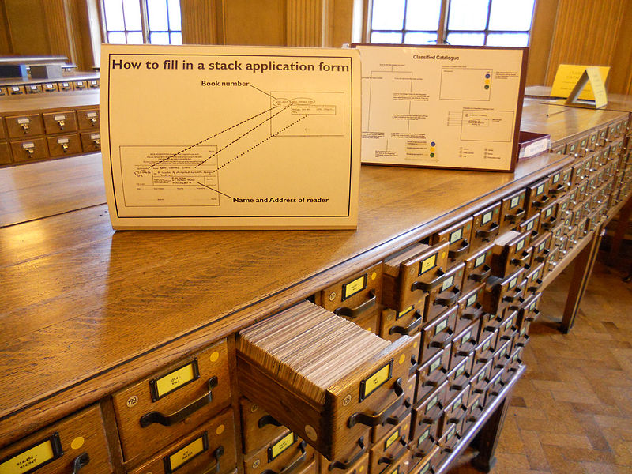
Access Points
Originally designed for card catalogs
  One card for every “authorized” access point
Four types “dictionary” catalog access points
  Title (uniform titles)
  Author (name authority)
  Subject (controlled vocabulary)
  Series
Other things can serve a similar purpose
  Call number (shelf order)
  “Keywords” (full-text search)

Slide 44
Functional Requirements for Authority Data (FRAD)
Name
  Canonical form for display to users
Identifier
  Canonical form for use by systems
Controlled access points
  Forms that can be used as a basis for access
Rules
  For creating access points
Agency
  Organization responsible for creating access points

Slide 45
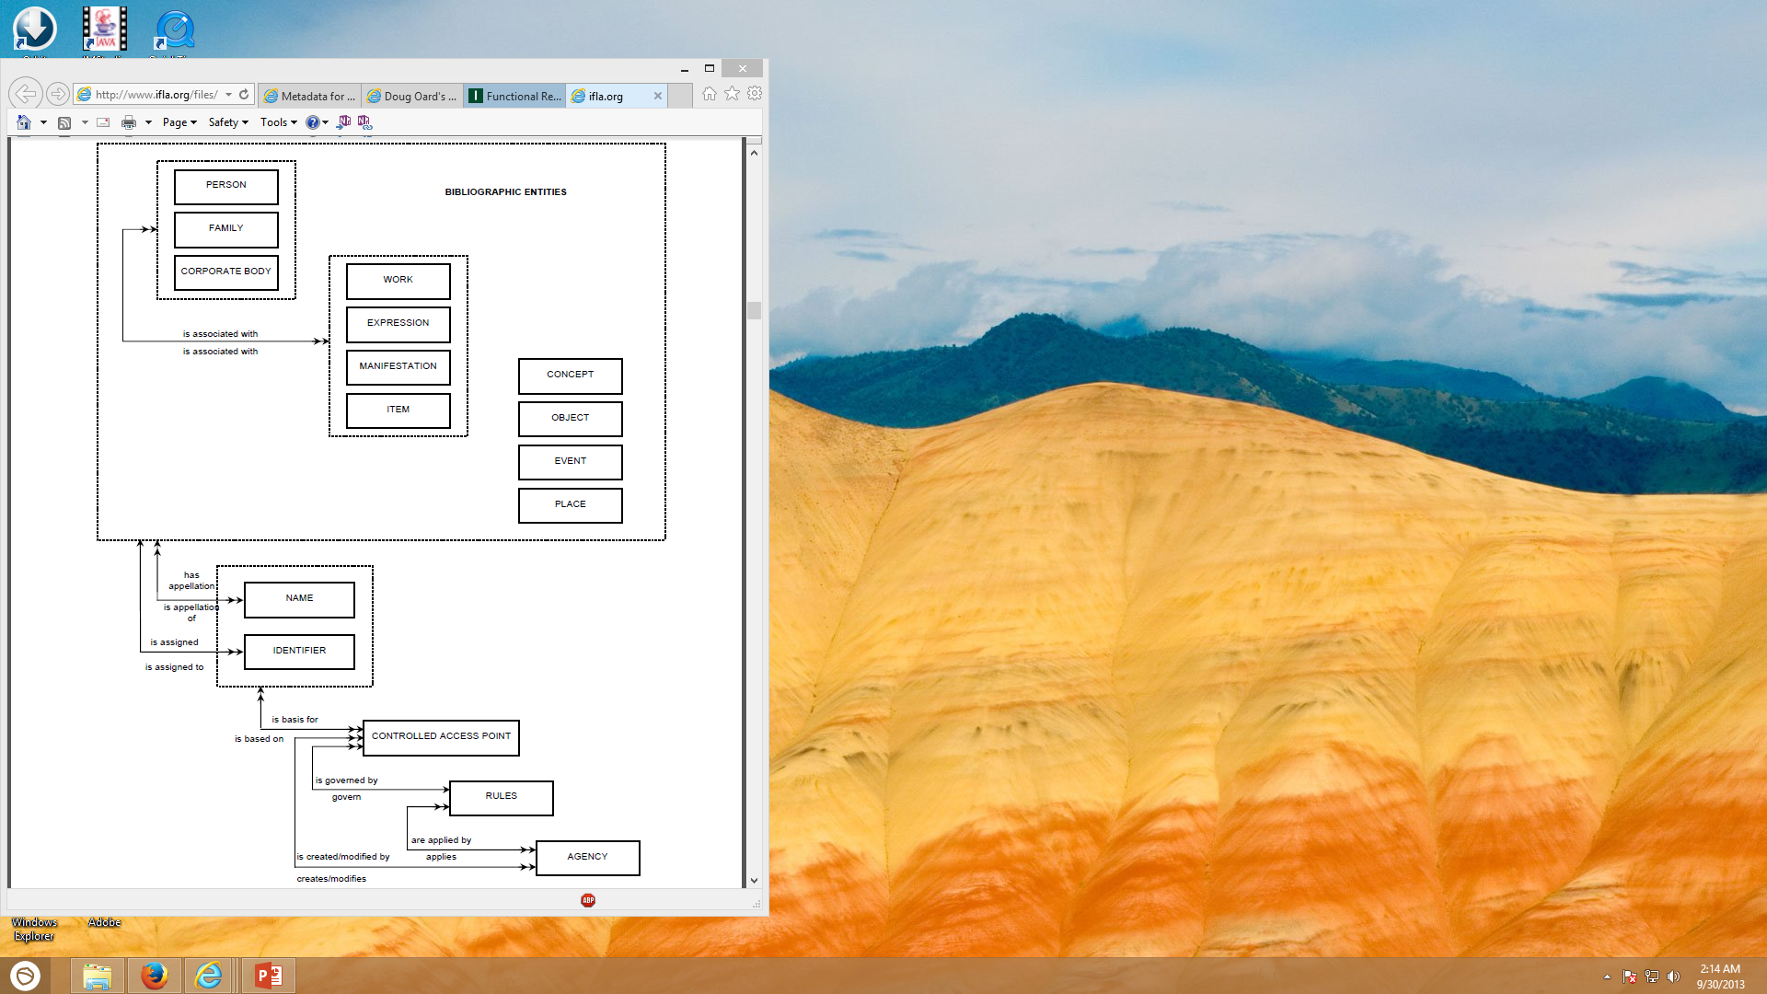
Functional Requirements for Authority Data
IFLA, 2013

Slide 46
FRBR Bibliographic User Tasks
Find it
  Search (“to find”)
  Recognize (“to identify”)
  Choose (“to select”)
Serve it
  Location (“to obtain”)

Slide 47
FRAD Authority Control User Tasks
Searcher tasks
  Find
  Identify
Authority control tasks
  Contextualize
  Justify

Slide 48
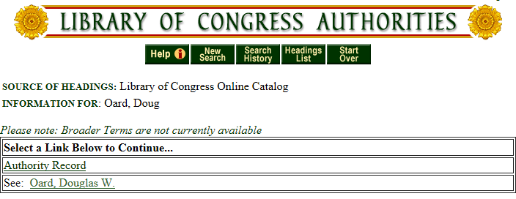
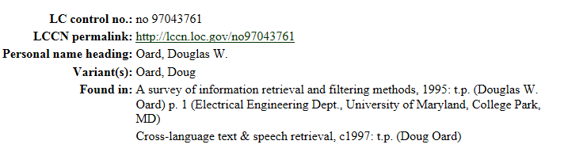
http://authorities.loc.gov/

Slide 49
Hands On
Find the authoritative LC name for one of ...
  http://ischool.umd.edu/faculty-staff/jennifer-j-preece
  http://www.umiacs.umd.edu/~jimmylin/
  http://terpconnect.umd.edu/~pwang/
  http://en.wikipedia.org/wiki/Robert_S._Taylor
  http://en.wikipedia.org/wiki/Hans_Peter_Luhn

Slide 50
Classification
Classification
  A system for organizing knowledge
Notation
  Expressing the classification in a systematic way

Slide 51
Library of Congress Subject Headings
Controlled vocabulary for subject access points
  Most commonly applied to books and serials
Used when a subject describes ≥20% of the work
Choose the most specific appropriate headings
  But if more than 3 subtopics, choose a broader heading

Slide 52
LCSH Subdivisions
Topical
  Archaeology – Methodology
Form
    Archaeology – Fiction
Chronological
    Archaeology – History – 18th century
Geographic
    Archaeology – Egypt

Slide 53
Hands On
Find the LCSH for one of:
  http://www.mayoclinic.com/health/heart-attack/DS00094
  http://en.wikipedia.org/wiki/AS-204
  http://www.apollotheater.org/
  http://www.flickr.com/photos/usnationalarchives/4153755504/
  http://en.wikipedia.org/wiki/Operation_Entebbe

Slide 54
Before You Go!
On a sheet of paper (no names), answer the following question:
What was the muddiest point in today’s class?

