Slide 1

Metadata
Week 4
LBSC 671
Creating Information Infrastructures

Slide 2
Muddiest Points
Memory madness
  Hard drives, DVD’s, solid state “disks,” tape, …
Digitization
  Images, audio, video, compression, file names, …
Where LOCKSS fits in all this
Digital preservation vs. digitization for preservation

Slide 3
Tonight
Finishing Preservation
Metadata

Slide 4
Preserving Behavior
Word processors
  Formatting, track changes, undo deleted text
Spreadsheets
  Formulas, visualizations
Databases
  Queries, forms, derived values
Computer-Assisted Design (CAD)
  Display, modification, manufacturing
Software
  Simulation, games, embedded systems, …

Slide 5
Behavior Preservation Strategies
Format migration
  For example, convert Word Perfect to PDF
Emulation
  Allows running old software on newer systems

Slide 6
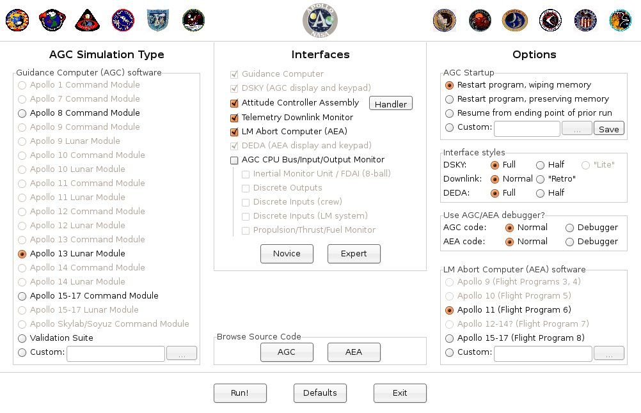
Apollo Guidance Computer Emulation
http://www.ibiblio.org/apollo/

Slide 7
An Integrated Strategy
Delay decay of organic materials
  But balance costs and benefits
Balance quality and scale
  Preservation: rescue at-risk collections
  Access: Quantity has a quality all its own
Design in diversity
  Technologies, risk exposure, institutions
Adequately resource the process

Slide 8
Tonight
Finishing Preservation
Metadata

Slide 9
Two Ways of Searching
Controlled
Vocabulary
Searcher
Free-Text
Searcher
Author
Indexer
Construct query from
terms that may
appear in documents
Write the document
using terms to
convey meaning
Choose appropriate
concept descriptors
Construct query from
available concept
descriptors
Content-Based
Query-Document
Matching
Metadata-Based
Query-Document
Matching
Query Terms
Document Terms
Document Descriptors
Query Descriptors
Retrieval Status Value

Slide 10
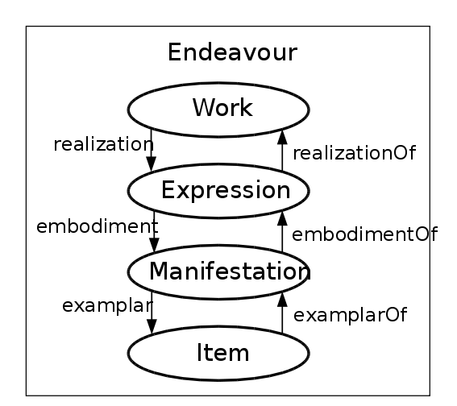
Functional Requirements for Bibliographic Records (FRBR)
Midsummer Night’s
Dream
2005 Free for All
August 23
Performance
Seat 23G

Slide 11
FRBR Bibliographic User Tasks
Find it
  Search (“to find”)
  Recognize (“to identify”)
  Choose (“to select”)
Serve it
  Location (“to obtain”)

Slide 12
FRBR Entity Types
Subject-Only Entities
  (abstract) Concepts
  (tangible) Objects
  (any kind of) Places
  Events
Subject or Responsibility Entities
  Persons
  “Corporate” Bodies (~any kind of organization)
  Families (technically, only in FRAD)
Product Entities
  Works, Expressions, Manifestations, Items

Slide 13
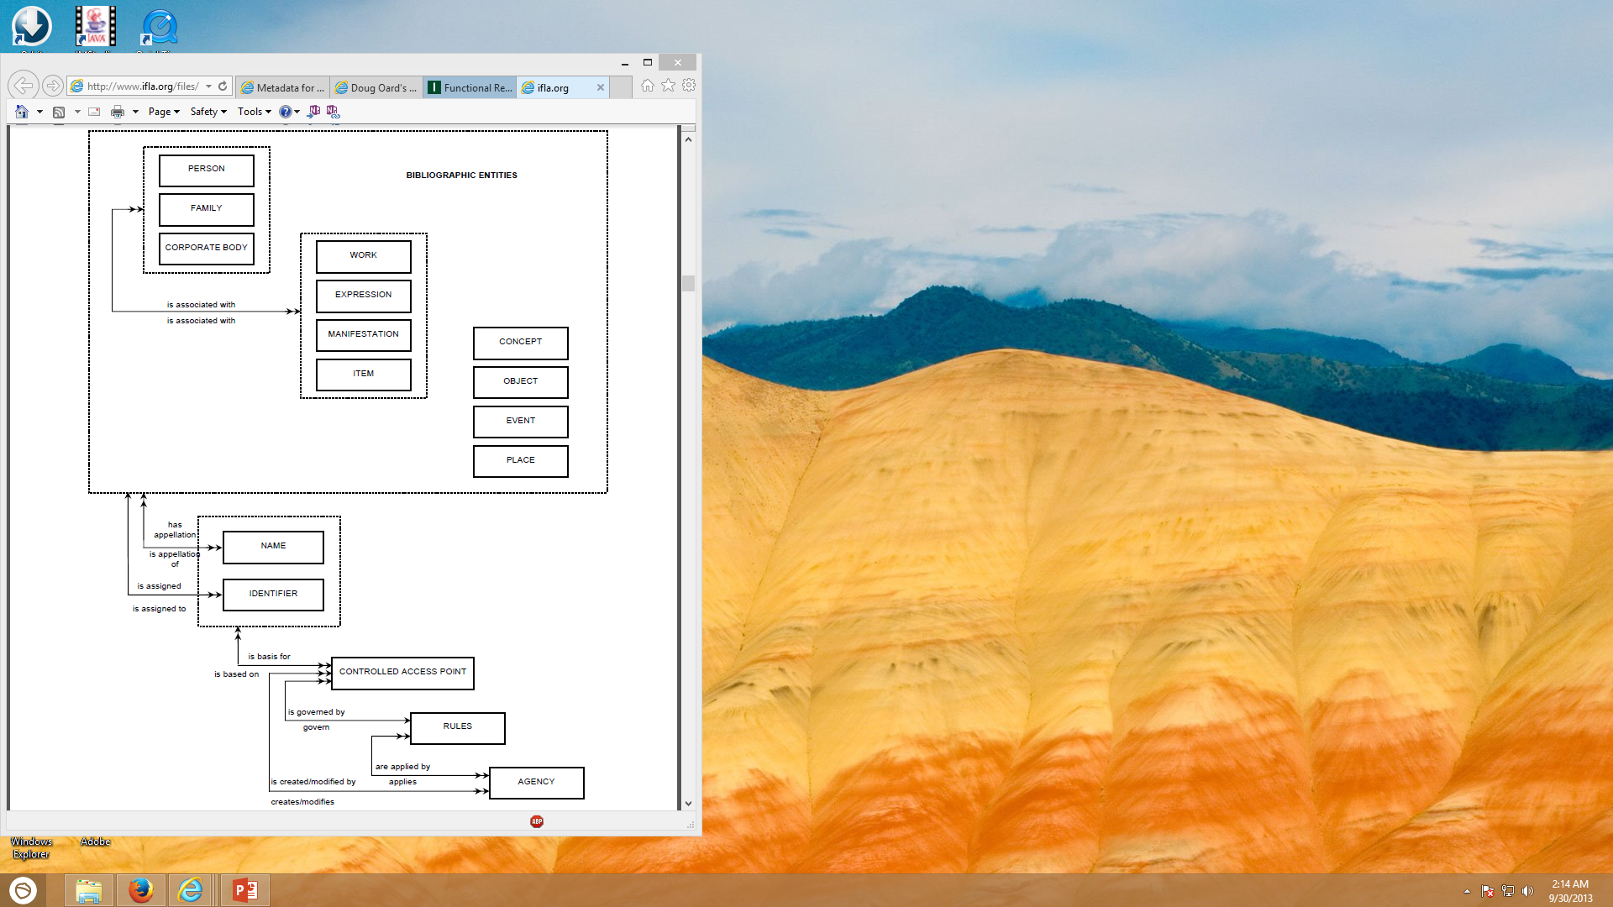
Functional Requirements for Authority Data
IFLA, 2013

Slide 14
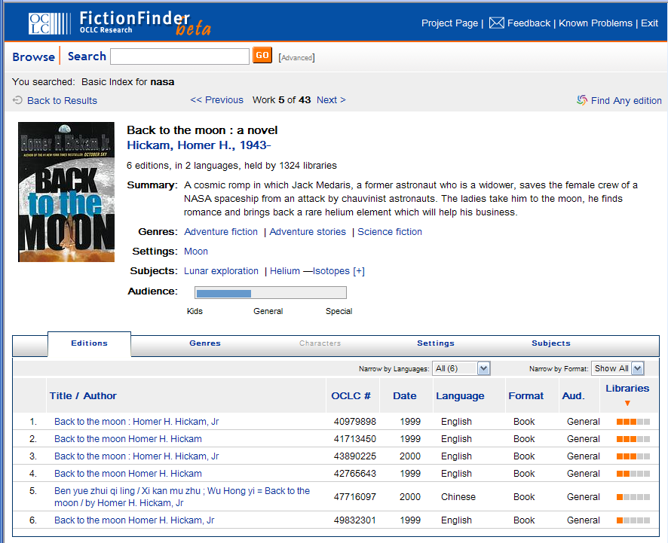
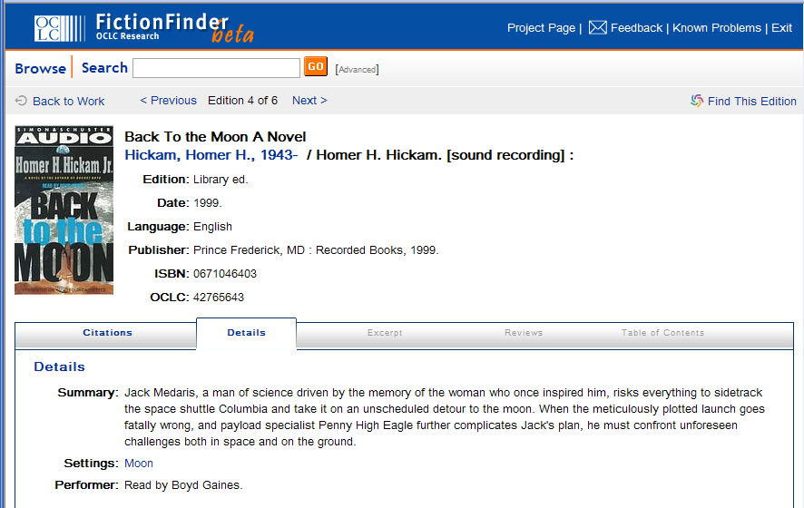
FRBR in OCLC’s FictionFinder

Slide 15
Dublin Core
Goals:
  Easily understood, implemented and used
  Broadly applicable to many applications
Approach:
  Intersect several standards (e.g., MARC)
  Suggest only “best practices” for element content
Implementation:
  Initially 15 optional and repeatable “elements”
    Refined using a growing set of “qualifiers”
  Now extended to 22 elements

Slide 16
Dublin Core Elements (version 1.1)
Content
Title
Subject [LCSH, MeSH, …]
Description
Type
Coverage [spatial, temporal, …]
Related resource
Rights
Instantiation
Date [Created, Modified, Copyright, …]
Format
Language
Identifier [URI, Citation, …]
Responsibility
Creator
Contributor
Source
Publisher

Slide 17
Resource Description Framework
XML schema for describing resources
Can integrate multiple metadata standards
  Dublin Core, P3P, PICS, vCARD, …
Dublin Core provides a XML “namespace”
  DC Elements are XML “properties
    DC Refinements are RDF “subproperties”
  Values are XML “content”

Slide 18
Dublin Core in RDF XML
<rdf:RDF
xmlns:rdf="http://www.w3.org/1999/02/22-rdf-syntax-ns#"
xmlns:dc="http://purl.org/dc/elements/1.1/">
<rdf:Description
rdf:about="http://media.example.com/audio/guide.ra">
<dc:creator>Rose Bush</dc:creator>
<dc:title>A Guide to Growing Roses</dc:title>
<dc:description>Describes process for planting and nurturing
different kinds of rose bushes.</dc:description>
<dc:date>2001-01-20</dc:date>
</rdf:Description>
</rdf:RDF>

Slide 19




Aspects of Metadata
Framework
  Functional Requirements for Bibliographic Records (FRBR)
Schema (“Data Fields and Structure”)
  Dublin Core
Guidelines (“Data Content and Values”)
  Resource Description and Access (RDA)
  Library of Congress Subject Headings (LCSH)
Representation (abstract “Data Format”)
  Resource Description Framework (RDF)
Serialization (“Data Format”)
  RDF in eXtensible Markup Language (RDF/XML)
Adapted from Elings and Waibel, First Monday, (12)3, 2007

Slide 20
Some Types of “Metadata”
Descriptive
  Content, creation process, relationships
Technical
  Format, system requirements
Administrative
  Acquisition, authentication, access rights
Preservation
  Media migration
Usage
  Display, derivative works
Not in
Taylor &
Joudrey
Adapted from
Introduction to Metadata,
Getty Information Institute (2000)

Slide 21
Metadata Encoding and Transmission Standard (METS)
Descriptive metadata (e.g., subject, author)
Administrative metadata (e.g., rights, provenance)
Technical metadata (e.g., resolution, color space)
Behavior (which program can render this?)
Structural map (e.g., page order)
  Structural links (e.g., Web site navigation links)
Files (the raw data)
Root (meta-metadata)

Slide 22
Aspects of Metadata
What kinds of objects can we describe?
  MARC, Dublin Core, FRBR, …
How can we convey it?
  MODS, RDF, OAI-PMH, METS
What can we say?
  LCSH, MeSH, PREMIS, …
What can we do with it?
  Discovery, description, reasoning

Slide 23
FRBR Bibliographic User Tasks
Find it
  Search (“to find”)
  Recognize (“to identify”)
  Choose (“to select”)
Serve it
  Location (“to obtain”)

Slide 24
Broader View of Metadata Uses
Have it
  Preservation (e.g., PREMIS)
  Validation
  Disposition
Find it
  Search/Recognize/Choose
  Browse (“Navigation”)
Serve it
  Persistent location
  Structure
  Surrogates
Use it
  Context
  Rights management
  User behavior capture
  Reasoning (“Semantic Web”)

Slide 25
Metadata Sources
Automated
  Capture
  Extraction
  Classification
Manual
  Professional
  Community
  Personal

Slide 26
Metadata Capture:
Exchangeable Image Format (EXIF)
Time
Location
Camera manufacturer and model
Camera orientation
Exposure information (shutter speed, f stop)
Thumbnail versions
  Altering the image may not change the thumbnail!

Slide 27
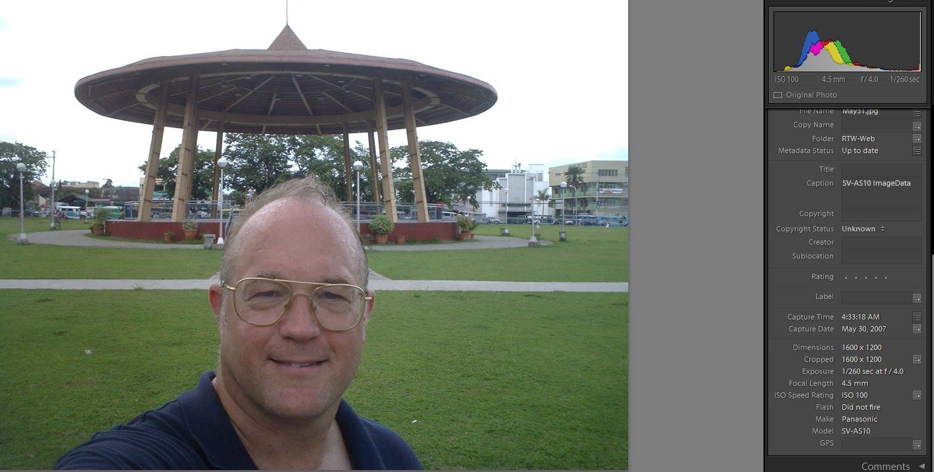
Inconsistent Metadata
http://www.umiacs.umd.edu/~oard/rtw/

Slide 28
Metadata Capture: Email
Message metadata
  Times
    Sent
    Resent
    Received
  Route
  In-reply-to
  Attachment file type
System metadata
  Folder

Slide 29
Metadata Capture:
Windows File System (NTFS)
Time file created (or copied)
  Most recent one; optionally “journaled”
Time file content changed (or made changeable)
  Most recent one; optionally “journaled”
Time file renamed (or moved)
  Most recent one
Time file metadata created or changed
  Most recent one
Time file accessed (content or metadata)
  Most recent one; optionally disabled

Slide 30
Metadata Capture:
Microsoft Word
Author
Title
Dates (may not agree with file system)
  Created
  Modified
  Accessed
  Printed
  Each tracked change

Slide 31
Metadata Capture: User Behavior
Minimum Scope
Segment
Object
Class
Examine
View
Select
Listen
Retain
Print
Bookmark
Save
Purchase
Subscribe
Delete
Behavior Category
Reference
Copy / paste
Forward
Quote
Reply
Link
Cite
Annotate
Mark up
Tag
Organize
Publish
Create
Type
Edit

Slide 32
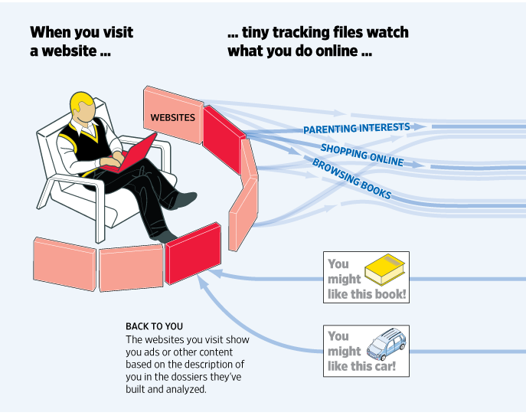
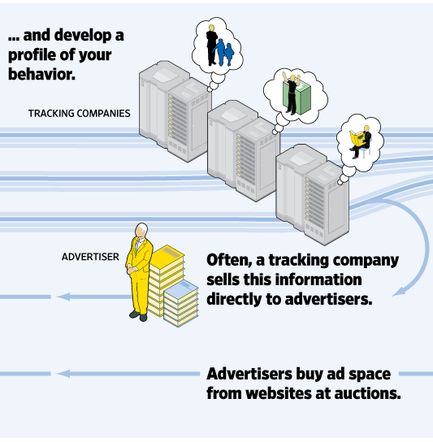
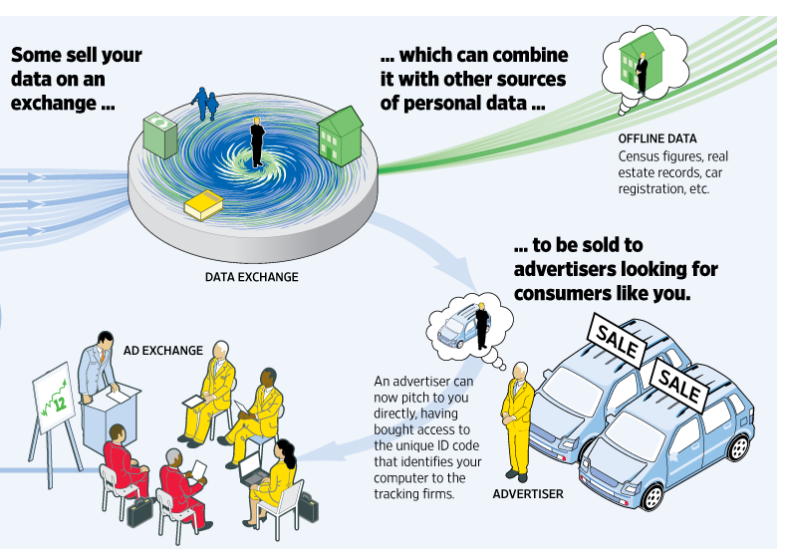
Exploiting Behavioral Metadata
http://wsj.com/wtk

Slide 33
Metadata Extraction:
Named Entity “Tagging”
Machine learning techniques can find:
  Location
  Extent
  Type
Two types of features are useful
  Orthography
    e.g., Paired or non-initial capitalization
  Trigger words
    e.g., Mr., Professor, said, …

Slide 34
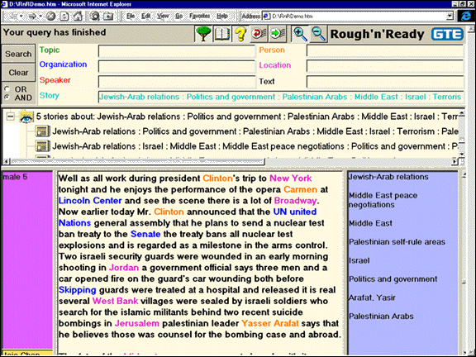

Slide 35
Metadata Sources
Automated
  Capture
  Extraction
  Classification
Manual
  Professional
  Community
  Personal

Slide 36
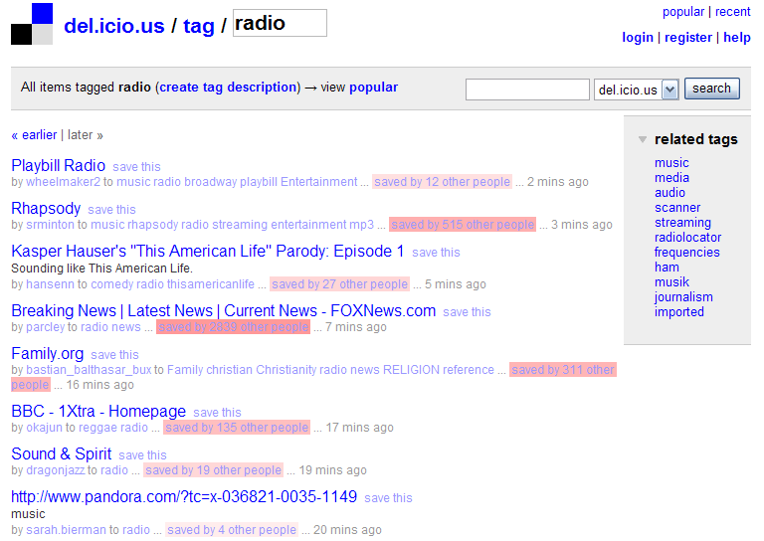
Community Metadata:
“Folksonomies”

Slide 37
Community Metadata:
Games With a Purpose
van Ahn and Dabbish, CHI 2004

Slide 38
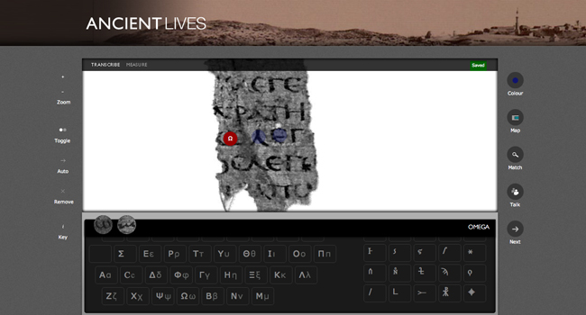
Community Metadata:
Crowdsourcing

Slide 39
Sources of File Type Metadata
Capture:
  MyDocument.xls
  Attachment MIME type
Extraction
  “Magic bytes”
Classification
  Machine learning on byte sequences
Manual
  Mechanical Turk

Slide 40
Metadata Challenges
Balancing cost and benefit
Accommodating dynamic factors
  Content
  Location
Reuse for unanticipated purposes
Remaining interpretable in the far future

Slide 41
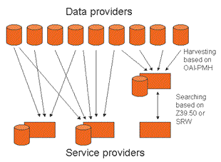
Open Archives Initiative-
Protocol for Metadata Harvesting
(OAI-PMH)

Slide 42
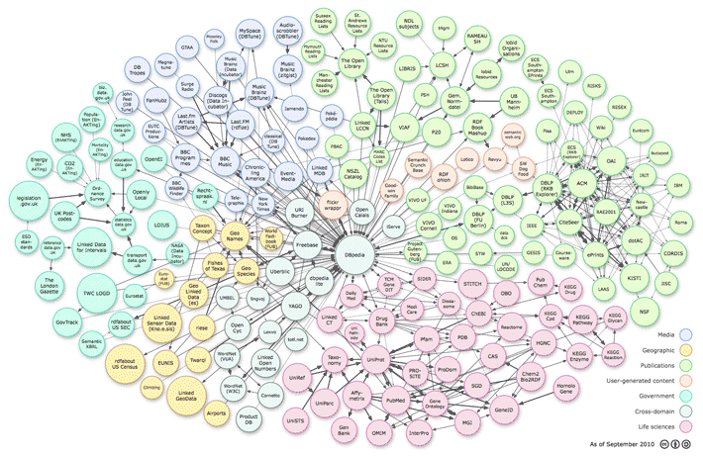
Linked Open Data

Slide 43
Web Ontology Language (OWL)
<owl:Class rdf:about="http://dbpedia.org/ontology/Astronaut">
<rdfs:label xml:lang="en">astronaut</rdfs:label>
<rdfs:label xml:lang="de">Astronaut</rdfs:label>
<rdfs:label xml:lang="fr">astronaute</rdfs:label>
<rdfs:subClassOf
rdf:resource="http://dbpedia.org/ontology/Person">
</rdfs:subClassOf>
</owl:Class>

Slide 44
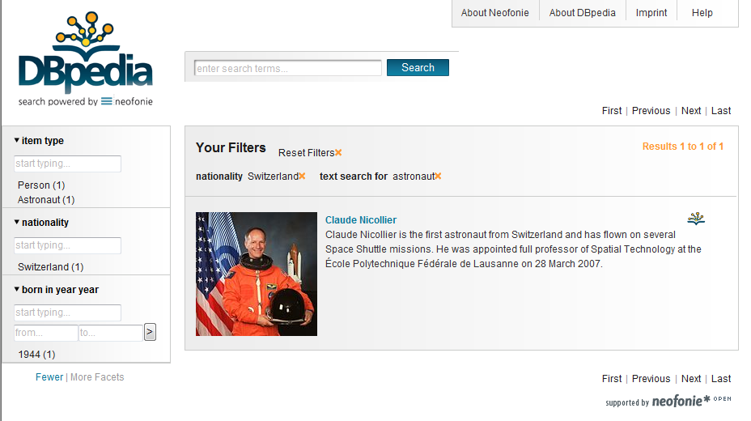
“Semantic Web” Search

Slide 45
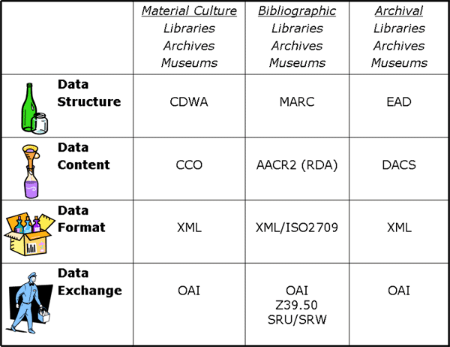
Putting It All Together
Adapted from Elings and Waibel, First Monday, (12)3, 2007

Slide 46
Before You Go!
On a sheet of paper (no names), answer the following question:
What was the muddiest point in today’s class?

