Slide 1
The User Experience
Week 15
LBSC 671
Creating Information Infrastructures

Slide 2
Tonight
Information architecture
Human-Computer Interaction (HCI)
Viruses and other nasty things
Open-source software

Slide 3
Information Architecture
The structural design of an “information space” to facilitate access to content
Consists of at least two components:
  Static design
  Interaction design

Slide 4
Static Design
Organizing Principles
  Logical: inherent structure
  Functional: by task
  Demographic: by user
Take advantage of metaphors
  Organizational: e.g., e-government
  Physical: e.g., online grocery store
  Functional: e.g., cut, paste, etc.
  Visual: e.g., octagon for stop

Slide 5
“Site Blueprint”
Main
Homepage
Teaching
Research
Other
Activities
LBSC 690
Ph.D.
Students
IR
Colloquium
INFM 718R
Publications
TREC
Doctoral
Seminar
Projects

Slide 6
Some Layout Guidelines
Contrast: make different things different
  to bring out dominant elements
  to create dynamism
Repetition: reuse design throughout the interface
  to create consistency
Alignment: visually connect elements
  to create flow
Proximity: make effective use of spacing
  to group related and separate unrelated elements

Slide 7
Screen Design: Use Grids
Navigation Bar
Navigation Bar
Content
Content
Navigation Bar
Related Links
Navigation Bar
Content
Content

Slide 8
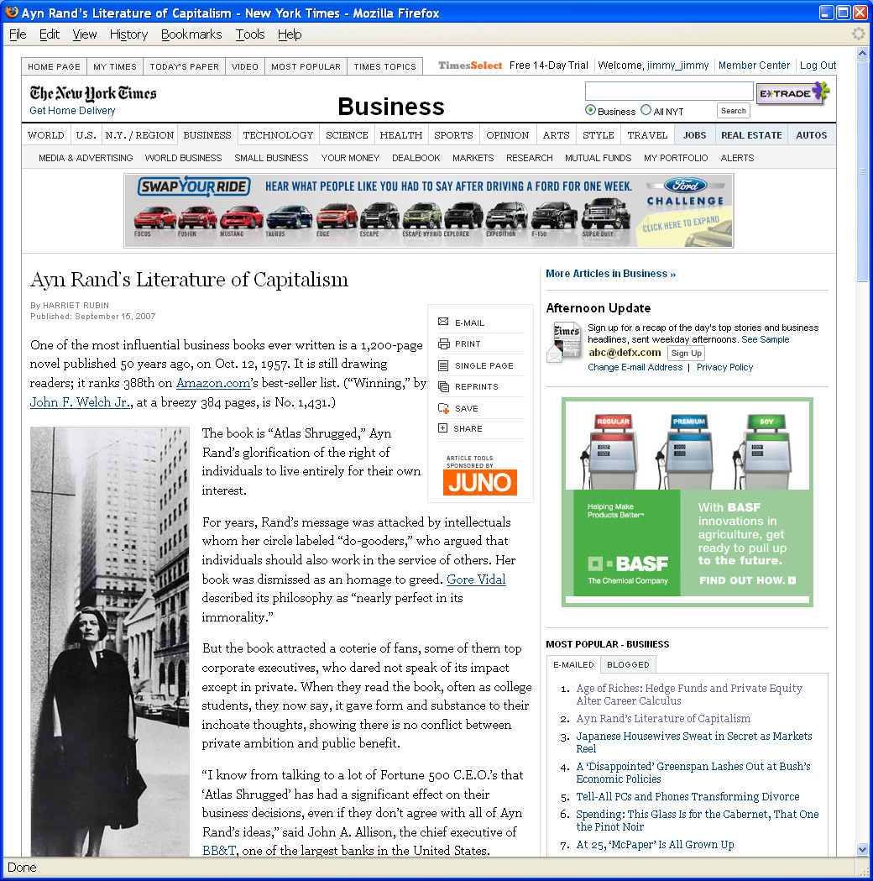
Grid Layout: NY Times

Slide 9
Grid Layout: NY Times
Navigation
Banner Ad
Another Ad
Content
Popular
Articles

Slide 10
Interaction Design
Chess analogy: a few simple rules that disguise an infinitely complex game
The three-part structure
  Openings: many strategies, lots of books about this
  End game: well-defined, well-understood
  Middle game: nebulous, hard to describe
Information navigation has a similar structure!
  Middle game is underserved
From Hearst, Smalley, & Chandler (CHI 2006)

Slide 11
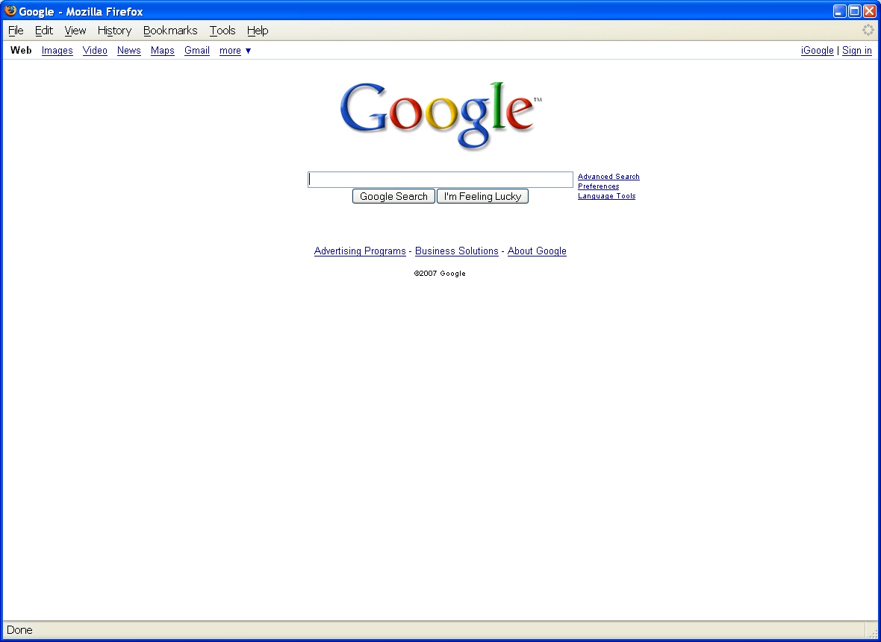
Opening Moves

Slide 12
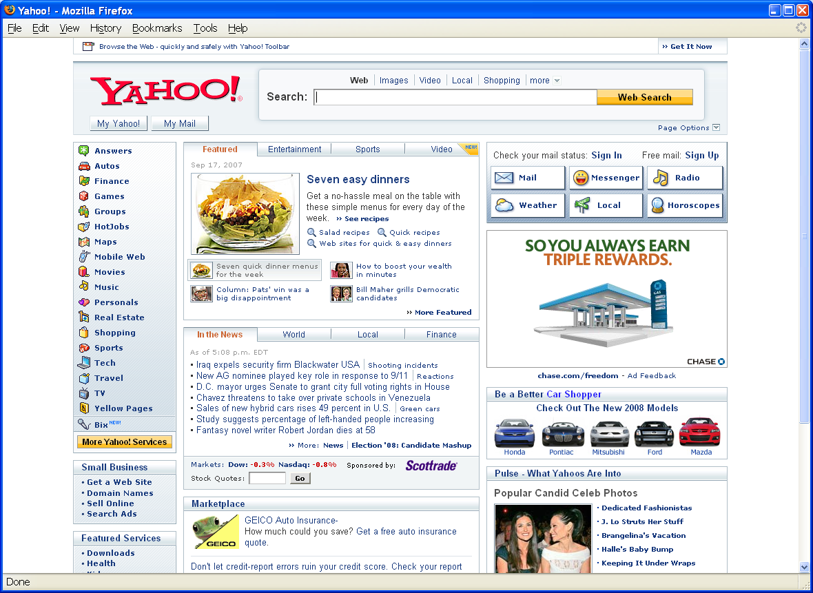
Opening Moves

Slide 13
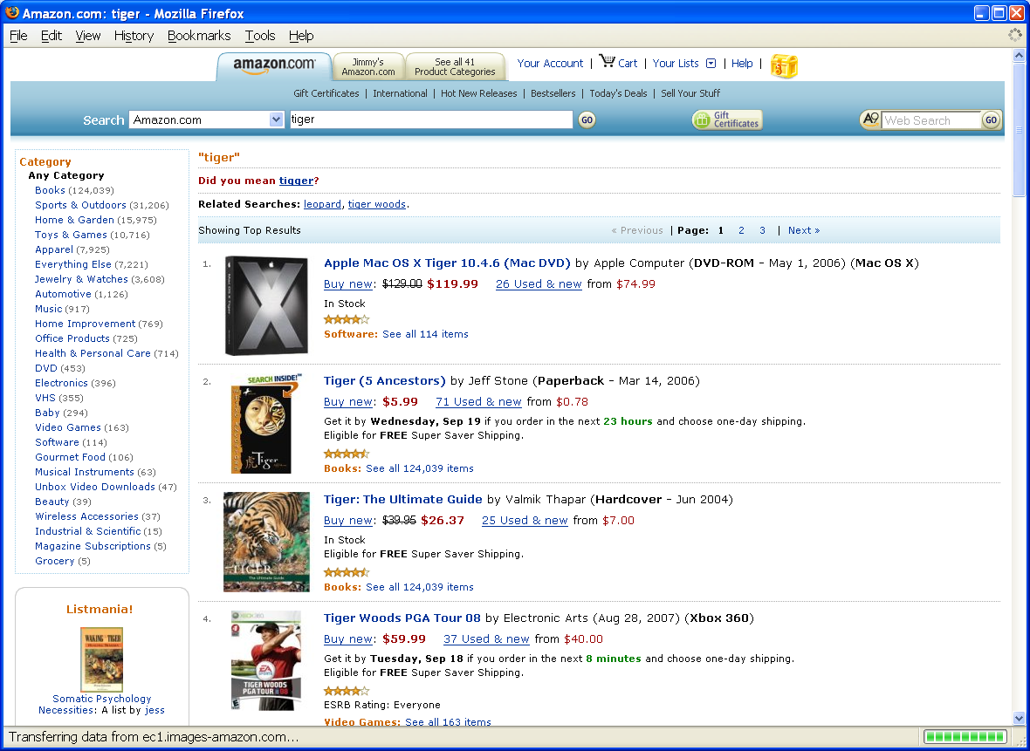
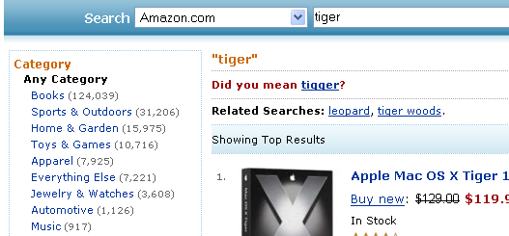
Middle Game

Slide 14
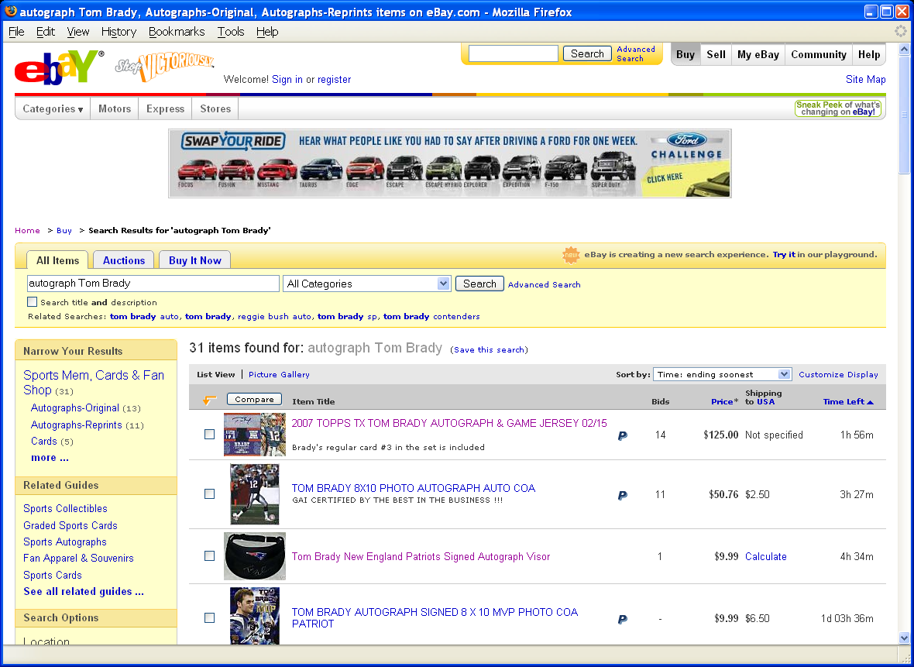
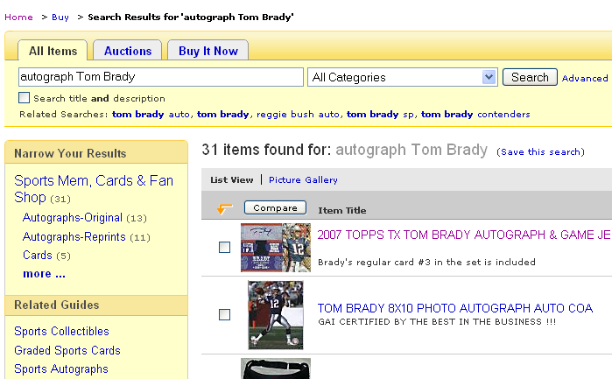
Middle Game

Slide 15
Navigation Patterns
Drive to content
Drive to advertisement
Move up a level
Move to next in sequence
Jump to related

Slide 16
Moore’s Law
computer
performance
transistors
speed
storage
...
1950
1990
2030

Slide 17
Human Cognition
human
performance
1950
1990
2030
1990

Slide 18
Human Computer Interaction
A discipline concerned with the
of interactive computing systems for human use
Design
Implementation
Evaluation

Slide 19
What are Humans Good At?
Sense low level stimuli
Recognize patterns
Reason inductively
Communicate with multiple channels
Apply multiple strategies
Adapt to changes or unexpected events
Notes:
Fuzzy and hard things

Slide 20
What are Computers Good At?
Sense stimuli outside human’s range
Calculate quickly and accurately
Store large quantities and recall accurately
Respond rapidly and consistently
Perform repetitive actions reliably
Work under heavy load for an extended period
Notes:
“Simple and sharply defined things” again paraphrasing George Miller

Slide 21
Synergy
Humans do what they are good at
Computers do what they are good at
Strengths of one cover weakness of the other

Slide 22
Types of Applications
Life critical
  Low error rate first and foremost
  Justifies an enormous design and testing effort
Custom Commercial
  Speed and error rate
Office and Home
  Easy learning, high user satisfaction, low cost
Creative
  User needs assessment is very challenging

Slide 23
User Characteristics
Physical
  Anthropomorphic (height, left handed, etc.)
  Age (mobility, dexterity, etc.)
Cognitive
Perceptual
  Sight, hearing, etc.
Personality
  Including cultural factors

Slide 24
Modeling Interaction
Human
Mental Models
Sight
Sound
Task
System
Hands
Voice
Software Models
Keyboard
Mouse
Task
User
Display
Speaker
Computer

Slide 25
Discussion Point: Mental Models
As a user, what do you need to know about a machine in order to interact with it effectively?

Slide 26
Mental Models
How the user thinks the machine works
  What actions can be taken?
  What results are expected from an action?
  How should system output be interpreted?
Mental models exist at many levels
  Hardware, operating system, and network
  Application programs
  Information resources

Slide 27
Stages of Interaction
Goals
Intention
Expectation
Evaluation
Conceptual
Model
Selection
Interpretation
Execution
Perception

Slide 28
The GOMS Perspective
Goals
  What the user is trying to achieve
Operators
  What capabilities the system provides
Methods
  How those capabilities can be used
Selection strategies
  Which method to choose in a specific case

Slide 29
Input Devices
Text
  Keyboard, optical character recognition
  Speech recognition, handwriting recognition
Direct manipulation
  2-D: mouse, trackball, touch pad, touch panel
  3-D: wand, data glove
Remote sensing
  Camera, speaker ID, head tracker, eye tracker

Slide 30
Keyboard
Produces character codes
  ASCII: American English
  Latin-1: European languages
  UNICODE: (nearly) Any language
    Pictographic languages need “entry methods”
Keyboard shortcuts help with data entry
  Different conventions for standard tasks abound
VT-100 standard” functions are common
  Differing layouts can inhibit usability

Slide 31
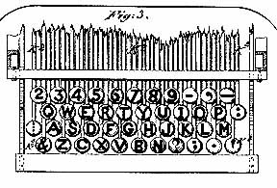
Design Example: QWERTY Keyboard
From http://home.earthlink.net/~dcrehr/whyqwert.html
Notes:
1878 patent image
The name "QWERTY" for our typewriter keyboard comes from the first six letters in the top alphabet row (the one just below the numbers). It is also called the "Universal" keyboard for rather obvious reasons. It was the work of inventor C. L. Sholes, who put together the prototypes of the first commercial typewriter in a Milwaukee machine shop back in the 1860's.

Slide 32
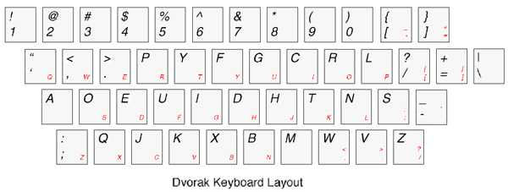
Dvorak Keyboard
From http://www.mwbrooks.com/dvorak/

Slide 33
2-D Direct Manipulation
Match control actions with on-screen behavior
  Use a cursor for visual feedback if needed
Rotary devices
  Mouse, trackball
Linear devices
  Touch pad, touch screen, iPod shuttle, joystick
Rate devices
  Laptop eraserhead

Slide 34
Modeling Interaction
Human
Mental Models
Sight
Sound
Task
System
Hands
Voice
Software Models
Keyboard
Mouse
Task
User
Display
Speaker
Computer

Slide 35
Human Senses
Visual
  Position/motion, color/contrast, symbols
Auditory
  Position/motion, tones/volume, speech
Haptic
  Mechanical, thermal, electrical, kinesthethic
Olfactory
  Smell, taste
Vestibular

Slide 36
Computer Output
Image display
  Fixed view, movable view, projection
Acoustic display
  Headphones, speakers, within-ear monitors
Tactile display
  vibrotactile, pneumatic, piezoelectric
Force feedback
  dexterous handmaster, joystick, pen

Slide 37
Computer Output
Inertial Display
  Motion-based simulators
Olfactory Display
  Chemical (requires resupply)
Locomotive display
  Stationary bicycle, treadmill, ... (trip hazards)
Temperature Display

Slide 38
Four Stages of Interaction
Forming an intention
  “What we want to happen”
  Internal mental characterization of a goal
  May comprise sub-goals (but rarely well planned)
  For example, “write e-mail to grandma”
Selection of an action
  Review possible actions and select most appropriate
  For example, “use Outlook to compose e-mail”

Slide 39
Four Stages of Interaction
Execution of the action
  Carry out the action using the computer
  For example, “double-click Outlook icon”
Evaluation of the outcome
  Compare results with expectations
  Requires perception, interpretation, and incremental evaluation
  For example, “did Outlook open?”

Slide 40
Interaction Styles
Graphical User Interfaces (GUI)
  Direct manipulation (2D, 3D)
  Menus
Language-based interfaces
  Command line interfaces
  Interactive voice response systems
Virtual Reality (VR)
  Direct manipulation
Ubiquitous computing
Notes:
Ubiquitous computing names the third wave in computing, just now beginning. First were mainframes, each shared by lots of people. Now we are in the personal computing era, person and machine staring uneasily at each other across the desktop. Next comes ubiquitous computing, or the age of calm technology, when technology recedes into the background of our lives. Alan Kay of Apple calls this "Third Paradigm" computing.

Slide 41
WIMP Interfaces
Windows
  Spatial context
Icons
  Direct manipulation
Menus
  Hierarchy
Pointing devices
  Spatial interaction

Slide 42
GUI Components
Windows (and panels)
  Resize, drag, iconify, scroll, destroy
Selectors
  Menu bars, pulldown lists
Buttons
  Labeled buttons, radio buttons, checkboxes
Icons (images)
  Select, open, drag, group

Slide 43
Direct Manipulation
Select a metaphor
  Desktop, CD player, map, …
Use icons to represent conceptual objects
  Watch out for cultural differences
Manipulate those objects with feedback
  Select (left/right/double click), move (drag/drop)

Slide 44
Visual Affordance
The perceived and actual fundamental properties
of the object that determine how it could be used
  Appearance indicates how the object should be used
    Chair for sitting
    Table for placing things on
    Knobs for turning
    Slots for inserting things into
    Buttons for pushing
Complex things may need explaining but
simple things should not
  When simple things need instructions, design has failed

Slide 45
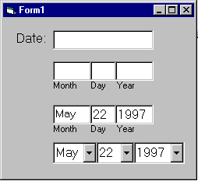
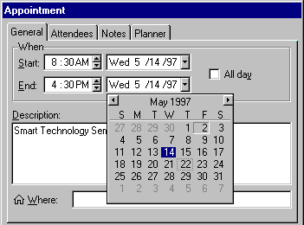
Visible Constraints: Date Entry

Slide 46
Causality
The thing that happens right after an action is assumed by people to be caused by that action
  “Feedback”
False causality
  Incorrect effect
    Invoking unfamiliar function just as computer hangs
    Causes “superstitious” behaviors
  Invisible effect
    Command with no apparent result often re-entered repeatedly
      For example, mouse click to raise menu on unresponsive system

Slide 47
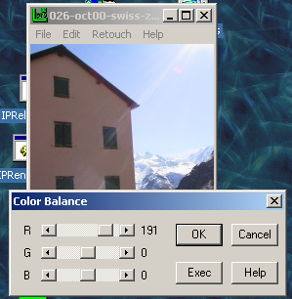
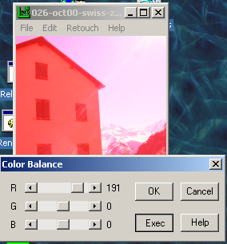
Causality: An Example
Effects visible only after Exec button is pressed
  Ok does nothing!
  Awkward to find appropriate color level
LViewPro

Slide 48
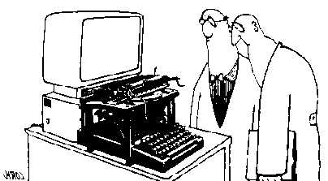
Transfer Effects
People transfer expectations from similar objects
  Positive: prior learning applies to new situation
  Negative: prior learning conflicts with new situation

Slide 49
Positive and Negative Transfer
“First we thought the PC was a calculator. Then we found out how to turn numbers into letters with ASCII — and we thought it was a typewriter. Then we discovered graphics, and we thought it was a television. With the World Wide Web, we've realized it's a brochure.” ― Douglas Adams
Caller: Hello, is this Tech Support?"
Tech: Yes, it is. How may I help you?
Caller: The cup holder on my PC is broken and I am within my warranty period. How do I go about getting that fixed?
Tech: I'm sorry, but did you say a cup holder?
Caller: Yes, it's attached to the front of my computer.
Tech: Please excuse me if I seem a bit stumped, it’s because I am. Did you receive this as part of a promotional, at a trade show? How did you get this cup holder? Does it have any trademark on it?
Caller: It came with my computer, I don't know anything about a promotional. It just has '4X' on it.
At this point the Tech Rep had to mute the call, because he couldn't stand it. The caller had been using the load drawer of the CD-ROM drive as a cup holder, and snapped it off the drive.

Slide 50
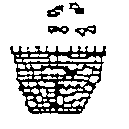


Cultural Associations
Because a trashcan in Thailand may look like this:
A Thai user is likely to be confused by this image popular in Apple interfaces:
Sun found their email icon problematic for some American urban dwellers who are unfamiliar with rural mail boxes.

Slide 51
Population Stereotypes/Idioms
People learn “idioms” that work in a certain way
  Red means danger
  Green means safe
Idioms vary in different cultures
  Light switches
    America: down is off
    Britain: down is on
  Faucets
    America: counter-clockwise on
    Britain: counter-clockwise off

Slide 52
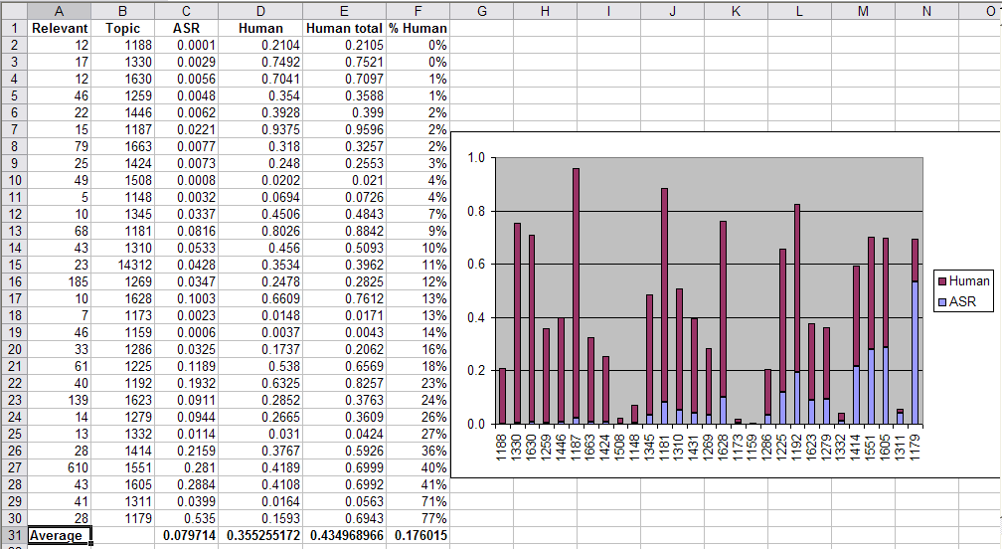
Spreadsheets: Direct Manipulation

Slide 53
Menus
Conserve screen space by hiding functions
  Menu bar, pop-up
Can hierarchically structured
  By application’s logic
  By convention (e.g., where is the print function?)
Tradeoff between breadth and depth
  Too deep ⇒ can become hard to find things
  Too broad ⇒ becomes direct manipulation
Notes:
A set of options displayed on the screen where the selection and execution of one or more of the options results in a change of the state of the interface.

Slide 54
Dynamic Queries
What to do when menus become too deep
  Merges keyboard and direct manipulation
Select menu items by typing part of a word
  After each letter, update the menu
  Once the word is displayed, user can click on it
Example: Windows help index

Slide 55
Language-Based Interfaces
Command Entry
  Compact and flexible
  Powerful in the hands of expert users
  Difficult for novices to learn
Natural Language
  Intuitive and expressive
  Ambiguity makes reliable interpretation difficult

Slide 56
“Seamless Interfaces”
Informative feedback
Easy reversal
User in control
  Anticipatable outcomes
  Explainable results
  Browsable content
Limited working memory load
  Query context
  Path suspension
Alternatives for novices and experts
  Scaffolding

Slide 57
Evaluation Measures
Time to learn
Speed of performance
Error rate
Retention over time
Subjective satisfaction

Slide 58
Evaluation Approaches
Extrinsic vs. intrinsic
Formative vs. summative
Human subjects vs. simulated users
Deductive vs. abductive

Slide 59
Evaluation Examples
Direct observation
  Evaluator observes users interacting with system
    in lab: user asked to complete pre-determined tasks
    in field: user goes through normal duties
  Validity depends on how contrived the situation is
Think-aloud
  Users speak their thoughts while doing the task
  May alter the way users do the task
Controlled user studies
  Users interact with system variants
  Correlate performance with system characteristics
  Control for confounding variables

Slide 60
Summary
HCI design starts with user needs + abilities
  Users have a wide range of both
Users must understand their tools
  And these tools can learn about their user!
Many techniques are available
  Direct manipulation, languages, menus, etc.
  Choosing the right technique is important

Slide 61
Denial of Service Attacks
Viruses
  Platform dependent
  Typically binary
Flooding
  Worms
  Zombies
  Chain letters

Slide 62
Viruses
1988: Less than 10 known viruses
1990: New virus found every day
1993: 10-30 new viruses per week
1999: 45,000 viruses and variants

Slide 63
Worms
Self-reproducing program that sends itself across a network
  Virus is dependent upon the transfer of files
  Worm spreads itself
SQL slammer worm (January 25, 2003) claimed 75,000 victims within 10 minutes

Slide 64
Viruses
Computer programs able to attach to files
Replicates repeatedly
  Typically without user knowledge or permission
Sometimes performs malicious acts

Slide 65
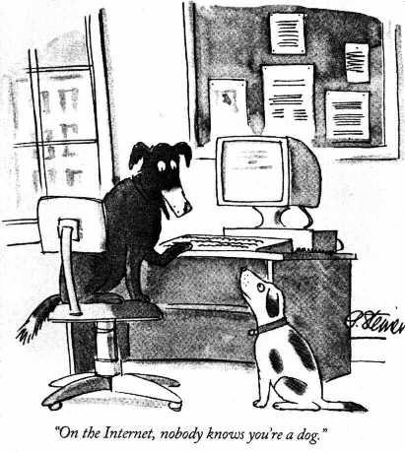

Slide 66
Authentication
Used to establish identity
Two types
  Physical (Keys, badges, cardkeys, thumbprints)
  Electronic (Passwords, digital signatures)
Protected with social structures
  Report lost keys
  Don’t tell anyone your password
Use SSH to defeat password sniffers

Slide 67
Good Passwords
Long enough not to be guessed
  Programs can try every combination of 5 letters
Not in the dictionary
  Programs can try every word in a dictionary
  every proper name, pair of words, date, every …
Mix upper case, lower case, numbers
Change it often
Reuse creates risks
  Abuse, multiple compromise

Slide 68
Authentication Attacks
Guessing
Brute force
Impersonation
“Phishing”
Theft

Slide 69
Symmetric Key Encryption
Same key used both for encryption and decryption
key
key
Alice
Bob
Encrypt
Cipher text
Decrypt
Plain text
Plain text
Insecure channel
eavesdropper
eavesdropper
eavesdropper

Slide 70
Asymmetric Key Encryption
Different keys used for encryption and decryption
Bob’s public key
Bob’s private key
Alice
Bob
Encrypt
Cipher text
Decrypt
Plain text
Plain text
Insecure channel
eavesdropper
eavesdropper
eavesdropper

Slide 71
Asymmetric Key Encryption
Key = a large number (> 1024 bits)
  Public key: known by all authorized encoders
  Private key: known only by decoder
One-way mathematical functions
  “Trapdoor functions”
    Like mixing paint (easy to do, hard to undo)
  Large numbers are easy to multiply, hard to factor
Importance of longer keys
  Keys < 256 bits can be cracked in a few hours
  Keys > 1024 bits presently effectively unbreakable

Slide 72
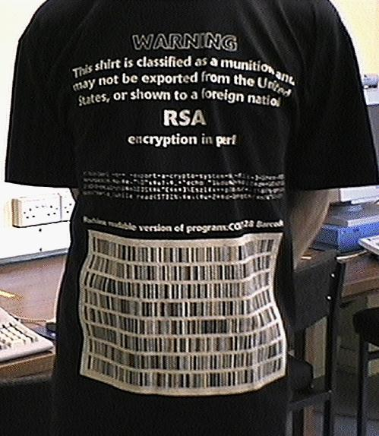
RSA “Public Key” Encryption
Until 1997 – Illegal to show this slide to non-US citizens!
print pack"C*", split/\D+/,
`echo "16iII*o\U@{$/=$z; [(pop,pop,unpack"H*",<>)]} \EsMsKsN0[lN*1lK[d2%Sa2/d0 <X+d*lMLa^*lN%0]dsXx++lMlN /dsM0<J]dsJxp"|dc`

Slide 73
Trojan Horse
Malicious program with undesired capabilities
  Log key strokes and sends them somewhere
  Create a “back door” administrator logon
Spyware: reports information about your activity without your knowledge
Doesn’t (necessarily) replicate

Slide 74
Real-Time Local Surveillance
Built-in features of standard software
  Browser history, outgoing email folders, etc.
“Parental control” logging software
  ChatNANNY, Cyber Snoop, FamilyCAM, …
Personal firewall software
  ZoneAlarm, BlackIce, …

Slide 75
Real-Time Centralized Surveillance
Proxy server
  Set up a Web server and enable proxy function
  Configure all browsers to use the proxy server
  Store and analyze Web server log files
Firewall
  Can monitor all applications, not just the Web

Slide 76
Forensic Examination
Scan for files in obscure locations
  Find-by-content for text, ACDSee for pictures, …
Examine “deleted” disk files
  Norton DiskDoctor, …
Decode encrypted files
  Possible for many older schemes

Slide 77
Integrity
How do you know what’s there is correct?
  Attribution is invalid if the contents can change
Access control would be one solution
Encryption offers an alternative

Slide 78
Digital Signatures
Alice “signs” (encrypts) with her private key
  Bob checks (decrypts) with her public key
Bob knows it was from Alice
  Since only Alice knows Alice’s private key
Non-repudiation: Alice can’t deny signing message
  Except by claiming her private key was stolen!
Integrity: Bob can’t change message
  Doesn’t know Alice’s Private Key

Slide 79
Key Management
Pubic announcement of public key
  e.g., append public key to the end of each email
  But I can forge the announcement
Establish a trusted “certificate authority”
  Leverage “web of trust” to authenticate authority
  Register public key with certificate authority

Slide 80
Certificate Authority
Certificate Authority
Bob’s public key
Bob’s public key
Bob’s private key
Alice
Bob
Encrypt
Cipher text
Decrypt
Plain text
Plain text
Insecure channel
eavesdropper
eavesdropper
eavesdropper

Slide 81
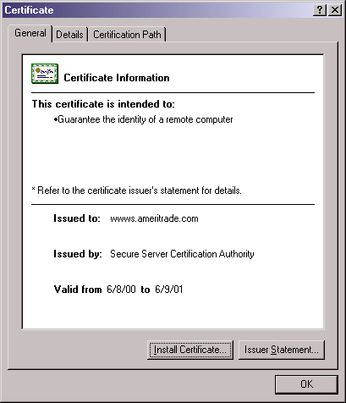
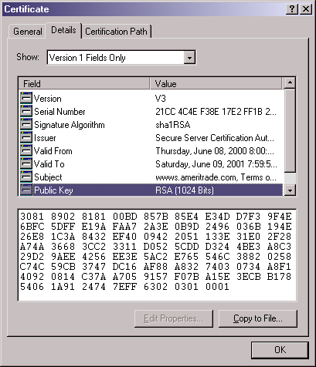
Certificates: Example

Slide 82
Practical Tips
Keep anti-virus software current
Keep software “patches” current
Change default settings
Be wary of anything free

Slide 83
Total Cost of Ownership
Planning
Installation
  Facilities, hardware, software, integration, migration, disruption
Training
  System staff, operations staff, end users
Operations
  System staff, support contracts, outages, recovery, …
Notes:
83
13

Slide 84
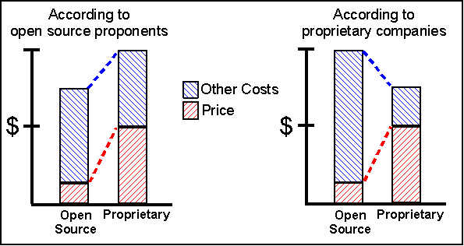
Total Cost of Ownership

Slide 85
Some Examples
 | Proprietary | Open Source
Operating system | Windows XP | Linux
Office suite | Microsoft Office | OpenOffice
Image editor | Photoshop | GIMP
Web browser | Internet Explorer | Mozilla
Web server | IIS | Apache
Database | Oracle | MySQL
Notes:
85

Slide 86
Open Source “Pros”
More eyes ⇒ fewer bugs
Iterative releases ⇒ rapid bug fixes
Rich community ⇒ more ideas
  Coders, testers, debuggers, users
Distributed by developers ⇒ truth in advertising
Open data formats ⇒ Easier integration
Standardized licenses

Slide 87
Open Source “Cons”
Communities require incentives
  Much open source development is underwritten
Developers are calling the shots
  Can result in feature explosion
Proliferation of “orphans”
Diffused accountability
  Who would you sue?
Fragmentation
  “Forking” may lead to competing versions
Little control over schedule

Slide 88
Open Source Business Models
Support Sellers
Loss Leader
Widget Frosting
Accessorizing
Sell distribution, branding, and after-sale services.
Give away the software to make a market for proprietary software.
If you’re in the hardware business, giving away software doesn’t hurt.
Sell accessories:
books, compatible hardware, complete systems with pre-installed software

Slide 89
Iron Rule of Project Management
You can control any two of:
  Capability
  Cost
  Schedule
Open source software takes this to an extreme

Slide 90
Estimating Completion Time
Rules of thumb
  1/3 specification
  1/6 coding
  1/2 test planning, testing, and fixing!
Add time for coding to learn as you go, but don’t take time away from the other parts!
  Reread the section on “gutless estimating” if you are tempted

