Slide 1

Content Management Systems
Week 14
LBSC 671
Creating Information Infrastructures

Slide 2
Putting the Pieces Together
Browser
Web Server
Database
HTML
SQL Query
CGI
HTML
Results

Slide 3
Why Database-Generated Pages?
Remote access to a database
  Client does not need the database software
Serve rapidly changing information
  e.g., Airline reservation systems
Provide multiple “access points”
  By subject, by date, by author, …
Record user responses in the database

Slide 4
Why Content Management Systems?
Separation of content and appearance
Separation of roles
Standardization of common “design patterns”
  Login and password recovery
  Headlines and drill-down
  Site map
  Search
  Shopping cart

Slide 5
Content Management Systems
WordPress
  http://wordpress.org
Joomla
  http://www.joomla.org
Drupal
  https://drupal.org

Slide 6
Roles
Information architecture design
Task assignment
Content generation and modification
Approval for “publication”
Publication
Error correction
Tracking task progress

Slide 7
Content Management System Structure
Database stores the content
  And access control data and parameters
Server scripting controls the user experience
  PHP readss database, generates HTML
(X)HTML conveys the user experience
User-side scripting enhances interactivity
  JavaScript may be used for form validation

Slide 8
Client Hardware
(PC)
Interface
Design
Web Browser
(IE, Firefox)
Client-side Programming
(JavaScript)
Interaction
Design
Interchange Language
(HTML, XML)
Server-side Programming
(PHP)
Business
rules
Database
(MySQL)
Server Hardware
(PC, Unix)

Slide 9
“Site Blueprint”
Main
Homepage
Teaching
Research
Other
Activities
LBSC 690
Ph.D.
Students
IR
Colloquium
INFM 718R
Publications
TREC
Doctoral
Seminar
Projects

Slide 10
Grid Layouts
Navigation Bar
Navigation Bar
Content
Content
Navigation Bar
Related Links
Navigation Bar
Content
Content

Slide 11
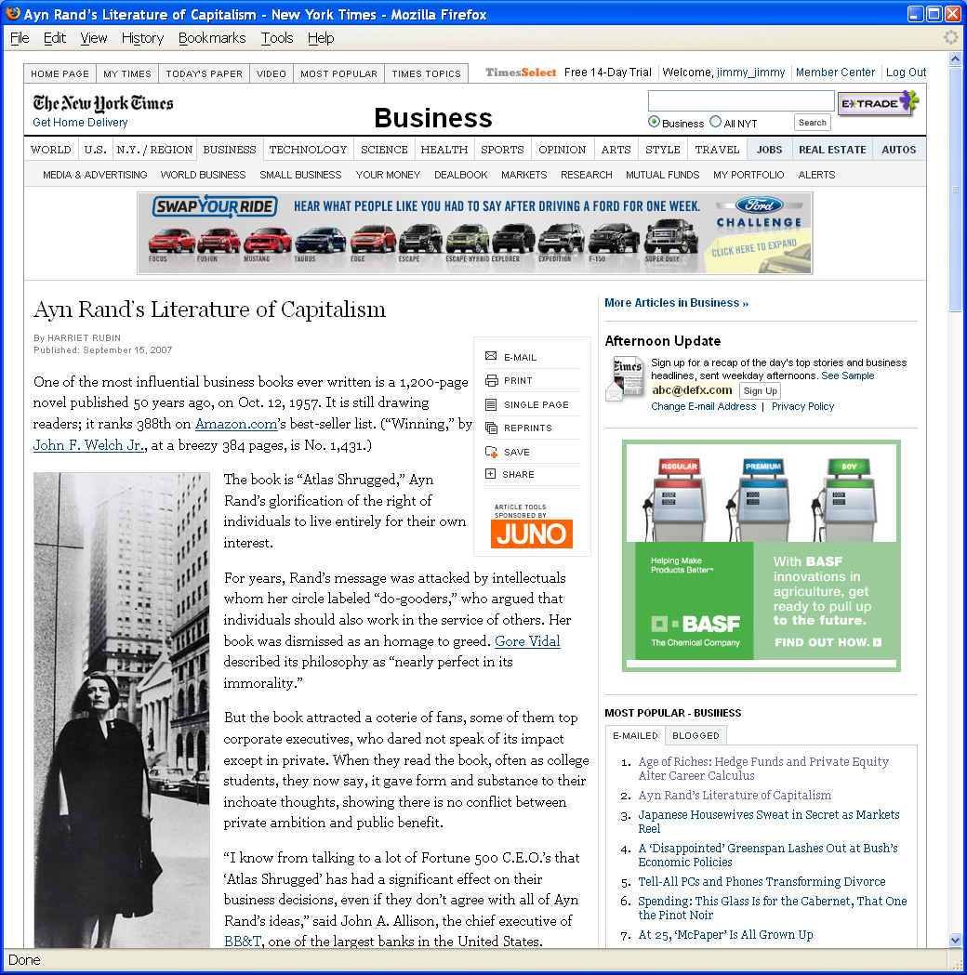
Grid Layout: NY Times

Slide 12
Grid Layout: NY Times
Navigation
Banner Ad
Another Ad
Content
Popular
Articles

Slide 13
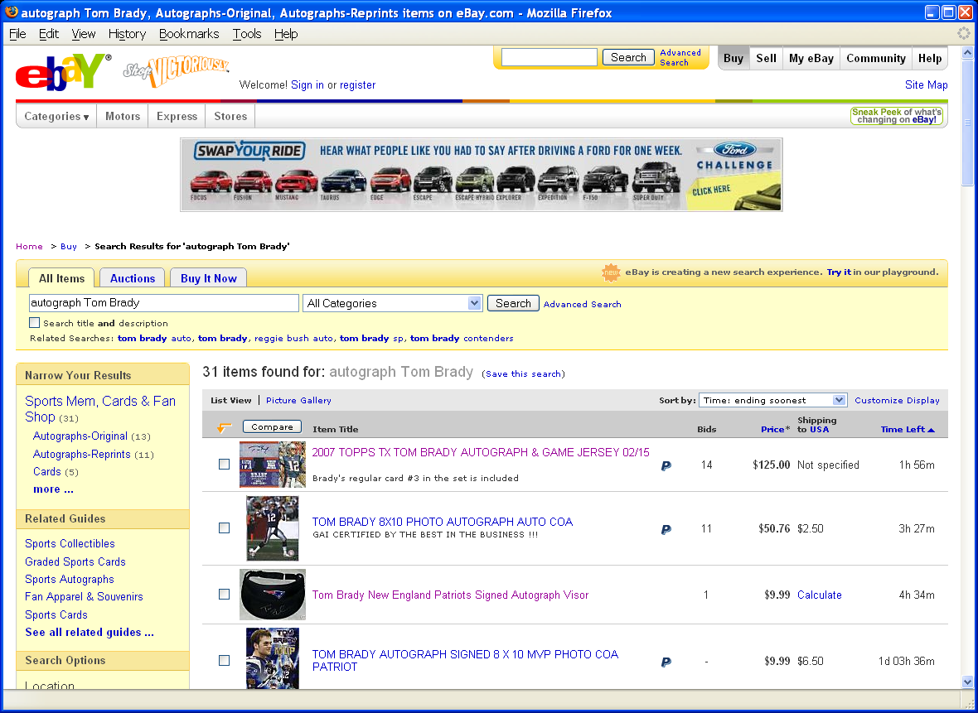
Grid Layout: ebay

Slide 14
Grid Layout: ebay
Navigation
Banner Ad
Navigation
Related
Search Results

Slide 15
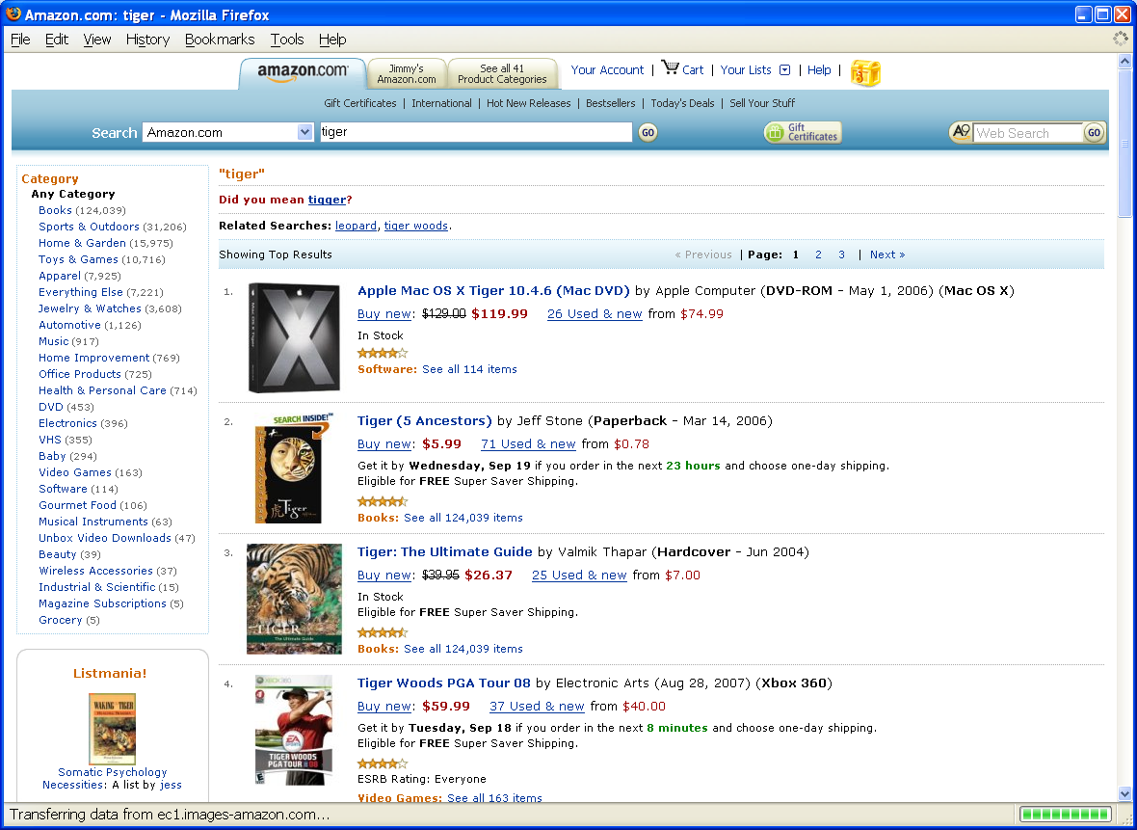
Grid Layout: Amazon

Slide 16
Grid Layout: Amazon
Navigation
Navigation
Related
Search Results

Slide 17
Some Layout Guidelines
Contrast: make different things different
  to bring out dominant elements
  to create dynamism
Repetition: reuse design throughout the interface
  to achieve consistency
Alignment: visually connect elements
  to create flow
Proximity: make effective use of spacing
  to group related and separate unrelated elements

Slide 18
Joomla Structure
Front end
  The Web site
Back end
  Where the Web site is defined

Slide 19
Joomla Components
Web sites are made up of rectangular pieces
  Called “modules”
Two basic types of modules:
  Displaying content (e.g., articles)
  Interaction (e.g., login)
Templates define where modules can be put
  Templates define abstract “positions”
  Joomla maps positions to layout in ways appropriate to the device

Slide 20
Joomla Features
Menus control navigation
  Menu items control where you can go
Categories group things (i.e., entities)
  University courses, Apollo missions, Meetups, …
Extensions allow you to add new capabilities
  JCE Editor, Image rotator, Google maps, …

Slide 21
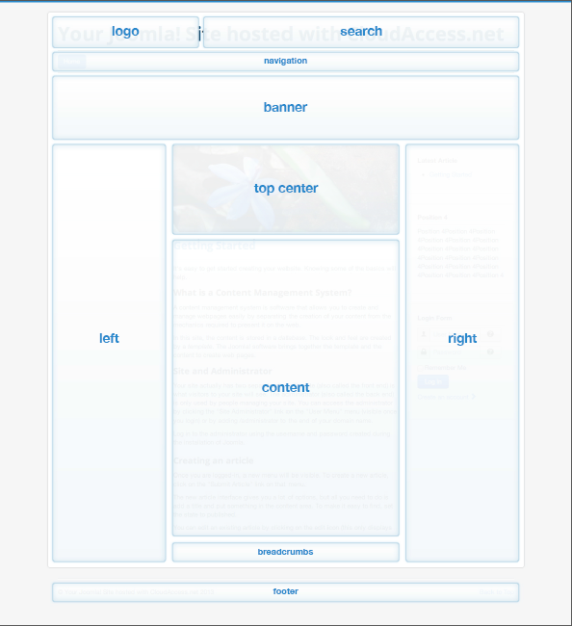

Slide 22
Joomla Hosting
Your own computer
  Useful as a way to try things out
  Not easily accessable to others
Demo account (for 30 days) at joomla.org
  You can pay to keep it past 30 days
Web hosting service
  Longer life, more support, or less cost
  More complex to set up

Slide 23
Joomla First Steps
System->Control Panel
  Gets to the back-end home
Install the Joomla Content Editor (JCE)
Learn how to insert content
  Images, text without formatting
Learn how to set up menu items
Learn how to control layout

Slide 24
Ajax Applications
Google Maps
  http://maps.google.com
Google Suggest
  http://www.google.com/webhp?complete=1&hl=en
Sajax Tables
  http://labs.revision10.com/?p=5
Sajax
  http://www.modernmethod.com/sajax/

Slide 25
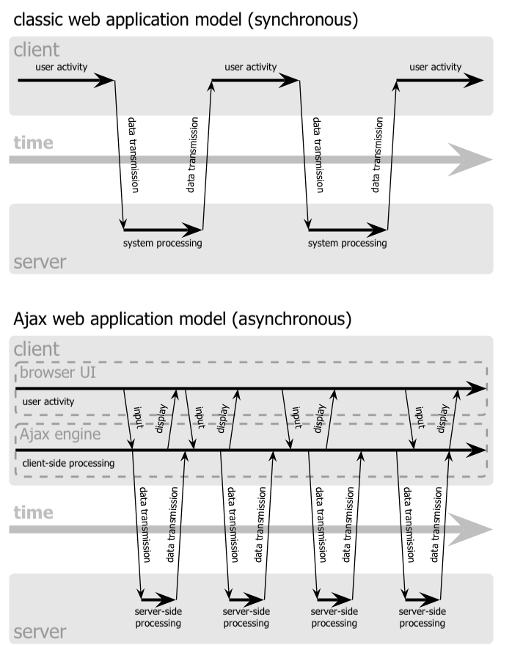

Slide 27
Navigation Patterns
Drive to content
Drive to advertisement
Move up a level
Move to next in sequence
Jump to related

Slide 28
Before You Go
On a sheet of paper, answer the following (ungraded) question (no names, please):
What was the muddiest point in this semester?

