Slide 1

Information Retrieval
Session 11
LBSC 671
Creating Information Infrastructures

Slide 2
Agenda
The search process
Information retrieval
Recommender systems
Evaluation

Slide 3
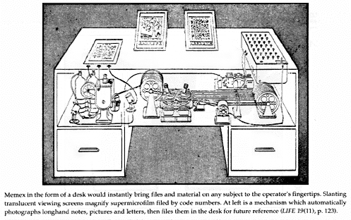
The Memex Machine

Slide 4
Information Hierarchy
More refined and abstract
Wisdom
Knowledge
Information
Data
Notes:
“Information” actually exists as part of a hierarchy, of how refined it is

Slide 5
Databases
IR
What we’re retrieving
Structured data. Clear semantics based on a formal model.
Mostly unstructured. Free text with some metadata.
Queries we’re posing
Formally (mathematically) defined queries. Unambiguous.
Vague, imprecise information needs (often expressed in natural language).
Results we get
Exact. Always correct in a formal sense.
Sometimes relevant, often not.
Interaction with system
One-shot queries.
Interaction is important.
Other issues
Concurrency, recovery, atomicity are critical.
Effectiveness and usability are critical.

Slide 6
Information “Retrieval”
Find something that you want
  The information need may or may not be explicit
Known item search
  Find the class home page
Answer seeking
  Is Lexington or Louisville the capital of Kentucky?
Directed exploration
  Who makes videoconferencing systems?
Notes:
5

Slide 7
The Big Picture
The four components of the information retrieval environment:
  User (user needs)
  Process
  System
  Data
What people care about!
What geeks care about!

Slide 8
Information Retrieval Paradigm
Search
Browse
Document
Delivery
Select
Examine
Query
Document

Slide 9
Supporting the Search Process
Source
Selection
Predict
Nominate
Choose
IR System
Query
Formulation
Query
Search
Ranked List
Selection
Query Reformulation
and
Relevance Feedback
Document
Examination
Document
Source
Reselection
Delivery

Slide 10
Supporting the Search Process
Source
Selection
IR System
Query
Formulation
Query
Search
Ranked List
Selection
Indexing
Document
Index
Examination
Document
Acquisition
Collection
Delivery

Slide 11
Human-Machine Synergy
Machines are good at:
  Doing simple things accurately and quickly
  Scaling to larger collections in sublinear time
People are better at:
  Accurately recognizing what they are looking for
  Evaluating intangibles such as “quality”
Both are pretty bad at:
  Mapping consistently between words and concepts
Notes:
17

Slide 12
Search Component Model
Utility
Human Judgment
Information Need
Document
Query Formulation
Query Processing
Query
Document Processing
Representation Function
Representation Function
Query Representation
Document Representation
Comparison Function
Retrieval Status Value
Notes:
6
Start 1:20

Slide 13
Ways of Finding Text
Searching metadata
  Using controlled or uncontrolled vocabularies
Searching content
  Characterize documents by the words the contain
Searching behavior
  User-Item: Find similar users
  Item-Item: Find items that cause similar reactions

Slide 14
Two Ways of Searching
Controlled
Vocabulary
Searcher
Free-Text
Searcher
Author
Indexer
Construct query from
terms that may
appear in documents
Write the document
using terms to
convey meaning
Choose appropriate
concept descriptors
Construct query from
available concept
descriptors
Content-Based
Query-Document
Matching
Metadata-Based
Query-Document
Matching
Query Terms
Document Terms
Document Descriptors
Query Descriptors
Retrieval Status Value

Slide 15
“Exact Match” Retrieval
Find all documents with some characteristic
  Indexed as “Presidents -- United States”
  Containing the words “Clinton” and “Peso”
  Read by my boss
A set of documents is returned
  Hopefully, not too many or too few
  Usually listed in date or alphabetical order

Slide 16
The Perfect Query Paradox
Every information need has a perfect document ste
  Finding that set is the goal of search
Every document set has a perfect query
  AND every word to get a query for document 1
  Repeat for each document in the set
  OR every document query to get the set query
The problem isn’t the system … it’s the query!
Notes:
14

Slide 17
Queries on the Web (1999)
Low query construction effort
  2.35 (often imprecise) terms per query
  20% use operators
  22% are subsequently modified
Low browsing effort
  Only 15% view more than one page
  Most look only “above the fold”
    One study showed that 10% don’t know how to scroll!

Slide 18
Types of User Needs
Informational (30-40% of queries)
  What is a quark?
Navigational
  Find the home page of United Airlines
Transactional
  Data: What is the weather in Paris?
  Shopping: Who sells a Viao Z505RX?
  Proprietary: Obtain a journal article

Slide 19
Ranked Retrieval
Put most useful documents near top of a list
  Possibly useful documents go lower in the list
Users can read down as far as they like
  Based on what they read, time available, ...
Provides useful results from weak queries
  Untrained users find exact match harder to use

Slide 20
Similarity-Based Retrieval
Assume “most useful” = most similar to query
Weight terms based on two criteria:
  Repeated words are good cues to meaning
  Rarely used words make searches more selective
Compare weights with query
  Add up the weights for each query term
  Put the documents with the highest total first

Slide 21
Simple Example: Counting Words
Query: recall and fallout measures for information retrieval
1
2
3
Query
Documents:
complicated
1
contaminated
1
1: Nuclear fallout contaminated Texas.
1
fallout
1
2: Information retrieval is interesting.
information
1
1
1
interesting
1
3: Information retrieval is complicated.
nuclear
1
retrieval
1
1
1
Texas
1

Slide 22
Discussion Point:
Which Terms to Emphasize?
Major factors
  Uncommon terms are more selective
  Repeated terms provide evidence of meaning
Adjustments
  Give more weight to terms in certain positions
    Title, first paragraph, etc.
  Give less weight each term in longer documents
  Ignore documents that try to “spam” the index
    Invisible text, excessive use of the “meta” field, …

Slide 23
“Okapi” Term Weights
TF component
IDF component

Slide 24
Index Quality
Crawl quality
  Comprehensiveness, dead links, duplicate detection
Document analysis
  Frames, metadata, imperfect HTML, …
Document extension
  Anchor text, source authority, category, language, …
Document restriction (ephemeral text suppression)
  Banner ads, keyword spam, …

Slide 25
Other Web Search Quality Factors
Spam suppression
  “Adversarial information retrieval”
  Every source of evidence has been spammed
    Text, queries, links, access patterns, …
“Family filter” accuracy
  Link analysis can be helpful

Slide 26
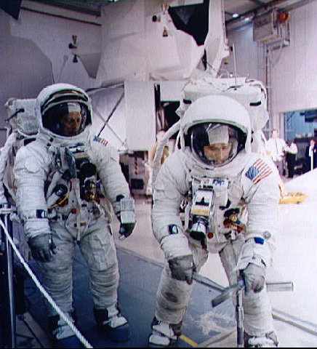
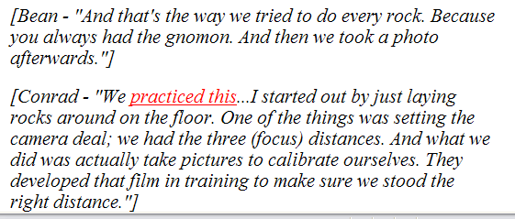
Indexing Anchor Text
A type of “document expansion”
  Terms near links describe content of the target
Works even when you can’t index content
  Image retrieval, uncrawled links, …

Slide 27
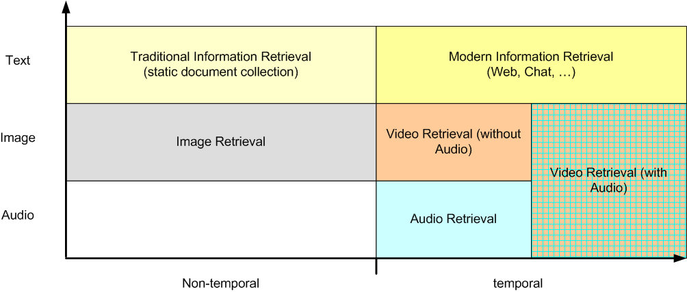
Information Retrieval Types
Source: Ayse Goker
Notes:
Traditional Information Retrieval considered a (rather) static textual document collection as source whereas…
Modern Information Retrieval moves away from that. The data is changing more rapidly (like the web). Time is important and even part of the data (News, Chat, part of the information).
Image retrieval (still-image e.g. photos, graphs)
Video retrieval (moving image - term may or may not include sound)
Audio retrieval (e.g. music, speech)
Total (including text retrieval) should be Multimedia IR but often is not.
(Note:MMIR usually refers to non-text retrieval).

Slide 28
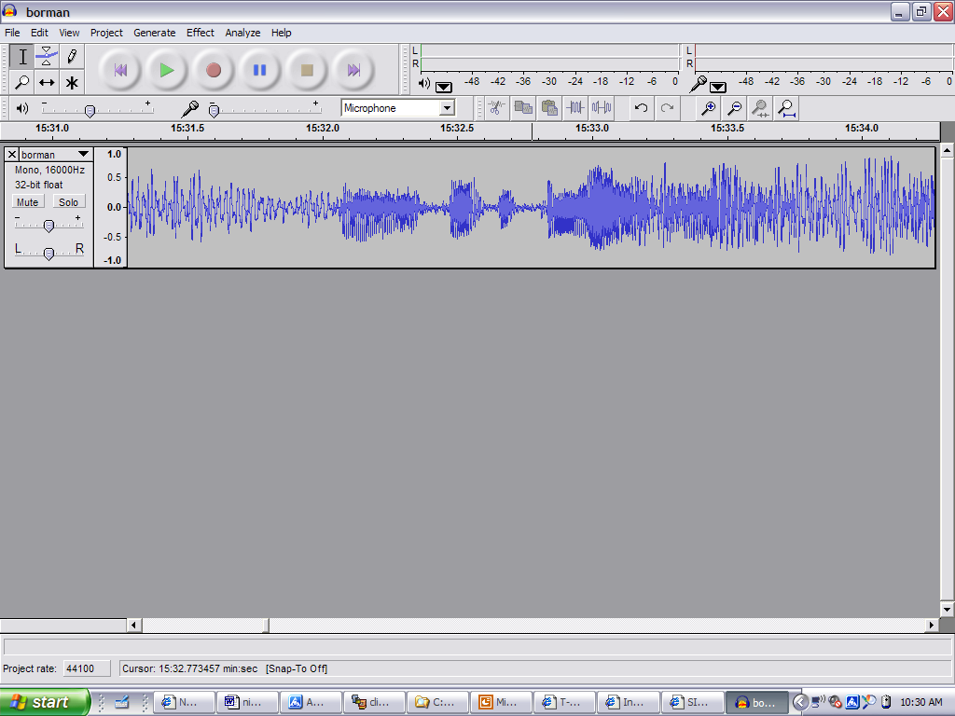
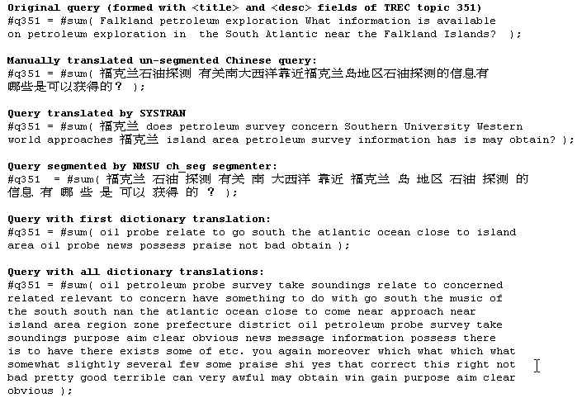
Expanding the Search Space
Scanned Docs
Identity: Harriet
“… Later, I learned that
John had not heard …”

Slide 29
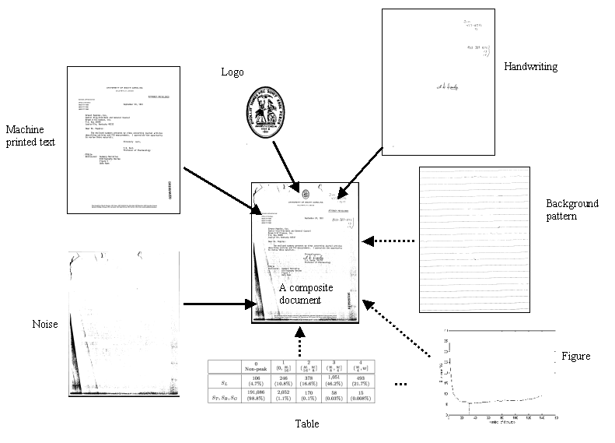
Page Layer Segmentation
Document image generation model
  A document consists many layers, such as handwriting, machine printed text, background patterns, tables, figures, noise, etc.

Slide 30
Searching Other Languages
English Definitions
Query
Formulation
Query
Query
Translation
Translated Query
Translated “Headlines”
Search
Ranked List
MT
Selection
Document
Examination
Document
Query Reformulation
Use
Notes:
The answer can be given by looking at interactions within the search process monolingual or multilingual.
Besides interested in nominate, interactive ir also interested in the three yellow boxes in predict and choose

Slide 31
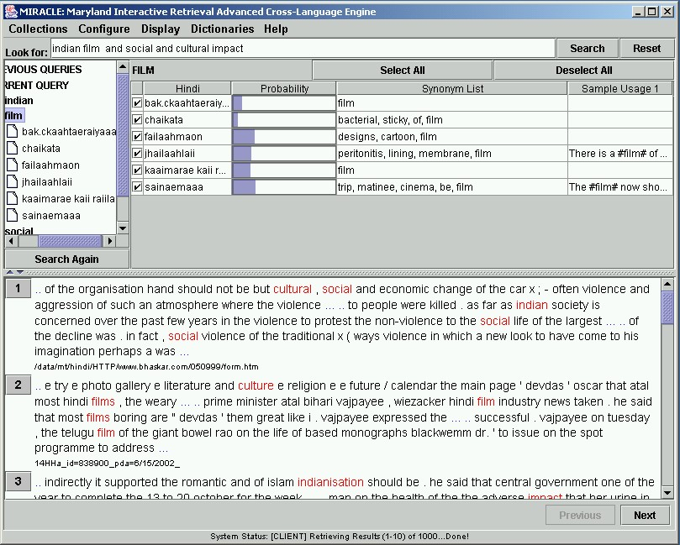

Slide 32
Speech Retrieval Architecture
Query
Formulation
Speech
Recognition
Boundary
Tagging
Automatic
Search
Content
Tagging
Interactive
Selection

Slide 33
High Payoff Investments
MT
OCR
Searchable
Fraction
Handwriting
Speech
Transducer Capabilities

Slide 34
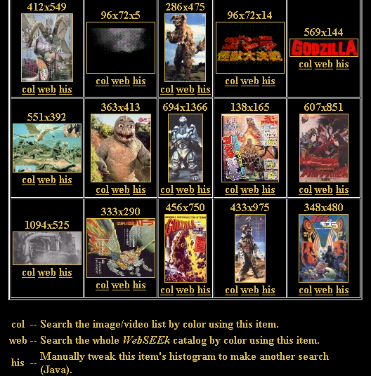
http://www.ctr.columbia.edu/webseek/

Slide 35
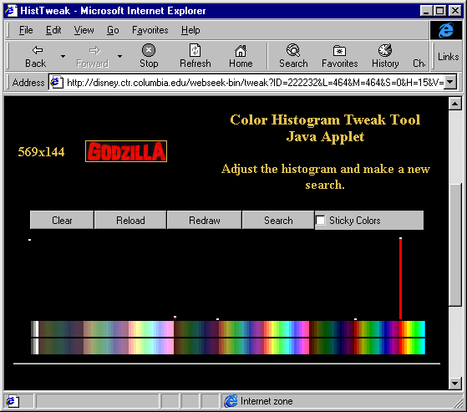
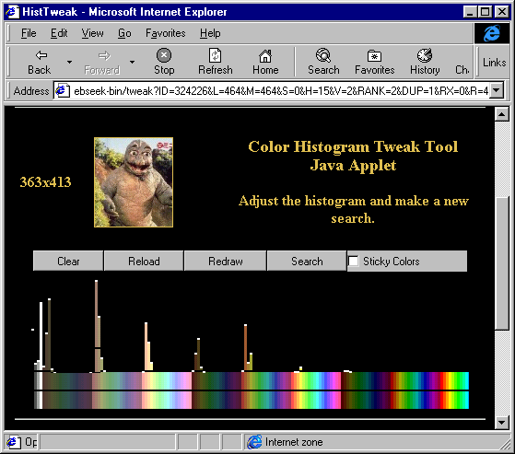
Color Histogram Example

Slide 36
Rating-Based Recommendation
Use ratings as to describe objects
  Personal recommendations, peer review, …
Beyond topicality:
  Accuracy, coherence, depth, novelty, style, …
Has been applied to many modalities
  Books, Usenet news, movies, music, jokes, beer, …
Notes:
27

Slide 37
Using Positive Information

Slide 38
Using Negative Information

Slide 39
Problems with Explicit Ratings
Cognitive load on users -- people don’t like to provide ratings
Rating sparsity -- needs a number of raters to make recommendations
No ways to detect new items that have not rated by any users

Slide 40
Putting It All Together
 | Free Text | Behavior | Metadata
Topicality
Quality
Reliability
Cost
Flexibility

Slide 41
Evaluation
What can be measured that reflects the searcher’s ability to use a system? (Cleverdon, 1966)
  Coverage of Information
  Form of Presentation
  Effort required/Ease of Use
  Time and Space Efficiency
  Recall
  Precision
Effectiveness

Slide 42
Evaluating IR Systems
User-centered strategy
  Given several users, and at least 2 retrieval systems
  Have each user try the same task on both systems
  Measure which system works the “best”
System-centered strategy
  Given documents, queries, and relevance judgments
  Try several variations on the retrieval system
  Measure which ranks more good docs near the top

Slide 43
Which is the Best Rank Order?
A.
B.
C.
D.
E.
F.
= relevant document

Slide 44
Precision and Recall
Precision
  How much of what was found is relevant?
  Often of interest, particularly for interactive searching
Recall
  How much of what is relevant was found?
  Particularly important for law, patents, and medicine

Slide 45
Measures of Effectiveness
Retrieved
Relevant

Slide 46
Precision-Recall Curves
Source: Ellen Voorhees, NIST

Slide 47
Affective Evaluation
Measure stickiness through frequency of use
  Non-comparative, long-term
Key factors (from cognitive psychology):
  Worst experience
  Best experience
  Most recent experience
Highly variable effectiveness is undesirable
  Bad experiences are particularly memorable

Slide 48
Summary
Search is a process engaged in by people
Human-machine synergy is the key
Content and behavior offer useful evidence
Evaluation must consider many factors

Slide 49
Before You Go
On a sheet of paper, answer the following (ungraded) question (no names, please):
What was the muddiest point in today’s class?

