Slide 1

Discovery and Delivery
Week 7
LBSC 671
Creating Information Infrastructures

Slide 2
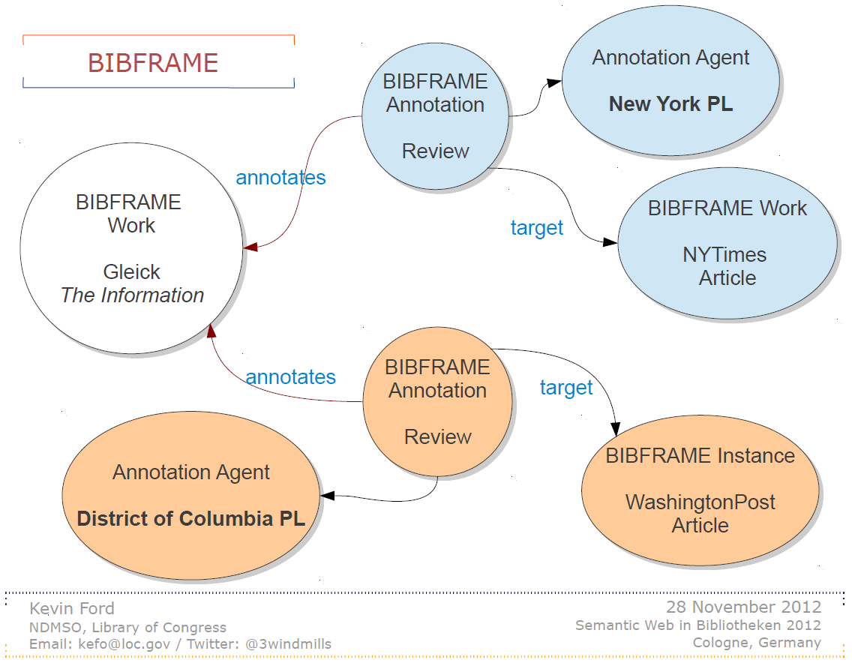

Slide 3
Tonight
Access points
Discovery
Delivery
Midterm exam review

Slide 4
Authority Control
Unify references to the same entity (synonyms)
  Samuel Clemens, Mark Twain
Distinguish references to different entities (homonyms)
  Michael Jordan (basketball), Michael Jordan (computers)
Establish “access points”
  Canonical and variant forms, to better support “find it” tasks

Slide 5
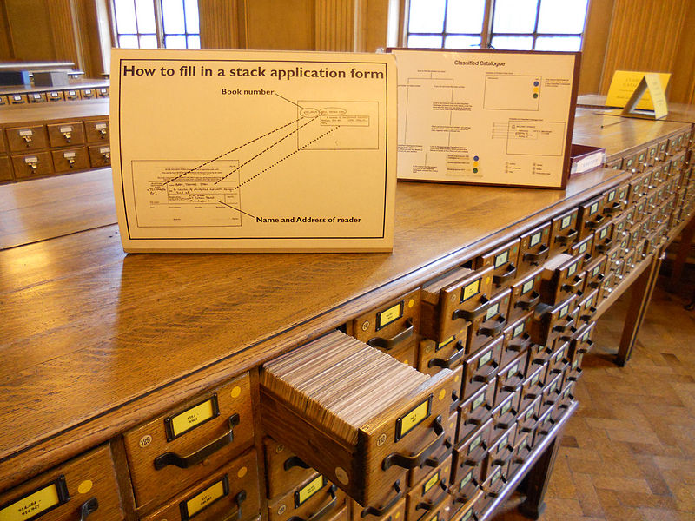
Access Points
Originally designed for card catalogs
  One card for every “authorized” access point
Four types “dictionary” catalog access points
  Title (uniform titles)
  Author (name authority)
  Subject (controlled vocabulary)
  Series
Other things can serve a similar purpose
  Call number (shelf order)
  “Keywords” (full-text search)

Slide 6
Functional Requirements for Authority Data (FRAD)
Name
  Canonical form for display to users
Identifier
  Canonical form for use by systems
Controlled access points
  Forms that can be used as a basis for access
Rules
  For creating access points
Agency
  Organization responsible for creating access points

Slide 7
FRBR Bibliographic User Tasks
Find it
  Search (“to find”)
  Recognize (“to identify”)
  Choose (“to select”)
Serve it
  Location (“to obtain”)

Slide 8
FRAD Authority Control User Tasks
Searcher tasks
  Find
  Identify
Authority control tasks
  Contextualize
  Justify

Slide 9


http://authorities.loc.gov/

Slide 10
Hands On
Find the authoritative LC name for one of ...
  http://ischool.umd.edu/faculty-staff/jennifer-j-preece
  http://www.umiacs.umd.edu/~jimmylin/
  http://terpconnect.umd.edu/~pwang/
  http://en.wikipedia.org/wiki/Robert_S._Taylor
  http://en.wikipedia.org/wiki/Hans_Peter_Luhn

Slide 11
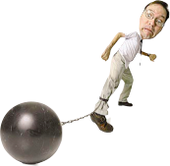
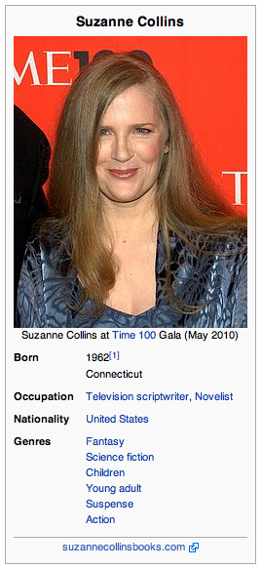
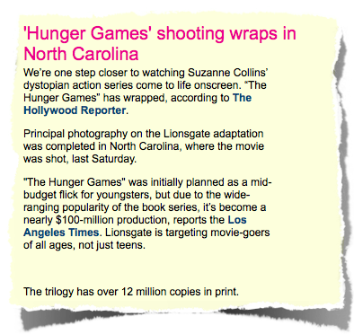
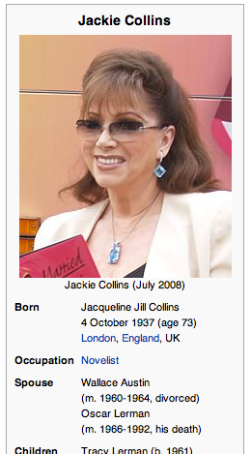

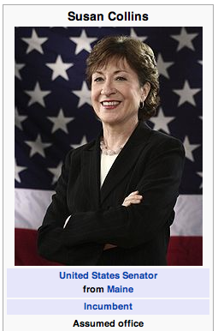
Entity Linking
Knowledge Base
Query

Slide 12

Entity Linking
Given
  A mention of a person’s name in a document
  A “knowledge base” containing information about a set of known entities
Determine
  Whether the mentioned person is in the knowledge base
  If so, where
Match unstructured text to structured knowledge source
  Related to:
    Record linkage: Structured to structured
    Co-reference resolution: Unstructured to unstructured

Slide 13

Entity Linking Task
Michael Phelps
Debbie Phelps, the mother of swimming star Michael Phelps, who won a record eight gold medals in Beijing, is the author of a new memoir, ...
818k+ entries
Michael Phelps | swimmer | 1985-
Michael E Phelps | biophysicist | 1939-
Mike Phelps | basketball player | 1961-
Edmund Phelps | economist | 1933-
…
Michael Phelps
Michael Phelps is the scientist most often identified as the inventor of PET, a technique that permits the imaging of biological processes in the organ systems of living individuals. Phelps has ...
Identify matching entry, or determine that entity is missing from KB.
Non-trivial due to name ambiguity, name variation, & KB absence.

Slide 14
Technical Approach
“According to the CDC the prevalence of H1N1 influenza in California prisons has increased ...”
Several phases
  1. Candidate identification (“triage”) based on target name
Query = “CDC”
California Dept. of Corrections
Cedar City Regional Airport
Cheerdance Competition
Communicable Disease Centre
Congress for Democratic Change
Consumers for Dental Choice
Control Data Corporation
Cult of the Dead Cow
NIL (Absence from KB)
US Center for Disease Control
...

Slide 15
Technical Approach
“According to the CDC the prevalence of H1N1 influenza in California prisons has...”
Several phases
  1. Candidate identification (“triage”) based on target name
  2. Candidate selection (“ranking”) exploiting document features using supervised machine learning
Query = “CDC”
1. California Dept. of Corrections
2. US Center for Disease Control
3. Cedar City Regional Airport (IATA code)
4. Communicable Disease Centre (Singapore)
5. Congress for Democratic Change (Liberian political party)
6. Cult of the Dead Cow (Hacker organization)
7. Control Data Corporation
8. NIL (Absence from KB)
9. Consumers for Dental Choice (non-profit)
10. Cheerdance Competition (Philippine organization)

Slide 16
Technical Approach
“According to the CDC the prevalence of H1N1 influenza in California prisons has...”
Several phases
  1. Candidate identification (“triage”) based on target name
  2. Candidate selection (“ranking”) exploiting document features using supervised machine learning
  3. Possibly choosing absence (NIL)
Query = “CDC”
1. California Dept. of Corrections
2. US Center for Disease Control
3. Cedar City Regional Airport (IATA code)
4. Communicable Disease Centre (Singapore)
5. Congress for Democratic Change (Liberian political party)
6. Cult of the Dead Cow (Hacker organization)
7. Control Data Corporation
8. NIL (Absence from KB)
9. Consumers for Dental Choice (non-profit)
10. Cheerdance Competition (Philippine organization)

Slide 17
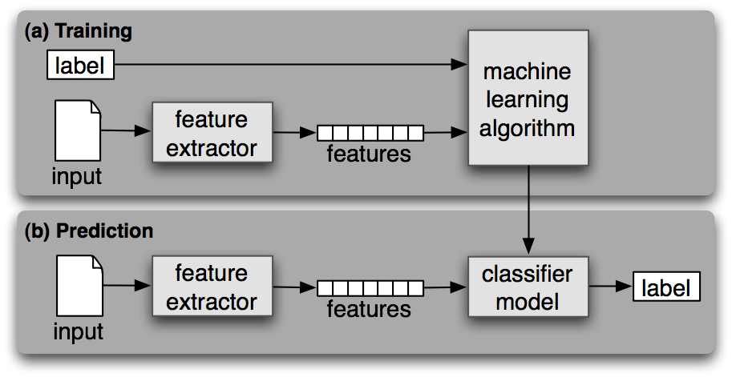
Supervised Machine Learning
Steven Bird et al., Natural Language Processing, 2006

Slide 18
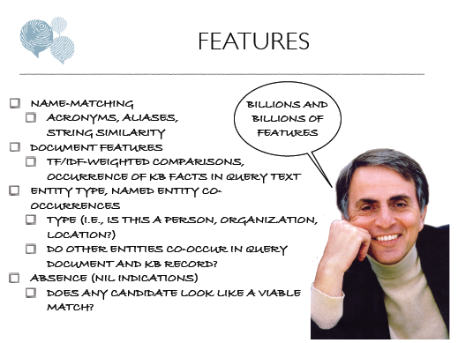

Slide 19
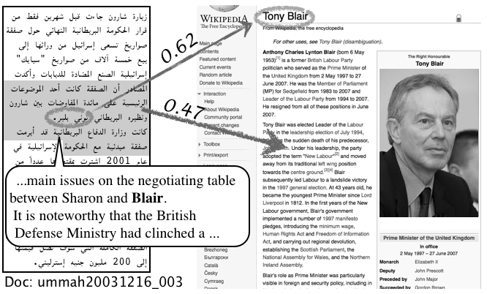
Cross-Language Entity Linking

Slide 20
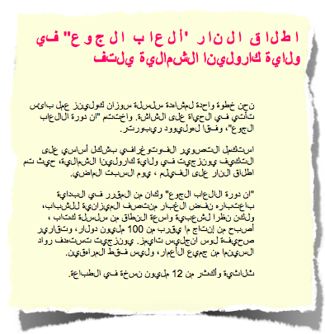

Cross-Language Entity Linking
Knowledge Base
Query

Slide 21
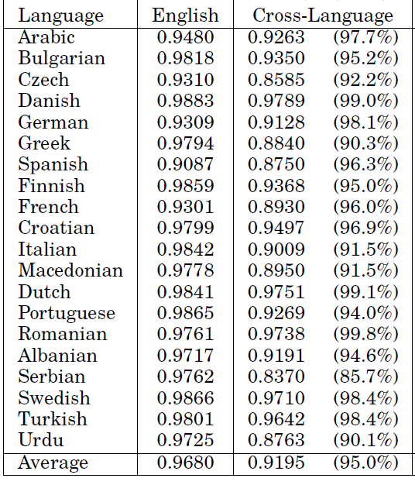
One-Best Person Linking Accuracy
Dawn Lawrie et al, Cross-Language Person-Entity Linking from Twenty Languages, under review (2013)

Slide 22
Classification
Classification
  A system for organizing knowledge
Notation
  Expressing the classification in a systematic way

Slide 23
Library of Congress Subject Headings
Controlled vocabulary for subject access points
  Most commonly applied to books and serials
Used when a subject describes ≥20% of the work
Choose the most specific appropriate headings
  But if more than 3 subtopics, choose a broader heading

Slide 24
LCSH Subdivisions
Topical
  Archaeology – Methodology
Form
    Archaeology – Fiction
Chronological
    Archaeology – History – 18th century
Geographic
    Archaeology – Egypt

Slide 25
Hands On
Find the LCSH for one of:
  http://www.mayoclinic.com/health/heart-attack/DS00094
  http://en.wikipedia.org/wiki/AS-204
  http://www.apollotheater.org/
  http://www.flickr.com/photos/usnationalarchives/4153755504/
  http://en.wikipedia.org/wiki/Operation_Entebbe

Slide 26
Tonight
Access points
Discovery
Delivery
Midterm exam review

Slide 27
Two Ways of Searching
Controlled
Vocabulary
Searcher
Free-Text
Searcher
Author
Indexer
Construct query from
terms that may
appear in documents
Write the document
using terms to
convey meaning
Choose appropriate
concept descriptors
Construct query from
available concept
descriptors
Content-Based
Query-Document
Matching
Metadata-Based
Query-Document
Matching
Query Terms
Document Terms
Document Descriptors
Query Descriptors
Retrieval Status Value

Slide 28
Supporting the Search Process
Source
Selection
IR System
Query
Formulation
Query
Search
Ranked List
Selection
Indexing
Document
Index
Examination
Document
Acquisition
Collection
Delivery

Slide 29
Online Public Access Catalog (OPAC)
Known-item search
  Author, Title
Topic search
  Title, subject headings
Result display
  Sort by publication date, “relevance,” …
Navigation
  Broader/narrower headings, other editions, …
Delivery
  Call number or (digital content) direct delivery

Slide 30
Tonight
Access points
Discovery
Delivery
Midterm exam review

Slide 31
Delivery (“Serve It”)
Assigning a shelf order
Moving physical materials
Controlling access to digital materials

Slide 32
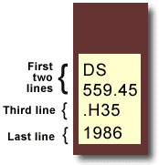
Library of Congress Classification
Book title: Uncensored War: The Media and Vietnam
Author: Daniel C. Hallin
Call Number: DS559.46 .H35 1986
The first two lines describe the subject of the book.
DS559.45 = Vietnamese Conflict
The third line often represents the author's last name.
H = Hallin
The last line represents the date of publication.
D History
DS1-937 History of Asia
DS520-560.72 Southeast Asia
DS556-559.93 Vietnam. Annam
DS557-559.9 Vietnamese Conflict
After other initial consonants for the second letter: use number: |  | a 3 | e 4 | i 5 | o 6 | r 7 | u 8 | y 9
For expansion for the letter: use number: |  | a-d 3 | e-h 4 | i-l 5 | m-o 6 | p-s 7 | t-v 8 | w-z 9
http://www.usg.edu/galileo/skills/unit03/libraries03_04.phtml

Slide 33
The World Is Flat (in LCC)
    HM846 .F74 2005
H Social sciences
HM Sociology
HM831 Social change – Causes
HM846 Technological Innovations. Technology.
.F74 Cutter number for Friedman, Thomas

Slide 34
The World Is Flat (in Dewey)
303.4833
300 Social science
300 Social sciences, sociology, & anthropology
303 Social processes
303.4 Social change
303.48 Causes of change
303.483 Development of science and technology
303.4833 Communication (Information technology)

Slide 35
Inter-Library Loan
Users search “union catalog” to find books
Remote library “ships” it to local library
  Often by scanning it, where practical
  Someone pays for this (local library or user)
Local library manages circulation
  Limited access period
  Some “return” mechanism

Slide 36
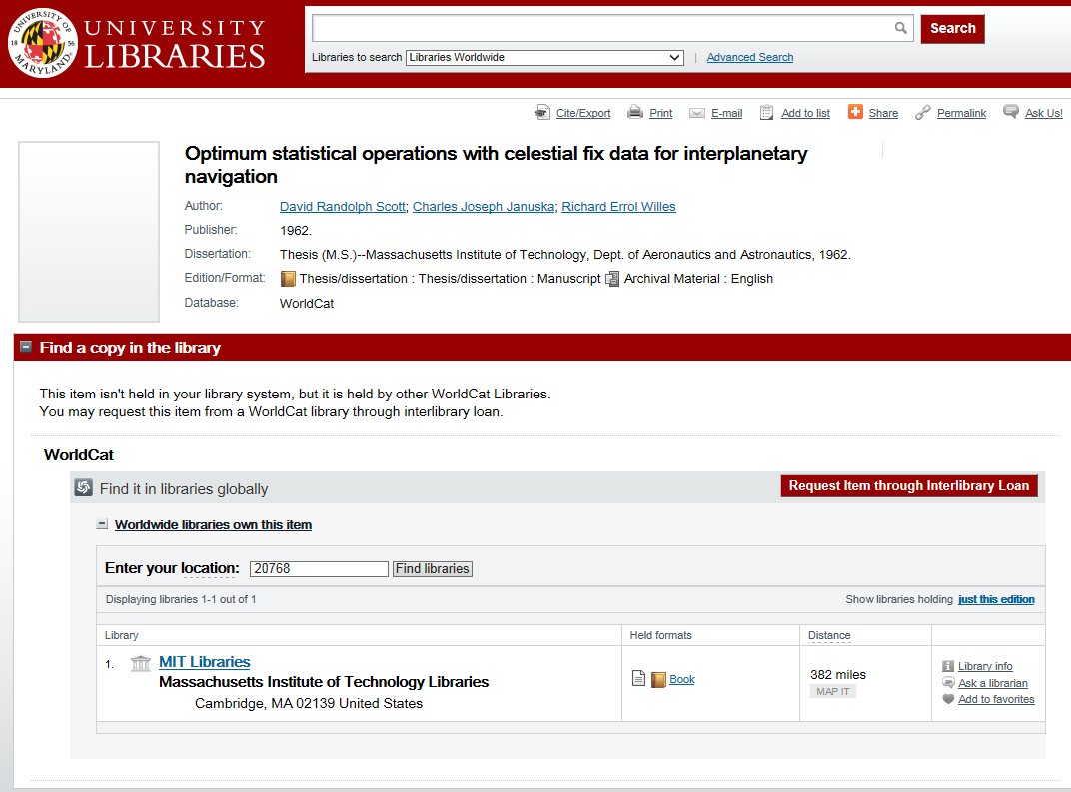

Slide 37
E-Book Distribution
OECD, E-Books: Development and Policy Considerations (2011)

Slide 38
Copyright
Balances two public interests
  Incentivizing production of new information
    Through owner’s interest in monetizing assets
  Fostering use of information
    First sale doctrine
    Fair use doctrine

Slide 39
First Sale Doctrine
Owner may transfer access of the owned copy
  But may not make a copy then transfer the copy
  This is what permits “lending libraries”
    Exception: no commercial lending of audio recordings
Licensing can apply more restrictive rules
  Establishes a conditional right of access
  This is what permits limited-

Slide 40
Fair Use Doctrine
Balance two desirable characteristics
  Financial incentives to produce content
  Desirable uses of existing information
Safe harbor agreement
  Book chapter, magazine article, picture, …
Developed in an era of physical documents
  Perfect copies/instant delivery alter the balance

Slide 41
Recent Copyright Laws
Copyright Term Extension Act (CTEA)
  Ruled constitutional (Jan 2003, Supreme Court)
Digital Millennium Copyright Act (DMCA)
  Prohibits circumvention of technical measures
  Implements WIPO treaty database protection

Slide 42
Digital Rights Management (DRM)
Goal: protect intellectual property rights
  Copyright relies on cost and quality of analog copies
Three interlocking strategies
  Make it difficult to produce an exact digital copy
  Encrypt the content and then control description
  Enforce policies to rebalance costs and benefits

Slide 43
Digital Rights Management
No standards, so proliferation of one-off solutions
  Many of which have caused unintended problems
Unilateral implementation can result in imbalance
  Establishing balance is a political process
The “analog hole” is technically intractable
  Unless interaction is needed

Slide 44
Midterm Exam
Posted by 5 AM on Tuesday October 28
  Due at 11 PM on Saturday November 2
  3 Hours, same process as the quiz (email, no talking, …)
Comprehensive
  Nature of information institutions
  Have it, find it, serve it
One question will be to create + represent a bibliographic description (w/authority control)
  One RDA+MARC, MODS or BIBFRAME option
  One DACS+EAD option

Slide 45
Before You Go!
On a sheet of paper (no names), answer the following question:
What was the muddiest point in today’s class?

