Slide 1

Representation
Week 6
LBSC 671
Creating Information Infrastructures

Slide 2
The character ‘A’
ASCII encoding: 7 bits used per character
  0 1 0 0 0 0 0 1 = 65 (decimal)
  0 1 0 0 0 0 0 1 = 41 (hexadecimal)
  0 1 0 0 0 0 0 1 = 101 (octal)
Number of representable character codes:
  2⁷ = 128
Some codes are used as “control characters”
  e.g. 7 (decimal) rings a “bell” (these days, a beep) (“^G”)

Slide 3
ASCII
| 0 NUL | 32 SPACE | 64 @ | 96 ` |
| 1 SOH | 33 ! | 65 A | 97 a |
| 2 STX | 34 " | 66 B | 98 b |
| 3 ETX | 35 # | 67 C | 99 c |
| 4 EOT | 36 $ | 68 D | 100 d |
| 5 ENQ | 37 % | 69 E | 101 e |
| 6 ACK | 38 & | 70 F | 102 f |
| 7 BEL | 39 ' | 71 G | 103 g |
| 8 BS | 40 ( | 72 H | 104 h |
| 9 HT | 41 ) | 73 I | 105 i |
| 10 LF | 42 * | 74 J | 106 j |
| 11 VT | 43 + | 75 K | 107 k |
| 12 FF | 44 , | 76 L | 108 l |
| 13 CR | 45 - | 77 M | 109 m |
| 14 SO | 46 . | 78 N | 110 n |
| 15 SI | 47 / | 79 O | 111 o |
Widely used in the U.S.
  American Standard Code for Information Interchange
  ANSI X3.4-1968
| 16 DLE | 48 0 | 80 P | 112 p |
| 17 DC1 | 49 1 | 81 Q | 113 q |
| 18 DC2 | 50 2 | 82 R | 114 r |
| 19 DC3 | 51 3 | 83 S | 115 s |
| 20 DC4 | 52 4 | 84 T | 116 t |
| 21 NAK | 53 5 | 85 U | 117 u |
| 22 SYN | 54 6 | 86 V | 118 v |
| 23 ETB | 55 7 | 87 W | 119 w |
| 24 CAN | 56 8 | 88 X | 120 x |
| 25 EM | 57 9 | 89 Y | 121 y |
| 26 SUB | 58 : | 90 Z | 122 z |
| 27 ESC | 59 ; | 91 [ | 123 { |
| 28 FS | 60 < | 92 \ | 124 | |
| 29 GS | 61 = | 93 ] | 125 } |
| 30 RS | 62 > | 94 ^ | 126 ~ |
| 31 US | 64 ? | 95 _ | 127 DEL |
Notes:
7

Slide 4
The Latin-1 Character Set
ISO 8859-1 8-bit characters for Western Europe
  French, Spanish, Catalan, Galician, Basque, Portuguese, Italian, Albanian, Afrikaans, Dutch, German, Danish, Swedish, Norwegian, Finnish, Faroese, Icelandic, Irish, Scottish, and English
Printable Characters, 7-bit ASCII
Additional Defined Characters, ISO 8859-1
Notes:
8

Slide 5
Other ISO-8859 Character Sets
-2
-6
-3
-7
-4
-8
-5
-9
Notes:
9

Slide 6
East Asian Character Sets
More than 256 characters are needed
  Two-byte encoding schemes (e.g., EUC) are used
Several countries have unique character sets
  GB in Peoples Republic of China, BIG5 in Taiwan, JIS in Japan, KS in Korea, TCVN in Vietnam
Many characters appear in several languages
  Research Libraries Group developed EACC
    Unified “CJK” character set for USMARC records
Notes:
10

Slide 7
Unicode
Single code for all the world’s characters
  ISO Standard 10646
Separates “code space” from “encoding”
  Code space extends Latin-1
    The first 256 positions are identical
  UTF-7 encoding will pass through email
    Uses only the 64 printable ASCII characters
  UTF-8 encoding is designed for disk file systems
Notes:
11

Slide 8
Limitations of Unicode
Produces larger files than Latin-1
Fonts may be hard to obtain for some characters
Some characters have multiple representations
  e.g., accents can be part of a character or separate
Some characters look identical when printed
  But they come from unrelated languages
Encoding does not define the “sort order”
Notes:
12

Slide 9
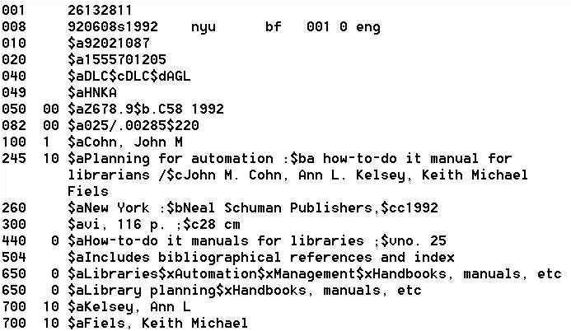
Machine-Readable Catalog (MARC)

Slide 10
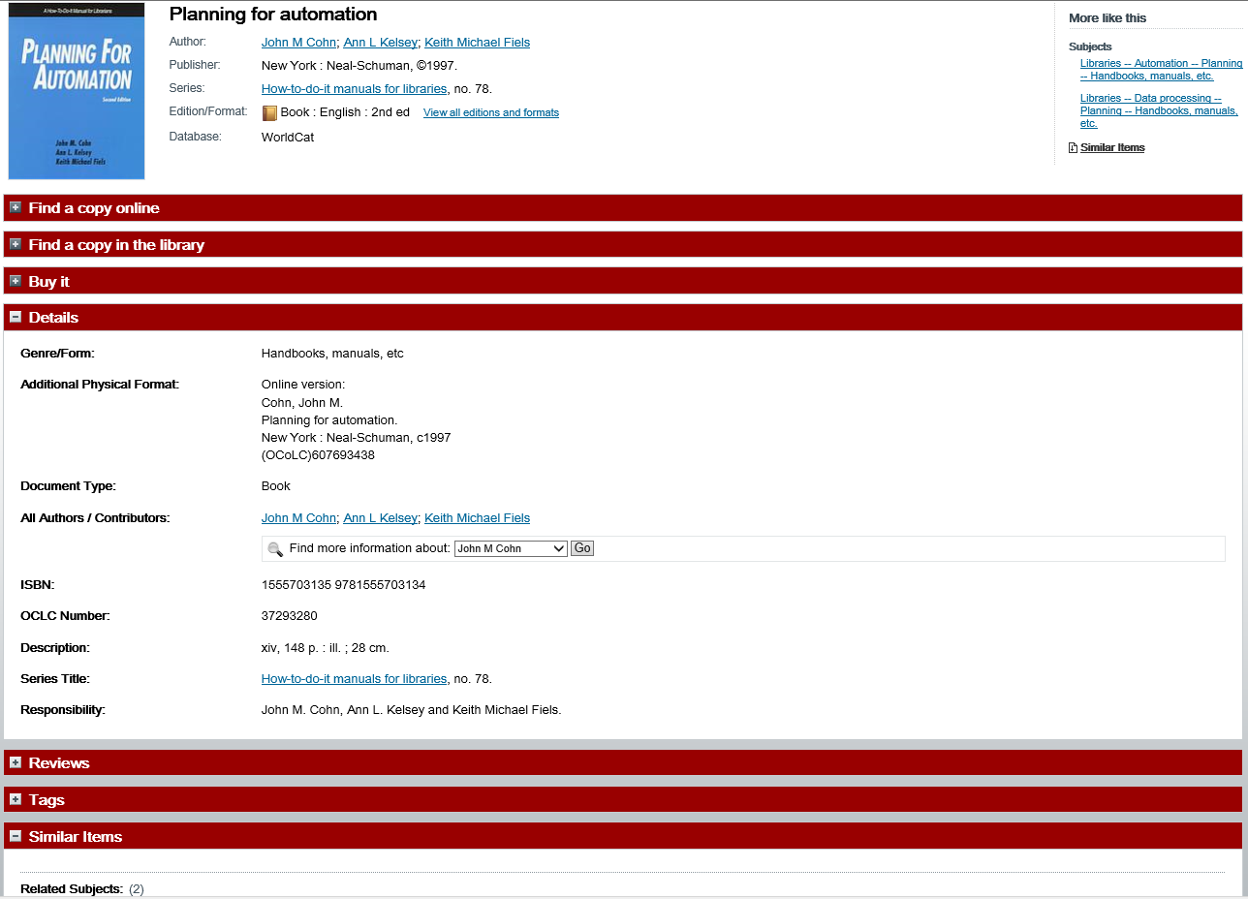

Slide 11
History of Structured Documents
Early standards were “typesetting languages”
  NROFF, TeX, LaTeX, SGML
HTML was developed for the Web
  Too specialized for other uses
Specialized standards met other needs
  Change tracking in Word, annotating manuscripts, …
XML seeks to unify these threads
  One standard format for printing, viewing, processing

Slide 12
eXtensible Markup Language (XML)
SGML was too complex
HTML was too simple
Goals for XML
  Easily adapted to specific tasks
    Rendering Web pages
    Encoding metadata
    “Semantic Web”
  Easily created
  Easily processed
  Easily read
  Concise

Slide 13
Some XML Applications
Text Encoding Initiative
  For adding annotation to historical manuscripts
  http://www.tei-c.org/
Encoded Archival Description
  To enhance automated processing of finding aids
  http://www.loc.gov/ead/
Metadata Encoding and Transmission Standard
  Bundles many types of metadata
  http://www.loc.gov/standards/mets/

Slide 14
Even More Uses of XML …
MARCXML – MARC in XML
MODS – Metadata Object Description Schema
CML – Chemical Markup Language
CellML – biological models
BSML – bioinformatic sequences
MAGE-ML – MicroArray Gene Expression
XSTAR – for archaeological research
AML – astronomy markup language
SportsML – for sharing sports data

Slide 15

Really Simple Syndication (RSS)
<?xml version="1.0"?>
<rss version="2.0">
<channel>
<title>Lift Off News</title>
<link>http://liftoff.msfc.nasa.gov/</link>
<description>Liftoff to Space Exploration.</description>
<language>en-us</language>
<pubDate>Tue, 10 Jun 2003 04:00:00 GMT</pubDate>
<lastBuildDate>Tue, 10 Jun 2003 09:41:01 GMT</lastBuildDate>
<docs>http://blogs.law.harvard.edu/tech/rss</docs>
<generator>Weblog Editor 2.0</generator>
<managingEditor>editor@example.com</managingEditor>
<webMaster>webmaster@example.com</webMaster>
<ttl>5</ttl>
<item>
<title>Star City</title>
<link>http://liftoff.msfc.nasa.gov/news/2003/news-starcity.asp</link>
<description>How do Americans get ready to work with Russians aboard the International Space Station? They take
a crash course in culture, language and protocol at Russia's Star City.</description>
<pubDate>Tue, 03 Jun 2003 09:39:21 GMT</pubDate>
<guid>http://liftoff.msfc.nasa.gov/2003/06/03.html#item573</guid>
</item>
</channel>
</rss>
See example at http://www.nytimes.com/services/xml/rss/

Slide 16
XML: A Family of Standards
Definition: DTD or Schema
  Known types of entities with “labels”
  Defines part-whole and is-a relationships
Markup: XML
  “Tags” regions of text with labels
Presentation: XSLT
  Specifies transformations
  Commonly used to create a HTML display

Slide 17
XML Example
View “The Song of the Wandering Aengus”
  http://www.umiacs.umd.edu/~oard/teaching/671/fall13/slides/6/xml.html
Built from three files
  yeats01.xml
  poem01.dtd
  poem01.xsl
Notes:
What is XML? What

Slide 18
XML Example
<?xml version="1.0"?>
<!DOCTYPE poem SYSTEM "poem01.dtd">
<?xml-stylesheet type="text/xsl" href="poem01.xsl"?>
<poem>
<title>The Song of Wandering Aengus</title>
<author> <firstname>W.B.</firstname>
<lastname>Yeats</lastname>
</author>
<stanza>
<line>I went on to the hazel wood,</line>
<linein>Because a fire was in my head,</linein>
<line>And cut and peeled a hazel wand,</line>
</stanza>
</poem>

Slide 19
Document Type Definition (DTD)
<!ELEMENT poem ( (title, author, stanza)* )>
<!ELEMENT title (#PCDATA) >
<!ELEMENT author (firstname, lastname) >
<!ELEMENT firstname (#PCDATA) >
<!ELEMENT lastname (#PCDATA) >
<!ELEMENT stanza (line+ | linein+) >
<!ELEMENT line (#PCDATA) >
<!ELEMENT linein (#PCDATA) >
#PCDATA span of text
a,b a followed by b
a|b either a or b
a* 0 or more a’s
a+ 1 or more a’s
Notes:
DTD defines a document type in
1. Its vocabulary, what kind of elements are allowed in the document type.
2. It defines a content model for each element. A content model is a pattern that tells what elements or data can go inside an element, in what order, in what number, and whether they are required or optional. Think of this as the “grammar” of the attribute.
#PCDATA => parsed character data. The characters will be checked by an XML parser for entity reference, which will then be replaced with their entity values

Slide 20
Specifying Appearance: XSL
<xsl:template match=“poem">
<html>
<body bgcolor="#FFFFCC">
<xsl:apply-templates/>
</html>
</html>
</xsl:template>
<xsl:template match=“title">
<h1>
<font color="Green">
<xsl:value-of/ select=“.”>
</font>
</h1>
</xsl:template>
Notes:
Extensible Stylesheet language XSL
http://www.w3.org/Style/CSS-vs-XSL

Slide 21
Some Basic Rules for XML
XML declaration is the first statement
  <?xml version="1.0"?>
An XML document is a “tree”
  Must contain one root element
  Other elements must be properly nested
All start tags must have end tags
XML is case sensitive
Attribute values must have quotation marks
  <item id=“33905”>
Certain characters are “reserved”
  For example: &lt; is used to represent <

Slide 22
Resource Description Framework
XML schema for describing resources
Can integrate multiple metadata standards
  Dublin Core, P3P, PICS, vCARD, …
Dublin Core provides a XML “namespace”
  DC Elements are XML “properties
    DC Refinements are RDF “subproperties”
  Values are XML “content”

Slide 23
XML Namespaces
<?xml version="1.0"?>
<rdf:RDF
xmlns:rdf="http://www.w3.org/1999/02/22-rdf-syntax-ns#"
xmlns:rss="http://purl.org/rss/1.0/"
xmlns:dc="http://purl.org/dc/elements/1.1/">
<rss:channel rdf:about="http://www.xml.com/xml/news.rss">
<rss:title>XML.com</rss:title>
<rss:link>http://xml.com/pub</rss:link>
<dc:description>
XML.com features a rich mix of
information and services for the XML community.
</dc:description>
<dc:subject>XML, RDF, metadata, information
syndication services</dc:subject>
<dc:identifier>http://www.xml.com</dc:identifier>
<dc:publisher>O'Reilly & Associates, Inc.</dc:publisher>
<dc:rights>Copyright 2000, O'Reilly &
Associates, Inc.</dc:rights>
</rss:channel>
</rdf:RDF>
Example from http://www.xml.com/pub/a/2000/10/25/dublincore/

Slide 24
Dublin Core in RDF XML
<rdf:RDF
xmlns:rdf="http://www.w3.org/1999/02/22-rdf-syntax-ns#"
xmlns:dc="http://purl.org/dc/elements/1.1/">
<rdf:Description
rdf:about="http://media.example.com/audio/guide.ra">
<dc:creator>Rose Bush</dc:creator>
<dc:title>A Guide to Growing Roses</dc:title>
<dc:description>Describes process for planting and nurturing
different kinds of rose bushes.</dc:description>
<dc:date>2001-01-20</dc:date>
</rdf:Description>
</rdf:RDF>

Slide 25
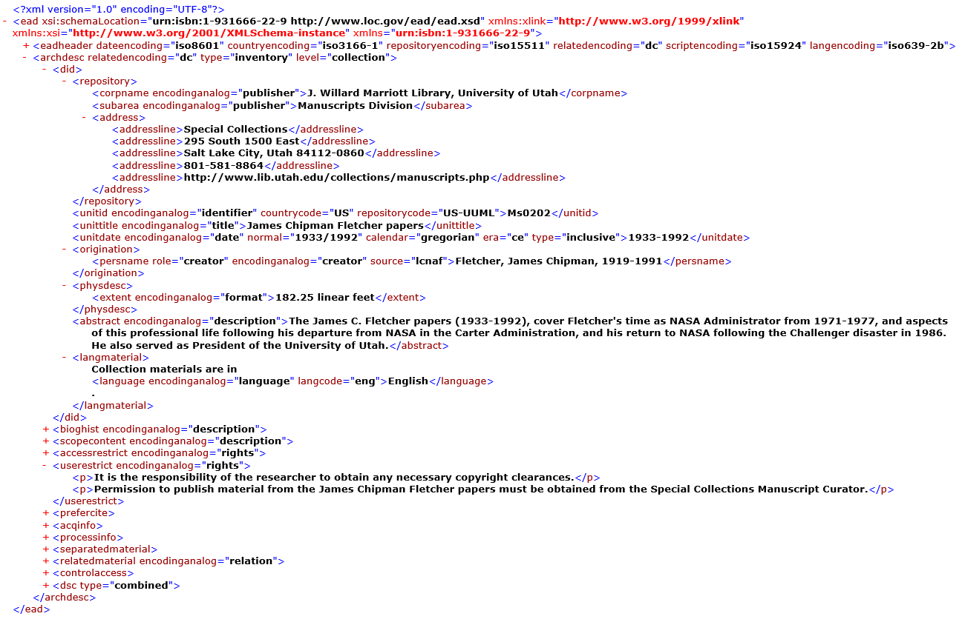
Encoded Archival Description (EAD)

Slide 26
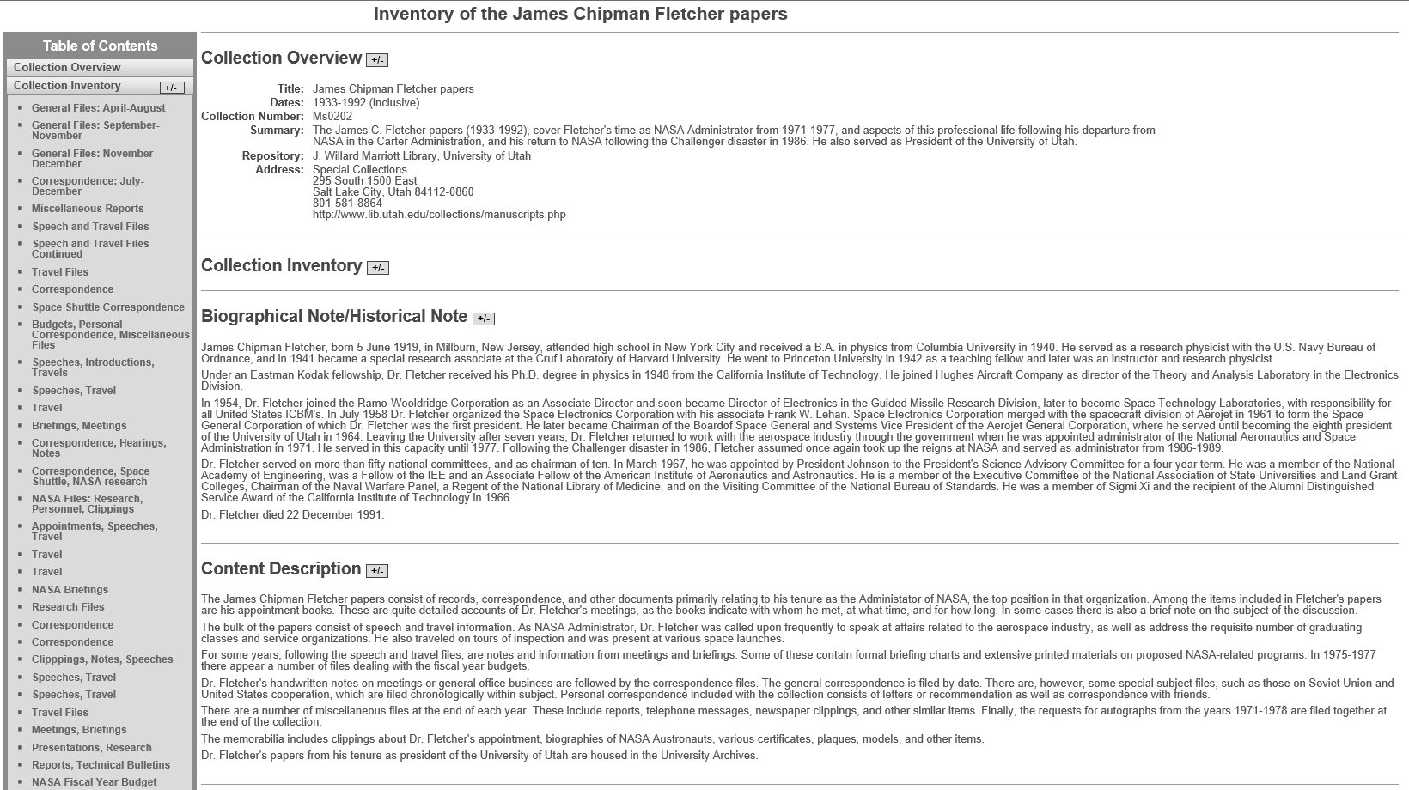
EAD Rendered for the Web

Slide 27
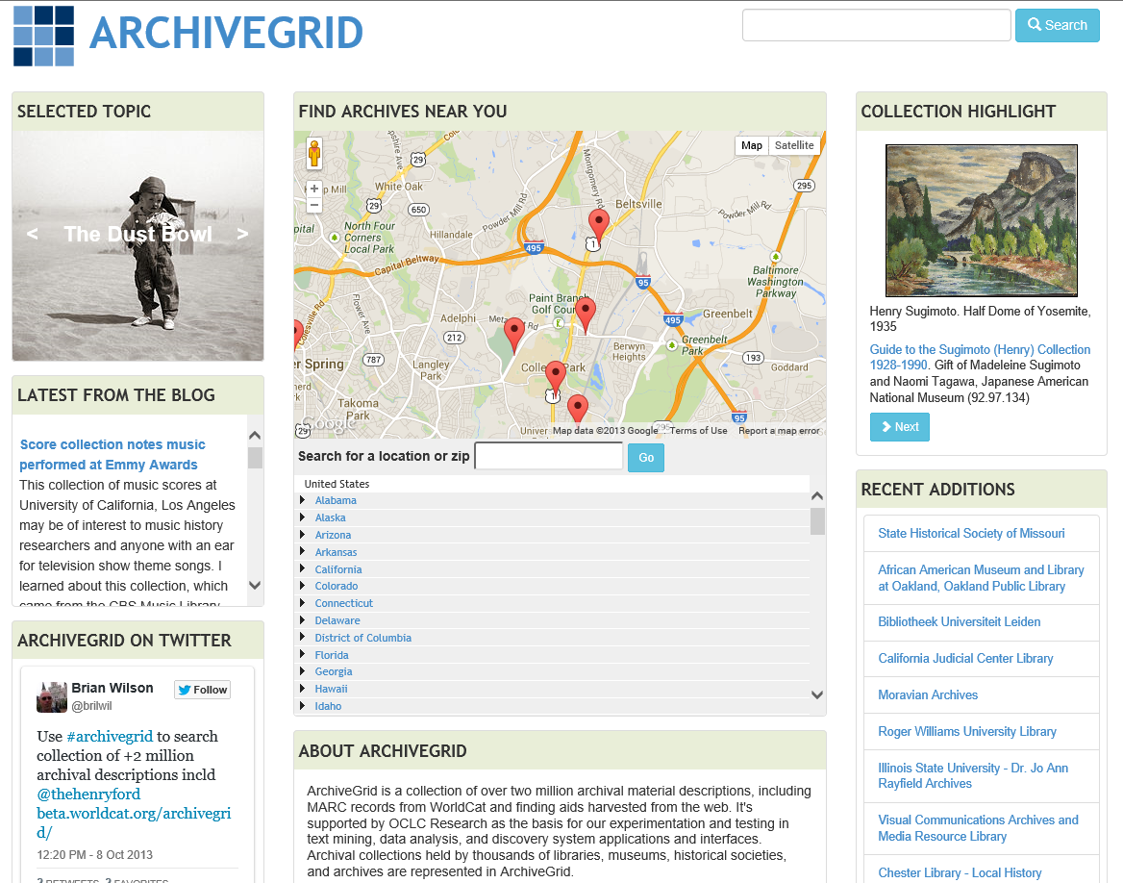
http://beta.worldcat.org/archivegrid/

Slide 28
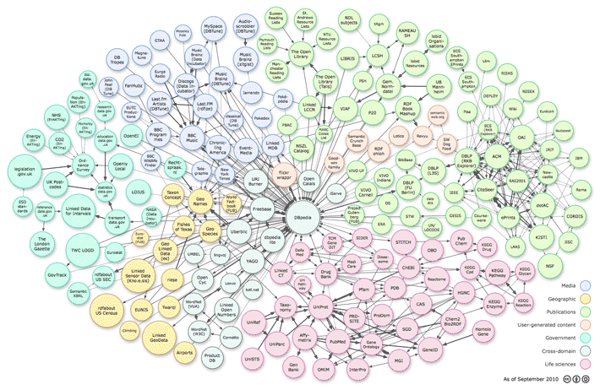
Linked Open Data

Slide 29




Deconstructing MARC
Sally McCallum, September, 2012

Slide 30
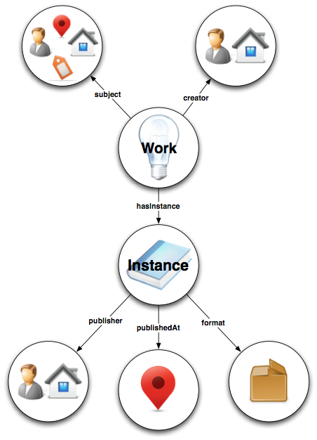
Bibliographic Framework Initiative
(BIBFRAME)
http://bibframe.org

Slide 31
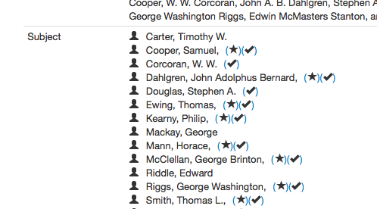
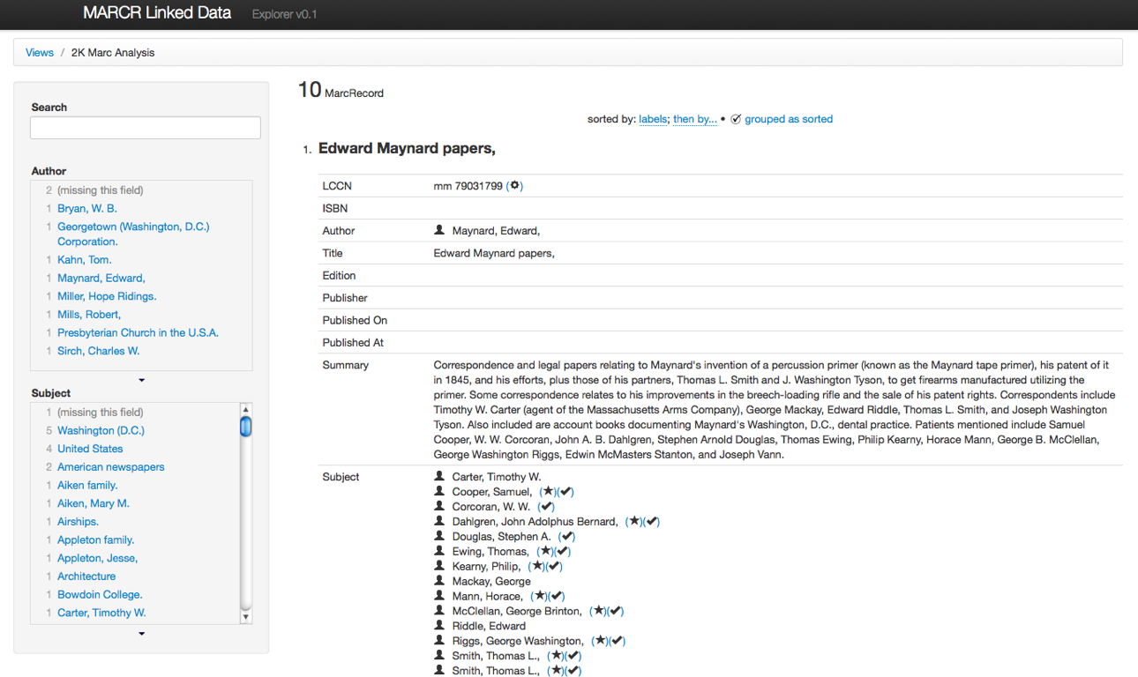

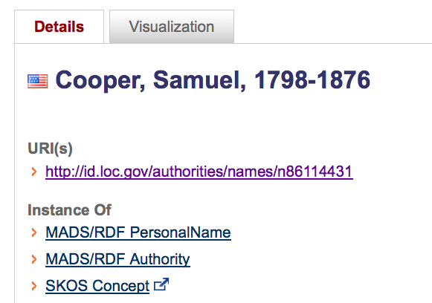
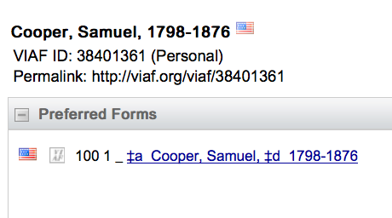

Slide 32
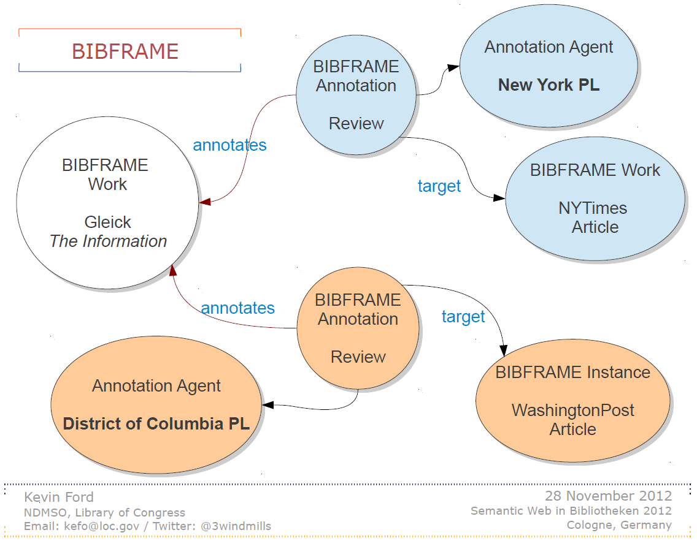

Slide 33
Before You Go!
On a sheet of paper (no names), answer the following question:
What was the muddiest point in today’s class?

