Slide 1
Description
Week 5
LBSC 671
Creating Information Infrastructures

Slide 2
Types of “Metadata”
Descriptive
Content, creation process, relationships
Technical
Format, system requirements
Usage
Display, derivative works
Administrative
Acquisition, authentication, access rights
Preservation
Media migration
Adapted from Introduction to Metadata,
Getty Information Institute (2000)

Slide 3
Five “Levels” of Metadata
Framework
Functional Requirements for Bibliographic Records (FRBR)
Schema (“Data Fields and Structure”)
Dublin Core
Guidelines (“Data Content and Values”)
Resource Description and Access (RDA)
Library of Congress Subject Headings (LCSH)
Representation (abstract “Data Format”)
Resource Description Framework (RDF)
Serialization (“Data Format”)
RDF in eXtensible Markup Language (RDF/XML)
Adapted from Elings and Waibel, First Monday, (12)3, 2007

Slide 4
Fostering Consistency
Content Standards
Resource Description and Access (RDA)
Describing Archives: a Content Standard (DACS)
Authority Control
Subject Authority
Name authority

Slide 5
FRBR Entity Types
Subject-Only Entities
(abstract) Concepts
(tangible) Objects
(any kind of) Places
Events
Subject or Responsibility Entities
Persons
(any kind of) “Corporate” Bodies
Families (technically, only in FRAD)
Product Entities
Works, Expressions, Manifestations, Items

Slide 6
Work
Expression
Manifestation
Item
is owned by
Person
is produced by
Family
is realized by
is created by
Corporate Body
many
Notes:
6
6
Let’s now move on to relationships for the Group 2 entities: person, family, and corporate body.
You see the relationships with the Group 1 entities in this picture:
work is created by a person, family, or corporate body
expression is realized by a person, family, or corporate body
manifestation is produced by a person, family, or corporate body
item is owned by a person, family, or corporate body.
The names of these Group 2 entities are controlled when they are used as access points in bibliographic records.
In the future we expect to see the names linked to descriptions of the resources and the links would indicate the specific type of relationship.

Slide 7
Work
The idea or impression in the mind of its creator
Completely abstract, no physical form
What all forms, presentations, publications, or performances of a work have in common
Romeo & Juliet
Homer’s Odyssey
Debussy’s Syrinx

Slide 8
Expression (Realization)
A work formulated into an ordered presentation
When a work takes a form
Can be notational, aural, kinetic, etc.
Excludes aspects of form not integral to the work
Font, layout, etc. (with some exceptions)
Attributes: Form, Language

Slide 9
Manifestation
Physical embodiment of an expression
The level usually described via cataloging
Set of physical objects that bear the same:
intellectual content (expression), and
physical form (item)
May have one or many items
Mona Lisa, Gone with the Wind, …
Attributes
Format, Physical medium, Manufacturer

Slide 10
Item
Instance of a manifestation
A thing!
Attributes:
Owned by, Location, Condition

Slide 11
Family of Works
Equivalent
Derivative
Descriptive
Free
Translation
Review
Microform
Reproduction
Edition
Summary
Casebook
Simultaneous
“Publication”
Abridged
Edition
Abstract
Dramatization
Digest
Novelization
Criticism
Screenplay
Copy
Libretto
Revision
Illustrated
Edition
Evaluation
Change of Genre
Exact
Reproduction
Parody
Translation
Expurgated
Edition
Annotated
Edition
Imitation
Variations or Versions
Same Style or
Thematic Content
Facsimile
Arrangement
Commentary
Reprint
Slight
Modification
Adaptation
Original Work - Same Expression
Same Work –
New Expression
New Work
Cataloging Rules Cut-Off Point
RDA for Georgia, 2011
Notes:
11
This picture shows a continuum of the relationships within a family of works as represented in manifestations <click> moving from left to right following this red arrow On the left <click> are those that are equivalent content, that are from the same expression of the same work. Once we introduce a change to the content, like a translation, <click> we have a new expression of the same work - and as we make further changes to the content we move further to the right, farther away from the original work. These are derivative expressions of the same work. Once that derivation crosses the <click> “magic line” of becoming more of the work of another person or corporate body, we consider it a new work, but it is part of the family of related works, even when the content moves on to be only describing <click> a work in the family at the right end of this continuum. Works in a descriptive relationship can also be said to be in a subject relationships, because the subject of those works is another work – as with a commentary on a work.
The ability to inform the user of these related works ties back to the ** collocating and finding functions of a catalog. We need to show users the pathways to related materials. The FRBR model reminds us of these important relationships that we should reflect in our catalogs and resource discovery systems for our users.

Slide 12
FRBR Bibliographic User Tasks
Find it
Search (“to find”)
Recognize (“to identify”)
Choose (“to select”)
Serve it
Location (“to obtain”)

Slide 13
Resource Description & Access (RDA)
RDA metadata describes entities associated with a resource to help users perform the following tasks:
Find information on that entity and on resources associated with the entity
Identify: confirm that the entity described corresponds to the entity sought, or to distinguish between two or more entities with similar names, etc.
Clarify the relationship between two or more such entities, or to clarify the relationship between the entity described and a name by which that entity is known
Understand why a particular name or title, or form of name or title, has been chosen as the preferred name or title for the entity

Slide 14
Components of RDA
“Elements” (Attributes)
Of manifestations and items
Of works and expressions
Of persons and corporate bodies
Of concepts
Relationships
Among product entities
Content entities: work, expression, manifestation, item
Between product and responsibility entities
Responsibility entities: person, family, corporate body
Between works and subject entities
Subject entities: concepts, objects, places, events

Slide 15
Bibliographic Relationships
Equivalence: exact (or nearly exact) copies
mp3 recording burned from a CD, …
Derivative: work based on/derived from another
Updated edition, adaptation, …
Descriptive: work that describes another work
Criticism, commentary, summary (e.g., Cliffs Notes), …

Slide 16
More Bibliographic Relationships
Whole-part: One work is part of another work
Volume in an encyclopedia, chapter in a book, …
Accompanying: A work meant to go with another work
Math workbook w/ textbook, index, documentation, …
Sequential: Work precedes/continues an existing work
Issues of a publication, sequels/prequels, …
Shared characteristic: Something in common
Author, title, language, subject, …

Slide 17
Authority Control
Unify references to the same entity (synonyms)
Samuel Clemens, Mark Twain
Distinguish references to different entities (homonyms)
Michael Jordan (basketball), Michael Jordan (computers)
Establish “access points”
Canonical and variant forms, to better support “find it” tasks

Slide 18
Functional Requirements for Authority Data
IFLA, 2013

Slide 19
Some RDA Elements for Products
Work
ID
Title
Date
etc.
Expression
ID
Form
Date
Language
etc.
Manifestation
ID
Title
Statement of responsibility
Edition
Imprint (place, publisher, date)
Form/extent of carrier
Terms of availability
Mode of access
etc.
Item
ID
Provenance
Location
etc.
RDA for Georgia, 2011
Notes:
19
Remember this slide from the earlier presentation that lists the elements that identify each of the FRBR Group 1 entities.

Slide 20
RDA: Person
“An individual or an identity established by an individual (either alone or in collaboration with one or more other individuals)”
Includes fictitious entities
Miss Piggy, Snoopy, etc. in scope if presented as having responsibility in some way for a work, expression, manifestation, or item
Also includes real non-humans
Only in US RDA test
RDA for Georgia, 2011
Notes:
In RDA a person can be an individual or an entity established by one individual alone or an identity established in collaboration with one or more other individuals. The scope statement at RDA 9.0 includes fictitious entities as persons. So, they can now be represented by authorized access points as creators or whatever role they play if they are presented on the resource as being responsible in some way .

Slide 21
RDA Person Examples
100 0# $a Miss Piggy.
245 10 $a Miss Piggy’s guide to life / $c
by Miss Piggy as told to Henry Beard.
700 1# $a Beard, Henry.
100 0# $a Lassie.
245 1# $a Stories of Hollywood / $c told
by Lassie.
RDA for Georgia, 2011
Notes:
Follow the same RDA instructions for the access points for fictitious entities and real non-human entities as you would for any other persons. What kind of name is it? A phrase? A given name? Apply the appropriate instruction. Don’t add a qualifier just to signal that the entity is not a human being; so, for example, don’t add “fictitious character” to the first example or “dog” to the second example here.

Slide 22
RDA: Language and Script
Names:
USA: In authorized and variant access points, apply the alternative to give a romanized form.
For some languages, can also give variant access points in original language/script
Other elements:
If RDA instructions don’t specify language, give element in English
Notes:
RDA gives you choices for language and script of the name of these entities just as it does for works. There is an alternative agencies may choose to apply: to give a transliterated form as a substitute if the title is given in a non-latin script in accordance with the principle of the convenience of the user.

Slide 23
RDA: Preferred Name
Used as the “authorized” (i.e., canonical) access point
Choose the form most commonly known
Variant spellings:
Choose the form found on the first resource received
If individual has more than one identity
Construct a preferred name for each identity
RDA for Georgia, 2011
Notes:
So, let’s start creating an authorized access point for a person.
The preferred name is the base for constructing the authorized access point when it is used in a bibliographic record or as the 100 in a name authority record. The variant name is used in see references, known in RDA as variant access points, in name authority records.
If the person has more than one identity, there are no longer any time period restrictions on establishing separate access points for each identity.
Another change from AACR2 related to variant spellings of the person’s name is to use the form found on the first resource received.

Slide 24
RDA: Additions to Preferred Name
title or other designation associated with person
date of birth and/or death * ^
fuller form of name * ^
period of activity of person * ^
profession or occupation *
field of activity of person *
* = if need to distinguish; ^ = option to add even if not needed
RDA for Georgia, 2011
Notes:
Here are those six possible additions. The symbols are a shorthand for the information you’ll find in those instructions about each element’s “core if” status and the existence of an option to add the information even if it’s not needed to differentiate between names for different persons.

Slide 25
RDA: Surnames Indicating Relationships
Include words, etc., (e.g., Jr., Sr., IV) in preferred name – not just to break conflict
100 1# $a Rogers, Roy, $c Jr., $d 1946-
## $a Growing up with Roy and Dale, 1986:
$b t.p.(Roy Rogers, Jr.) p. 16 (born
1946)
RDA for Georgia, 2011
Notes:
Another change from AACR2 is to include words or numerals indicating relationships in the preferred name; under AACR2, such words/numerals can be used only as additions to break conflicts.
In this example, the date already makes the access point unique; the AACR2 form would not include “Jr.”
However, during the Test, we didn’t change how that term is given in MARC; we continued to give it in subfield $c rather than making it be part of subfield $a.

Slide 26
RDA: Terms of Address When Needed
When the name consists only of the surname
(Seuss, Dr.)
For a married person identified only by a partner’s name and a term of address
(Davis, Maxwell, Mrs.)
If part of a phrase consisting of a forename(s) preceded by a term of address
(Sam, Cousin)
RDA for Georgia, 2011
Notes:
Terms of address (Dr., Mrs., etc.) in RDA cannot be used as additions to names. But they will be “legal” as part of a preferred name in the three situations listed on this slide.

Slide 27
RDA: Profession or Occupation
Core:
for a person whose name consists of a phrase or appellation not conveying the idea of a person, or
if needed to distinguish one person from another with the same name
Overlap with “field of activity”
100 1# $a Watt, James $c (Gardener)
RDA for Georgia, 2011
Notes:
Also from FRAD, Field of activity is a core element in two different situations:
1) when the name of the person doesn’t convey the idea of a person; or
2) when this information is needed to distinguish one name from another.
Sometimes it is difficult to determine what is Field of activity vs. Profession or occupation. (In the future there may be a proposal to IFLA to merge these two attributes in FRAD.)
Now in MARC subfield $c, this element also will always be enclosed in parentheses; the AACR2 practice is to use different punctuation depending on the type of name (given name, etc., vs. surname, etc.).

Slide 28
RDA: Field of Activity of Person
Field of endevor, area of expertise, etc., in which a person is or was engaged
Core:
For a person whose name consists of a phrase or appellation not conveying the idea of a person, or
If needed to distinguish one person from another with the same name
100 0# $a Spotted Horse $c (Crow Indian chief)
RDA for Georgia, 2011
Notes:
Field of activity, from FRAD, is a core element in two different situations:
1) when the name of the person doesn’t convey the idea of a person; or
2) when this information is needed to distinguish one name from another.
Now in MARC subfield $c, this element will always be enclosed in parentheses; the AACR2 practice is to use different punctuation depending on the type of name (given name, etc., vs. surname, etc.).
Are there any questions about the elements for constructing an authorized access point for a person?

Slide 29
RDA: Associated Date for Person
Three dates:
Date of birth
Date of death
Period of activity of the person
Guidelines for probable dates are in RDA 9.3.1
RDA for Georgia, 2011
Notes:
There are three dates associated with a person. The Period of activity information is used to break a conflict only when the fuller form of name is not available – remember the order on slide 14 as given in RDA 9.19.
RDA does not have any restrictions on time period for giving “period of activity” information as AACR2 does.
Guidelines for giving probable dates for any of the three dates are in RDA 9.3.1.

Slide 30
RDA: Associated Place for Person
Place of birth
Place of death
Country associated with the person
Place of residence
RDA for Georgia, 2011
Notes:
We won’t talk about these non-access point elements on this and subsequent slides but you’ll have the information here and you can read more in the RDA text.

Slide 31
DACS Principles
Records in archives possess unique characteristics.
The principle of respect des finds is the basis of archival arrangement and description.
Arrangement involves identification of groupings within material.
Description reflects arrangement.
The rules of description apply to all archival materials regardless of form or medium.
The principles of archival description apply equally to records created by corporate bodies, individuals, or families.
Archival descriptions may be presented at varying levels of detail to produce a variety of outputs.
The creators of archival materials, as well as the materials themselves, must be described.

Slide 32
(Single-Level) DACS Elements
Required
Optional
Reference code
Name+location of repository
Title
Date
Extent
Name of creator(s)
Scope and content
Conditions governing access
Languages and scripts
Plus, for “Optimal”
Administrative/biographical history
Access points
System of arrangement
Physical access
Technical access
Conditions for reproduction and use
(other) Finding aids
Custodial history
Immediate source of acquisition
Appraisal, destruction, scheduling
Accruals (anticipated additions)
Existence+location of originals
Existence+location of copies
Related archival materials
Publication note
Notes
Description control

Slide 33
Modeling Use of Language
Normative
Observe how people do talk or write
Somehow, come to understand what they mean each time
Create a theory that associates language and meaning
Interpret language use based on that theory
Descriptive
Observe how people do talk or write
Someone “trains” us on what they mean each time
Use statistics to learn how those are associated
Reverse the model to guess meaning from what’s said

Slide 34
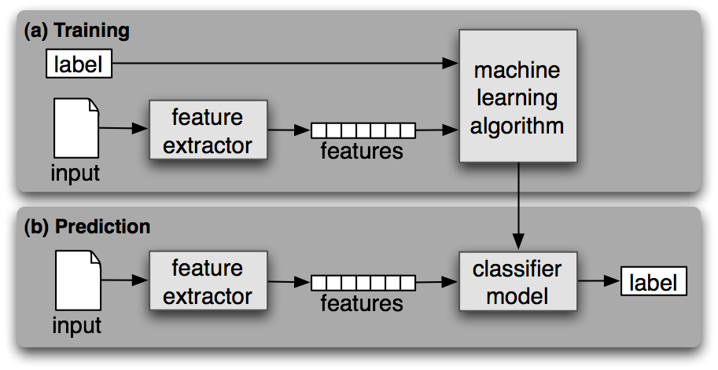
Supervised Machine Learning
Steven Bird et al., Natural Language Processing, 2006

Slide 35
Some Examples of Features
Topic
Counts for each word
Sentiment
Counts for each word
Human values
Counts for each word
Sentence splitting
Ends in one of .!?
Next word capitalized
Part of speech
Word ends in –ed, -ing, …
Previous word is a, to, …
Named entity
All+only first letters caps
Next word is said, went, …
Gender of person name
Last letter

Slide 36
Metadata Extraction: Named Entity “Tagging”
Machine learning techniques can find:
Location
Extent
Type
Two types of features are useful
Orthography
e.g., Paired or non-initial capitalization
Trigger words
e.g., Mr., Professor, said, …

Slide 37
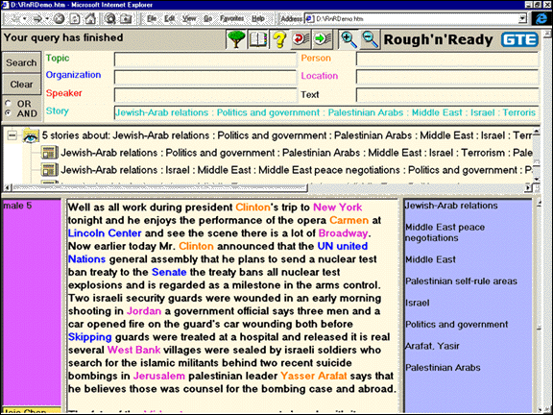

Slide 38
Gender Classification Example
>>> classifier.show_most_informative_features(5) Most Informative Features
last_letter = 'a' female : male = 38.3 : 1.0 last_letter = 'k' male : female = 31.4 : 1.0 last_letter = 'f' male : female = 15.3 : 1.0 last_letter = 'p' male : female = 10.6 : 1.0 last_letter = 'w' male : female = 10.6 : 1.0
>>> for (tag, guess, name) in sorted(errors): print 'correct=%-8s guess=%-8s name=%-30s'
correct=female guess=male name=Cindelyn ... correct=female guess=male name=Katheryn correct=female guess=male name=Kathryn ... correct=male guess=female name=Aldrich ... correct=male guess=female name=Mitch ... correct=male guess=female name=Rich ...
NLTK Naïve Bayes

Slide 39
Sentiment Classification Example
>>> classifier.show_most_informative_features(5)
Most Informative Features
contains(outstanding) = True pos : neg = 11.1 : 1.0
contains(seagal) = True neg : pos = 7.7 : 1.0
contains(wonderfully) = True pos : neg = 6.8 : 1.0
contains(damon) = True pos : neg = 5.9 : 1.0
contains(wasted) = True neg : pos = 5.8 : 1.0

Slide 40
Supervised Learning Techniques
Decision Tree
Explainable (near the top)
Naïve Bayes
Efficient training
Maximum Entropy
Good use of limited training data
k-Nearest-Neighbor
Easily extended to multi-class problems

Slide 41
Machine Learning for Classification: The k-Nearest-Neighbor Classifier

Slide 42
Supervised Learning Limitations
Rare events
It can’t learn what it has never seen!
Overfitting
Too much memorization, not enough generalization
Unrepresentative training data
Reported evaluations are often very optimistic
It doesn’t know what it doesn’t know
So it always guesses some answer
Unbalanced “class frequency”
Consider this when deciding what’s good enough

Slide 43
Before You Go!
On a sheet of paper (no names), answer the following question:
What was the muddiest point in today’s class?

