Slide 1

Acquisition
Week 2
LBSC 671
Creating Information Infrastructures

Slide 2
Muddiest Points
My “5 levels” of metadata
Moore’s Law
  And other technical stuff
Life cycle models

Slide 3
Five Levels of Metadata
Framework
  Functional Requirements for Bibliographic Records (FRBR)
Schema
  Dublin Core
Vocabulary
  Library of Congress Subject Headings (LCSH)
Representation
  Resource Description Framework (RDF)
Serialization
  RDF in eXtensible Markup Language (RDF/XML)
Adapted from Dante Alighieri, Comedia (c. 1321)

Slide 4
Some Metadata Process Examples
Created By
Human
Machine
Indexing | Machine-assisted indexing
HTML metadata field | Search engine
Human
Used By
Machine

Slide 5
Two Basic Technologies
Print
  Physicality closely couples collection and access
  Cost structure shapes production and use
  Management of scarcity
Digital
  Collection and access are more easily separated
  Cost structure shapes production and use
  Management of abundance

Slide 6
Tonight
Accessioning, appraisal and deaccessioning in archives
Selection, acquisition and weeding in libraries
Crawling by Web search engines

Slide 7
Selection and Acquisition Criteria
LAC [Libraries and Archives Canada] will develop:
  a comprehensive collection of published Canadiana that documents the published heritage of Canada and materials published elsewhere of interest to Canada, and that supports the creation of a comprehensive national bibliography to make that heritage known and accessible,
  records holdings sufficient to document the functions and activities of the Government of Canada, and
  a representative collection of records of heritage value that document the historical development and diversity of Canadian society.
LAC Digital Collection Development Policy, 2006

Slide 8
Some Types of “Archives”
Government
  Legal, cultural
Institutional
  Liability, institutional memory
Manuscript repositories
  Research, preservation

Slide 9
Some Sources for Collections
Institutional components
  Transferred from records management
Donors
  Typically deed of gift specifies terms
Purchase

Slide 10
National Archives Records Schedules
Schedule 1. Civilian Personnel Records
Schedule 2. Payrolling and Pay Administration Records
Schedule 3. Procurement, Supply, and Grant Records
Schedule 4. Property Disposal Records
Schedule 5. Budget Preparation, Presentation, and Apportionment Records
Schedule 6. Accountable Officers' Accounts Records
Schedule 7. Expenditure Accounting Records
Schedule 8. Stores, Plant, and Cost Accounting Records
Schedule 9. Travel and Transportation Records
Schedule 10. Motor Vehicle Maintenance and Operations Records
Schedule 11. Space and Maintenance Records
Schedule 12. Communications Records
Schedule 13. Printing, Binding, Duplication, and Distribution Records
Schedule 14. Information Services Records
Schedule 15. Housing Records
Schedule 16. Administrative Management Records
Schedule 17. Cartographic, Aerial Photographic, Architectural, and Engineering Records
Schedule 18. Security and Protective Services Records
Schedule 20. Electronic Records
Schedule 21. Audiovisual Records
Schedule 23. Records Common to Most Offices Within Agencies
Schedule 24. Information Technology Operations and Management Records
Schedule 25. Ethics Program Records
Schedule 26. Temporary Commissions, Boards, Councils and Committees
Schedule 27. Records of the Chief Information Officer

Slide 11
Collection Development Policies
Mission
  Intended (“statement of purpose”): 92%
  Emergent (“strengths of holdings”): 53%
Scope
  Subject: 84%
  Geographic: 84%
  Time frame: 57%
Anticipated use
  Users: 59%
  Activities: 53%
Cynthia Sauer, Ding the Best We Can, (2001)

Slide 12
Basis for Exceptions
Donor relationship: 70%
Implicit broadening of scope
  Risk of destruction:` 49%
  Exceptional opportunity: 30%
Prestige
  Publicity value: 15%
  Attract future resources: 12%
  Institutional competition: 6%
Cynthia Sauer, Ding the Best We Can, (2001)

Slide 13
Evolutionary Policy
Envision
  Available materials, future use, existing alternatives
React
  Establish decision basis for individual cases
Evolve
  Changing mission, resources, opportunities, pressures
Codify
  Decide which parts to put in writing (and why!)

Slide 14
Why Codify?
Develop shared vision with stakeholders
  Keep resources in line with requirements
  Minimize unintended policy drift
Facilitate appropriate donations
  Solicit in-scope donations
  Communicate limitations to donors
Facilitate referrals
Foster continuity in the decision process

Slide 15
Appraisal
Value
  Evidential
  Informational
Costs
  Storage, arrangement, description, preservation, …
Stakeholder interests
  Primary: Institutional needs
  Primary: Accountability
  Secondary: Other future record users

Slide 16
Deaccessioning
Space limits
Policy changes
Technology changes

Slide 17
Tonight
Accessioning, appraisal and deaccessioning in archives
Selection, acquisition and weeding in libraries
Crawling by Web search engines

Slide 18
A Collection Development Policy
Customer use is the most powerful influence on the Library’s collection. …The other driving force is the Library’s strategic plan.
… selections are made to provide depth and diversity of viewpoints to the existing collection and to build the world-class Western History/Genealogy and African American Research Library collections. …
… The Library provides materials to support each individual’s journey, and does not place a value on one customer’s needs or preferences over another’s. …
Materials for children and teenagers are intended to broaden their vision, support recreational reading …
Denver Public Library, 2012

Slide 19
Why Libraries Collect
Access
  Current users
  Future users
  Social responsibility
Prestige

Slide 20
Selection
Scope
  Demographics, research focus, …
Quality metrics
  Publisher, author, impact factor, …
Practical factors
  Cost, language, availability elsewhere, …
Use
  Circulation, inter-library loan, requests, …

Slide 21
Publishing Infrastructure
Publishers
  Intermediation on behalf authors
Vendors
  Intermediation on behalf of libraries
  Value added services
    Electronic Data Interchange (EDI)
    Stock profiles (on approval)
    Shelf-ready books

Slide 22
Access models
Ownership (“just in case”)
  Unlimited use for an unlimited period
  Right of first sale vs. license restrictions
Subscription
  Unlimited (or limited) use for a defined period
  Single vs. multiple users
Pay-per-view (“just in time”)

Slide 23
Use-Driven Acquisition
Online catalog includes unpurchased items
First few access requests cause rental each time
Next request results in unlimited-use subscription (or ownership)
Transfers some risk to vendor
  Lowers cost of low-use items
  Somewhat raise cost of high use items

Slide 24
Zipf’s Law

Slide 25
The “Big Deal”
Bundled access (usually to serials)
  Vendor goal: cross-sell lower-demand items
  Incentive: Access to much more content
    Sometimes with some delay (e.g., 1 year)
Risks:
  Future access to subscription content
  Future price increases

Slide 26
Open Access
Self-archiving
  Personal Web sites
  Institutional repositories
Publishing
  Author pays
  Volunteer labor

Slide 27
Weeding (“Library Hygiene”)
Presumes some limited asset
  e.g., shelf space, browsing time, …
Anticipated future use
  Reshelving and circulation statistics
  Historical value
  Sufficiency of single copies
  Last copy doctrine
Condition
  Preservation costs

Slide 28
Tonight
Accessioning, appraisal and deaccessioning in archives
Selection, acquisition and weeding in libraries
Crawling by Web search engines

Slide 29
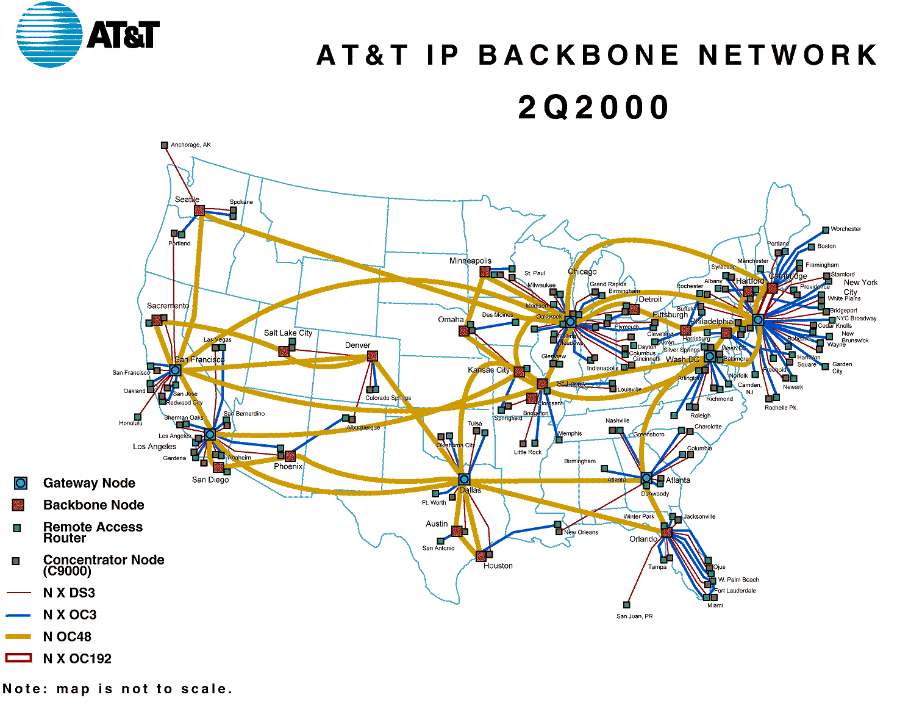
The Internet

Slide 30
The Web
The Protocols
  Uniform Resource Locator (URL)
  Hypertext Markup Language (HTML)
  Hypertext Transport Protocol (HTTP)
Content types
  Static, dynamic, streaming, transactional
Access
  Public, protected, or intranet?

Slide 31
Crawling the Web

Slide 32
Robots Exclusion Protocol
Requires voluntary compliance by crawlers
Exclusion by site
  Create a robots.txt file at the server’s top level
  Indicate which directories not to crawl
Exclusion by document (in HTML head)
  Not implemented by all crawlers
  <meta name="robots“ content="noindex,nofollow">

Slide 33
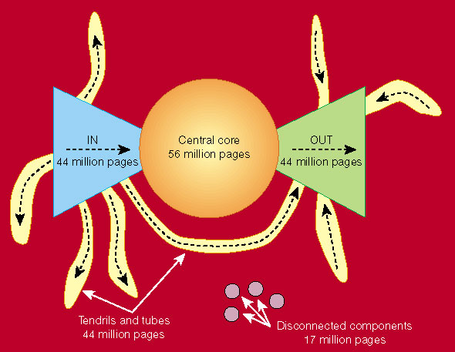
Link Structure of the Web
Nature 405, 113 (11 May 2000) | doi:10.1038/35012155

Slide 34
Web Crawl Challenges
Discovering “islands” and “peninsulas”
Duplicate and near-duplicate content
  30-40% of total content
Link rot
  Changes at ~1% per week
Network instability
  Temporary server interruptions
  Server and network loads
Dynamic content generation

Slide 35
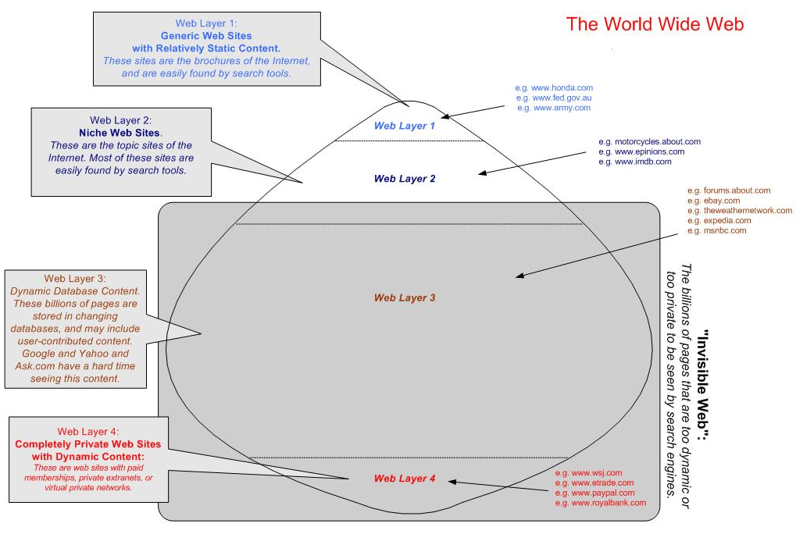

Slide 36
The “Deep Web”
Estimates for 2008

Slide 37
Hands on:
The Internet Archive
alexa.com Web crawls since 1997
  http://archive.org
Check out the iSchool’s Web site from 1998!
  http://www.clis.umd.edu

Slide 38
Global Internet Users
Web Pages

Slide 39
Most Widely-Spoken Languages
Source: Ethnologue (SIL), 1999

Slide 40
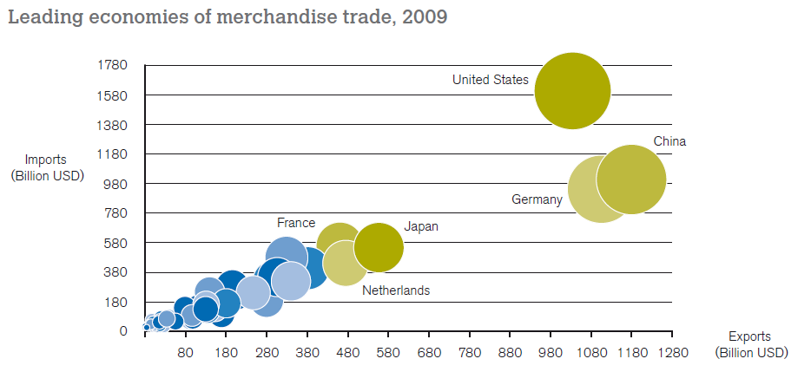
Global Trade
Source: World Trade Organization 2010 Annual Report
Notes:
This chart shows the 15 nations with at least 100 billion dollars in annual imports and exports.
Together, these nations account for 73% of the world’s exports
World trade thus defines nine major languages:
English, German, Japanese, Chinese, French, Italian, Dutch, Korean, Spanish
There are three key drivers that decide which languages get attention.
Where is the money. The G7 languages are well covered
Where are the people. This seems to have a much smaller effect.
Where are the problems: This explains the interest in Farsi, Korean, etc.

Slide 41
Homework G3
Life Cycle Analysis of your collection
  Choose no more than 5 content types
Creation
Use
Evolution
Disposition

Slide 42
Before You Go
On a sheet of paper, answer the following (ungraded) question (no names, please):
What was the muddiest point in today’s class?

