Slide 1

Content Management Systems
Week 13
LBSC 671
Creating Information Infrastructures

Slide 2
Why Content Management Systems?
Separation of content and appearance
Separation of roles
Standardization of common “design patterns”
  Login and password recovery
  Headlines and drill-down
  Site map
  Search
  Shopping cart

Slide 3
Content Management Systems
WordPress
  http://wordpress.org
Joomla
  http://www.joomla.org
Drupal
  https://drupal.org

Slide 4
Roles
Information architecture design
Task assignment
Content generation and modification
Approval for “publication”
Publication
Error correction
Tracking task progress

Slide 5
Content Management System Structure
Database stores the content
  And access control data and parameters
Server scripting controls the user experience
  PHP readss database, generates HTML
(X)HTML conveys the user experience
User-side scripting enhances interactivity
  JavaScript may be used for form validation

Slide 6
Client Hardware
(PC)
Interface
Design
Web Browser
(IE, Firefox)
Client-side Programming
(JavaScript)
Interaction
Design
Interchange Language
(HTML, XML)
Server-side Programming
(PHP)
Business
rules
Database
(MySQL)
Server Hardware
(PC, Unix)

Slide 7
“Site Blueprint”
Main
Homepage
Teaching
Research
Other
Activities
LBSC 690
Ph.D.
Students
IR
Colloquium
INFM 718R
Publications
TREC
Doctoral
Seminar
Projects

Slide 8
Grid Layouts
Navigation Bar
Navigation Bar
Content
Content
Navigation Bar
Related Links
Navigation Bar
Content
Content

Slide 9
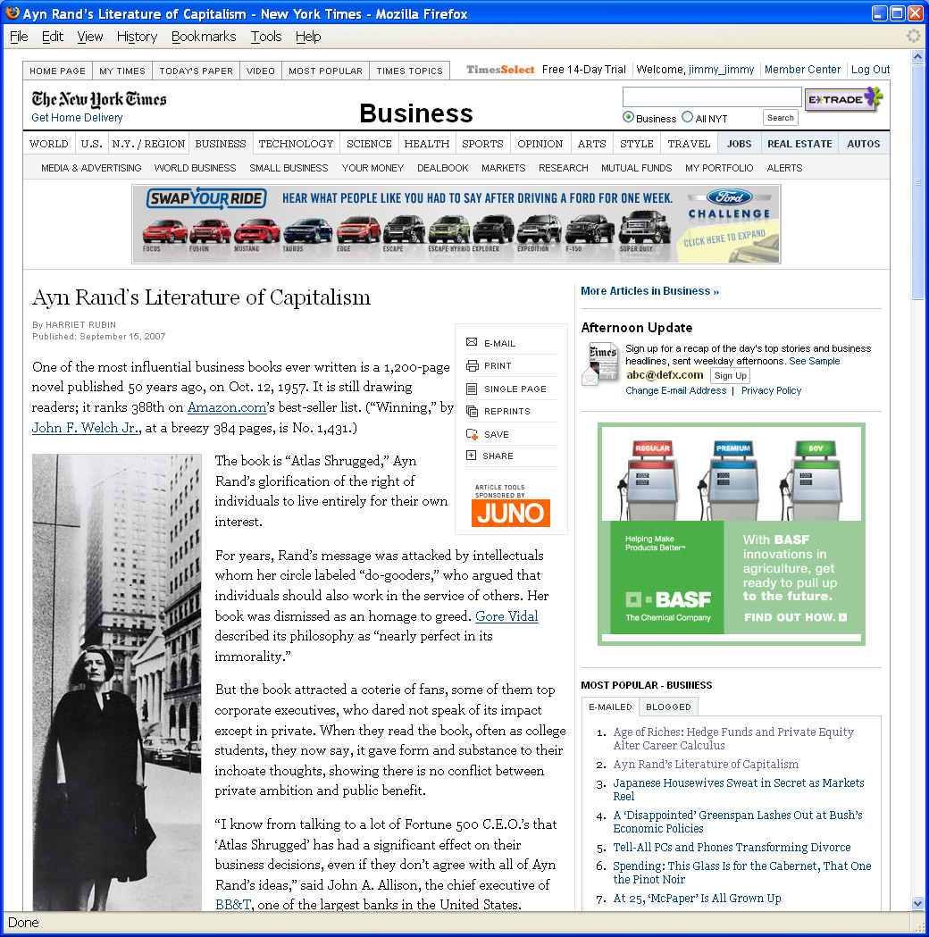
Grid Layout: NY Times

Slide 10
Grid Layout: NY Times
Navigation
Banner Ad
Another Ad
Content
Popular
Articles

Slide 11
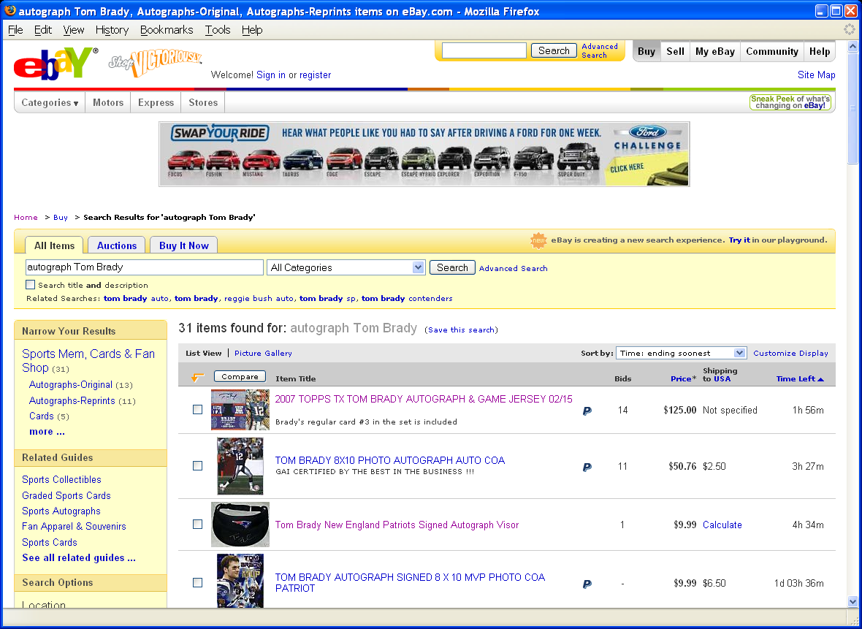
Grid Layout: ebay

Slide 12
Grid Layout: ebay
Navigation
Banner Ad
Navigation
Related
Search Results

Slide 13
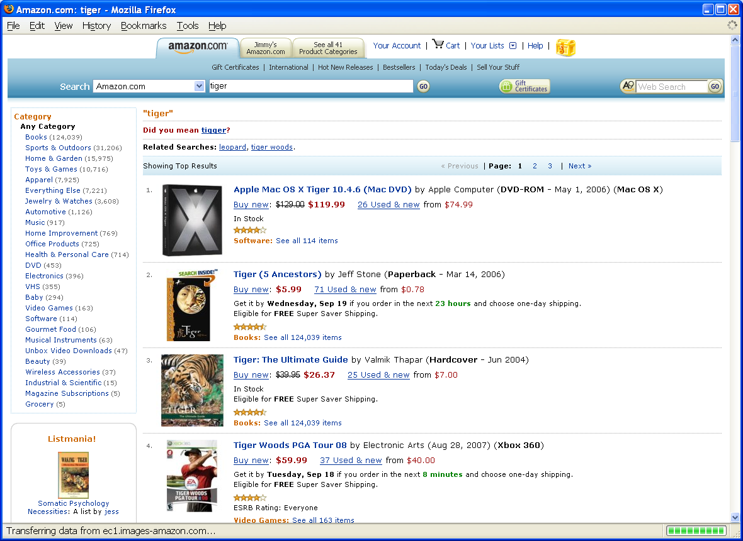
Grid Layout: Amazon

Slide 14
Grid Layout: Amazon
Navigation
Navigation
Related
Search Results

Slide 15
Some Layout Guidelines
Contrast: make different things different
  to bring out dominant elements
  to create dynamism
Repetition: reuse design throughout the interface
  to achieve consistency
Alignment: visually connect elements
  to create flow
Proximity: make effective use of spacing
  to group related and separate unrelated elements

Slide 16
Interaction Design
Chess analogy: a few simple rules that disguise an infinitely complex game
The three-part structure
  Openings: many strategies, lots of books about this
  End game: well-defined, well-understood
  Middle game: nebulous, hard to describe
Information navigation has a similar structure!
  Middle game is underserved
From Hearst, Smalley, & Chandler (CHI 2006)

Slide 17
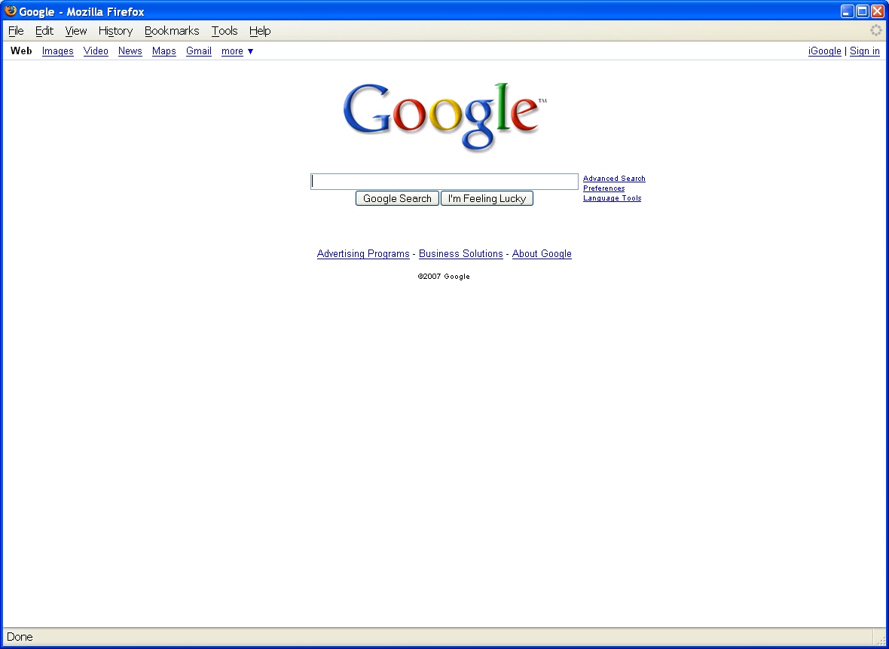
Opening Moves

Slide 18
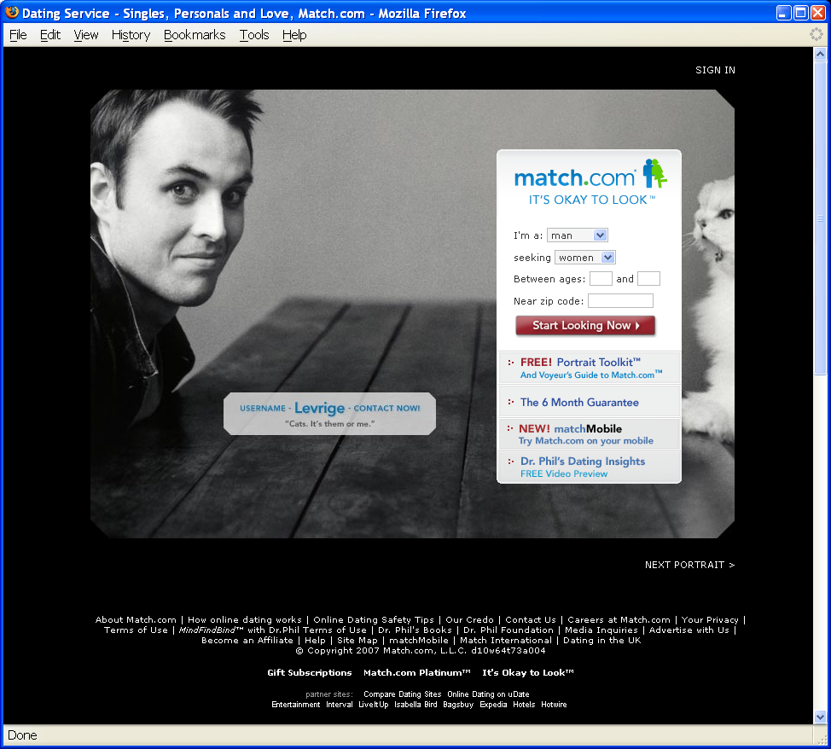
Opening Moves

Slide 19
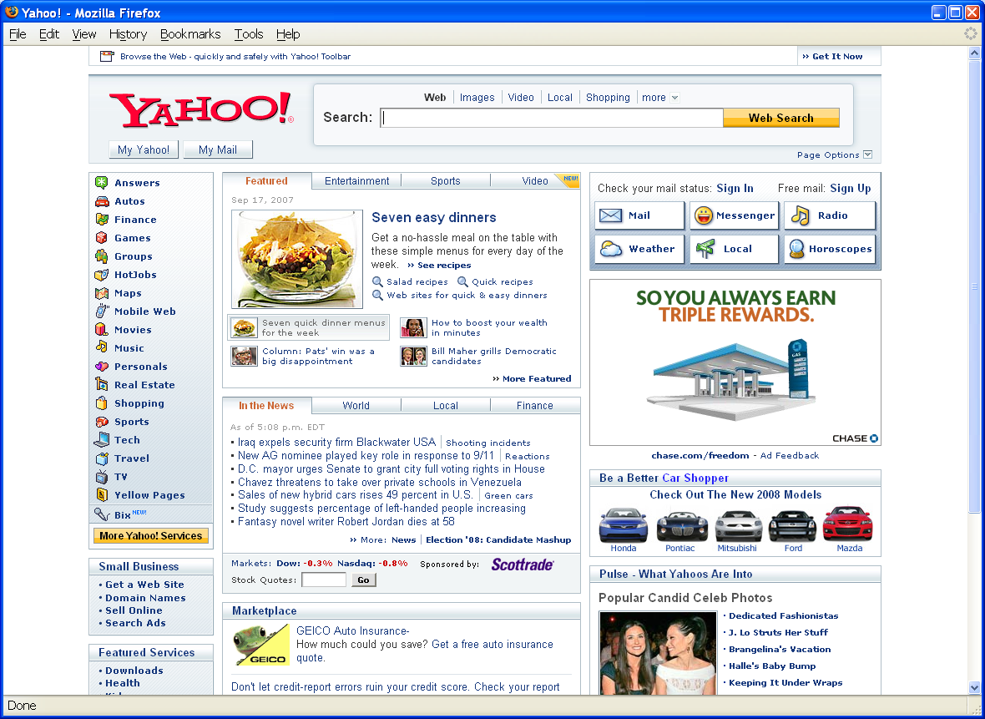
Opening Moves

Slide 20
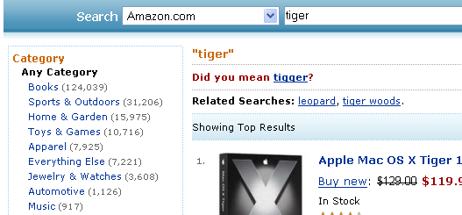
Middle Game

Slide 21

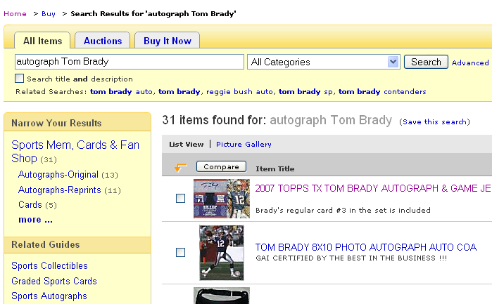
Middle Game

Slide 22
Joomla Structure
Front end
  The Web site
Back end
  Where the Web site is defined

Slide 23
Joomla Components
Web sites are made up of rectangular pieces
  Called “modules”
Two basic types of modules:
  Displaying content (e.g., articles)
  Interaction (e.g., login)
Templates define where modules can be put
  Templates define abstract “positions”
  Joomla maps positions to layout in ways appropriate to the device

Slide 24
Joomla Features
Menus control navigation
  Menu items control where you can go
Categories group things (i.e., entities)
  University courses, Apollo missions, Meetups, …
Extensions allow you to add new capabilities
  JCE Editor, Image rotator, Google maps, …

Slide 25
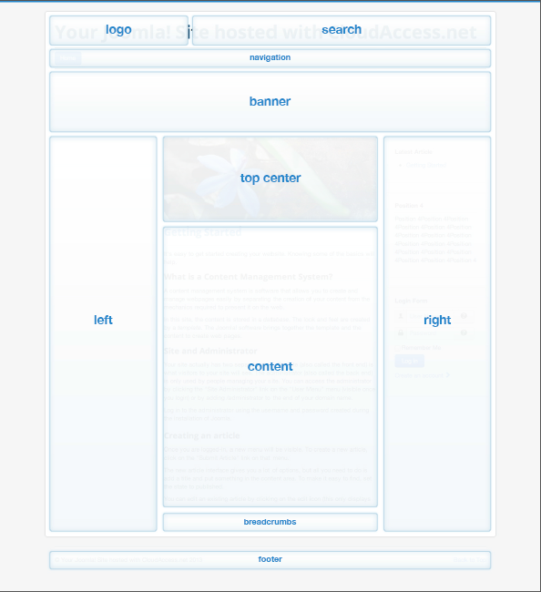

Slide 26
Joomla Hosting
Your own computer
  Useful as a way to try things out
  Not easily accessable to others
Demo account (for 30 days) at joomla.org
  You can pay to keep it past 30 days
Web hosting service
  Longer life, more support, or less cost
  More complex to set up

Slide 27
Joomla First Steps
System->Control Panel
  Gets to the back-end home
Install the Joomla Content Editor (JCE)
Learn how to insert content
  Images, text without formatting
Learn how to set up menu items
Learn how to control layout

Slide 28
Ajax Applications
Google Maps
  http://maps.google.com
Google Suggest
  http://www.google.com/webhp?complete=1&hl=en
Sajax Tables
  http://labs.revision10.com/?p=5
Sajax
  http://www.modernmethod.com/sajax/

Slide 29
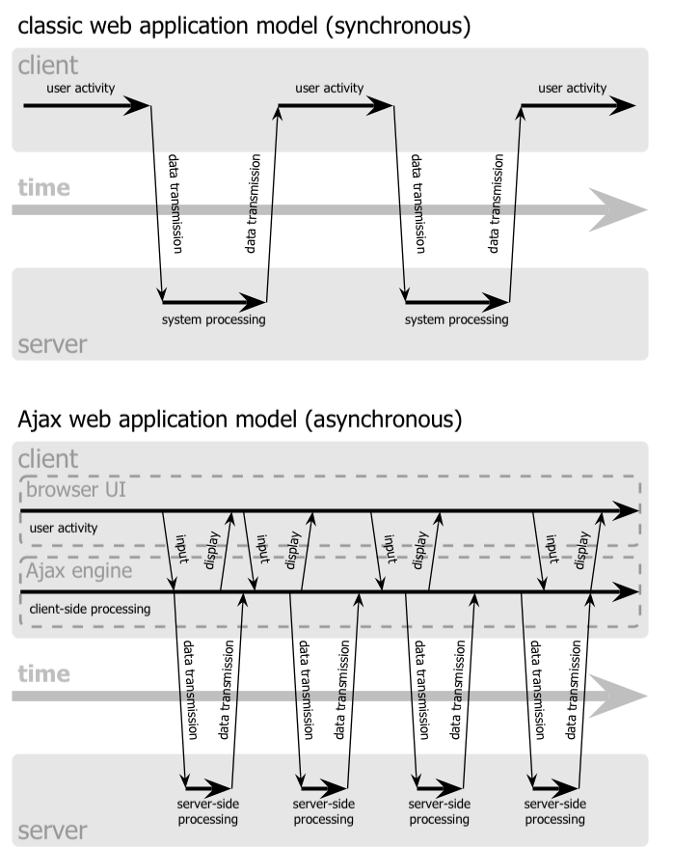

Slide 31
Navigation Patterns
Drive to content
Drive to advertisement
Move up a level
Move to next in sequence
Jump to related

Slide 32
Evaluation Approaches
Formative vs. summative
Extrinsic vs. intrinsic
Quantitative vs. qualitative
  Deductive vs. inductive
User study vs. simulation

Slide 33
Evaluation Examples
Direct observation
  Evaluator observes users interacting with system
    in lab: user asked to complete pre-determined tasks
    in field: user goes through normal duties
  Validity depends on how contrived the situation is
Think-aloud
  Users speak their thoughts while doing the task
  May alter the way users do the task
Controlled user studies
  Users interact with system variants
  Correlate performance with system characteristics
  Control for confounding variables

Slide 34
Evaluation Measures
Time to learn
Speed of performance
Error rate
Retention over time
Subjective satisfaction

Slide 35
Human-Computer Interaction
A discipline concerned with the
Design
Implementation
Evaluation
of interactive computing systems for human use
Notes:
35

Slide 36
Synergy
Humans do what they are good at
Computers do what they are good at
Strengths of one cover weakness of the other

Slide 37
Interaction
Forming an intention
  Internal mental characterization of a goal
Selection of an action
  Review possible actions, select most appropriate
Execution of the action
  Carry out appropriate actions with the system
Evaluation of the outcome
  Compare results with expectations

Slide 38
Stages of Interaction
Goals
Intention
Expectation
Evaluation
Selection
Interpretation
Mental Activity
Physical Activity
System
Execution
Perception

Slide 39
Challenges of HCI
Goals
Intention
Expectation
Evaluation
“Gulf of Execution”
“Gulf of Evaluation”
Selection
Interpretation
Mental Activity
Physical Activity
System
Execution
Perception

Slide 40
What is good design?
Goals
Intention
Expectation
Evaluation
Mental
Model
Selection
Interpretation
Mental Activity
Physical Activity
System
Execution
Perception

Slide 41
Modeling Interaction
Human
Mental Models
Sight
Sound
Task
System
Hands
Voice
Software Models
Keyboard
Mouse
Task
User
Display
Speaker
Computer

Slide 42
Mental Models
How the user thinks the machine works
  What actions can be taken?
  What results are expected from an action?
  How should system output be interpreted?
Mental models exist at many levels
  Hardware, operating system, and network
  Application programs
  Information resources

Slide 43
Static Design
Organizing principles
  Logical: e.g., chronological, alphabetical
  Functional: by task
  Demographic: by user
Metaphors
  Organizational: e.g., e-government
  Physical: e.g., online grocery store
  Functional: e.g., cut, paste
  Visual: e.g., octagon for stop

Slide 44
Before You Go
On a sheet of paper, answer the following (ungraded) question (no names, please):
What was the muddiest point in this semester?

