Slide 1
Stranger in a Strange Land
Guest presentation LBSC 671
Robert Spangler
Nov 18, 2013

Slide 2
My background & who I am
Robert Spangler
robert.spangler@nara.gov
IT Specialist at NARA, 2002-present
  hired in a “mini-wave” of concern over NARA’s ability to handle electronic records
  A non-archivist in an Archives, however, is always a bit of a stranger in a strange land.

Slide 3
Previous experience
Executive Office of the President (White House)
  Email and Office Automation Systems Management
    1990-1996, 2000-2002
Citigroup Information Services
  Global Messaging Manager 1996-2000
Digital Equipment Corporation and Various Contractors
  Public and Private Client Support 1981-1990

Slide 4
Education, then and now
BS, MBA, University of Pittsburgh
Teaching LBSC 682 at UMD, Fall 2013
  “Management of Electronic Records and Information”
Planning to Teach “Implementing Digital Curation” Spring 2014

Slide 5
NARA
The National Archives and Records Administration (NARA) is an independent agency of the Federal government charged with preserving and documenting government and historical records and with providing public access to those records

Slide 6
Washington Facilities
National Archives Building
  7th and Penn, DC
  Home of the Charters of Freedom
National Archives at College Park
  “Archives 2”

Slide 7
Agency Leadership
The chief administrator of NARA is the Archivist of the United States
Incumbent is David Ferriero, since 2009. Prior:
  Director, New York Public Library
  Duke and MIT library positions
General Structure (tracks the lifecycle of records...)
  Agency Services
  Research Services
  Office of Innovation
  Information Services
    Other administrative support

Slide 8
Regional facilities
There are facilities across the country with research rooms, archival holdings, and microfilms of documents of federal agencies and courts pertinent to each region.
Anchorage, Alaska, Pacific Alaska Region
Atlanta, Georgia, Southeast Region
Boston, Massachusetts, Northeast Region
Chicago, Illinois, Great Lakes Region
Denver, Colorado, Rocky Mountain Region
Fort Worth, Texas, Southwest Region

Slide 9
Regional facilities (cont’d)
Kansas City, Missouri, Central Plains Region
New York City, New York, Northeast Region
Philadelphia, Pennsylvania, Mid Atlantic Region
Riverside, California, Pacific Region
San Bruno, California, Pacific Region
Seattle, Washington, Pacific Alaska Region

Slide 10
St. Louis Personnel Records
Three offices in the St. Louis, Missouri area comprise the National Personnel Records Center.
Spanish Lake, Missouri, Military Personnel Records Center
Valmeyer, Illinois and St. Louis, Missouri, Civilian Personnel Records Center
In addition, Federal Records Centers exist in each region that house materials owned by Federal agencies. Federal Records Centers are not open for public research. For example, the FRC in Lenexa, Kansas holds items from the treatment of John F. Kennedy after his fatal shooting in 1963.

Slide 11
Presidential Libraries
Herbert Hoover Presidential Library in West Branch, Iowa
Franklin D. Roosevelt Presidential Library in Hyde Park, New York
Harry S. Truman Presidential Library in Independence, Missouri
Dwight D. Eisenhower Presidential Library in Abilene, Kansas
John F. Kennedy Presidential Library in Boston, Massachusetts
Lyndon B. Johnson Presidential Library in Austin, Texas
Richard Nixon Presidential Library and Museum in Yorba Linda, California
Gerald R. Ford Presidential Library in Ann Arbor, Michigan
Gerald R. Ford Presidential Museum in Grand Rapids, Michigan
Jimmy Carter Presidential Library in Atlanta, Georgia
Ronald Reagan Presidential Library in Simi Valley, California
George Bush Presidential Library in College Station, Texas
William J. Clinton Presidential Library in Little Rock, Arkansas
George W. Bush Presidential Library in Dallas, Texas

Slide 12
Also of Note...
Archivist of the United States~
not only maintains the official documentation of the passage of amendments to the U.S. Constitution by state legislatures, but has the authority to declare when the constitutional threshold for passage has been reached, and therefore when an act has become an amendment.
NARA also transmits votes of the Electoral College to Congress.
The Federal Register is a division of NARA; it is the official journal of the federal government of the United States that contains most routine publications and public notices of government agencies

Slide 13
The records lifecycle
Records Management:
Creation or receipt of information in the form of records,
Classification of the records to a taxonomy or file plan,
Maintenance and use of the records in operations
Disposition: Disposal or to an archive (if permanent)
Archiving:
Appraisal/transfer of the records by an archives,
Processing: Description, finding aids, other preparation.
Preservation of the records
Access and reference of the records by researchers

Slide 14
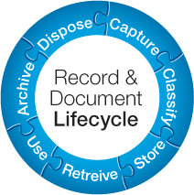

Slide 15
National Archives and Records Administration
Records Management:
Creation or receipt of information in the form of records,
Classification of the records to a taxonomy or file plan,
Maintenance and use of the records in operations
Disposition: Disposal or to an archive (if permanent)
Archiving:
Appraisal/transfer of the records by an archives,
Processing: Description, finding aids, other preparation.
Preservation of the records
Access and reference of the records by researchers

Slide 16
NARA’s responsibility for records
Formulate records management policy
Promulgate records management guidance
Approve proposed records schedules and disposition actions
Provide oversight on records compliance
Facilitate transfer of permanently valuable records to the Archives

Slide 17
The Archives part of NARA
Preserve and make available the permanently valuable records of the government “for the life of the Republic”
  From our current strategic plan:
  NARA drives openness, cultivates public participation, and strengthens our nation’s democracy through public access to high-value government records

Slide 18
Emergence of Electronic Records
What may have worked for paper may not work anymore across the lifecycle
We have left the relatively simple world where records schedules easily correlated to records creation, thence to archival constructs such as “series”
E-records are specific technical entities in and of themselves and not just electronic versions of paper

Slide 19
E-records and Records Management
Records Management:
Creation or receipt of information in the form of records,
What does this mean in a world where central filing systems are gone and users create their own records simply by doing their jobs?
Classification of the records to a taxonomy or file plan,
How do we do this when no one is willing to file their own records?
Maintenance and use of the records in operations
Monolithic RM Applications have failed. Now what do we do?
Disposition: Disposal or to an archive (if permanent)
Transfer is now a complex technical task, not moving a box of paper.

Slide 20
E-records and Archiving
Archiving:
Appraisal/transfer of the records by an archives,
Are we appraising “records” now or “systems”?
Processing: Description, finding aids, other preparation.
Is reference the same in the age of the Google search box?
Preservation of the records
Access today’s documents in 50 years?
Access and reference of the records by researchers
What do we do about restrictions and classified material?

Slide 21
Capstone and Email as an Exemplar
developed as a way to solve the “email question” one and for all:
  Is email a record?
  The conundrum:
    We can’t take all the email
    We can’t not take email
    There aren’t enough eyeballs in the world to file and read and process and preserve all the email
  Email, as used in Federal agencies, simply does not lend itself to tried and true records management and archival principles. So what can be done?

Slide 22
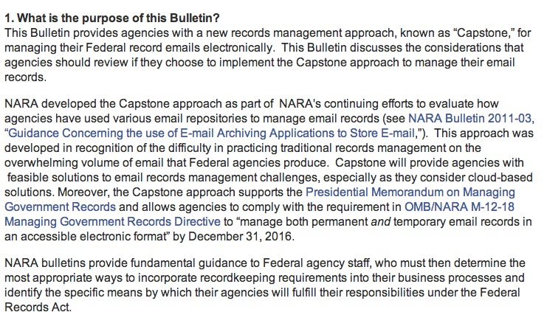

Slide 23
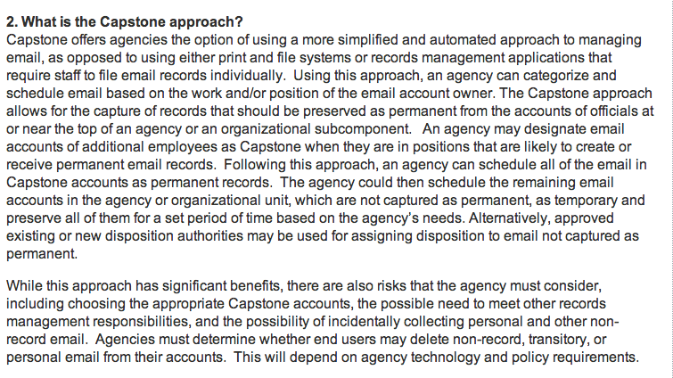

Slide 24
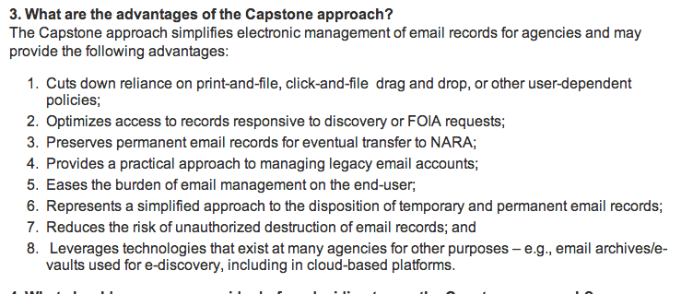

Slide 25
Why Capstone is a solid technical approach
It is practical and cognizant of technical realities
  No one is going to adhere to a complicated email “file plan.”
  The “full appraisal” approach is not feasible
It lends itself to a realistic transfer scenario.
  “top officials” = “email system mailboxes”
However, the process still needs to be guided by the archival framework:
  What should be saved?
  What are the criteria for description, preservation, etc.?

Slide 26
The larger lessons
IT and information science skills are inextricably intertwined when it comes to e-records, and by inference for the professionals who will be applying these skills in archives, libraries, etc.
Archivists, librarians, and other information professionals cannot shy away from “mucking about” in applicable technology. It cannot be seen as a necessary evil, or as something to be approached reluctantly.
  That said, it doesn’t mean information professionals need to be network engineers or programmers
There is room in the profession for “moving the needle” - bringing in some “native” IT people and teaching them libraries, archives, etc.

