Slide 1

Relational Databases
Week 11
LBSC 671
Creating Information Infrastructures

Slide 2
Types of Relationships
Many-to-Many
1-to-Many
1-to-1

Slide 3
Project Team E-R Example
manage-role
1
1
member-of
M
student
team
1
M
creates
human
implement-role
1
M
needs
1
client
project
d
php-project
ajax-project

Slide 4
Normalized Table Structure
Persons: id, fname, lname, userid, password
Contacts: id, ctype, cstring
Ctlabels: ctype, string
Students: id, team, mrole
Iroles: id, irole
Rlabels: role, string
Projects: team, client, pstring

Slide 5
Database “Programming”
Natural language
  Goal is ease of use
    e.g., Show me the last names of students in CLIS
  Ambiguity sometimes results in errors
Structured Query Language (SQL)
  Consistent, unambiguous interface to any DBMS
  Simple command structure:
    e.g., SELECT Last name FROM Students WHERE Dept=CLIS
  Useful standard for inter-process communications
Visual programming (e.g., Microsoft Access)
  Unambiguous, and easier to learn than SQL

Slide 6
The SELECT Command
Project chooses columns
  Based on their label
Restrict chooses rows
  Based on their contents
    e.g. department ID = “HIST”
These can be specified together
  SELECT Student ID, Dept WHERE Dept = “History”

Slide 7
Restrict Operators
Each SELECT contains a single WHERE
Numeric comparison
  <, >, =, <>, …
    e.g., grade<80
Boolean operations
  e.g., Name = “John” AND Dept <> “HIST”

Slide 8
Using Microsoft Access
Create a database called M:\rides.mdb
  File->New->Blank Database
Specify the fields (columns)
  “Create a Table in Design View”
Fill in the records (rows)
  Double-click on the icon for the table

Slide 9
Creating Fields
Enter field name
  Must be unique, but only within the same table
Select field type from a menu
  Use date/time for times
  Use text for phone numbers
Designate primary key (right mouse button)
Save the table
  That’s when you get to assign a table name

Slide 10
Entering Data
Open the table
  Double-click on the icon
Enter new data in the bottom row
  A new (blank) bottom row will appear
Close the table
  No need to “save” – data is stored automatically

Slide 11
Building Queries
Copy ride.mdb to your M:\ drive
“Create Query in Design View”
  In “Queries”
Choose two tables, Flight and Company
Pick each field you need using the menus
  Unclick “show” to not project
  Enter a criterion to “restrict”
Save, exit, and reselect to run the query

Slide 12
Some Details About Access
Joins are automatic if field names are same
  Otherwise, drag a line between the fields
Sort order is easy to specify
  Use the menu
Queries form the basis for reports
  Reports give good control over layout
  Use the report wizard - the formats are complex
Forms manage input better than raw tables
  Invalid data can be identified when input
  Graphics can be incorporated

Slide 13
Databases in the Real World
Some typical database applications:
  Banking (e.g., saving/checking accounts)
  Trading (e.g., stocks)
  Airline reservations
Characteristics:
  Lots of data
  Lots of concurrent access
  Must have fast access
  “Mission critical”

Slide 14
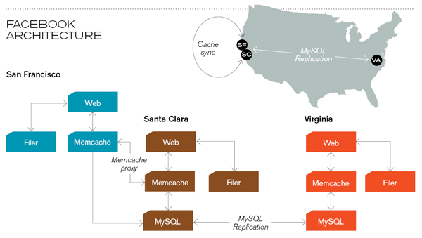
Caching servers: 15 million requests per second, 95% handled by memcache (15 TB of RAM)
Database layer: 800 eight-core Linux servers running MySQL (40 TB user data)
Source: Technology Review (July/August, 2008)

Slide 15
Database Integrity
Registrar database must be internally consistent
  Enrolled students must have an entry in student table
  Courses must have a name
What happens:
  When a student withdraws from the university?
  When a course is taken off the books?

Slide 16
Integrity Constraints
Conditions that must always be true
  Specified when the database is designed
  Checked when the database is modified
RDBMS ensures integrity constraints are respected
  So database contents remain faithful to real world
  Helps avoid data entry errors

Slide 17
Referential Integrity
Foreign key values must exist in other table
  If not, those records cannot be joined
Can be enforced when data is added
  Associate a primary key with each foreign key
Helps avoid erroneous data
  Only need to ensure data quality for primary keys

Slide 18
Concurrency
Thought experiment: You and your project partner are editing the same file…
  Scenario 1: you both save it at the same time
  Scenario 2: you save first, but before it’s done saving, your partner saves
Whose changes survive?
A) Yours B) Partner’s C) neither D) both E) ???
Notes:
4

Slide 19
Concurrency Example
Possible actions on a checking account
  Deposit check (read balance, write new balance)
  Cash check (read balance, write new balance)
Scenario:
  Current balance: $500
  You try to deposit a $50 check and someone tries to cash a $100 check at the same time
  Possible sequences: (what happens in each case?)
Deposit: read balance
Deposit: write balance
Cash: read balance
Cash: write balance
Deposit: read balance
Cash: read balance
Cash: write balance
Deposit: write balance
Deposit: read balance
Cash: read balance
Deposit: write balance
Cash: write balance

Slide 20
Database Transactions
Transaction: sequence of grouped database actions
  e.g., transfer $500 from checking to savings
“ACID” properties
  Atomicity
    All-or-nothing
  Consistency
    Each transaction must take the DB between consistent states.
  Isolation:
    Concurrent transactions must appear to run in isolation
  Durability
    Results of transactions must survive even if systems crash

Slide 21
Making Transactions
Idea: keep a log (history) of all actions carried out while executing transactions
  Before a change is made to the database, the corresponding log entry is forced to a safe location
Recovering from a crash:
  Effects of partially executed transactions are undone
  Effects of committed transactions are redone
the log

Slide 22
Putting the Pieces Together
Browser
Web Server
Database
HTML
SQL Query
CGI
HTML
Results

Slide 23
Why Database-Generated Pages?
Remote access to a database
  Client does not need the database software
Serve rapidly changing information
  e.g., Airline reservation systems
Provide multiple “access points”
  By subject, by date, by author, …
Record user responses in the database

Slide 24
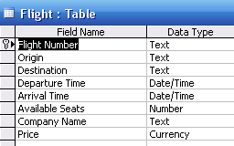
Structured Query Language
DESCRIBE Flight;

Slide 25
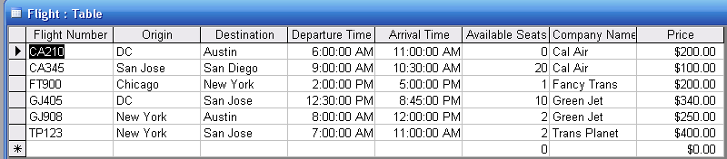
Structured Query Language
SELECT * FROM Flight;

Slide 26
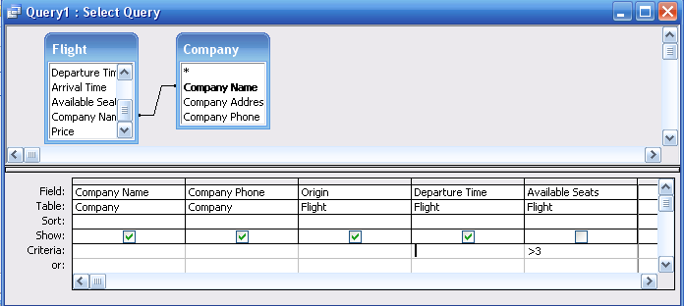
Structured Query Language
SELECT Company.CompanyName, Company.CompanyPhone, Flight.Origin, Flight.DepartureTime
FROM Flight,Company
WHERE Flight.CompanyName=Company.CompanyName
AND Flight.AvailableSeats>3;

Slide 27
Issues to Consider
Benefits of Databases
  Multiple views
  Data reuse
  Scalable
  Access control
Costs of Databases
  Formal modeling
  Complex (learn, design, implement, debug)
  Brittle (relies on multiple communicating servers)
  Not crawlable

Slide 28
Key Ideas
Databases are a good choice when you have
  Lots of data
  A problem that contains inherent relationships
Design before you implement
Join is the most important concept
  Project and restrict just remove undesired stuff

Slide 29
RideFinder Exercise
Design a database to match passengers with available rides for Spring Break
  Drivers phone in available seats
    They want to know about interested passengers
  Passengers call up looking for rides
    They want to know about available rides
    No “ride wanted” ads
  These things happen in no particular order

Slide 30
Exercise Goals
Identify the tables you will need
  First decide what data you will need
    What questions will be asked?
  Then design normalized tables
    Start with binary relations if that helps
Design the queries
  Using join, project and restrict
  What happens when a passenger calls?
  What happens when a driver calls?

Slide 31
Reminder: Starting E-R Modeling
What questions must you answer?
What data is needed to generate the answers?
  Entities
    Attributes of those entities
  Relationships
    Nature of those relationships
How will the user interact with the system?
  Relating the question to the available data
  Expressing the answer in a useful form

Slide 32
Exercise Logistics
Work in groups of 3 or 4
Brainstorm data requirements for 5 minutes
  Do passengers care about the price?
  Do drivers care how much luggage there is?
Develop tables and queries for 15 minutes
  Don’t get hung up on one thing too long
Compare you answers with another group
  Should take about 5 minutes each

Slide 33
Making Tables from E-R Diagrams
Pick a primary key for each entity
Build the tables
  One per entity
  Plus one per M:M relationship
  Choose terse but memorable table and field names
Check for parsimonious representation
  Relational “normalization”
  Redundant storage of computable values
Implement using a DBMS

Slide 34
Before You Go
On a sheet of paper, answer the following (ungraded) question (no names, please):
What was the muddiest point in today’s class?

