Slide 1

The Web
Week 10
LBSC 671
Creating Information Infrastructures

Slide 2
Virtual Private Networks
a secure private network over the public Internet
Public Internet
Intranet
virtual “leased line”
Intranet

Slide 3
Tonight
Think about what the Web “is”
Learn to create a Web page
Begin to think about Web design
Talk conceptually about databases

Slide 4
Internet ≠ Web
Internet: collection of global networks
Web: way of managing information exchange
There are many other uses for the Internet
  File transfer (FTP)
  Email (SMTP, POP, IMAP)

Slide 5
The World-Wide Web
My Browser
Local copy of
Page requested
Requested Page
Proxy Server
Fetch Page
Remote Sever
Send Request
Internet
Notes:
A server that sits between a client application, such as a Web browser, and a real server. It intercepts all requests to the real server to see if it can fulfill the requests itself. If not, it forwards the request to the real server. Proxy servers have two main purposes:
Improve Performance: Proxy servers can dramatically improve performance for groups of users. This is because it saves the results of all requests for a certain amount of time. Consider the case where both user X and user Y access the World Wide Web through a proxy server. First user X requests a certain Web page, which we'll call Page 1. Sometime later, user Y requests the same page. Instead of forwarding the request to the Web server where Page 1 resides, which can be a time-consuming operation, the proxy server simply returns the Page 1 that it already fetched for user X. Since the proxy server is often on the same network as the user, this is a much faster operation. Real proxy servers support hundreds or thousands of users. The major online services such as Compuserve and America Online, for example, employ an array of proxy servers.
Filter Requests: Proxy servers can also be used to filter requests. For example, a company might use a proxy server to prevent its employees from accessing a specific set of Web sites.

Slide 6
“The Web”
HTML
HTTP
Email
FTP
RTSP
URL
URL
(e.g.,http://www.foo.org/snarf.html)
Web
Server
File System
Internet
communication
protocols
HTML
(data/display)
HTTP
(transfer)

Slide 7
What is the Web?
Protocols
  HTTP, HTML, or URL?
Perspective
  Content or behavior?
Content
  Static, dynamic or streaming?
Access
  Public, protected, or internal?

Slide 8
Perspectives on the Web
Web “sites”
  In 2002, OCLC counted any server at port 80
  Total was 3 million, an undercount
    Misses many servers at other ports
    Some servers host unrelated content (e.g., TerpConnect)
Web “pages”
  In 2012, Google counted any URL it has seen
  Total was 30 trillion, an overcount
    Includes dead links, spam, …
Web “use”
  Google users pose 3 billion queries a day

Slide 9
Crawling the Web

Slide 10
Robots Exclusion Protocol
Requires voluntary compliance by crawlers
Exclusion by site
  Create a robots.txt file at the server’s top level
  Indicate which directories not to crawl
Exclusion by document (in HTML head)
  Not implemented by all crawlers
  <meta name="robots“ content="noindex,nofollow">

Slide 11
Web Crawl Challenges
Discovering “islands” and “peninsulas”
Duplicate and near-duplicate content
  30-40% of total content
Link rot
  Changes at ~1% per week
Network instability
  Temporary server interruptions
  Server and network loads
Dynamic content generation

Slide 12
Duplicate Detection
Structural
  Identical directory structure (e.g., mirrors, aliases)
Syntactic
  Identical bytes
  Identical markup (HTML, XML, …)
Semantic
  Identical content
  Similar content (e.g., with a different banner ad)
  Related content (e.g., translated)

Slide 13
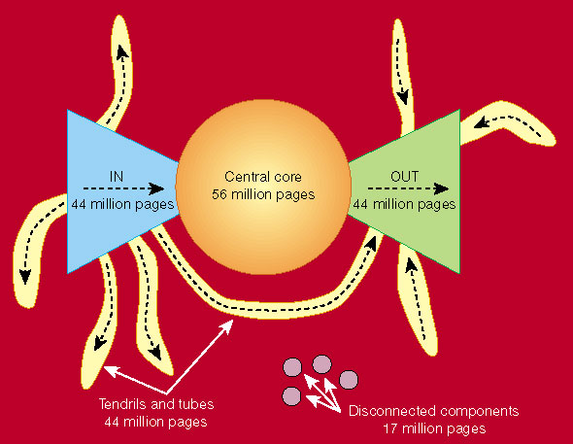
Link Structure of the Web
Nature 405, 113 (11 May 2000) | doi:10.1038/35012155

Slide 14
Global Internet Users
Web Pages

Slide 15
Most Widely-Spoken Languages
Source: Ethnologue (SIL), 1999

Slide 16
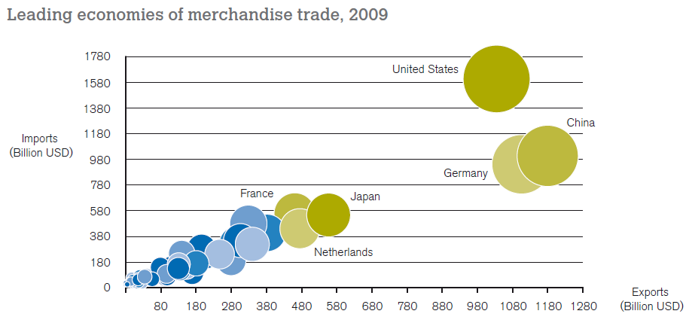
Global Trade
Source: World Trade Organization 2010 Annual Report
Notes:
This chart shows the 15 nations with at least 100 billion dollars in annual imports and exports.
Together, these nations account for 73% of the world’s exports
World trade thus defines nine major languages:
English, German, Japanese, Chinese, French, Italian, Dutch, Korean, Spanish
There are three key drivers that decide which languages get attention.
Where is the money. The G7 languages are well covered
Where are the people. This seems to have a much smaller effect.
Where are the problems: This explains the interest in Farsi, Korean, etc.

Slide 17
Why is there a Web?
Affordable storage
  300,000 words/$ in 1995
Adequate backbone capacity
  25,000 simultaneous transfers in 1995
Adequate “last mile” bandwidth
  1 second/screen in 1995
Display capability
  10% of US population in 1995
Effective search capabilities
  Lycos and Yahoo were started in 1995

Slide 18
Web Standards
HTML
  How to write and interpret the information
URL
  Where to find it
HTTP
  How to get it
Notes:
Link this to postal service

Slide 19
Uniform Resource Locator (URL)
Uniquely identify Web pages
Domain name
File name
http://www.glue.umd.edu:80/~oard/teaching.html
Protocol
Port
Path

Slide 20
HyperText Markup Language (HTML)
Simple document structure language for Web
Advantages
  Adapts easily to different display capabilities
  Widely available display software (browsers)
Disadvantages
  Does not directly control layout

Slide 21
“Hello World” HTML
This is the header
<html>
<head>
<title>Hello World!</title>
</head>
<body>
<p>Hello world! This is my first webpage!</p>
</body>
</html>
This is the actual content of the HTML document

Slide 22
Hands On:
Learning HTML From Examples
Use Internet Explorer to find a page you like
  http://www.glue.umd.edu/~oard
On the “Page” menu select “View Source” (in IE)
  Opens a notepad window with the source
Compare HTML source with the Web page
  Observe how each effect is achieved

Slide 23
Hands On: “Adopt” a Web Page
Modify the HTML source using notepad
  For example, change the page to yours
Save the HTML source somewhere
  In the “File” menu, select “Save As”
  Put the name in quotes (e.g., “test.html”)
FTP it to your ../pub directory on terpconnect
View it
  http://terpconnect.umd.edu/~(yourlogin)/test.html

Slide 24
Tips
Edit files on your own machine
  Upload when you’re happy
Save early, save often!
Reload browser to see changes
File naming
  Don’t use spaces
  Punctuation matters

Slide 25
HTML Document Structure
“Tags” mark structure
  <html>a document</html>
  <ol>an ordered list</ol>
  <i>something in italics</i>
Tag name in angle brackets <>
  Not case sensitive (unlike XML)
Open/Close pairs
  Close tag is sometimes optional (unlike XML)

Slide 26
Logical Structure Tags
Head
  Title
Body
  Headers: <h1> <h2> <h3> <h4> <h5>
  Lists: <ol>, <ul> (can be nested)
  Paragraphs:<p>
  Definitions: <dt><dd>
  Tables: <table> <tr> <td> </td> </tr> </table>
  Role: <cite>, <address>, <strong>, …

Slide 27
Physical Structure Tags
Bold: <b></b>
Italics: <i></i>
Typeface: <font face=“Arial”></font>
Size: <font size=“+1”></font>
Color: <font color=“990000”></font>

Slide 28
(Hyper)Links
index.html
<html>
<head>
<title>Hello World!</title>
</head>
<body>
<p>Hello world! This is my first webpage!</p>
<p>Click <a href="test.html">here</a> for another page.</p>
</body>
</html>
test.html
<html>
<head>
<title>Another page</title>
</head>
<body>
<p>This is another page.</p>
</body>
</html>

Slide 29
Hypertext “Anchors”
Internal anchors: somewhere on the same page
  <a href=“#students”> Students</a>
    Links to: <a name=“students”>Student Information</a>
External anchors: to another page
  <a href=“http://www.clis.umd.edu”>CLIS</a>
  <a href=“http://www.clis.umd.edu#students”>CLIS students</a>
URL may be complete, or relative to current page
  <a href=“video/week2.rm”>2</a>
File name (in URL) is case sensitive (on Unix servers)
  Protocol and domain name are not case sensitive

Slide 30
Images
<img src=“URL”> or <img src=“path/file”>
  <img src=“http://www.clis.umd.edu/IMAGES/head.gif”>
  SRC: can be url or path/file
  ALT: a text string
  ALIGN: position of the image
  WIDTH and HEIGHT: size of the image
Can use as anchor:
  <a href=URL><img src=URL2></a>
Example:
  http://www.umiacs.umd.edu/~daqingd/Image-Alignment.html

Slide 31
Tables
<table>
eenie | mennie | miney
mo | catch | a tiger
by | the | toe
<tr>
<td>
</td>
<td>
</td>
<td>
</td>
</tr>
<tr>
<td>
</td>
<td>
</td>
<td>
</td>
</tr>
<tr>
<td>
</td>
<td>
</td>
<td>
</td>
</tr>
</table>

Slide 32
Table Example
<table align=“center”>
<caption align=“right”>The caption</caption>
< tr align=“LEFT”>
<th> Header1 </th>
<th> Header2</th>
</tr>
<tr><td>first row, first item </td>
<td>first row, second item</td></tr>
< tr><td>second row, first item</td>
<td>second row, second item</td></tr>
</table>
Notes:
Table can basically put all the html into it
Better keep with basic table elements so that you have wider auidence
Use indent to help you to read the table source data

Slide 33
Wire Framing
Design, brainstorming technique
  Highly conceptual
  Low-fi
  Low risk, low cost
  Rapid
Incorporates three elements of Web design:
  Information design: Which information will go where?
  Navigation design: How will users get around?
  Interface design: How do elements convey functionality?

Slide 34
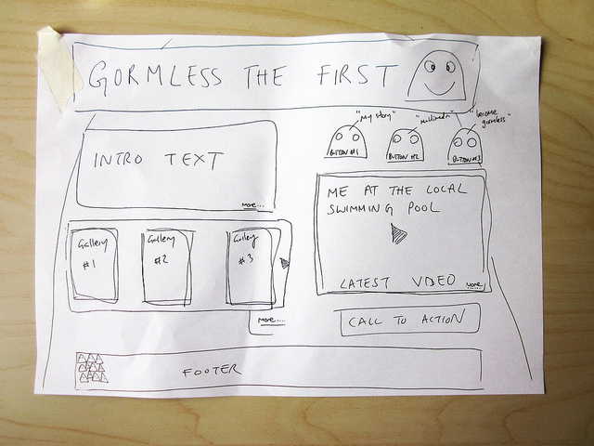
Notes:
By Flickr user Simon Collision. http://www.flickr.com/photos/collylogic/4971094116/.

Slide 35
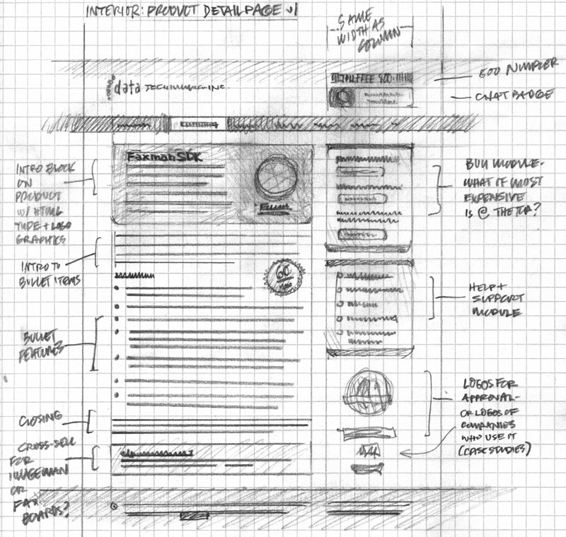
Notes:
By Flickr user Mike Rohde. http://www.flickr.com/photos/rohdesign/3307066409/.

Slide 36
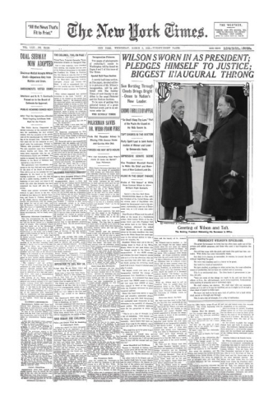
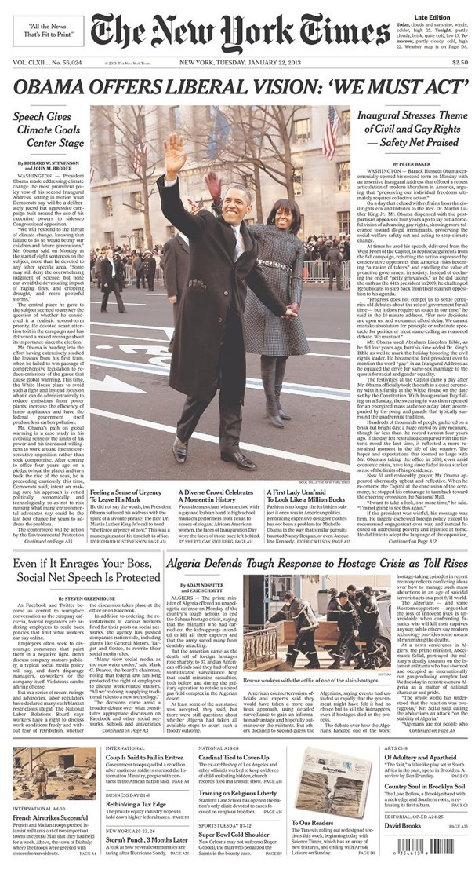
Notes:
1913 & 2013

Slide 37
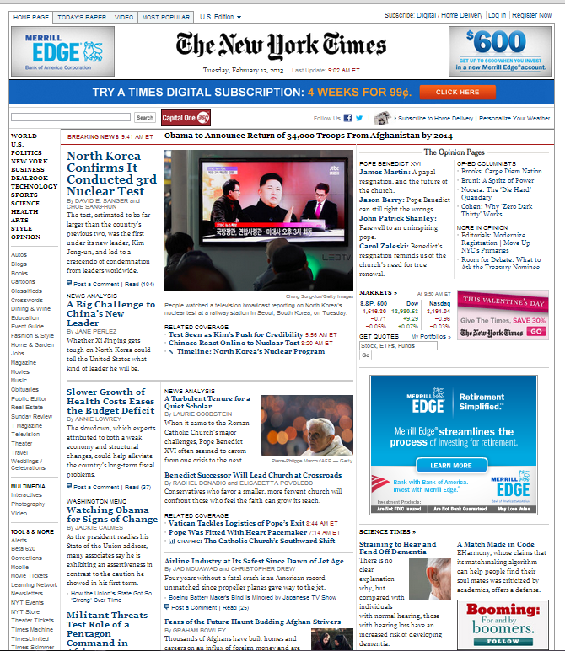
Notes:
Print & online

Slide 38
Databases
Database
  Collection of data, organized to support access
  Models some aspects of reality
DataBase Management System (DBMS)
  Software to create and access databases
Relational Algebra
  Special-purpose programming language

Slide 39
Structured Information
Field An “atomic” unit of data
  number, string, true/false, …
Record A collection of related fields
Table A collection of related records
  Each record is one row in the table
  Each field is one column in the table
Primary Key The field that identifies a record
  Values of a primary key must be unique
Database A collection of tables

Slide 40
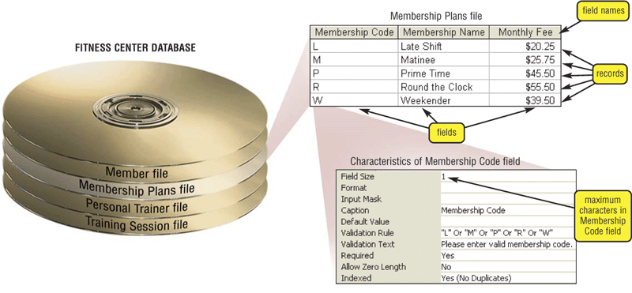
A Simple Example
primary key

Slide 41
Registrar Example
Which students are in which courses?
What do we need to know about the students?
  first name, last name, email, department
What do we need to know about the courses?
  course ID, description, enrolled students, grades

Slide 42
A “Flat File” Solution
Discussion Topic
Why is this a bad approach?

Slide 43
Goals of “Normalization”
Save space
  Save each fact only once
More rapid updates
  Every fact only needs to be updated once
More rapid search
  Finding something once is good enough
Avoid inconsistency
  Changing data once changes it everywhere

Slide 44
Relational Algebra
Tables represent “relations”
  Course, course description
  Name, email address, department
Named fields represent “attributes”
Each row in the table is called a “tuple”
  The order of the rows is not important
Queries specify desired conditions
  The DBMS then finds data that satisfies them

Slide 45
A Normalized Relational Database
Student Table
Department Table
Course Table
Enrollment Table

Slide 46
Approaches to Normalization
For simple problems (like the homework)
  Start with “binary relationships”
    Pairs of fields that are related
  Group together wherever possible
  Add keys where necessary
For more complicated problems
  Entity relationship modeling (LBSC 670)

Slide 47
Example of Join
Student Table
Department Table
“Joined” Table

Slide 48
Problems with Join
Data modeling for join is complex
  Useful to start with E-R modeling
Join are expensive to compute
  Both in time and storage space
But it is joins that make databases relational
  Projection and restriction also used in flat files

Slide 49
Some Lingo
“Primary Key” uniquely identifies a record
  e.g. student ID in the student table
“Compound” primary key
  Synthesize a primary key with a combination of fields
  e.g., Student ID + Course ID in the enrollment table
“Foreign Key” is primary key in the other table
  Note: it need not be unique in this table

Slide 50
Project
New Table
SELECT Student ID, Department

Slide 51
Restrict
New Table
WHERE Department ID = “HIST”

Slide 52
Entity-Relationship Diagrams
Graphical visualization of the data model
Entities are captured in boxes
Relationships are captured using arrows

Slide 53
Registrar ER Diagram
Student
Student ID
First name
Last name
Department
E-mail
…
Enrollment
Student
Course
Grade
…
has
has
associated with
Course
Course ID
Course Name
…
Department
Department ID
Department Name
…

Slide 54
Getting Started with E-R Modeling
What questions must you answer?
What data is needed to generate the answers?
  Entities
    Attributes of those entities
  Relationships
    Nature of those relationships
How will the user interact with the system?
  Relating the question to the available data
  Expressing the answer in a useful form

Slide 55
“Project Team” E-R Example
manage-role
1
M
member-of
1
student
team
1
M
creates
human
implement-role
1
1
needs
M
client
project
d
php-project
ajax-project

Slide 56
Components of E-R Diagrams
Entities
  Types
    Subtypes (disjoint / overlapping)
  Attributes
    Mandatory / optional
  Identifier
Relationships
  Cardinality
  Existence
  Degree

Slide 57
Types of Relationships
Many-to-Many
1-to-Many
1-to-1

Slide 58
Making Tables from E-R Diagrams
Pick a primary key for each entity
Build the tables
  One per entity
  Plus one per M:M relationship
  Choose terse but memorable table and field names
Check for parsimonious representation
  Relational “normalization”
  Redundant storage of computable values
Implement using a DBMS

Slide 59
Normalization
1NF: Single-valued indivisible (atomic) attributes
  Split “Doug Oard” to two attributes as (“Doug”, “Oard”)
  Model M:M implement-role relationship with a table
2NF: Attributes depend on complete primary key
  (id, impl-role, name)->(id, name)+(id, impl-role)
3NF: Attributes depend directly on primary key
  (id, addr, city, state, zip)->(id, addr, zip)+(zip, city, state)
4NF: Divide independent M:M tables
  (id, role, courses) -> (id, role) + (id, courses)
5NF: Don’t enumerate derivable combinations

Slide 60
Normalized Table Structure
Persons: id, fname, lname, userid, password
Contacts: id, ctype, cstring
Ctlabels: ctype, string
Students: id, team, mrole
Iroles: id, irole
Rlabels: role, string
Projects: team, client, pstring

Slide 61
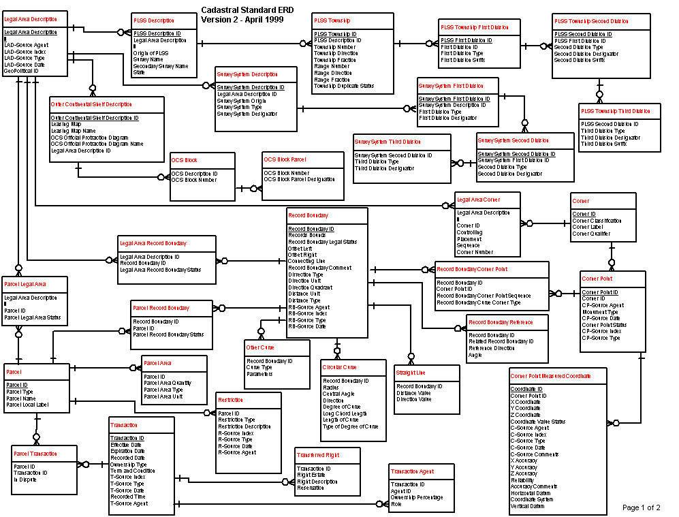
A More Complex ER Diagram
cadastral: a public record, survey, or map of the value, extent, and ownership of land as a basis of taxation.
Source: US Dept. Interior Bureau of Land Management,
Federal Geographic Data Committee Cadastral Subcommittee
http://www.fairview-industries.com/standardmodule/cad-erd.htm

Slide 62
Key Ideas
Databases are a good choice when you have
  Lots of data
  A problem that contains inherent relationships
Design before you implement
  This is just another type of programming
  The mythical person-month applies!
Join is the most important concept
  Project and restrict just remove undesired stuff

Slide 63
Before You Go
On a sheet of paper, answer the following (ungraded) question (no names, please):
What was the muddiest point in today’s class?

