Slide 1

Information Infrastructures
Week 1
LBSC 671
Creating Information Infrastructures

Slide 2
Tonight
What’s this class about?
Pieces of the puzzle
All the usual stuff (syllabus, grading, …)

Slide 3
“Information”
Wisdom
Knowledge
Information
Data

Slide 4
Infrastructures
Setting
  Embedded
  Pervasive
Design
  Reflects practice
  Reflects standards
  Path dependent
Learned
Transparent when it works
  But visible when it fails!
Star and Ruhleder (1996)

Slide 5
“Information Institutions”
Schools
  School libraries, Academic libraries
Libraries
  Public, Special, Subscription, (bookstores?)
Archives
  Government, Corporate, …
  Special collections, Historical societies
Museums
  Art, Material culture, Natural history
Search engines
  Google, Bing, Baidu, Yandex
“LAM”

Slide 6
LBSC 791
Designing Principled Inquiry
LBSC 631
Achieving Organizational Excellence
TOP
BACK
LBSC 671
Creating Information Infrastructures
FRONT
LBSC 602
Serving Information Needs

Slide 7
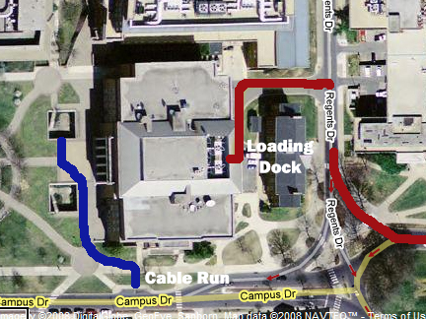

Slide 8
The MLS Program
Specializations
  Information and Diverse Populations
  Government Information Management & Services
  School Library
  Archives, Records, and Information Management
    History and Library Science dual degree program
  Curation and Management of Digital Assets
Unspecializations
  Research (Masters thesis option)
  Individualized Program Plan

Slide 9
Some Related iSchool Courses
LBSC
  683: Electronic Records
  684: Arrangement & Description
  708X: E-Discovery
  770: Bibliographic Control
  773: Classification Theory
  783: Technical Services
  784: Digital Preservation
  785: Appraisal
  786: Preservation
INST
  630: Programming
  631: HCI Fundamentals
  640: Digital Curation Principles
  715: Knowledge Management
  733: Database Design
  734: Information Retrieval
  735: Computational Linguistics
  737: Digging into Data
INFM
  741: Social Computing
  743: Internet Applications

Slide 10
Tonight
What’s this class about?
Pieces of the puzzle
All the usual stuff (syllabus, grading, …)

Slide 11
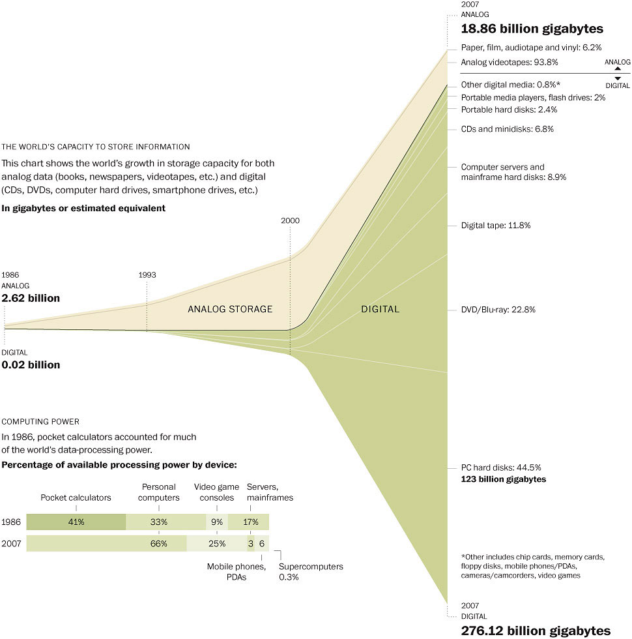
Washington Post (2007)

Slide 12
“Data In Motion” vs. “Data At Rest”
IDC Digital Universe white paper (2008)

Slide 13
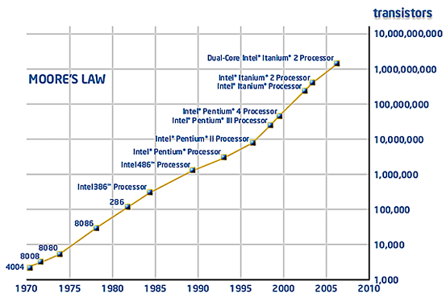

Slide 14
The Functional View
Have it
  Identify the existence of information resources
  Systematically assemble a collection
Find it
  Identify the works contained in the collection
  Describe the content of the collection
  Support intellectual access
Serve it
  Provide physical access
Hagler (1997), as interpreted in Taylor and Joudrey (2009)

Slide 15
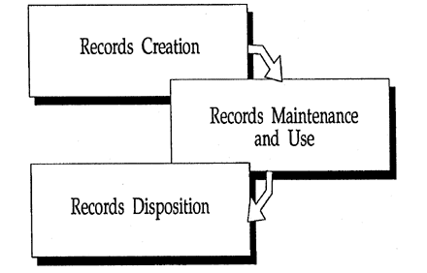
NARA Records Life Cycle
National Archives and Records Administration (2000)

Slide 16
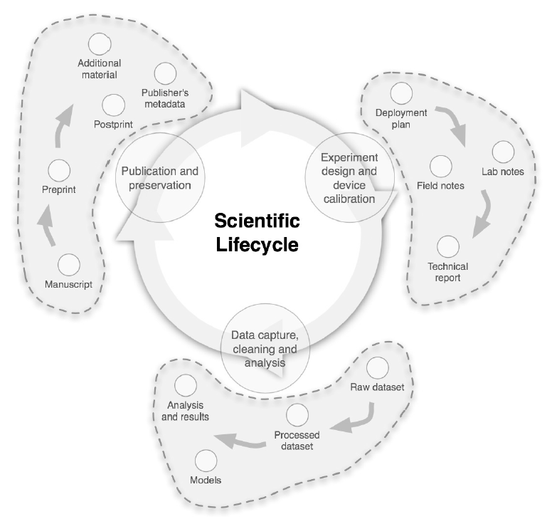
A Scientific Information Lifecycle
Alberto Pepe, AAHEP4 Summit (2010)

Slide 17
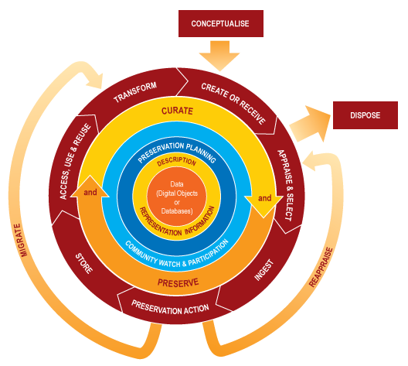
DCC Digital Curation Life Cycle

Slide 18
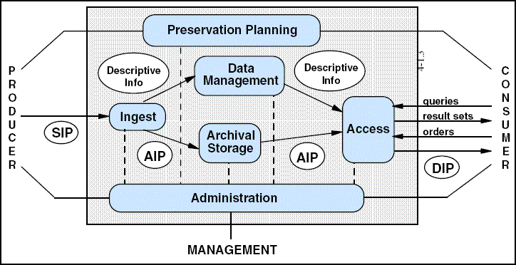
OAIS Reference Model

Slide 19
Types of “Metadata”
Descriptive
  Content, creation process, relationships
Technical
  Format, system requirements
Usage
  Display, derivative works
Administrative
  Acquisition, authentication, access rights
Preservation
  Media migration
Adapted from Introduction to Metadata,
Getty Information Institute (2000)

Slide 20
Five Levels of Metadata
Framework
  Functional Requirements for Bibliographic Records (FRBR)
Schema
  Dublin Core
Vocabulary
  Library of Congress Subject Headings (LCSH)
Representation
  Resource Description Framework (RDF)
Serialization
  RDF in eXtensible Markup Language (RDF/XML)
Adapted from Dante Alighieri, Comedia (c. 1321)

Slide 21
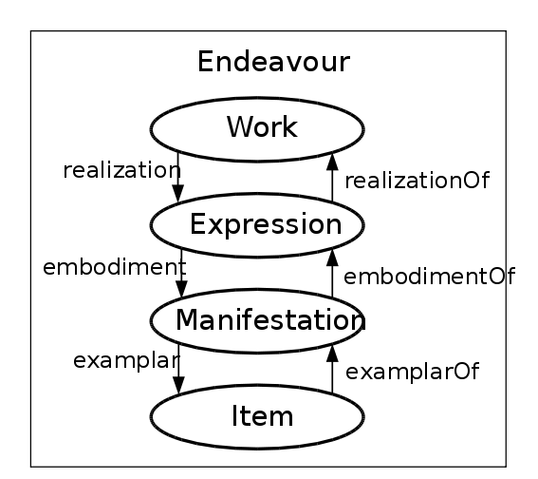
FRBR
The Organization
of Information
Third Edition
Paperback
(ISBN 978-1-59…)
Copy 2
(barcode 102343…)

Slide 22
Dublin Core
Title
Creator
Date
Type
Subject
Language
Identifier
…

Slide 23
LCSH
INFORMATION FOR: Library science.
Narrower Term: Classification--Books--Library science
Narrower Term: Collectanea files
Narrower Term: Communication in library science.
Narrower Term: Comparative librarianship.
Narrower Term: International librarianship.
Narrower Term: Medical librarianship
Narrower Term: Mentoring in library science.
Narrower Term: Minorities in library science
Narrower Term: Music librarianship.
…
See Also: Bibliography.
See Also: Documentation.
See Also: Information science.

Slide 24
RDF XML
<?xml version="1.0"?>
< rdf:RDF
xmlns:rdf="http://www.w3.org/1999/02/22-rdf-syntax-ns#"
xmlns:dc= "http://purl.org/dc/elements/1.1/">
< rdf:Description rdf:about="http://www.w3schools.com">
<dc:description>W3Schools - Free tutorials</dc:description>
<dc:publisher>Refsnes Data as</dc:publisher>
<dc:date>2008-09-01</dc:date>
<dc:type>Web Development</dc:type>
<dc:format>text/html</dc:format>
<dc:language>en</dc:language>
< /rdf:Description>
< /rdf:RDF>

Slide 25
Some Challenges
Evolution of information production
Impersistence of access to digital content
  Location, content, format, status
Separation of content and services
Invisibility to stakeholders
Institutional boundaries (e.g., LAM)
Christine Borgman, The Invisible Library (2001)

Slide 26
My Homework P2
Setting: Mission reconstruction app
Collection: Apollo 15
  Pre-flight planning
  In-flight activities
  Post-flight analysis
  Post-flight recollections

Slide 27
Tonight
What’s this class about?
Pieces of the puzzle
All the usual stuff (syllabus, grading, …)

Slide 28
Class Structure
Start promptly at 5:30, end promptly at 8:15
  Except Dec 2 (5:00-7:45 that day)
Typically, two breaks
  10 minutes after the first hour
  5 minutes after the second hour
Bring a computer and use it
  But stay focused on the class discussion
  Current tuition+fees ≈ $133 per class session

Slide 29
Approach
Readings (done before class)
  Acquire background
  Ready source for details
Class sessions
  Develop conceptual structure
Homework (done after class)
  Gain hands-on experience
Quiz, exams
  Focus effort, measure progress

Slide 30
The Grand Plan
Be It
Infrastructures
Practitioners
Acquisition
Computing
Have
It
Storage
Web
Metadata
Databases
Homework
Find
It
Description
IR
Quiz
Representation
CMS
Midterm
Serve
It
Discovery
HCI
Final

Slide 31
Reading Strategies
Assignments are found in two places:
  Textbook chapters listed on schedule
  Additional readings on a separate page
Set aside an hour per assigned reading
  Not all on the same day!
Read initially for understanding, not detail
  You can find details later (if you know where!)

Slide 32
Grading
50%-55% individual work
  Exams: 35% for the best, 15% for the other
45%-50% your choice (individual or group)
  5% each for best 10 of the 11 homework/quiz
  First and last homework are graded pass/fail
  Others (and quiz) graded on a 0-5 scale
No curve
  90-100 some sort of A, 80-89 some sort of B, …

Slide 33
The Fine Print
Group work is encouraged on homework
  But you must personally write what you turn in
Deadlines are firm and sharp
  Allowances for individual circumstances are included in the grading computation
Academic integrity is a serious matter
  No group work during the exams or the quiz!
  Scrupulously respect time limits

Slide 34
Finding Me
Doug Oard
Office: HBK 2118F
  I’m normally there from 4:45-5:15 on class days
  I’m also normally happy to stay after class
  People in the E-Discovery lab know if I am around
Email: oard@umd.edu
  Expect an answer within 24 hours
  Include a phone number if discussion would help
  Indicate if you do not want answers sent to the class

Slide 35
A Personal Approach to Learning
Work ahead, so that you are never behind
Find new questions everywhere
  Then find the answers somewhere
Enrich your practical skills relentlessly
Pick topics you want to learn more about

Slide 36
Before You Go
On a sheet of paper, answer the following (ungraded) question (no names, please):
What was the muddiest point in today’s class?

