Slide 1

Content Management Systems
Week 9
INFM 603

Slide 2
Muddiest Points
How JSON differs from XML
  And how JSONP differs from JSON
How Ajax works
Examples of JavaScript without Ajax
How to make an API
Can API’s be used by anyone?

Slide 3
Agenda
Questions
Drupal
Project Plan
Human-Computer Interaction

Slide 4
Relational normalization
Structured programming
Software patterns
Object-oriented design
Functional decomposition
Client Hardware
(PC)
Interface
Design
Web Browser
(IE, Firefox)
Client-side Programming
(JavaScript)
Interaction
Design
Interchange Language
(HTML, XML)
Server-side Programming
(PHP)
Business
rules
Database
(MySQL)
Server Hardware
(PC, Unix)

Slide 5
Content Management Systems
Database to store content
  Also stores access control data and parameters
PHP to control user experience
  Reads database, generates HTML
  “Canned” settings provide standard behaviors
HTML to convey user experience
Allows limited interactivity
  Most user actions require a server response
  JavaScript may be used for form validation

Slide 6
Information Architecture
The structural design of an “information space” to facilitate access to content
Two components:
  Static design
  Interaction design

Slide 7
Static Design
Organizing principles
  Logical: e.g., chronological, alphabetical
  Functional: by task
  Demographic: by user
Metaphors
  Organizational: e.g., e-government
  Physical: e.g., online grocery store
  Functional: e.g., cut, paste
  Visual: e.g., octagon for stop

Slide 8
“Site Blueprint”
Main
Homepage
Teaching
Research
Other
Activities
LBSC 690
Ph.D.
Students
IR
Colloquium
INFM 718R
Publications
TREC
Doctoral
Seminar
Projects

Slide 9
Grid Layouts
Navigation Bar
Navigation Bar
Content
Content
Navigation Bar
Related Links
Navigation Bar
Content
Content

Slide 10

Grid Layout: NY Times

Slide 11
Grid Layout: NY Times
Navigation
Banner Ad
Another Ad
Content
Popular
Articles

Slide 12
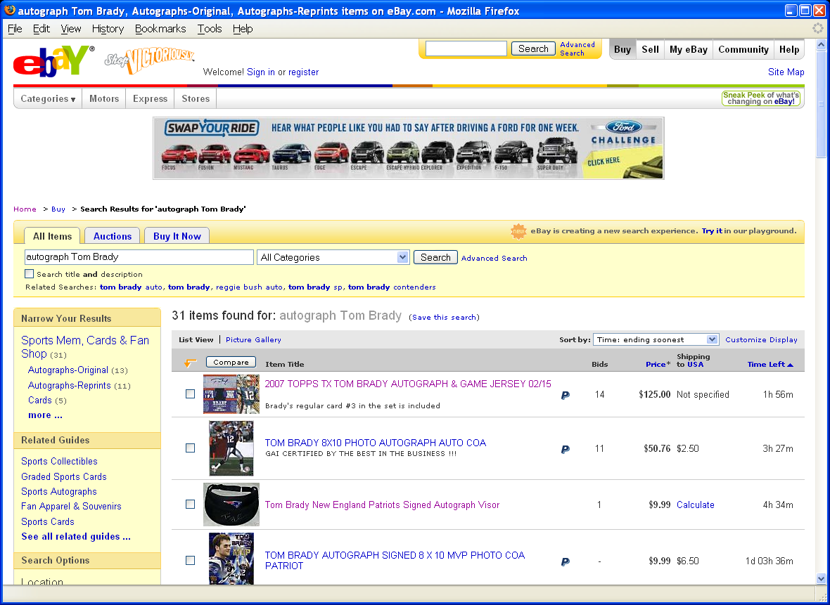
Grid Layout: ebay

Slide 13
Grid Layout: ebay
Navigation
Banner Ad
Navigation
Related
Search Results

Slide 14

Grid Layout: Amazon

Slide 15
Grid Layout: Amazon
Navigation
Navigation
Related
Search Results

Slide 16
Some Layout Guidelines
Contrast: make different things different
  to bring out dominant elements
  to create dynamism
Repetition: reuse design throughout the interface
  to achieve consistency
Alignment: visually connect elements
  to create flow
Proximity: make effective use of spacing
  to group related and separate unrelated elements

Slide 17
Interaction Design
Chess analogy: a few simple rules that disguise an infinitely complex game
The three-part structure
  Openings: many strategies, lots of books about this
  End game: well-defined, well-understood
  Middle game: nebulous, hard to describe
Information navigation has a similar structure!
  Middle game is underserved
From Hearst, Smalley, & Chandler (CHI 2006)

Slide 18
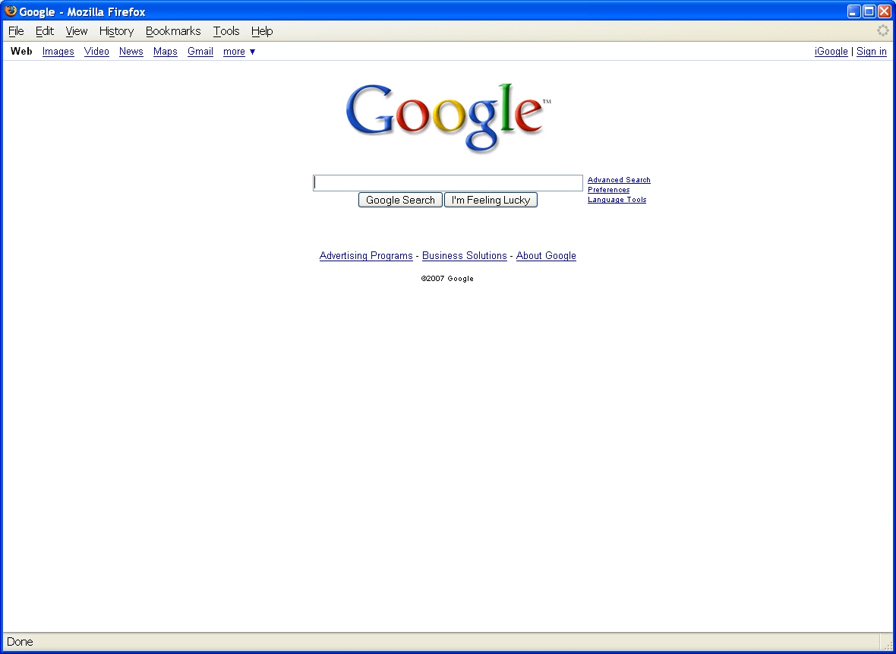
Opening Moves

Slide 19
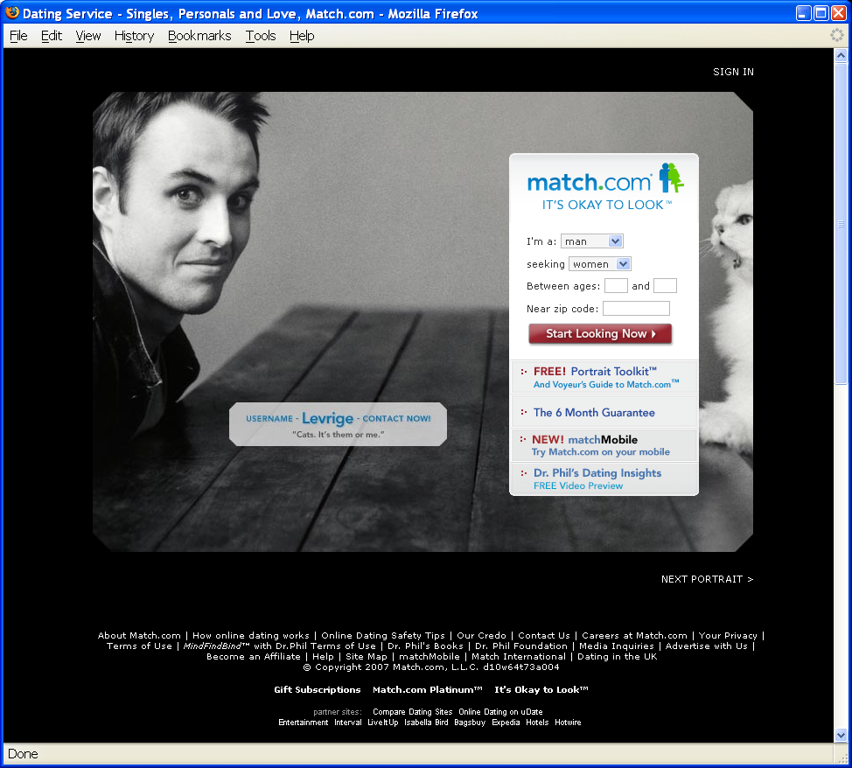
Opening Moves

Slide 20
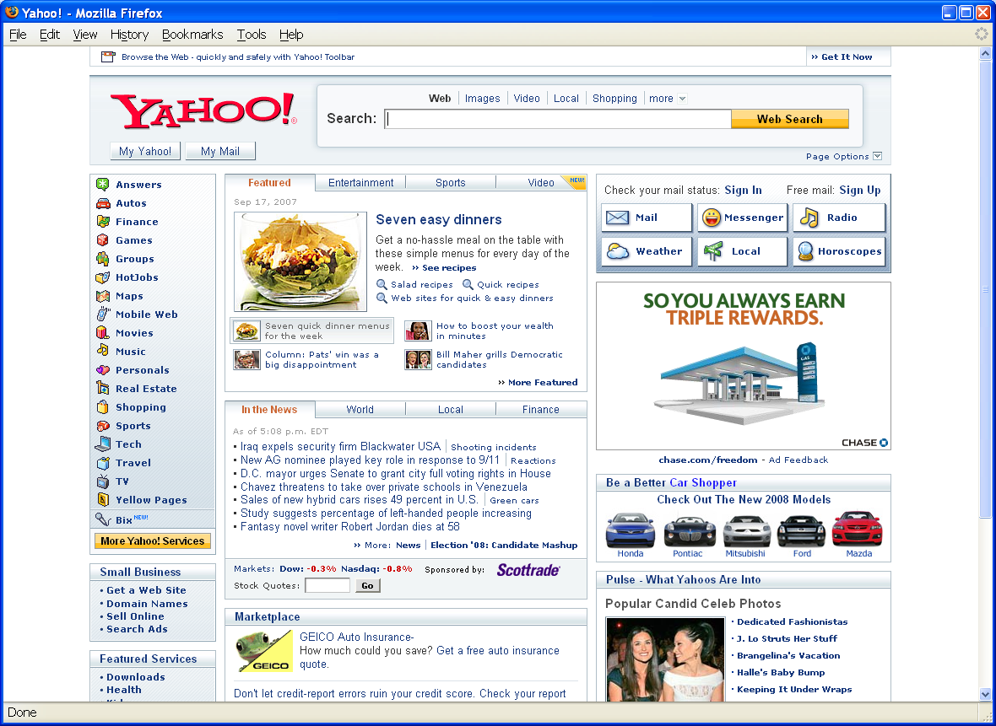
Opening Moves

Slide 21
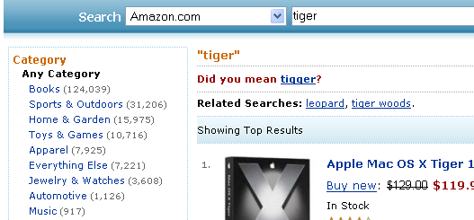
Middle Game

Slide 22

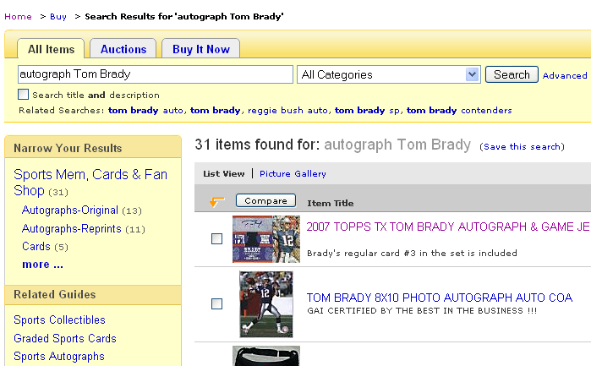
Middle Game

Slide 23
Navigation Patterns
Drive to content
Drive to advertisement
Move up a level
Move to next in sequence
Jump to related

Slide 24
Drupal Structure
Regions
  Header, left sidebar, content, right sidebar, footer
  Structure->Blocks->Demonstrate Blocks Region
Blocks
  Navigation, login, Drupal, help, content, search
  Optional: who’s online, recent comments, …
Menus
  Main, navigation, user

Slide 25
Drupal Content (“Nodes”)
Basic Page
Article
  By default allows comments
Blog entry
Forum topic

Slide 26
Optional Drupal Modules
Aggregator
Blog
Forum
Book
Contact form
Poll
Search
Statistics
Trigger
Translation

Slide 27
Some Downloadable Modules
Content Construction Kit
Views
OpenLayer
Dynamic Display Block
Embedded Media
Image Cache
Calendar
Share

Slide 28
Installing Drupal
Download and install XAMPP
  Add c:\xampp\mysql\bin to your path
Download and install Drupal version 7.x
  Configure for local use (“first time user guide”)
  Ignore SMTP error messages
Configure your site
  Add some “splash page” content
  Set user permissions

Slide 29
Drupal’s Use of MySQL
USE drupal;
SHOW TABLES;
SELECT * FROM users;
SELECT * FROM nodes;
SELECT * FROM node_revisions;

Slide 30
Modifying Drupal
Work with what’s there
  Content
  Configuration
Download a distribution profile
Edit the CSS files
Edit the PHP code
Edit the database contents

Slide 31
Agenda
Questions
Drupal
Project Plan
Human-Computer Interaction

Slide 32
The Project Plan
One-page contract
Goal The problem to be solved
Product What you plan to deliver
Scope Available time and personnel
Roles What you expect each other to do

Slide 33
What are Requirements?
Attributes
  Appearance
  Concepts (represented by data)
Behavior
  What it does
  How you control it
  How you observe the results

Slide 34
The Requirements Interview
Focus the discussion on the task
  Look for entities that are mentioned
Discuss the system’s most important effects
  Displays, reports, data storage
  Learn where the system’s inputs come from
  People, stored data, devices, …
Note any data that is mentioned
  Try to understand the structure of the data
Shoot for the big picture, not every detail

Slide 35
Agenda
Questions
Drupal
Project Plan
Human-Computer Interaction

Slide 36
Human-Computer Interaction
A discipline concerned with the
Design
Implementation
Evaluation
of interactive computing systems for human use
Notes:
36

Slide 37
Synergy
Humans do what they are good at
Computers do what they are good at
Strengths of one cover weakness of the other

Slide 38
Interaction
Forming an intention
  Internal mental characterization of a goal
Selection of an action
  Review possible actions, select most appropriate
Execution of the action
  Carry out appropriate actions with the system
Evaluation of the outcome
  Compare results with expectations

Slide 39
Stages of Interaction
Goals
Intention
Expectation
Evaluation
Selection
Interpretation
Mental Activity
Physical Activity
System
Execution
Perception

Slide 40
Challenges of HCI
Goals
Intention
Expectation
Evaluation
“Gulf of Execution”
“Gulf of Evaluation”
Selection
Interpretation
Mental Activity
Physical Activity
System
Execution
Perception

Slide 41
What is good design?
Goals
Intention
Expectation
Evaluation
Mental
Model
Selection
Interpretation
Mental Activity
Physical Activity
System
Execution
Perception

Slide 42
Modeling Interaction
Human
Mental Models
Sight
Sound
Task
System
Hands
Voice
Software Models
Keyboard
Mouse
Task
User
Display
Speaker
Computer

Slide 43
Mental Models
How the user thinks the machine works
  What actions can be taken?
  What results are expected from an action?
  How should system output be interpreted?
Mental models exist at many levels
  Hardware, operating system, and network
  Application programs
  Information resources

Slide 44
Evaluation Approaches
Formative vs. summative
Extrinsic vs. intrinsic
Quantitative vs. qualitative
  Deductive vs. inductive
User study vs. simulation

Slide 45
Evaluation Examples
Direct observation
  Evaluator observes users interacting with system
    in lab: user asked to complete pre-determined tasks
    in field: user goes through normal duties
  Validity depends on how contrived the situation is
Think-aloud
  Users speak their thoughts while doing the task
  May alter the way users do the task
Controlled user studies
  Users interact with system variants
  Correlate performance with system characteristics
  Control for confounding variables

Slide 46
Evaluation Measures
Time to learn
Speed of performance
Error rate
Retention over time
Subjective satisfaction

