Slide 1
INFM 603: Information Technology and Organizational Context
Session 8: PHP and Asynchronous Programming
Jimmy Lin
The iSchool University of Maryland
Thursday, March 23, 2015

Slide 2
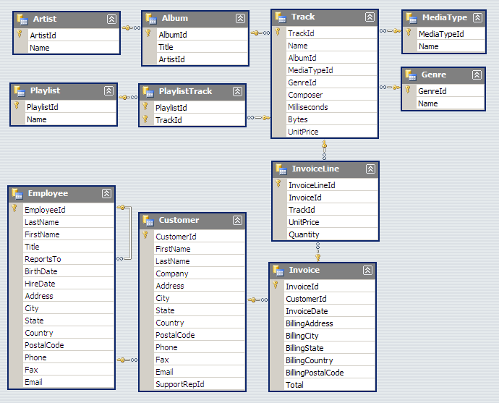
Warmup Exercises

Slide 3
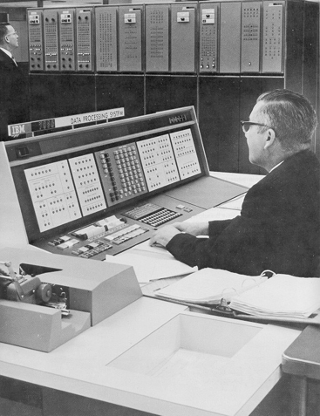
Databases Yesterday…

Slide 4
Databases today…
Wait, but these are websites?

Slide 5
Websites that are really databases
Most of the content is in a database
Web pages are dynamically constructed from results of database queries

Slide 6
Multi-Tiered Architectures
Browser
Browser
Client
Server
Web Server
Web Server
“Middleware”
Database
Database

Slide 7
Putting the Pieces Together…
Browser
Web Server
Database (MySQL)
HTML
SQL query
CGI
PHP
HTML
Results

Slide 8
What is PHP?
PHP is a server-side scripting language
Must run on a server (not in the browser)
More specifically, runs inside the web server
Typical PHP script:
Fetches input from user forms
Executes SQL queries
Constructs an HTML page containing results
Part of the “LAMP” stack
Linux, Apache, MySQL, PHP

Slide 9
PHP Scripts
Are just like normal HTML pages
With the exception of code between <?php … ?>
Variables begin with dollar signs
E.g., $a, $b
Use “echo” to output HTML
Just like document.writeln(…) in JavaScript
Use “.” to concatenate string
E.g., “here is” . “ some text”
Just like “here is” + “ some text” in JavaScript

Slide 10
Sample PHP Script
Get input from user from
Connect to the database
Execute SQL query
Process results to generate HTML

Slide 11
Synchronous vs. Asynchronous
What’s different about the web today from 15 years ago?

Slide 12
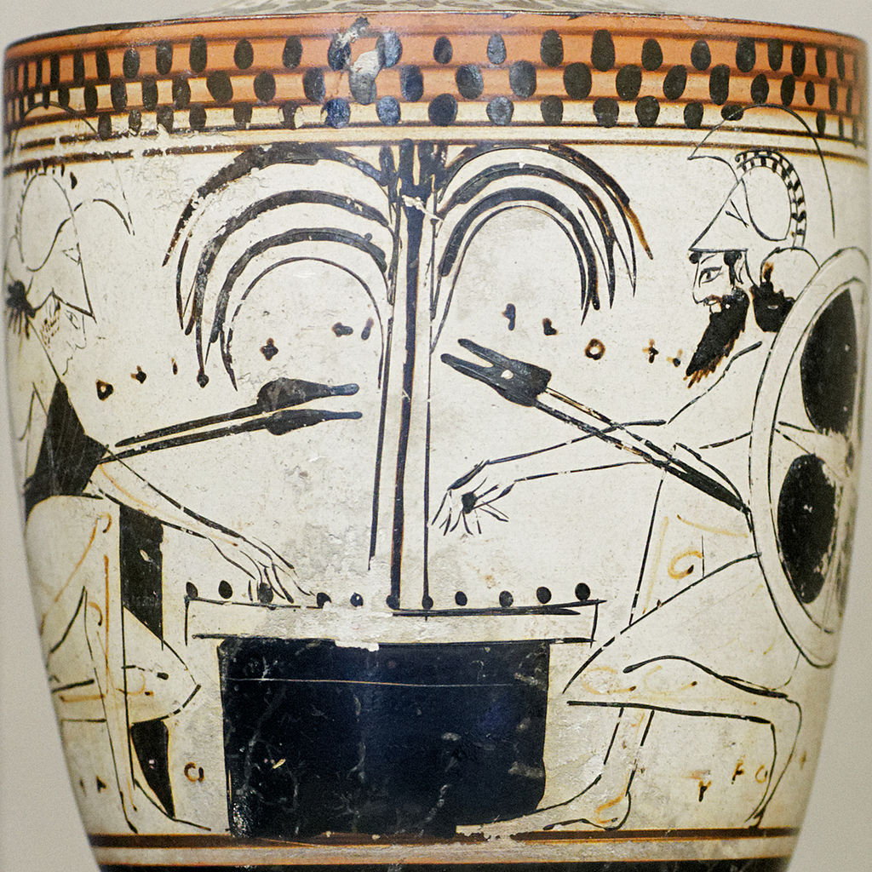
Ajax

Slide 13
What’s Ajax?
Asynchronous JavaScript and XML
The only thing you need to learn:
Get this URL
var url = "...";
var request = new XMLHttpRequest();
request.open("GET", url);
request.onload = function() {
if (request.status == 200) {
// Your code here
}
};
request.send(null);
Callback function

Slide 14
What’s at the URL?
A static file (e.g., JSON)
How is JSON the same or different from XML?
{
name: "Fido",
weight: 40, breed: "Mixed", loves: ["walks", "fetching balls"]
}

Slide 15
What’s at the URL?
An application programming interface (API)
How do we write APIs?
http://download.finance.yahoo.com/d/quotes.csv?s=GOOG&f=nsl1op
Think of this as a function call!
argument1=value&argument2=value...

Slide 16
Got it?
Source: The Matrix

Slide 17
Muddiest Point

