Slide 1

Functions and Data Structures
Week 4
INFM 603

Slide 2
Programming in Four Parts
Structured Programming
Data Structures
Modular Programming
Object-Oriented Programming

Slide 3
Arrays
A set of elements
  For example, the number of days in each month
Each element is assigned an index
  A number used to refer to that element
    For example, x[4] is the fifth element (count from zero!)
  Arrays and iteration work naturally together
“Constructor” allocates space
  var myArray = new Array(5); // all unitialized
  var myArray = [42, 17, , 22, 1]; // partially initialized

Slide 4
Indexing Values
expenses [0]= “25”;
expenses[1] = “30”;
…
expenses[365] =“100”;
OR
var expenses = [“25”,”30”,…”100”];
var expenses = new Array (“25”,”30”,…”100”);
Index always starts at 0
0 1 2 3 4 5 6 7 8

Slide 5
Array Example
// allocate five-element Array (indexed 0..4)
var n = new Array(5);
// assign values to each element of Array n
for (var i=0; i<n.length; i++) {
n[i] = i;
}
// output index and value of each element
for (var i=0; i<n.length; i++) {
document.writeln(i + “: “ + n[i]);
}

Slide 6
Data Structures
Constant
  Names given to unchanging values (for readability)
Scalar
  Single-valued item (int, float, boolean)
Object
  Multi-valued item, mixed data types [+methods]
Array
  Integer-indexed set of objects (usually of one type)
Associative array (“hash table”)
  Object-index set of objects (usually of one type)

Slide 7
Associative Arrays in JavaScript
var myArray = new Array();
myArray[‘Monday'] = 1;
myArray[‘Tuesday'] = 2;
myArray[‘Wednesday'] = 3;
// show the values stored
for (var i in myArray) { // skips unitialized
alert('key is: ' + i +
', value is: ' + myArray[i]);
}

Slide 8
Common Uses of Arrays
Iterative computation
Queue (FIFO)
Stack (LIFO)

Slide 9
Hands On
Write a JavaScript program that asks you for three numbers and outputs the last one
Use arrays instead of three different variables

Slide 10
<!DOCTYPE html>
<html>
<body>
<script>
var numbers = new Array();
var c,input;
for (c=0;c<3;c++) {
input = prompt(“Type a number");
numbers[c] = input;
}
document.writeln("The last number is" + numbers[2]);
</script>
</body>
</html>

Slide 11
Array Methods
array.join()
  Put together all elements as a string
array.sort()
  Order alphabetically
array.reverse()
  Reverse order of array
array1.concat(array2,array3,…)
  Concatenates two or more arrays

Slide 12
Functions
Reusable code for complex code blocks
  Takes zero or more values as “parameters”
  Returns at most one value as the “result”
function convertToCelsius(f) {
var celsius = 5/9 * (f-32);
return celsius;
}
var fh = 60;
c = convertToCelsius(fh);
c = convertToCelsius(fh);
function convertToCelsius(f) {
var celsius = 5/9 * (f-32);
return celsius;
}

Slide 13
More Examples
var r = weirdAddition(2, 4);
var a = 2;
var b = 3;
var s = weirdAddition(a, b);
function weirdAddition(a, b) {
var result = a + b - 0.5;
return result;
}

Slide 14
Writing JavaScript Functions
Convenient to put in the <head> section
  Use <!-- … //--> to prevent display of code
…
<head>
<script language="JavaScript" type="text/javascript">
<!--
function calculate() {
var num = eval(document.input.number.value);
…
document.output.number.value = total;
}
//-->
</script>
</head>
…

Slide 15
Uses of Functions
Compactness
  Minimizing duplicative code
Modular programming
  Abstraction
  Reusability
  Avoid “side effects”

Slide 16
Function Format
function Name(parameter1, parameter2,…) {
statements
}

Slide 17
Example
<html>
<head>
<meta charset=UTF-8" />
<title>JavaScript Program Template</title>
</head>
<body>
<script>
/*ask for user input*/
var day = prompt("Enter day");
var kind = prompt("Enter kind");
/*call function*/
menu(day, kind);
/* Function definition */
function menu(day, kind) {
var actualChoices;
if (day === "Monday" || kind === "healthy") {
actualChoices = "<h2>chicken</h2>";
} else {
actualChoices = "<h2>steak, cheesecake, whip cream, lard</h2>";
}
document.writeln("The " + kind + " Menu for " + day + " ");
document.writeln(actualChoices);
}
</script>
</body>
</html>

Slide 18
Parameter Passing
Scalars are copied
  “Pass by value”
Arrays (and all objects) pass “by reference”
  The values in the array are not copied
    Be careful to make “side effects” explicit
  No need to return the same reference
Functions can also be passed as parameters
  Unchangable, so “by reference” = “by value”
Returned values work the same way

Slide 19
Returning a Function’s Result
function Name(parameter1, parameter2,…) {
statements;
return value;
}

Slide 20
<html> <head>
<meta charset="utf-8" />
<title>Functions</title>
</head>
<body>
<script>
/* calling main */
main();
function main() {
/* Where we call the other functions */
var firstValue = Number(prompt("First Value"));
var secondValue = Number(prompt("Second Value"));
var max;
max = maxValue(firstValue, secondValue);
alert("Maximum value is: " + max);
}
function maxValue(value1, value2) {
var maximum;
if (value1 > value2) {
maximum = value1;
} else {
maximum = value2;
}
return maximum; // what happens if we don't return a value?
}
</script> </body> </html>

Slide 21
Hands On
Write a JavaScript function that asks for two names and returns the one with the shortest length

Slide 22
<html>
<body>
<script>
/* calling main */
var firstName = prompt("First Name");
var secondName = prompt("Second Name");
var max;
max = maxValue(firstValue, secondValue);
alert("Longest string is: " + max);
function maxValue(value1, value2) {
var maximum;
if (value1.length > value2.length) {
maximum = value1;
} else {
maximum = value2;
}
return maximum; // what happens if we don't return a value?
}
</script>
</body>
</html>

Slide 23
Scope of a Variable
In JavaScript, var “declares” a variable
  var mystery; create a variable without defining its type
  var b = true; create a boolean b and set it to true
  var n = 1; create an integer n and set it to 1
  var s = “hello”; create a string s and set it to “hello”
Variables declared in a function are “local”
  Function parameters are implicitly declared (local)
  Same name outside function refers to different variable
All other variables are “global”

Slide 24
Global vs Local Variables
<html>
<head>
<meta charset="utf-8" />
<title>Pass by value</title>
</head>
<body>
<script type="text/javascript">
/* calling main */
main();
var m = 10, t = 20;
document.writeln("Before m value is: " + m + ", t value is: " + t + "<br />");
wrongSwap(m, t);
document.writeln("After m value is: " + m + ", t value is: " + t);
/* What is wrong with this function? */
function wrongSwap(x, y) {
var temp = x;
x = y;
y = temp;
}
</script>
</body>
</html>
What does this program do?
Try it!

Slide 25
Modify Global Variables
<html>
<body>
<script type="text/javascript">
var m = 10, t = 20;
document.writeln("Before m value is: " + m + ", t value is: " + t + "<br />");
wrongSwap(m, t);
document.writeln("After m value is: " + m + ", t value is: " + t);
/* What is wrong with this function? */
function wrongSwap(x, y) {
var temp = x;
var temp2 = y;
m = temp2;
t = temp;
}
</script>
</body>
</html>

Slide 26

Sequential Search
Source: Wikipedia

Slide 27
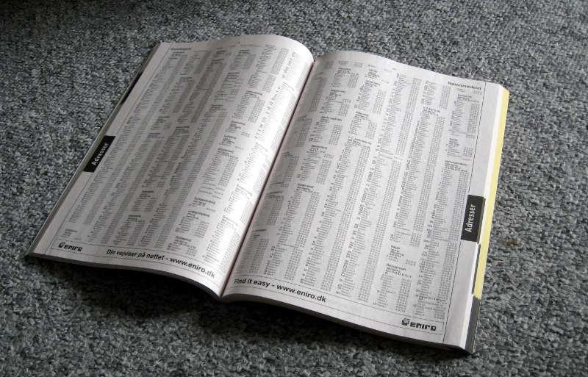
Binary Search
Source: Wikipedia

Slide 28
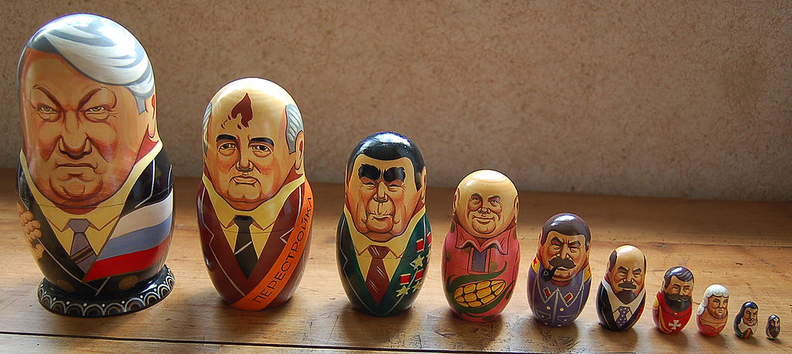
Recursion
Source: Wikipedia

Slide 29
Recursion
A function can call itself
  Local variables are different each time
Every invocation of the function must end
  There must be a path that ends the recursion
  That path must eventually be taken
  The usual way to do this is an initial if statement
Never essential
  But sometimes more elegant than iteration

Slide 30
Binary Search with Recursion
function binarySearch(theArray, key, low, high) {
var middle;
if (low>=high) { // Safety check!
if (key==theArray[low]) {
return low;
} else {
return -1;
}
} else {
middle = Math.floor((low+high)/2); // Explicit!
buildOutput( theArray, low, middle, high );
if (key<=theArray[middle]) { // Equality!
return binarySearch(theArray, key, low, middle);
} else {
return binarySearch(theArray, key, middle+1, high);
}
}
}

Slide 31
Some Math Functions
Math.abs() – Absolute value
  Example: Math.abs(-10)
Math.max() – Maximum of two values
  Example: Math.max(10, 20)
Math.sqrt() – Square root
  Example: Math.sqrt(4)
Math.random() – Random value between 0 and less than 1
  Example: Math.random()
Constants
  Math.PI – Mathematical constant pi

Slide 32
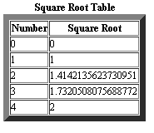
One More Example
Write a JavaScript program that asks for a number (n) and writes an HTML table with two columns:
  Column1: numbers 0 to n
  Column2: square root of
  number
For n=4

Slide 33
<!doctype html>
<html>
<head>
<meta http-equiv="Content-Type" content="text/html; charset=UTF-8" />
<title>Square Root Table</title>
</head>
<body>
<script type="text/javascript">
var currValue = 0;
var maximumValue;
maximumValue = Number(prompt("Enter maximum value"));
document.writeln("<table border=\"10\">");
document.writeln("<caption> Table</caption>");
document.writeln("<tr><th>Number</th><th>2*Number</th></tr>");
while (currValue <= maximumValue) {
document.writeln("<tr><td>" + currValue + "</td><td>" + currValue*2 +"</td></tr>");
currValue = currValue + 1;
}
document.writeln("</table>");
</script>
</body>
</html>

Slide 34
Documentation Tips
Reflect your pseudocode in your code
  Use meaningful variable names
  Use functions for abstractable concepts
    And name those functions well
  Use comments to fill remaining gaps
Add a comment to identify each revision
  Give author, date, nature of the change
Waste space effectively
  Use indentation and blank lines to guide the eye

Slide 35
Using JavaScript with Forms
HTML:
<form name="input" action=" ">
Please enter a number:
<input size="10" value=" " name="number"/>
</form>
<form name="output" action=" ">
The sum of all numbers up to the number above is
<input size="10" value=" " name="number" readonly="true"/>
</form>
Reads in a value from the first form
(eval method turns it into a number)
JavaScript:
var num = eval(document.input.number.value);
document.output.number.value = 10;
Changes the value in the second form

Slide 36
HTML Form Element Types
Textarea (multiple lines)
Input
  Text (single line)
  Password (like text, but masked)
  Hidden (like text, but not displayed at all)
  Button
  Checkbox (multiple selection)
  Radio (single selection)
Select (dropdown list)
see http://www.w3schools.com/html/html_forms.asp for examples

Slide 37
Linking Forms to Functions
Events:
  Actions that users perform
An “event handler” is triggered by an event
  onClick: the user clicked on the item
  onMouseover: the mouse moved onto the item
  onMouseout: the mouse moved off of the item

Slide 38
Referring to Form Content
<form name=years>
<b>Please enter your age</b>
<input type=text name=box />
</form>
…
var age = document.years.box.value;
<form action = " ">
<p>Enter integer search key<br />
<input id = "inputVal" type = "text" />
</form>
…
var inputVal = document.getElementById("inputVal");
var searchKey = inputVal.value;

Slide 39
Looking Ahead
Objects
Events

Slide 40
Events
Events allow an HTML webpage to react to a users’ behavior (event handler)
  Click of a mouse
  Mouse over an element
  User strokes a key
  Image has been loaded
  Input field is changed (forms)

Slide 41
More complex events…Forms
Click on button to select an action
Text box for entering a line of text
Radio buttons for making one selection among a group of options
Check boxes for selecting or deselecting a single, independent option
Lists of things to select one

Slide 42
Push Button
<!DOCTYPE html>
<html>
<body>
<form>
<input type="button" value="This is a button">
</form>
</body>
</html>

Slide 43

Text Box
<!DOCTYPE html>
<html>
<body>
<textarea rows="3" cols="30">
This is a text area.
</textarea>
</body>
</html>

Slide 44

Radio Button
<!DOCTYPE html>
<html>
<body>
<form>
<input type="radio" name=“fruit" value="apples">Apples<br>
<input type="radio" name=“fruit" value="oranges">Oranges<br>
<input type="submit" value="Send">
</form>
</body>
</html>

Slide 45

Check Box
<!DOCTYPE html>
<html>
<body>
<form >
<input type="checkbox" name="vehicle" value="Bike">I have a bike<br>
<input type="checkbox" name="vehicle" value="Car">I have a car
</form>
</body>
</html>

Slide 46

List
<!DOCTYPE html>
<html>
<body>
<form >
<select name="fruits">
<option value="oranges">Oranges</option>
<option value="apples">Apples</option>
<option value="lemons">Lemons</option>
<option value="bananas">Bananas</option>
</select>
</form>
</body>
</html>

Slide 47
Handling Events…JavaScript!
JavaScript is responsible for “doing things” when buttons are clicked
<input type="button" value="This is a button">
<input type="button" value="This is a button"
onclick="myFunction()">

Slide 48
Handling Events…JavaScript!
<input type="button" value="This is a button"
onclick="myJSFunction()">
<script>
function myJSFunction()
{ do something}
</script>

Slide 49
Example with Push Button
<!DOCTYPE html>
<html>
<body>
<script>
function myJSFunction()
{
document.getElementById("demo").innerHTML="Hello World";
}
</script>
<form>
<input type="button" onclick="myJSFunction()" value="This is a button">
</form>
<p id="demo"></p>
</body>
</html>
Try this

Slide 50
Text Box: access text
<p><input type="text" id="textInput"><br/></p>
var textInput = document.getElementById("textInput");
var textValue = textInput.value;
alert(textValue);

Slide 51
Text Box
<!doctype html>
<html lang="en">
<body
<title>Forms</title>
<meta charset="utf-8">
<script>
function handleClick() {
var textInput = document.getElementById("textInput"); USE THE DOM
var textValue = textInput.value;
alert("The input text is: " + textValue);
}
</script>
</head>
<body>
<form>
<p><input type="text" id="textInput" size="40"><br/></p>
<p><input onclick="handleClick()" type="button" id="button" value="Click me!"></p>
</form>
</body>
</html>

Slide 52
Radio Button
<input id="radioone" type="radio" name=“select" value=“one“>One
<input id="radiotwo" type="radio" name=“select" value=“two“>Two</p>
var onechecked = document.getElementById("radioone").checked;
alert(“button one checked: " + onechecked);

Slide 53
<!doctype html>
<html lang="en">
<body
<title>Forms</title>
<meta charset="utf-8">
<script>
function handleClick() {
var onechecked = document.getElementById("radioone").checked;
var twochecked = document.getElementById("radiotwo").checked;
alert("one checked: " + onechecked+" two checked "+twochecked);
}
</script>
</head>
<body>
<form>
<input id="radioone" type="radio" name=“select" value=“one“>One
<input id="radiotwo" type="radio" name=“select" value=“two“>Two</p>
<p><input onclick="handleClick()" type="button" id="button" value="Click me!"></p>
</form>
</body>
</html>

Slide 54
Check Box
<input id="checkDog" type="checkbox" name="pet" value="dog">I have a dog<br>
var hasDog = document.getElementById("checkDog").checked;

Slide 55
<!doctype html>
<html lang="en">
<body
<title>Forms</title>
<meta charset="utf-8">
<script>
function handleClick() {
var hasDog = document.getElementById("checkDog").checked;
var hasCat = document.getElementById("checkCat").checked;
alert("dog? " + hasDog+ " cat? " + hasCat);
}
</script>
</head>
<body>
<form>
<p>
<input id="checkDog" type="checkbox" name="pet" value="dog">I have a dog<br>
<input id="checkCat" type="checkbox" name="pet" value="cat">I have a cat
</p>
<p><input onclick="handleClick()" type="button" id="button" value="Click me!"></p>
</form>
</body>
</html>

Slide 56
List
<select id="selectInput">
<option value="oranges">Oranges</option>
</select>
<script>
var selectInput = document.getElementById("selectInput");
var selectedIndex = selectInput.selectedIndex;
var selectedValue = selectInput.options[selectedIndex].value;

Slide 57
<!doctype html>
<html lang="en">
<body
<title>Forms</title>
<meta charset="utf-8">
<script>
function handleClick() {
var selectInput = document.getElementById("selectInput");
var selectedIndex = selectInput.selectedIndex;
var selectedValue = selectInput.options[selectedIndex].value;
alert("Which fruit do you prefer? " + selectedValue);
}
</script>
</head>
<body>
<form>
<p>
<select id="selectInput">
<option value="oranges">Oranges</option>
<option value="lemons">Lemons </option>
<option value="apples">Apples</option>
<option value="bananas">Bananas</option>
</select>
</p>
<p><input onclick="handleClick()" type="button" id="button" value="Click me!"></p>
</form>
</body>
</html>

Slide 58
Before You Go
On a sheet of paper, answer the following (ungraded) question (no names, please):
What was the muddiest point in today’s class?

