Slide 1
Web Infrastructure
Week 2
INFM 603

Slide 2
Agenda
Questions
HTML
CSS
JavaScript

Slide 3
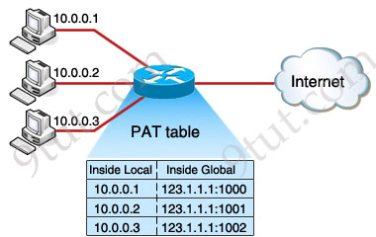
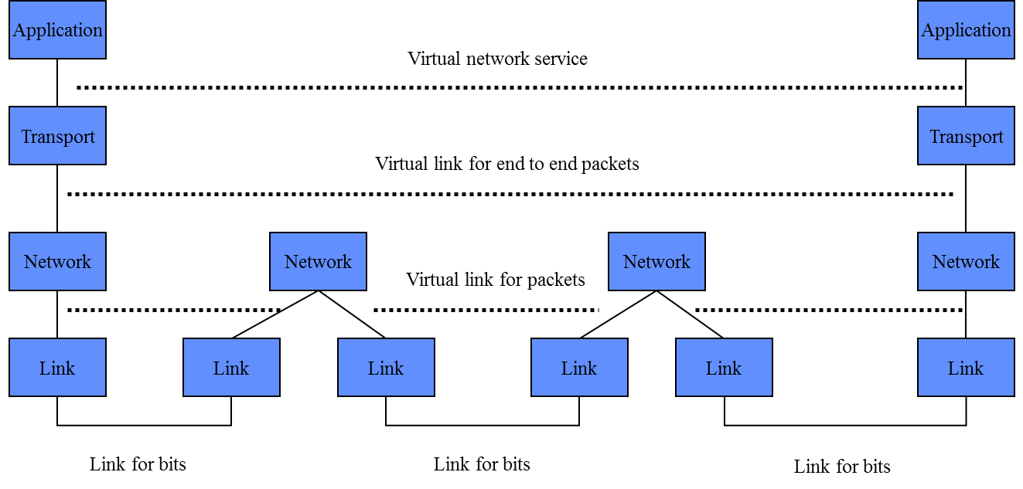
Some Muddiest Points
How to make and host a Web page (!!)
Port address translation
How it all fits together
Protocol layers

Slide 4
“The Web”
HTML
HTTP
Email
FTP
RTSP
URL
URL
(e.g.,http://www.foo.org/snarf.html)
Web
Server
File System
Internet
communication
protocols
HTML
(data/display)
HTTP
(transfer)

Slide 5
HyperText Transfer Protocol (HTTP)
Send request
GET /path/file.html HTTP/1.0
From: someuser@jmarshall.com
User-Agent: HTTPTool/1.0
Server response
HTTP/1.0 200 OK
Date: Fri, 31 Dec 1999 23:59:59 GMT
Content-Type: text/html
Content-Length: 1354
<html><body> <h1>Happy New Millennium!</h1> … </body> </html>
Notes:
The Difference Between FTP and HTTP File Transfer Protocol, or FTP, is a protocol used to upload files from a workstation to a FTP server or download files from a FTP server to a workstation. It is the way that files get transferred from one device to another in order for the files to be available on the Internet. When ftp appears in a URL it means that the user is connecting to a file server and not a Web server and that some form of file transfer is going to take place. Most FTP servers require the user to log on to the server in order to transfer files. In contrast, Hyper Text Transfer Protocol, or HTTP, is a protocol used to transfer files from a Web server onto a browser in order to view a Web page that is on the Internet. Unlike FTP, where entire files are transferred from one device to another and copied into memory, HTTP only transfers the contents of a web page into a browser for viewing. FTP is a two-way system as files are transferred back and forth between server and workstation. HTTP is a one-way system as files are transported only from the server onto the workstation's browser. When http appears in a URL it means that the user is connecting to a Web server and not a file server. The files are transferred but not downloaded, therefore not copied into the memory of the receiving device.

Slide 6
What’s a Document?
Content
Structure
Appearance
Behavior

Slide 7
History of Structured Documents
Early standards were “typesetting languages”
NROFF, TeX, LaTeX, SGML
HTML was developed for the Web
Specialized standards met other needs
Change tracking in Word, annotating manuscripts, …
XML seeks to unify these threads
One standard format for printing, viewing, processing

Slide 8
HyperText Markup Language (HTML)
Simple document structure language for Web
Advantages
Adapts easily to different display capabilities
Widely available display software (browsers)
Disadvantages
Does not directly control layout

Slide 9
“Hello World” HTML
This is the header
<html>
<head>
<title>Hello World!</title>
</head>
<body>
<p>Hello world! This is my first webpage!</p>
</body>
</html>
This is the actual content of the HTML document

Slide 10
Logical Structure Tags
Head
Title
Body
Headers: <h1> <h2> <h3> <h4> <h5>
Lists: <ol>, <ul> (can be nested)
Paragraphs:<p>
Definitions: <dt><dd>
Tables: <table> <tr> <td> </td> </tr> </table>
Role: <cite>, <address>, <strong>, …

Slide 11
HTML Document Structure
“Tags” mark structure
<html>a document</html>
<ol>an ordered list</ol>
<i>something in italics</i>
Tag name in angle brackets <>
Not case sensitive
Open/Close pairs
Close tag is sometimes optional (if unambiguous)

Slide 12
Physical Structure Tags
Font
Typeface: <font face=“Arial”></font>
Size: <font size=“+1”></font>
Color: <font color=“990000”></font>
http://webmonkey.wired.com/webmonkey/reference/color_codes/Emphasis
Bold: <b></b>
Italics: <i></i>

Slide 13
(Hyper)Links
index.html
<html>
<head>
<title>Hello World!</title>
</head>
<body>
<p>Hello world! This is my first webpage!</p>
<p>Click <a href="test.html">here</a> for another page.</p>
</body>
</html>
test.html
<html>
<head>
<title>Another page</title>
</head>
<body>
<p>This is another page.</p>
</body>
</html>

Slide 14
Hypertext “Anchors”
Internal anchors: somewhere on the same page
<a href=“#students”> Students</a>
Links to: <a name=“students”>Student Information</a>
External anchors: to another page
<a href=“http://www.clis.umd.edu”>CLIS</a>
<a href=“http://www.clis.umd.edu#students”>CLIS students</a>
URL may be complete, or relative to current page
<a href=“video/week2.rm”>2</a>
File name part of URL is case sensitive (on Unix servers)
Protocol and domain name are not case sensitive

Slide 15
Link Structure of the Web

Slide 16
Images
<img src=“URL”> or <img src=“path/file”>
<img src=“http://www.clis.umd.edu/IMAGES/head.gif”>
SRC: can be url or path/file
ALT: a text string
ALIGN: position of the image
WIDTH and HEIGHT: size of the image
Can use as anchor:
<a href=URL><img src=URL2></a>
Example:
http://www.umiacs.umd.edu/~daqingd/Image-Alignment.html

Slide 17
Tables
<table>
eenie | mennie | miney
mo | catch | a tiger
by | the | toe
<tr>
<td>
</td>
<td>
</td>
<td>
</td>
</tr>
<tr>
<td>
</td>
<td>
</td>
<td>
</td>
</tr>
<tr>
<td>
</td>
<td>
</td>
<td>
</td>
</tr>
</table>

Slide 18
Table Example
<table align=“center”>
<caption align=“right”>The caption</caption>
< tr align=“LEFT”>
<th> Header1 </th>
<th> Header2</th>
</tr>
<tr><td>first row, first item </td>
<td>first row, second item</td></tr>
< tr><td>second row, first item</td>
<td>second row, second item</td></tr>
</table>
See also: http://www.umiacs.umd.edu/~daqingd/Simple-Table.html
Notes:
Table can basically put all the html into it
Better keep with basic table elements so that you have wider auidence
Use indent to help you to read the table source data

Slide 19
Rendering
Different devices have different capabilities
Desktop or laptop computer
Handheld device
Rendering maps logical tags to physical layout
Controls line wrap, size, font…
Place the title in the page border
Render <h1> as 24pt Times
Render <strong> as bold

Slide 20
Tips
Edit files on your own machine
Upload when you’re happy
Save early, save often, just save!
Reload browser to see changes
File naming
Don’t use spaces
Punctuation matters

Slide 21
What’s Wrong with the Web?
HTML
Confounds structure and appearance (XML)
HTTP
Can’t recognize related transactions (Cookies)
URL
Links breaks when you move a file (PURL)
Notes:
Html was introduced forhow the content should be displayed in the browser
But now html are asked to do things like
1. Tightly control document display
2. Be flexible enough to describe different, specific type of information
3. Convey information in a variety of media and formats
4. Define complex linking relationships between documents
5. Publish a single set of information across a variety of media

Slide 22
The XML Family Tree
SMIL
SpeechML
XUL
XHTML
MathML
RDF
HTML
TEI
. . .
. . .
XML
SGML

Slide 23
Some Basic Rules for All XML
XML is case sensitive
XML declaration is the first statement
<?xml version="1.0"?>
An XML document is a “tree”
Must contain one root element
Other elements must be properly nested
All start tags must have end tags
Attribute values must have quotation marks
<item id=“33905”>
Certain characters are “reserved”
For example: &lt; is used to represent <

Slide 24
XHTML: Cleaning up HTML
<?xml version="1.0" encoding="iso-8859-1"?>
<html xmlns="http://www.w3.org/TR/xhtml1" >
<head>
<title> Title of text XHTML Document </title>
</head>
<body>
<div class="myDiv">
<h1> Heading of Page </h1>
<p> here is a paragraph of text. I will include inside this paragraph
a bunch of wonky text so that it looks fancy. </p>
<p>Here is another paragraph with <em>inline emphasized</em>
text, and <b> absolutely no</b> sense of humor. </p>
<p>And another paragraph, this one with an <img src="image.gif"
alt="waste of time" /> image, and a <br /> line break. </p>
</div>
</body></html>

Slide 25
Defining Blocks of Text
<div> … </div>
Named region
Implies a paragraph break,
Can include multiple paragraphs
<p> … </p>
Individual paragraph
<span> … <span>
Any region
Does not create a paragraph break

Slide 26
CSS
Separating content and structure from appearance
Rules for defining styles “cascade” from broad to narrow:
Browser default
External style sheet
Internal style sheet
Inline style

Slide 27
Basics of CSS
Basic syntax:
Example:
Causes
Font to be center-aligned
Font to be Arial and black
selector {property: value}
HTML tag you want to modify…
The property you want to change…
The value you want the property to take
p { text-align: center;
color: black;
font-family: arial }

Slide 28
Different Ways of Using CSS
Inline style:
Causes only this tag to have the desired properties
Internal stylesheet:
Causes all tags to have the desired properties
<p style="font-family:arial; color:blue“>…</p>
…
<head>…
<style type="text/css" >
p { font-family:arial; color:blue}
</style>
</head>
<body>
<p>…</p>
…

Slide 29
Customizing Classes
Ability to define customized styles for standard HTML tags:
…
<head>…
<style type="text/css">
p.style1 { font-family:arial; color:blue}
p.style2 { font-family:serif; color:red}
</style>
</head>
<body>
<p class=“style1“>…</p>
<p class=“style2“>…</p>
…

Slide 30
External Style Sheets
Store formatting metadata in a separate file
mystyle.css
p.style1 { font-family:arial; color:blue}
p.style2 { font-family:serif; color:red}
…
<head>…
<link rel="stylesheet" href="mystyle.css" type="text/css" />
</head>
<body>
<p class=“style1">…</p>
<p class=“style2">…</p>
…

Slide 31
HTML Editors
Several are available
Adobe Dreamweaver, available from terpware
Microsoft Word, available from terpware
You may still need to edit the HTML file
Some editors use browser-specific features
Some HTML features may be unavailable
File names may be butchered when you upload
Detailed patterns can make hand-editing difficult

Slide 32
Some Style Guidelines
Provide appropriate “access points”
Users’ navigation strategies differ
Design useful navigational aids
Search may lead users to the middle of a site
Include some indication of recency
Date of last update, “new” icons, etc.
Indicate who is responsible for the content
Helps readers assess authority

Slide 33
Some Accessibility Guidelines
Design for device independence
Maintain compatibility with earlier browsers
Provide alternative pages if necessary
Provide alternatives to aural and visual content
Alt tags for images, transcripts for audio
Make it easy for assistive devices to work
Give a title to each frame
Use tables only for data, not to control layout

Slide 34
Section 508 (Federal Web pages)
A text equivalent for every non-text element shall be provided.
Equivalent alternatives for any multimedia presentation shall be synchronized with the presentation.
Web pages shall be designed so that all information conveyed with color is also available without color.
Documents shall be organized so they are readable without requiring an associated style sheet.
Redundant text links shall be provided for each active region of a server-side image map.
Client-side image maps shall be provided instead of server-side image maps except where the regions cannot be defined with an available geometric shape.
Row and column headers shall be identified for data tables.
Markup shall be used to associate data cells and header cells for data tables that have two or more logical levels of row or column headers.
Frames shall be titled with text that facilitates frame identification and navigation.
Pages shall be designed to avoid causing the screen to flicker with a frequency >2 Hz and <55 Hz.
A text-only page, with equivalent information or functionality, shall be provided when compliance cannot be accomplished in any other way. The content shall be updated when the primary page changes
When pages use scripting languages to display content or to create interface elements, the information provided by the script shall be identified with functional text that can be read by assistive technology.
When a web page requires that an applet, plug-in or other application be present on the client system to interpret page content, the page must provide a link to a plug-in or applet that complies with the above.
When electronic forms are designed to be completed on-line, the form shall allow people using assistive technology to access the information, field elements, and functionality required.
A method shall be provided that permits users to skip repetitive navigation links.
When a timed response is required, the user shall be alerted and given sufficient time to indicate more time is required.

Slide 35
Validation Services
HTML cross-browser compatibility
http://validator.w3.org
CSS cross-browser compatibility
http://jigsaw.w3.org/css-validator/
Section 508 compliance
http://www.cynthiasays.com/
Try them on http://www.umd.edu ☹

Slide 36
Programming for the Web
JavaScript [Client-side]
Server embeds a program in HTML
Browser runs the program when it gets to it
PHP “Common Gateway Interface” [Server-side]
HTML form sends field values to the server
Server passes field values to a program
Program generates a Web page as a response
Ruby on Rails [Ajax]
Server sends browser a generic program to run
Browser and server programs exchange XML-encoded data

Slide 37
Software
Software models some aspects of reality
Input and output represent the state of the world
Software describes how the two are related
Examples
Ballistic computations
Google
Microsoft Word

Slide 38
Programming Languages
Used to specify every detail of the model
Special purpose
Able to specify an entire class of models
Spreadsheets (Excel, ...)
Databases (Access, Oracle, ...)
General purpose
Able to specify any possible model
JavaScript, Java, Ruby, Perl, C, C++, ...

Slide 39
History of Programming
Machine language
Language that machine can understand
Assembly language
Assembler translates “symbolic” references to machine instructions and memory locations into machine code
High-level languages
Compiler rewrites everything in machine code OR
Interpreter performs the specified actions at “run time”

Slide 40
Programming Languages
Ruby
PHP
Java
C++
JavaScript
Assembly Language
Machine Language
Hardware

Slide 41
Machine Language
Everything is a binary number
Operations
Data
00001000 ADD
00010101 number to be added (21)
01010110 memory location to add it to (86)
00001000 00010101 01010110

Slide 42
Assembly Language
Symbolic instructions and addresses
Symbolic instruction “ADD”
Symbolic address “SUM1”
For instance
ADD 21, SUM1

Slide 43
High level Languages
Procedural (modular) Programming
Group instructions into meaningful abstractions
C, Pascal, Perl
Object oriented programming
Group “data” and “methods” into “objects”
Naturally represents the world around us
C++, Java, JavaScript, PHP, Ruby

Slide 44
JavaScript
<HTML>
<HEAD>
<TITLE>My first script</TITLE>
</HEAD>
<BODY BGCOLOR=WHITE>
<H1>
<SCRIPT LANGUAGE=JAVASCRIPT TYPE="TEXT/JAVASCRIPT">
document.write("Hello, world!")
</SCRIPT>
</H1>
</BODY></HTML>

Slide 45
Variables
Data types:
Boolean: true, false
Number: 5 9 3.1415926
String: “Hello World”
A “variable” holds a value (of some data type)
Represented as “variable names”: x celsiusTemp
Variables are “dynamically typed” at run time
If you use it as a string, it’s a string …
Variable names are case sensitive in JavaScript

Slide 46
Operators
-x reverse the sign of x (negation)
6+5 Addition (numeric)
“Hello” + “ World” Concatenation (strings) [note the space]
2.1 * 3 Multiply (treats the int as a float)
4 + “ Horsemen” Concatenation (treats 4 as a string)

Slide 47
Assignment Statements
Assignment sets the value of a variable
x = 5 set the value of x to be 5
[a command, not an assertion!!]
x = 5*x Multiply x by 5 and save the result in x
x = 5+8/4*2 Set x to 5+((8/4)*2) [precedence rules!]
x += y x = x + y
x++ x = x + 1
JavaScript statements end with a semicolon
Optional at the end of a line

Slide 48
Some Useful Predefined “Methods”
document.writeln(“…”);
String gets rendered as (X)HTML
Include “<br />” to force a line break
window.alert(“…”);
String is written verbatim as text
Include “\n” to force a line break
foo = window.prompt(“…”);
String is shown verbatim as text
Result is whatever string the user enters

Slide 49
Functions (non-object “Methods”)
Reusable code for complex “statements”
Takes one or more values as “parameters”
Returns at most one value as the “result”
function convertToCelsius(f) {
var celsius = 5/9 * (f-32);
return celsius;
}
var f = 60;
c = convertToCelsius(f);
c = convertToCelsius(60);
function convertToCelsius(f) {
var celsius = 5/9 * (f-32);
return celsius;
}

Slide 50
Writing JavaScript Functions
Convenient to put it in the <head> section
Use <!-- … //--> to prevent display of code
…
<head>
<script language="JavaScript" type="text/javascript">
<!--
function calculate() {
var num = eval(document.input.number.value);
…
document.output.number.value = total;
}
//-->
</script>
</head>
…

Slide 51
Scope of a Variable
In JavaScript, var “declares” a variable
var mystery; create a variable without defining its type
var b = true; create a boolean b and set it to true
var n = 1; create an integer n and set it to 1
var s = “hello”; create a string s and set it to “hello”
Variables declared in a function are “local”
Same name outside function refers to different variable
All other variables are “global”

Slide 52
More JavaScript Statements
Invocation of a function
Temperature.toCelsius(104);
Return a value from a function
return celsius;

Slide 53
Basic Control Structures
Sequential
Perform instructions one after another
Conditional
Perform instructions contingent on something
Repetition
Repeat instructions until a condition is met
Not much different from cooking recipes!

Slide 54
Sequential Control Structure
a = 2;
b = 3;
c = a * b;

Slide 55
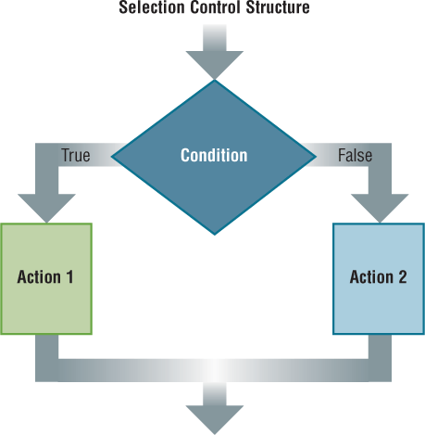
Conditional Selection Control Structure
if (gender == “male”) {
greeting = “Hello, Sir”;
}
else {
greeting = “Hello, Madam”;
}

Slide 56
Boolean Operators
x == y true if x and y are equal [use == not =]
x != y true if x and y are not equal
x > y true if x is greater than y
x <= y true if x is smaller than or equal to y
x && y true if both x and y are true
x || y true if either x or y is true
!x true if x is false

Slide 57
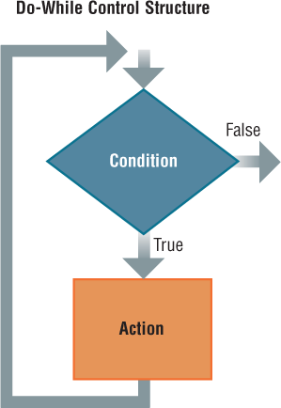
Repetition Control Structure
Program Example 1:
n = 1
while ( n <= 10) {
document.writeln(n);
n++
}
Program 2:
For (n = 1; n <= 10; n++) {
document.writeln(n);
}

Slide 58
Arrays
A set of elements
For example, the number of days in each month
Each element is assigned an index
A number used to refer to that element
For example, x[4] is the fifth element (count from zero!)
Arrays and repetitions work naturally together

Slide 59
Handling Events
Events:
Actions that users perform while visiting a page
Use event handlers to response events
Event handlers triggered by events
Examples of event handlers in Javascript
onMouseover: the mouse moved over an object
onMouseout: the mouse moved off an object
onClick: the user clicked on an object

Slide 60
Using JavaScript with Forms
HTML:
<form name="input" action="">
Please enter a number:
<input size="10" value=" " name="number"/>
</form>
<form name="output" action="">
The sum of all numbers up to the number above is
<input size="10" value=" " name="number" readonly="true"/>
</form>
Reads in a value from the first form
(eval method turns it into a number)
JavaScript:
var num = eval(document.input.number.value);
document.output.number.value = 10;
Changes the value in the second form

Slide 61
Hands On: Adopt a JavaScript Program
Launch a Web browser
http://www.umiacs.umd.edu/~oard/teaching/603/spring15/slides/2/selector.htm
See how it behaves if you are 13 (or 65)
View source and read the program
Save a local copy
Make some changes and see how it works

Slide 62
Programming Tips
Attention to detail!
Careful where you place that comma, semicolon, etc.
Write a little bit of code at a time
Add some functionality, make sure it works, move on
Don’t try to write a large program all at once
Debug by viewing the “state” of your program
Print values of variables using document.write
Is the value what you expected?

Slide 63
Before You Go
On a sheet of paper, answer the following (ungraded) question (no names, please):
What was the muddiest point in today’s class?

