Slide 1

Distributed Teams
Week 13
INFM 603

Slide 2
Agenda
Distributed teams
Project presentation prep
Final exam prep

Slide 3
Strategic Choices
Acquisition
  Proprietary (“COTS”)
  Open source
Implementation
  Integrate “Best-of-breed” systems
  “One-off” custom solution
Notes:
3
4

Slide 4
Global Software Development
Barriers
Solutions
Geographic distance
Temporal distance
Linguistic & cultural distance
Fear and trust
Organizational structure
Process
Infrastructure
Project Architecture
Cultural ambassadors
Configuration management
Face to face kickoffs
Modularity
Well defined interfaces
Effective handoffs
Win-win strategies

Slide 5
Extreme Programming
Planning game
Customer involvement
Coding standards
Simplicity of design
Pair programming
Continuous integration
Refactoring
Small functional releases
Collective ownership
Sustainable pacing
Metaphor

Slide 6
Open Source “Pros”
More eyes ⇒ fewer bugs
Iterative releases ⇒ rapid bug fixes
Rich community ⇒ more ideas
  Coders, testers, debuggers, users
Distributed by developers ⇒ truth in advertising
Open data formats ⇒ Easier integration
Standardized licenses

Slide 7
Open Source “Cons”
Communities require incentives
  Much open source development is underwritten
Developers are calling the shots
  Can result in feature explosion
Proliferation of “orphans”
Diffused accountability
  Who would you sue?
Fragmentation
  “Forking” may lead to competing versions
Little control over schedule

Slide 8
Total Cost of Ownership
Planning
Installation
  Facilities, hardware, software, integration, migration, disruption
Training
  System staff, operations staff, end users
Operations
  System staff, support contracts, outages, recovery, …
Notes:
8
13

Slide 9
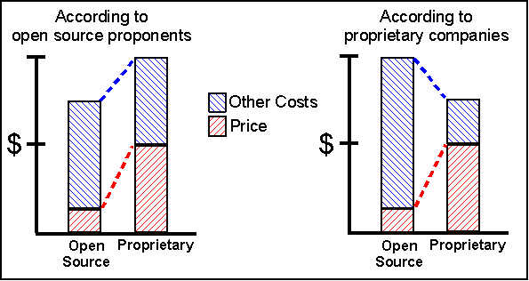
Total Cost of Ownership

Slide 10
Open Source Business Models
Support Sellers
Loss Leader
Widget Frosting
Accessorizing
Sell distribution, branding, and after-sale services.
Give away the software to make a market for proprietary software.
If you’re in the hardware business, giving away software doesn’t hurt.
Sell accessories:
books, compatible hardware, complete systems with pre-installed software

Slide 11
Project Presentations
Maximum of 25 minutes
Goals (from the user’s perspective)
Demo
Task division between partners
Most interesting implementation details
Complete list of limitations
Lessons learned
Project process improvement (optional)

Slide 12
Final Exam
2 hours
  Starts at 6:00 sharp (be early)
  Ends at 8:00 sharp
Take it anywhere
  Classroom will be available
  Ask me questions by email or phone
Open everything
  But no communication with any other person
Available from the Web and by email
Submitted to me by email

Slide 13
Unified Modeling Language
Real systems are more complex than anyone can comprehend
Key idea: Progressive refinement
  Carve the problem into pieces
  Carve each piece into smaller pieces
  When the pieces are small enough, code them
UML provides a formalism for doing this
  But it does not provide the process

Slide 14
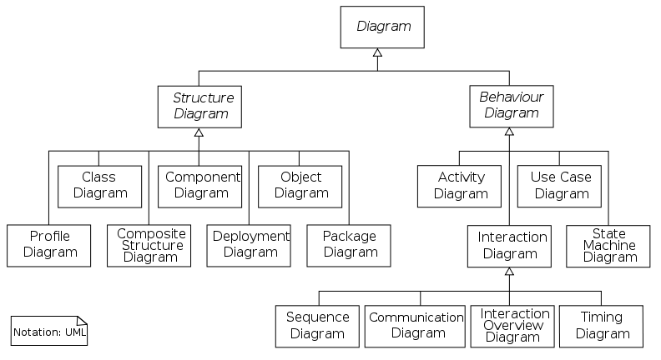
Unified Modeling Language

Slide 15
Specifying Structure
Capturing the big picture
  Use case diagram (interactions with the world)
  Narrative
  Scenarios (examples to provoke thinking)
Designing the object structure
  Class diagram (“entity-relationship” diagram)
  Object diagram (used to show examples)

Slide 16
Specifying Behavior
Represent a candidate workflow
  Activity diagram (a “flowchart”)
Represent object interactions for a scenario
  Collaboration diagram (object-based depiction)
  Sequence diagram (time-based depiction)
Represent event-object interactions
  Statechart diagram (a “finite state machine”)

Slide 17
Use Case Design
Use Case Diagram
  Input-output behavior
Use Case Narrative
  Explains each use case
Use Case Scenario
  Activity diagram shows how the use cases are used together

Slide 18
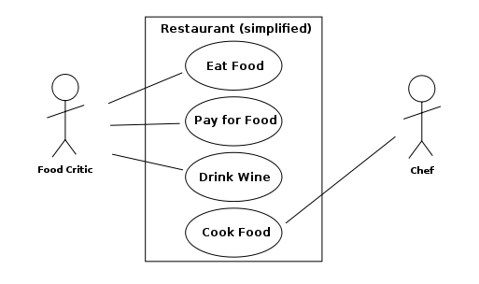
Use Case Diagram

Slide 19
Use Case Diagram
External “actors”
  Roles of people
  Types of systems
Use cases
  Top-level functions (solid arrows to/from actors)
Relationships among use cases
  Always-depends-on (dashed <<include>>)
  Sometimes-is-depended-on (dashed <<extend>>)
  Inherits-from (solid triangle-arrow)

Slide 20
Activity Diagram: Modeling Decisions

Slide 21
Sequence Diagram
Activation
Message
Thanks to Satish Mishra

Slide 22
Good Uses for UML
Focusing your attention
  Design from the outside in
Representing partial understanding
  Says what you know, silent otherwise
Validate that understanding
  Structuring communication with stakeholders

Slide 23
Avoiding UML Pitfalls
Don’t sweat the notation too much
  The key is to be clear about what you mean!
Don’t try to make massive conceptual leaps
  Leverage encapsulation to support abstraction
Don’t get to attached to your first design
  Goal is to find weaknesses in your understanding

