Slide 1

Software Engineering
Week 12
INFM 603

Slide 2
The System Life Cycle
Systems analysis
  How do we know what kind of system to build?
User-centered design
  How do we discern and satisfy user needs?
Implementation
  How do we build it?
Management
  How do we use it?
Notes:
3

Slide 3
Software Engineering
Systematic
  Repeatable
Disciplined
  Transferable
Quantifiable
  Managable

Slide 4
Prehistoric Software Development
Heroic age of software development:
  Small teams of programming demigods wrestle with many-limbed chaos to bring project to success … sooner or later … maybe …
  Kind of fun for programmers ...
  … not so fun for project stakeholders!

Slide 5
The Waterfall Model
Key insight: invest in the design stage
  An hour of design can save a week of debugging!
Three key documents
  Requirements
    Specifies what the software is supposed to do
  Specification
    Specifies the design of the software
  Test plan
    Specifies how you will know that it did it

Slide 6

The Waterfall Model
Requirements
Specification
Software
Test Plan

Slide 7
Coding
Coding standards
  Layout (readable code is easier to debug)
  Design Patterns
    Avoid common pitfalls, build code in expected manner
  Verification: code checkers
Code review
  Computers don't criticize; other coders do!
  Formalized in pair programming
  (Proofs of correctness)
Code less
  Bugs per 100 lines is surprisingly invariant
  Libraries: maximise re-use of code, yours and others

Slide 8
Coding Standards Examples
Use set and get methods
  Limits unexpected “side effects”
Check entry conditions in each method
  Flags things as soon as they go wrong
Write modular code
  Lots of method calls means lots of checks

Slide 9
Version Control
Supports asynchronous revision
  Checkout/Checkin model
  Good at detecting incompatible edits
  Not able to detect incompatible code
Revision Tree
  Named versions
  Described versions
Standard tools are available
  SVN (centralized), git (distributed)
  Key idea: store only the changes

Slide 10
Types of “Testing”
Design walkthrough
  Does the design meet the requirements
Code walkthrough
  Does the code implement the requirements?
Functional testing
  Does the code do what you intended?
Usability testing
  Does it do what the user needs done?

Slide 11
Functional Testing
  Unit testing
    Components separately
  Integration testing
    Subsystems
  System testing
    Complete system (with some coverage measure)
Regression testing
  Invariant output from invariant input

Slide 12
Planning Functional Testing
You can’t test every possibility
  So you need a strategy
Several approaches
  Object-level vs. system-level
  Black box vs. white box
  Ad-hoc vs. systematic
  Broad vs. deep
Choose a mix that produces high confidence

Slide 13
Planning Usability Testing
Define one or more scenarios
  Based on the requirements (not your design!)
  Focus only on implemented functions
Provide enough training to get started
  Usually with a little supervised practice
Banish pride of authorship
  Best to put programmers behind one-way glass!
Record what you see
  Notes, audiotape, videotape, key capture

Slide 14
Types of Errors
Syntax errors
  Detected at compile time
Run time exceptions
  Cause system-detected failures at run time
Logic errors
  Cause unanticipated behavior (detected by you!)
Design errors
  Fail to meet the need (detected by stakeholders)

Slide 15
Bug Tracking
Bugs are alleged errors
  System-level or component level
  Development or deployment
  True bugs or misuse/misunderstanding
Bug tracking is needed
  Particularly on large projects
Standard tools are available
  e.g., Bugzilla

Slide 16
Debugging is harder than coding!
“Debugging is twice as hard as writing the code in the first place. Therefore, if you write the code as cleverly as possible, you are, by definition, not smart enough to debug it”
– Brian W. Kernighan and P. J. Plauger, The Elements of Programming

Slide 17
The Spiral Model
Build what you think you need
  Perhaps using the waterfall model
Get a few users to help you debug it
  First an “alpha” release, then a “beta” release
Release it as a product (version 1.0)
  Make small changes as needed (1.1, 1.2, ….)
Save big changes for a major new release
  Often based on a total redesign (2.0, 3.0, …)

Slide 18
The Spiral Model
2.3
1.2
0.5
1.1
2.2
1.0
2.1
2.0
3.0

Slide 19
Unpleasant Realities
The waterfall model doesn’t work well
  Requirements usually incomplete or incorrect
The spiral model is expensive
  Rule of thumb: 3 iterations to get it right
  Redesign leads to recoding and retesting

Slide 20
The Rapid Prototyping Model
Goal: explore requirements
  Without building the complete product
Start with part of the functionality
  That will (hopefully) yield significant insight
Build a prototype
  Focus on core functionality, not in efficiency
Use the prototype to refine the requirements
Repeat the process, expanding functionality

Slide 21
Rapid Prototyping + Waterfall
Update
Requirements
Write
Specification
Initial
Requirements
Choose
Functionality
Create
Software
Build
Prototype
Write
Test Plan

Slide 22
Objectives of Rapid Prototyping
Quality
  Build systems that satisfy the real requirements by focusing on requirements discovery
Affordability
  Minimize development costs by building the right thing the first time
Schedule
  Minimize schedule risk by reducing the chance of requirements discovery during coding

Slide 23
Characteristics of Good Prototypes
Easily built (about a week’s work)
  Requires powerful prototyping tools
  Intentionally incomplete
Insightful
  Basis for gaining experience
  Well-chosen focus (DON’T built it all at once!)
Easily modified
  Facilitates incremental exploration

Slide 24
Prototype Demonstration
Choose a scenario based on the task
Develop a one-hour script
  Focus on newly implemented requirements
See if it behaves as desired
  The user’s view of correctness
Solicit suggestions for additional capabilities
  And capabilities that should be removed

Slide 25
A Disciplined Process
Agree on a project plan
  To establish shared expectations
Start with a requirements document
  That specifies only bedrock requirements
Build a prototype and try it out
  Informal, focused on users -- not developers
Document the new requirements
Repeat, expanding functionality in small steps

Slide 26
What is NOT Rapid Prototyping?
Focusing only on appearance
  Behavior is a key aspect of requirements
Just building capabilities one at a time
  User involvement is the reason for prototyping
Building a bulletproof prototype
  Which may do the wrong thing very well
Discovering requirements you can’t directly use
  More efficient to align prototyping with coding

Slide 27
Agile Methods
Prototypes that are “built to last”
Planned incremental development
  For functionality, not just requirements elictitation
Privileges time and cost
  Functionality becomes the variable

Slide 28
Agile Methods
Specification
Release
Implementation
Requirements
Establishment
Experience

Slide 29
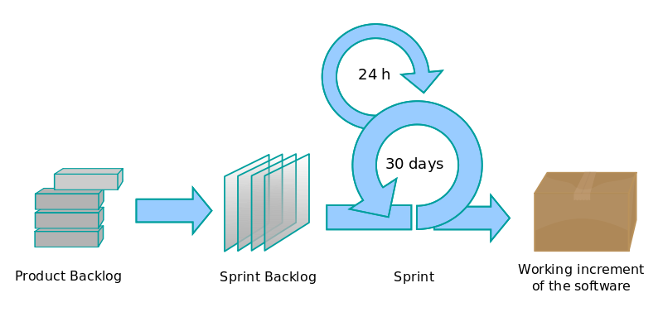
SCRUM

Slide 30
Basic SCRUM Cycle
The sprint:
  Basic unit of development
  Fixed duration (typically one month)
  End target is a working system (not a prototype)
Sprint planning meeting
  Discussion between product owner and development team on what can be accomplished in the sprint
  Sprint goals are owned by the development team

Slide 31
Disadvantages
Can be chaotic
Dependent on a good SCRUM master to reconcile priorities
Requires dedication of team members
Slicing by “user stories” isn’t always feasible

Slide 32
SCRUM: Key Concepts
Roles:
  Product owner: voice of the customer
  Development team: small team software engineers
  Scrum master: primary role as facilitator
User stories: short non-technical description of desired user functionality
  “As a user, I want to be able to search for customers by their first and last names”
  “As a site administrator, I should be able to subscribe multiple people to the mailing list at once”

Slide 33
Standup Meetings
Short, periodic status meetings (often daily)
Three questions:
  What have you been working on (since the last standup)?
  What are you planning to work on next?
  Any blockers?

Slide 34
Software Quality Assurance Models
Patterned on other quality assurance standards
  e.g., ISO 9000
Focus is on measuring quality of process management
  Models don't tell you how to write good software
  They don't tell you what process to use
  They assess whether you can measure your process
    If you can’t measure it, you can’t improve it!

Slide 35
ISO 15504
ISO 15504 has six capability levels for each process:
1. Not performed
2. Performed informally
3. Planned and tracked
4. Well-defined
5. Quantitatively controlled
6. Continuously improved

Slide 36
Total Cost of Ownership
Planning
Installation
  Facilities, hardware, software, integration, migration, disruption
Training
  System staff, operations staff, end users
Operations
  System staff, support contracts, outages, recovery, …
Notes:
36
13

Slide 37
Management Issues
Policy
  Privacy, access control, appropriate use, …
Training
  System staff, organization staff, “end users”
Operations
  Fault detection and response
  Backup and disaster recovery
  Audit
  Cost control (system staff, periodic upgrades, …)
Planning
  Capacity assessment, predictive reliability, …
Notes:
13

Slide 38
Strategic Choices
Acquisition
  Proprietary (“COTS”)
  Open source
Implementation
  Integrate “Best-of-breed” systems
  “One-off” custom solution
Notes:
38
4

Slide 39
Open Source “Pros”
More eyes ⇒ fewer bugs
Iterative releases ⇒ rapid bug fixes
Rich community ⇒ more ideas
  Coders, testers, debuggers, users
Distributed by developers ⇒ truth in advertising
Open data formats ⇒ Easier integration
Standardized licenses

Slide 40
Open Source “Cons”
Communities require incentives
  Much open source development is underwritten
Developers are calling the shots
  Can result in feature explosion
Proliferation of “orphans”
Diffused accountability
  Who would you sue?
Fragmentation
  “Forking” may lead to competing versions
Little control over schedule

Slide 41
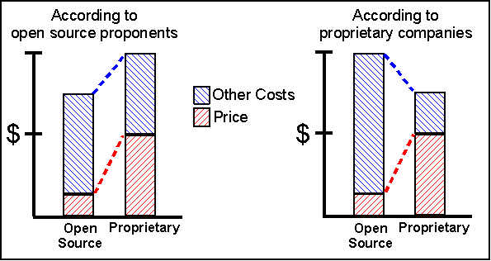
Total Cost of Ownership

Slide 42
Open Source Business Models
Support Sellers
Loss Leader
Widget Frosting
Accessorizing
Sell distribution, branding, and after-sale services.
Give away the software to make a market for proprietary software.
If you’re in the hardware business, giving away software doesn’t hurt.
Sell accessories:
books, compatible hardware, complete systems with pre-installed software

Slide 43
Unified Modeling Language
Real systems are more complex than anyone can comprehend
Key idea: Progressive refinement
  Carve the problem into pieces
  Carve each piece into smaller pieces
  When the pieces are small enough, code them
UML provides a formalism for doing this
  But it does not provide the process

Slide 44
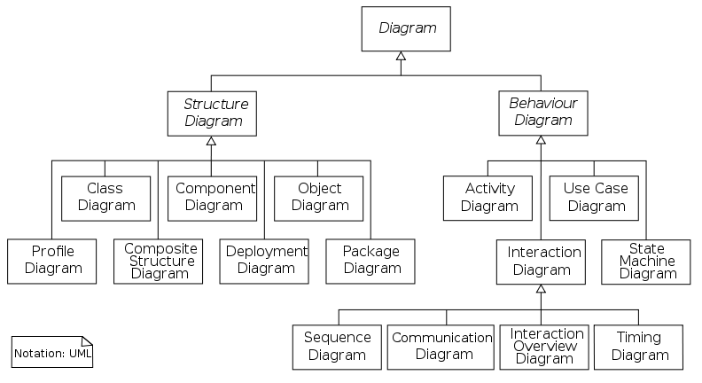
Unified Modeling Language

Slide 45
Specifying Structure
Capturing the big picture
  Use case diagram (interactions with the world)
  Narrative
  Scenarios (examples to provoke thinking)
Designing the object structure
  Class diagram (“entity-relationship” diagram)
  Object diagram (used to show examples)

Slide 46
Specifying Behavior
Represent a candidate workflow
  Activity diagram (a “flowchart”)
Represent object interactions for a scenario
  Collaboration diagram (object-based depiction)
  Sequence diagram (time-based depiction)
Represent event-object interactions
  Statechart diagram (a “finite state machine”)

Slide 47
Use Case Design
Use Case Diagram
  Input-output behavior
Use Case Narrative
  Explains each use case
Use Case Scenario
  Activity diagram shows how the use cases are used together

Slide 48
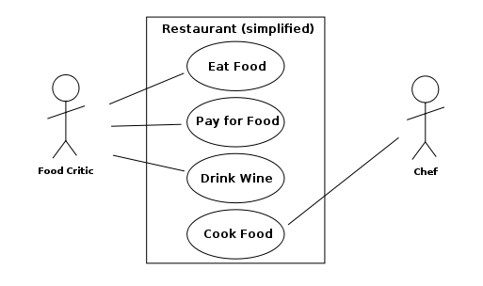
Use Case Diagram

Slide 49
Use Case Diagram
External “actors”
  Roles of people
  Types of systems
Use cases
  Top-level functions (solid arrows to/from actors)
Relationships among use cases
  Always-depends-on (dashed <<include>>)
  Sometimes-is-depended-on (dashed <<extend>>)
  Inherits-from (solid triangle-arrow)

Slide 50
Activity Diagram: Modeling Decisions

Slide 51
Sequence Diagram
Activation
Message
Thanks to Satish Mishra

Slide 52
Good Uses for UML
Focusing your attention
  Design from the outside in
Representing partial understanding
  Says what you know, silent otherwise
Validate that understanding
  Structuring communication with stakeholders

Slide 53
Avoiding UML Pitfalls
Don’t sweat the notation too much
  The key is to be clear about what you mean!
Don’t try to make massive conceptual leaps
  Leverage encapsulation to support abstraction
Don’t get to attached to your first design
  Goal is to find weaknesses in your understanding

Slide 54
Advantages of SCRUM
Fundamentally iterative, recognizes that requirements change
Development team in charge of the sprint backlog
  Favors self-organization rather than top-down control
  Reprioritize in response to changing requirements and progress
Time-limited sprints ensure periodic delivery of new product increments
  Allows opportunities to receive user feedback, change directions, etc.
Buzzword = velocity

