Slide 1

Mobile Apps
INFM 603
Week 10

Slide 2
Agenda
Questions
Mobile Apps
HCI
Project discussions

Slide 3
Native Apps
Live on device
Access to all device features
  GPS, accelerometer, compass, list of contacts
Written for specific platform
  Android, Blackberry, iOS,…
Can be acquired from an app store
  Google Play or Apple app store

Slide 4
Mobile Apps
Not real apps, just websites with look and feel of a native app
Written to work on specific browser
Coded in HTML5, Javascript, CSS
Not in official appstores

Slide 5
Hybrid Apps
Part native, part web
The browser is in the app
Coded in HTML5, CSS and JavaScript
Wrapper specific to each type of phone
Available in app store
  Cheap way of having a presence on the stores

Slide 6



Notes:
Iphone-android-mobile web

Slide 7
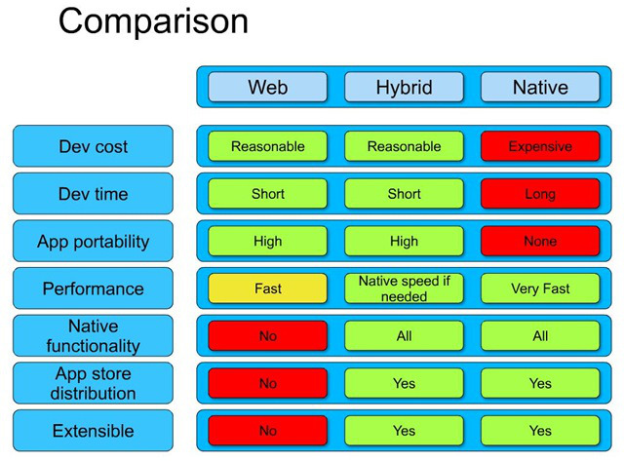

Slide 8
From HTML to the Marketplace
Generate the code for your app
Test it on different browsers and platforms
  Add phone features depending on platform
“Package” the code to make it an app
  If Web app, add wrapper around code
  If native app, simply compile
Put it in the marketplace
https://play.google.com/store

Slide 9
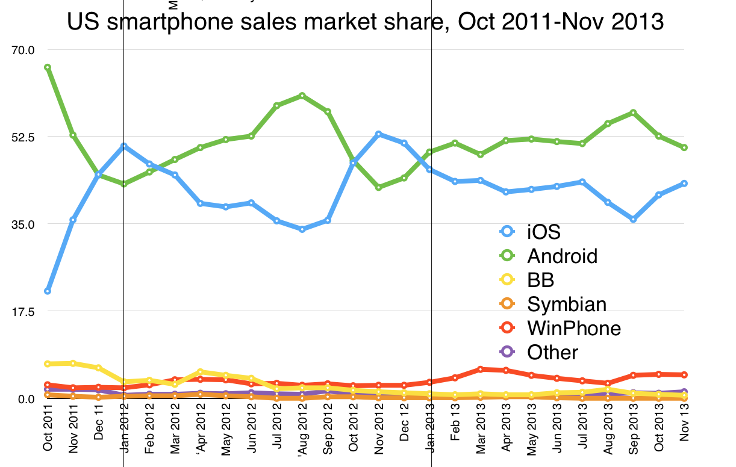
Market Fragmentation:
Operating Systems

Slide 10
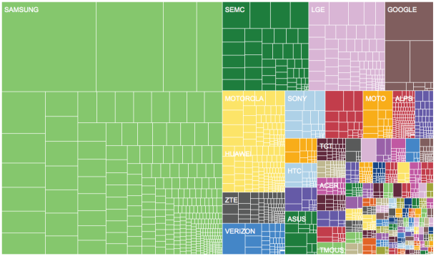
Market Fragmentation: Devices

Slide 11
Emulators
Allow you to test how your code would look like across different types of platforms
  Sencha or Phonegap
Compile hybrid applications to make them “native” and ready for market place

Slide 12
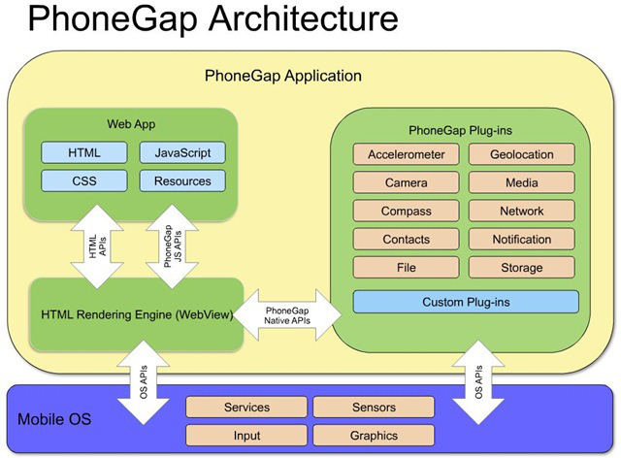

Slide 13
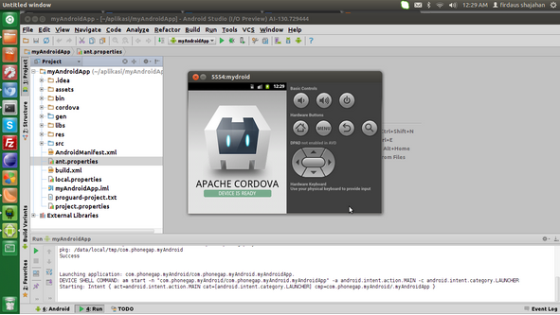

Slide 14
Hybrid App Development
PhoneGap
  SDK for each operating system (android, iPhone, …)
  Program in HTML, Javascript,…
  Package as a native app
  Test in cell phone
Ripple (http://emulate.phonegap.com)
  Emulates PhoneGap on Chrome

Slide 15
Mobile User Interface
Smaller form factors
Touch interfaces
Acceleration sensing
Orientation awareness
Simulations of physical behavior

Slide 16
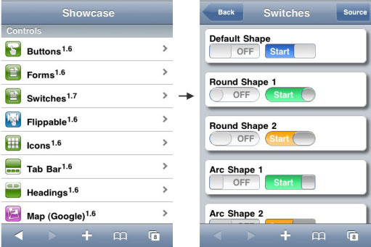
User Interfaces for Mobiles
Best Practices
Responsive Layouts

Slide 17
Geolocation
Location-based services acquire information about where you are
Think about potential privacy issues
http://www.google.com/intl/en/privacy/lsf.html

Slide 18
Geolocation Method
navigator.geolocation
if (navigator.geolocation) navigator.geolocation.getCurrentPosition(showPosition);
function showPosition(position){
x.innerHTML=
}

Slide 19
Geolocation Method
function showPosition(position){
x.innerHTML
}
The final coordinates are:
position.coords.latitude
position.coords.longitude

Slide 20
Hands On
Write a program that prints the geolocation of a user when a button is clicked
  Test it on your browser
  Test it on ripple and change geolocation values
  <script type="text/javascript“ src="phonegap.js"></script>

Slide 21
readlocation.html
<!DOCTYPE html>
<html> <body>
<p id="demo">Click the button to get your coordinates:</p>
<button onclick="getLocation()">Try It</button>
<script type="text/javascript" src="phonegap.js"></script>
<script>
var x=document.getElementById("demo");
function getLocation() {
if (navigator.geolocation) {
navigator.geolocation.getCurrentPosition(showPosition);
} else{
x.innerHTML="Geolocation is not supported by this browser.";
}
}
function showPosition(position) {
x.innerHTML="Latitude: “ + position.coords.latitude + "<br>Longitude: “ +
position.coords.longitude;
}
</script>
</body> </html>

Slide 22
dist2saopaulo.html
<!DOCTYPE html>
<html> <body>
<p id="demo">Click the button to get distance between you and Sao Paolo, Brazil:</p>
<button onclick="getLocation()">Try It</button>
<script type="text/javascript" src="phonegap.js"></script>
<script>
var x=document.getElementById("demo");
function getLocation() {
if (navigator.geolocation) {
navigator.geolocation.getCurrentPosition(showPosition);
} else{
x.innerHTML=
"Geolocation is not supported by this browser.";
}
}
function showPosition(position) {
var sp1=-23.55;
var sp2=-46.6333;
var dist = distance(position.coords.latitude,sp1,position.coords.longitude,sp2);
x.innerHTML="Latitude: " + position.coords.latitude +
"<br>Longitude: " + position.coords.longitude + "<br>"+ " Distance between the two "+ dist + “ km”;
}
</script>
</body> </html>
function distance(lat1,lat2,lon1,lon2) {
var R = 6371;
var dLat = toRad(lat2-lat1);
var dLon = toRad(lon2-lon1);
var lat1 = toRad(lat1);
var lat2 = toRad(lat2);
var a = Math.sin(dLat/2) * Math.sin(dLat/2) +
Math.sin(dLon/2) * Math.sin(dLon/2) *
Math.cos(lat1) * Math.cos(lat2);
var c = 2 * Math.atan2(Math.sqrt(a), Math.sqrt(1-a));
var d = R * c;
return d;
}
function toRad(Value) {
return Value * Math.PI / 180;
}

Slide 23
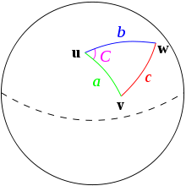
Haversine Distance
DC:+38.8951
-77.03

Slide 24
plotlocation.html
function showError(error) {
switch(error.code) {
case error.PERMISSION_DENIED:
x.innerHTML="User denied the request for Geolocation."
break;
case error.POSITION_UNAVAILABLE:
x.innerHTML="Location information is unavailable."
break;
case error.TIMEOUT:
x.innerHTML="The request to get user location timed out."
break;
case error.UNKNOWN_ERROR:
x.innerHTML="An unknown error occurred."
break;
}
}
<!DOCTYPE html>
<html> <body>
<p id="demo">Click the button to get your position:</p>
<button onclick="getLocation()">Try It</button>
<div id="mapholder"></div>
<script>
var x=document.getElementById("demo");
function getLocation() {
if (navigator.geolocation) {
navigator.geolocation.getCurrentPosition(showPosition,showError);
} else{
x.innerHTML="Geolocation is not supported by this browser.";
}
}
function showPosition(position) {
var latlon=position.coords.latitude+","+position.coords.longitude;
var img_url=http://maps.googleapis.com/maps/api/staticmap?center=+latlon+"&zoom=14&size=400x300&sensor=false";
document.getElementById("mapholder").innerHTML="<img src='"+img_url+"'>";
}
</script> </body> </html>

Slide 25
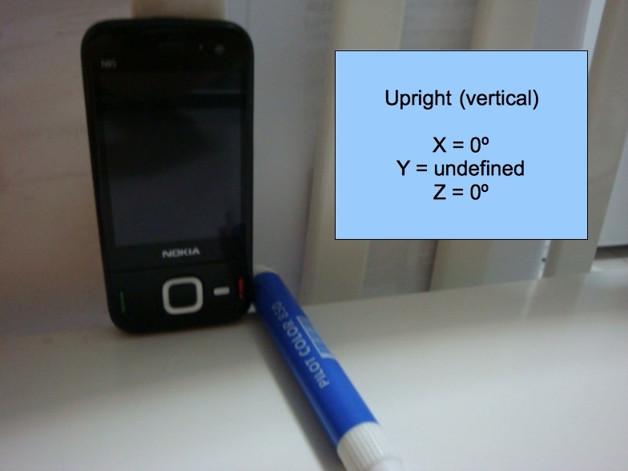
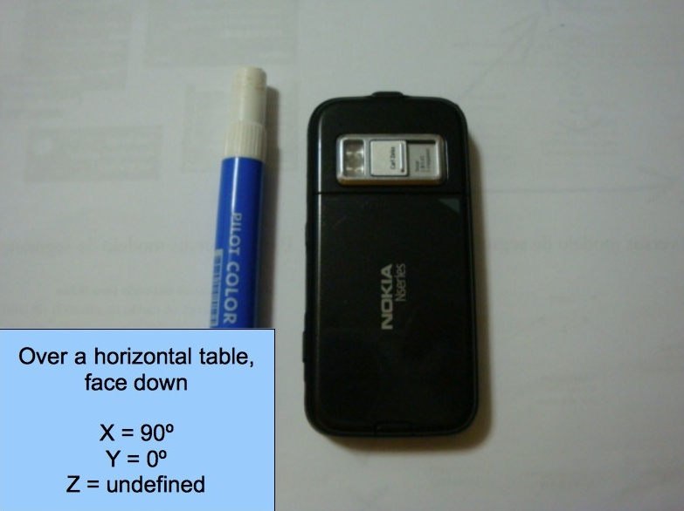
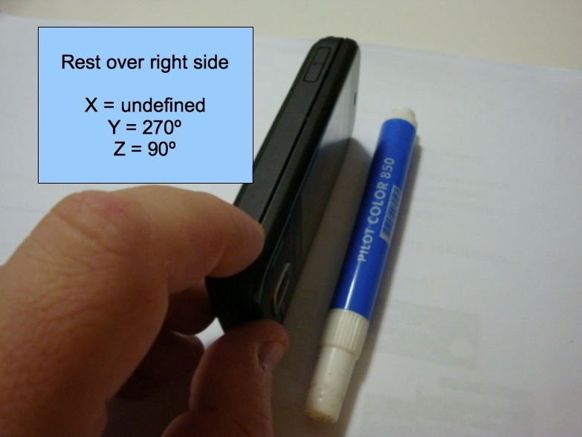
Accelerometer

Slide 26
readaccelerometer.html
<!DOCTYPE html>
<html> <head>
<title>Acceleration Example</title>
<script type="text/javascript" charset="utf-8" src="phonegap-1.2.0.js"></script>
<script type="text/javascript" charset="utf-8">
// Wait for PhoneGap to load
document.addEventListener("deviceready", onDeviceReady, false);
// PhoneGap is ready
function onDeviceReady() {
navigator.accelerometer.getCurrentAcceleration(onSuccess, onError);
}
// onSuccess: Get a snapshot of the current acceleration
//
function onSuccess(acceleration) {
alert('Acceleration X: ' + acceleration.x + '\n' +
'Acceleration Y: ' + acceleration.y + '\n' +
'Acceleration Z: ' + acceleration.z + '\n' +
'Timestamp: ' + acceleration.timestamp + '\n');
}
// onError: Failed to get the acceleration
//
function onError() {
alert('onError!');
}
</script>
</head> <body>
<h1>Example</h1>
<p>getCurrentAcceleration</p>
</body> </html>
only works with cordova

Slide 27
faceup.html
function startWatch() {
var options = { frequency: 100 };
watchID =
navigator.accelerometer.watchAcceleration(
onSuccess, onError, options);
}
function stopWatch() {
if (watchID) {
navigator.accelerometer.clearWatch(watchID);
watchID = null;
}
}
function onError() {
alert('onError!');
}
<!DOCTYPE html> <!DOCTYPE html>
<html> <head>
<title>Acceleration Example</title>
<script type="text/javascript" charset="utf-8"
src="phonegap-1.2.0.js"></script>
<script type="text/javascript" charset="utf-8">
var watchID = null;
document.addEventListener("deviceready", onDeviceReady, false);
function onDeviceReady() {
startWatch();
}
function onSuccess(acceleration) {
var element = document.getElementById('accelerometer');
if ((0.9<=acceleration.y) && (acceleration.y<= 1.1) && (0<=acceleration.z) && (acceleration.z <= 0.1)&& (0<=acceleration.x) && (acceleration.z <= 0.1) ) {
element.innerHTML = 'Acceleration X: ' + acceleration.x + '<br />' + 'Acceleration Y: ' + acceleration.y + '<br />' +
'Acceleration Z: ' + acceleration.z + '<br />' + 'Timestamp: ' + acceleration.timestamp + '<br />'+
"<img src=upright.JPG>";
} else {
element.innerHTML = 'Acceleration X: ' + acceleration.x + '<br />' + 'Acceleration Y: ' + acceleration.y + '<br />' +
'Acceleration Z: ' + acceleration.z + '<br />' + 'Timestamp: ' + acceleration.timestamp + '<br />'+"not upright";
}
}
</script> </head> <body> <div id="accelerometer">Waiting for accelerometer...</div> </body> </html>

Slide 28
Human-Computer Interaction
A discipline concerned with the
Design
Implementation
Evaluation
of interactive computing systems for human use
Notes:
28

Slide 29
Synergy
Humans do what they are good at
Computers do what they are good at
Strengths of one cover weakness of the other

Slide 30
Interaction
Forming an intention
  Internal mental characterization of a goal
Selection of an action
  Review possible actions, select most appropriate
Execution of the action
  Carry out appropriate actions with the system
Evaluation of the outcome
  Compare results with expectations

Slide 31
Stages of Interaction
Goals
Intention
Expectation
Evaluation
Selection
Interpretation
Mental Activity
Physical Activity
System
Execution
Perception

Slide 32
Challenges of HCI
Goals
Intention
Expectation
Evaluation
“Gulf of Execution”
“Gulf of Evaluation”
Selection
Interpretation
Mental Activity
Physical Activity
System
Execution
Perception

Slide 33
What is good design?
Goals
Intention
Expectation
Evaluation
Mental
Model
Selection
Interpretation
Mental Activity
Physical Activity
System
Execution
Perception

Slide 34
Modeling Interaction
Human
Mental Models
Sight
Sound
Task
System
Hands
Voice
Software Models
Keyboard
Mouse
Task
User
Display
Speaker
Computer

Slide 35
Mental Models
How the user thinks the machine works
  What actions can be taken?
  What results are expected from an action?
  How should system output be interpreted?
Mental models exist at many levels
  Hardware, operating system, and network
  Application programs
  Information resources

Slide 36
Evaluation Approaches
Formative vs. summative
Extrinsic vs. intrinsic
Quantitative vs. qualitative
  Deductive vs. inductive
User study vs. simulation

Slide 37
Evaluation Examples
Direct observation
  Evaluator observes users interacting with system
    in lab: user asked to complete pre-determined tasks
    in field: user goes through normal duties
  Validity depends on how contrived the situation is
Think-aloud
  Users speak their thoughts while doing the task
  May alter the way users do the task
Controlled user studies
  Users interact with system variants
  Correlate performance with system characteristics
  Control for confounding variables

Slide 38
Evaluation Measures
Time to learn
Speed of performance
Error rate
Retention over time
Subjective satisfaction

