Slide 1
iClasses Project
INFM 603, Spring 2012
Mary John, Marcelo Ramagem

Slide 2
Introduction
The Big Picture
What: Web application to aggregate course info
Who: MIM Students, Prospects, and MIM Advisor.
When: Use before signing-up for classes
Where: In the cloud!
Why: Because course info is scattered
How: Drupal CMS

Slide 3
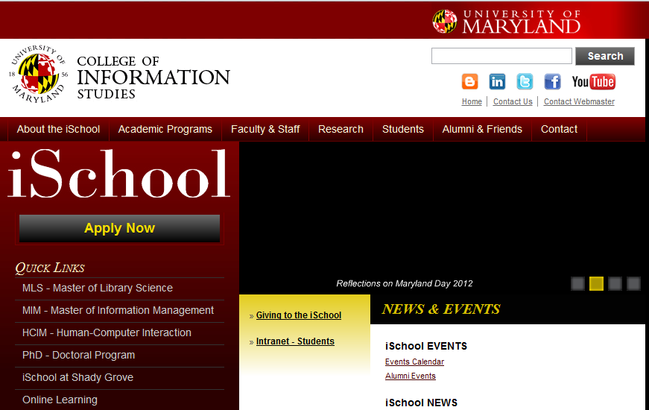
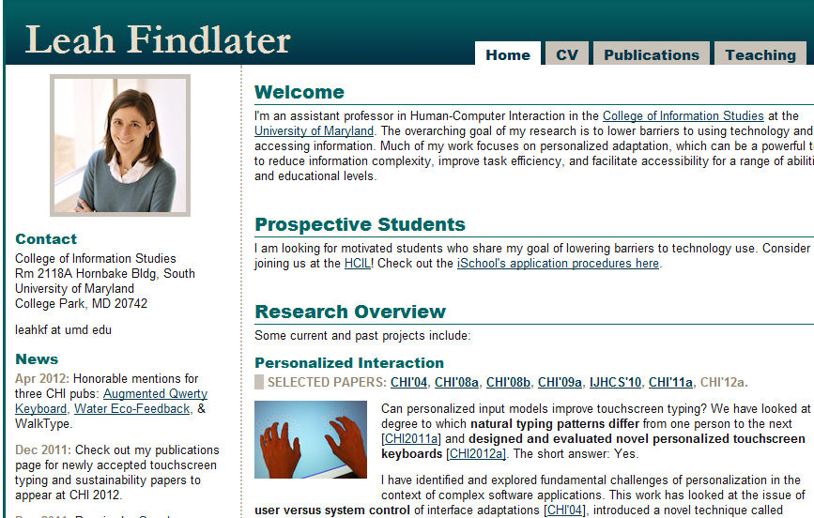
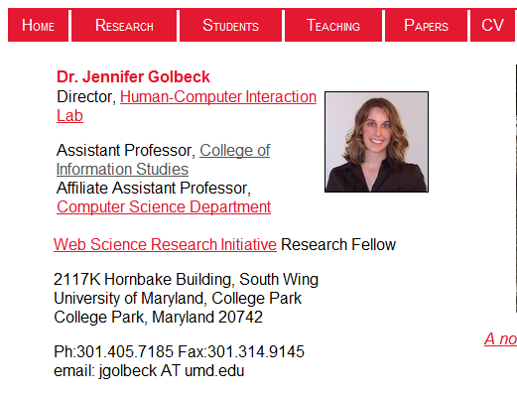
Syllabus,
Professor,
Projects, etc
MIM Student
Problem!

Slide 4
Browse info
Receive Alerts
iClasses.com
MIM Student
Solution

Slide 5
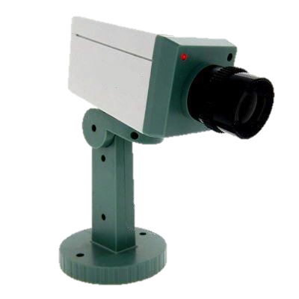
Aggregate Course Info
Monitor 3rd Party Sites
Automated Notifications
3 Core Features

Slide 6
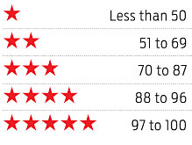
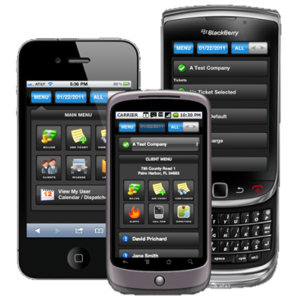
Social Sharing
Student Commenting
Course Ratings
Mobile
UMD Integration
“Nice to haves…”

Slide 7
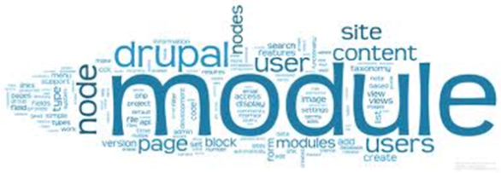
WAMP
Database
Server Language
Drupal Components
Win2K3 Web Server
Site Monitoring
Our Tools

Slide 8
Modules Tested
Our Quest for Modules…
queryPath | WebForm
SimpleHTML Dom Parser | qForms
Job Scheduler | Feeds Crawler
Comment Subject | Watcher
FiveStar | Many Mail
CronJob | HTPassword Protection

Slide 9
Modules Used
Links: standard custom content field for adding URL links
Views: query content and display it in customized fashion
Entity Reference: field to lookup data in other tables
String Overrides: replaces text so you can rename default naming conventions
Watcher: subscribe to specific content notifications
CCKTools: built into to D7 and allows for custom fields
Ctools: a required dependency module (used indirectly)
Token: a required dependency module (used indirectly)
Entity: a required dependency module (used indirectly)

Slide 10
PLANNED IMPLEMENTATION MODEL
Module
(Watcher, Querypath)
New updates ?
Yes
Yes
External Websites
1
2
N
O
Updates
STOP
Student 1
iClasses Website
Student 2
3
Triggers
Student 3
Module
(manymails)
Email Updates
Student 4
4

Slide 11
ACTUAL IMPLEMENTATION MODEL
Website Watcher
(changedetection.com)
Monitors New updates
Yes
Yes
External Websites
1
N
O
2
STOP
Emails
Student 1
MIM Advisor
Email Updates
4
Student 2
3
Updates
Student 3
iClasses Website
Student 4

Slide 12
Started overly ambitious
Focus on user goals not technology
Drupal powerful but poorly documented (also wack-a-mole)
Integration of disparate data is TOUGH!
Reflections

Slide 13
Questions?
Thank You!

