Slide 1
INFM603 Project Presentation
Jenny Wu
Prachi Chhokar

Slide 2
Goals
The goals of Scholars Web-Net are to:
  provide a space for the ARHU graduate students, studying under various departments and colleges at ARHU to host their individual websites
  allow ARHU graduate students to easily interact with each other, share project related work, help fellow students on similar projects

Slide 3

Goal #1 - web space
login using UMD ID
profile creation
website management(theme)

Slide 4
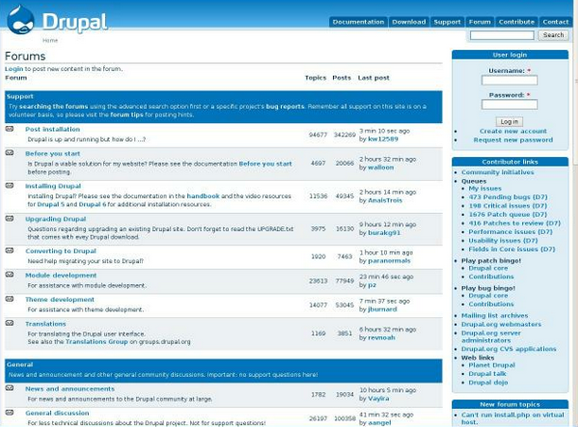
Goal #2 - interaction
contact sharing
activity sharing & discovery
  forum module

Slide 5
Work division
Jenny
user need analysis/ requirements gathering
setting up & managing hosting space
managing mySQL databases & backend configurations
system testing
Prachi
system implementation
system testing
module implementation and tweaking
theme implementation

Slide 6
Implementation details
Ldap module
Activate ldap module from the modules page.
Download ldap integration module from the website.
Activate the ldap module.
Create a server with the connection parameters.
PHP code changes:
Automating the profile creation after ldap login.
Fetch the user id and create unique URL for each website.
scholarregister.pages.inc - default value ->$site_owner->name.
Forum module
Enable forum form the modules list.
Create a forum container.

Slide 7
Implementation details
Theme (Layout front page)
Added university wrapper to the theme.
Html code generated by the UMD website.Code put under themes folder. Put under sites/all/theme/openscholar/openscholar_base/page.tpl.php
Removed the default video that appears on the front page. (openscolar_front.blocks.inc)
Changing Css files. openschoalr_default.css,openschoalr_base.cc
Changes to views
openscholar_site (view changed) to display the Name of the scholar.
Removed the feature flag from the view.
Removed the site logo from the front page.
Blocks
Edited content_top block.
Edited content_bottom block.

Slide 8
Limitations
Server Issues
Php memory limit (128M memory requirement)
File permissions changed everytime uploaded in the server
php max_execution_time error
Database Issues
Clearing cache tables (when reloading the drupal environment)
Buggy drupal-openscholar website
The latest versions come with some bugs that can created login issues
No access to apache logs,php.ini etc
Not able to restore session of admin while logged in. However, same version works perfectly well on localhost.
Could not separate out the drupal themes with openscholar themes

Slide 9

Lessons learned
Newer isn't always the better
  openscholar beta 11 vs beta 14
Don't believe everything people say
inaccurate server requirements
Time is a precious asset
Sometimes you just need a fresh start
  reinstalling system multiple times

Slide 10

Questions?

