Slide 1
GOODIES CHINESE RESTAURANT & SUB SHOP
INFM 603 Final Project
Naumaan Nasir
Rob Dorsey

Slide 2
OUTLINE
Project Goals
Our Client
Implementation
HTML Prototype
Attempts at Creating Online Site
Adding Drupal Themes
Drupal Gardens Benefits & Problems/Obstacles
Testing
Future Work
What We Learned

Slide 3
Project Goals & Objectives
Goals
Plan and create a live Website for real user
Utilize functionality and benefits of Drupal
Generate business and income for user
Involve user in project as much as possible
Objectives
Satisfy Specific User Requirements
Satisfy INFM 603 Class Requirements
Complete a functional site by 5/16/2012

Slide 4
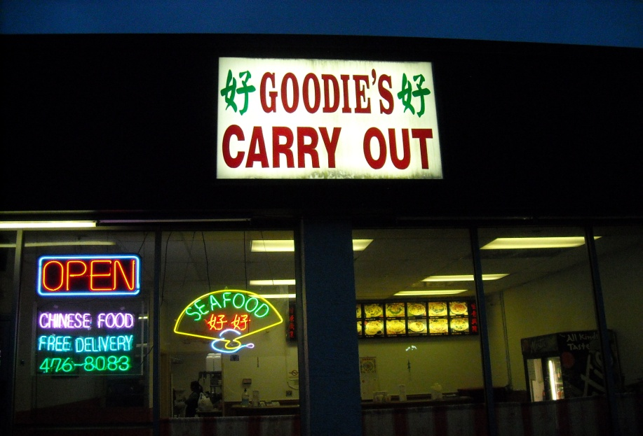
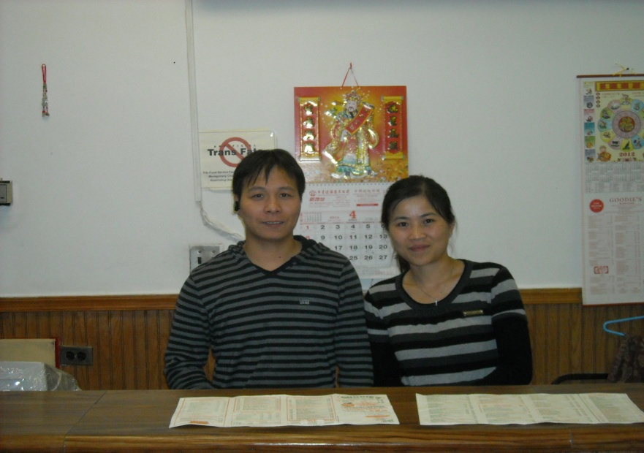
About Our Customer
Small family owned business
Friendly, familiar, easy to work with
Non-technical
Spoke limited English

Slide 5
Planning & Gathering Requirements
Planning
Prototyping (HTML & Vizio)
Drupal usage
Methodology
Requirements
User Interview
Looking at other sites
Prototyping
Iterative process

Slide 6
Challenges and Obstacles
Challenges
User’s Language Barrier
User’s lack of technical familiarity
Virtual Machine
Obstacles
Drupal functionality and compatibility

Slide 7
Implementation
HTML Prototype
Attempts at Creating Online Site
Adding Drupal Themes
Drupal Gardens
DG Benefits
DG Problems/Obstacles #1
DG Problems/Obstacles #2

Slide 8
HTML Prototype
Has most of the basic items we and user wanted
Learned more about HTML
Much time spent creating Chinese “Hao” character

Slide 9
Attempts at Creating Online Site
U of Md “Grace” Virtual Machine
Xampp install instructions didn’t work
4 different U of Md Help Desks, dozen+ phone calls , several emails later, still not finished
Unfamiliarity with Linux
Pay for web-hosting service?

Slide 10
Adding Drupal Themes
HTML site looked “flat”
Need Drupal anyway for course requirements
Many themes wont install on Drupal 7
Themes features seem “restrictive”
Necessary to “go behind the scenes” using CSS, Style sheets; Firebug

Slide 11
Drupal Gardens
A “Mini-Revelation”

Slide 12
Drupal Gardens Benefits
Avoids VM site problems
We avoid cost of webhosting service
Free “real” site – user avoids webhosting cost
Built-in features facilitate interactive use w/o PHP and DB manipulation

Slide 13
Drupal Website

Slide 14
Drupal Gardens Problems #1
Navigation bar overlaid header containing site name
Had to put space in front of site name to keep from cutting off navigation bar at the top of screen
Problems getting Chinese characters and site name next to each other
Created image w both Chinese chars & site name
Wont resize some images
Discover card vs. “Food” image

Slide 15
Drupal Gardens Problems #2
Items display differently in different screens
Logged out/Logged in/Edit mode
Causes much extra work formatting displays
WYSIWYG tab isn’t always WYSIWYG
Wont display “webcounter”
Displays in edit mode but not display mode
If logged in as non-admin user, cant log out
Must delete cookies for site
Wont center items on Navigation tab
Not a problem?

Slide 16
Testing
Customer input and feedback
Weekly meetings with user
Self-testing
Different modes: Logged out/Logged in/Edit mode
Firefox and IE
User testing
General feedback from several people
Recommendations from website designer
Contextual inquiry

Slide 17
Future Work
Solve “blurry menu“ issue
Could just create a text menu
Find way to include “webcounter”
Other Drupal themes may help resolve issues
Drupal tech support may be able to help
Test using on mobile device
Continue working with users to help use and manage site effectively

Slide 18
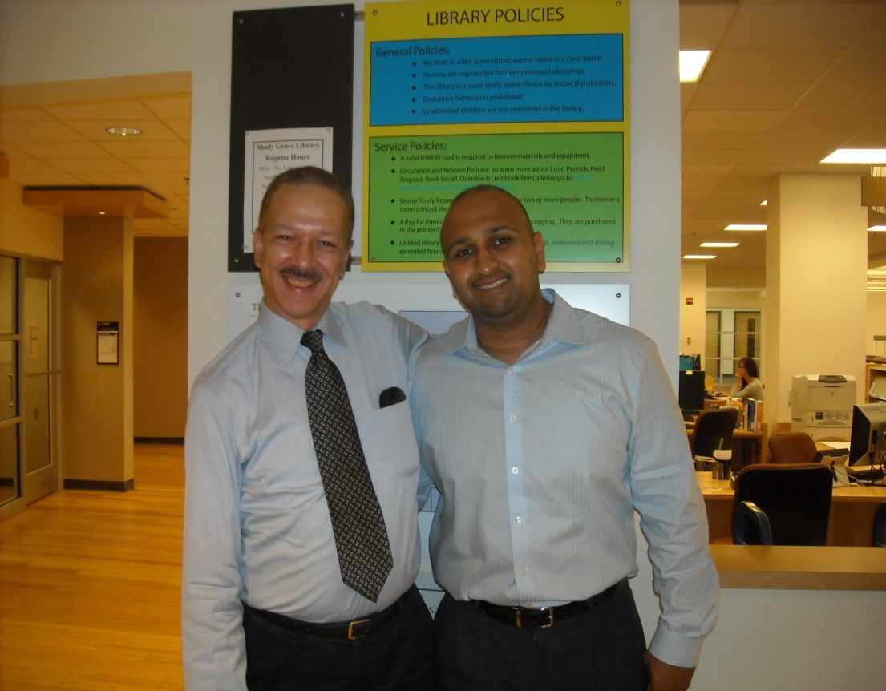
What We Learned
Takes forever to do anything, even small tasks
Need to allow more time for testing
Gained much technical knowledge & experience
It was fun!!

