Slide 1
In Service of Seniors
Steven Dodge & Jackie Sauter
INFM603 Spring 2012
in-service-of-seniors.org
Notes:
jackie

Slide 2
Agenda
Goals
Demo
Division of Labor
Implementation Details
Limitations
Reflections
Future Recommendations

Slide 3
Miss America Goal
Build a website that allows seniors to receive volunteer help from their neighbors and each other for everyday tasks, such as:
Companionship
Exercise
Education
Groceries
House maintenance
Social events
Technology
Transportation
Etc.

Slide 4
Audiences
Seniors
Volunteers
17.5M seniors 65+ are online (2009)
Popular activities & destinations:
Email
Google, Windows Media Player, Facebook, YouTube, Amazon
Frequent volunteers:
VolunteerMatch
HandsOn Greater DC Cares
Serve DC
Find relevant service opportunities
User profiles
Notes:
According to a study by Nielsen, in 2009, 17.5 million people aged 65 and older were online. In that study, the most common activity that seniors participated in was email, and the top online destinations included Google, Windows Media Player, Facebook, YouTube, and Amazon (Nielsen, 2009). To satisfy these users, ISOS will use these websites’ design strategies as inspiration for ISOS’s design, and make use of email for the services provided. In addition, ISOS will need to ensure optimal ease of use for the seniors user group, and ensure that there is a mechanism built in to establish trust between the seniors and volunteers.
Volunteers who visit ISOS will have likely visited numerous other volunteering websites. In the Washington, D.C. metro area, examples include the websites for the following organizations: Volunteer Match, HandsOn Greater DC Cares, and Serve DC. On all of these sites, profiles are used to manage user accounts, and the key functionality is the ability to find relevant service opportunities based on the user’s interests. ISOS will need to adopt user profiles and match users to pertinent opportunities in order for ISOS to succeed.

Slide 5
Requirements
Functional
General content management
Navigation, search, login/out
User profiles
Community members
Community organizations
Help Requests
Create them
List them
Volunteer sign up
Nonfunctional
Security
Accounts
Permissions
Performance

Slide 6
Process Example: Help Request
Log in/Create account
Create help request
Fill out help request form
Is valid? Y/N
If Y, request created

Slide 7
Demo Time

Slide 8
Division of Labor
Steven
Jackie
Initial set-up, backups
CiviCRM – primary wrangler
PHP manipulation
Search functionality
Theme, images, logo, general appearance
Sample data & content build-out
Help section
Shared: Testing & troubleshooting

Slide 9
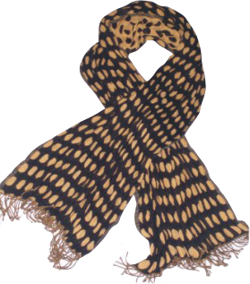
Technology & Implementation
Buy
GoDaddy.com
CiviCRM
vs.
Build
University of Maryland Virtual Machines
A conglomeration of custom code and prebuilt modules

Slide 10
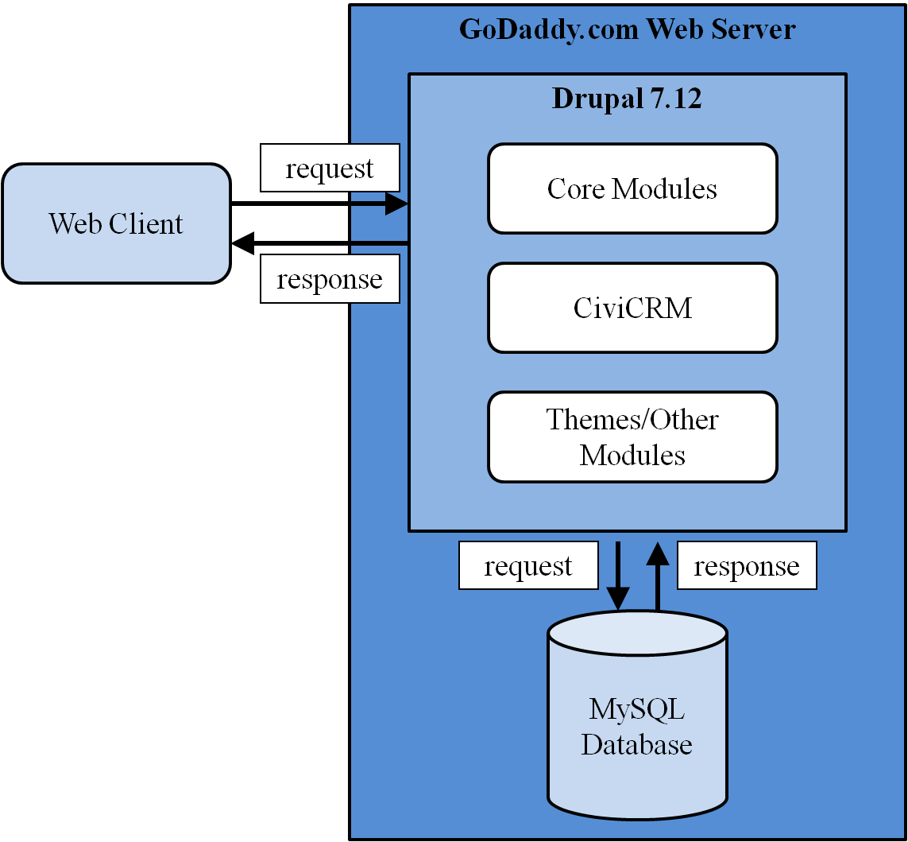
Implementation

Slide 11
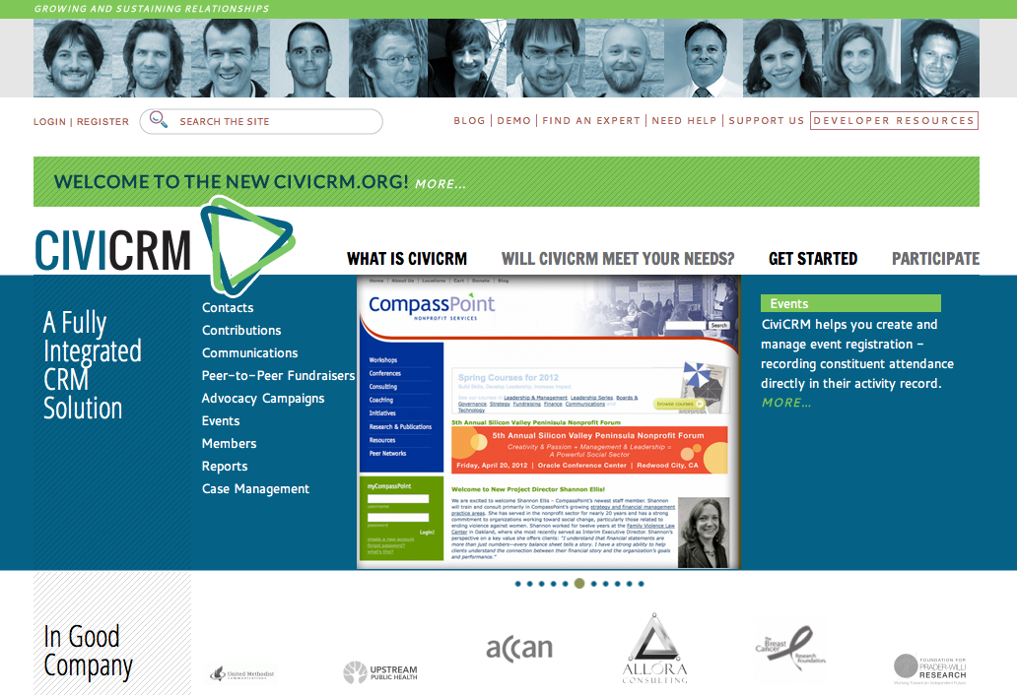
CiviCRM

Slide 12
CiviCRM
Petition
Grants
Membership
Contributions
Survey
Reporting
Events
Profiles
Email
Campaign
Pledges
Workflows
Case Management

Slide 13
CiviCRM
Pros
Extensive documentation
“Events” = Help Requests
Automated messaging to contacts
Syncs with Drupal accounts
Cons
Superfluous components
“Admin Within an Admin”—Drupal relationship
Required customization

Slide 14
Other Drupal Installs
Chaos Tool Suite
Finder Module
Profile 2 Module
Views Module
Marinelli Theme

Slide 15
Limitations
Schedule and Scope
Search Capabilities
CiviCRM Customization and Integration
Proxy Relationships

Slide 16
Lessons Learned: Coordination & Documentation
Sprint # | Requirements | Design | Development | Testing | Deployment
Sprint 1 | 4/11/2012 | 4/13/2012 | 4/15/2012 | 4/17/2012 | 4/18/2012
Sprint 2 | 4/18/2012 | 4/20/2012 | 4/22/2012 | 4/24/2012 | 4/25/2012
Sprint 3 | 4/25/2012 | 4/27/2012 | 4/29/2012 | 5/1/2012 | 5/2/2012

Slide 17
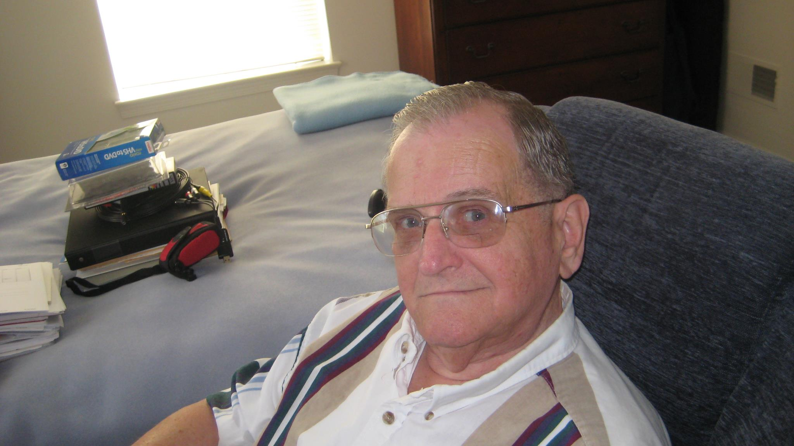
Lessons Learned: User Input

Slide 18
Lessons Learned: Software Assurance

Slide 19
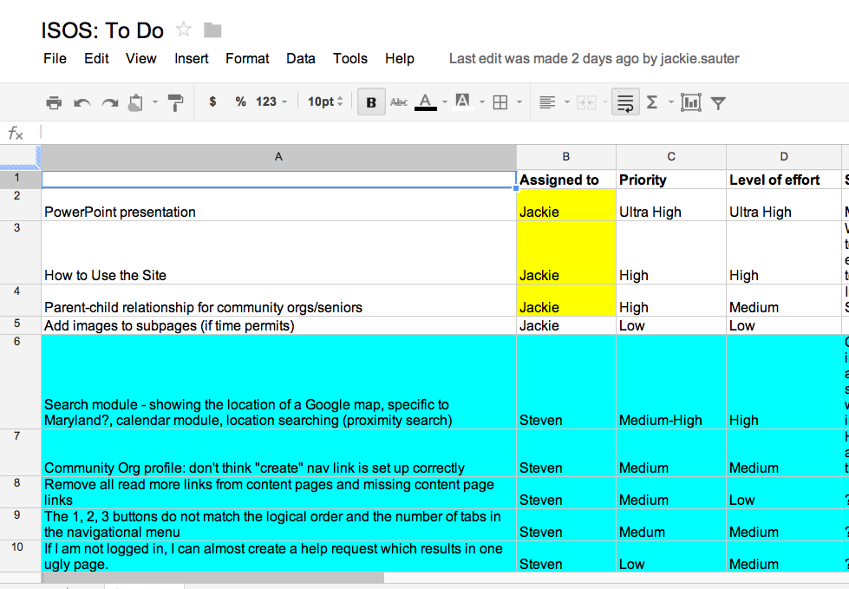
Lessons Learned: Software Assurance

Slide 20
Future Recommendations
Open Pandora's box
More structure
Start earlier
Midpoint demo in class

Slide 21
Any Questions?
Steven Dodge & Jackie Sauter
INFM603 Spring 2012
in-service-of-seniors.org
Notes:
jackie

