Slide 1
Relational Databases
Week 9
INFM 603

Slide 2
Agenda
Questions
Relational database design
Microsoft Access
MySQL
Scalability

Slide 3
Databases
Database
Collection of data, organized to support access
Models some aspects of reality
DataBase Management System (DBMS)
Software to create and access databases
Relational Algebra
Special-purpose programming language

Slide 4
Structured Information
Field An “atomic” unit of data
number, string, true/false, …
Record A collection of related fields
Table A collection of related records
Each record is one row in the table
Each field is one column in the table
Primary Key The field that identifies a record
Values of a primary key must be unique
Database A collection of tables

Slide 5
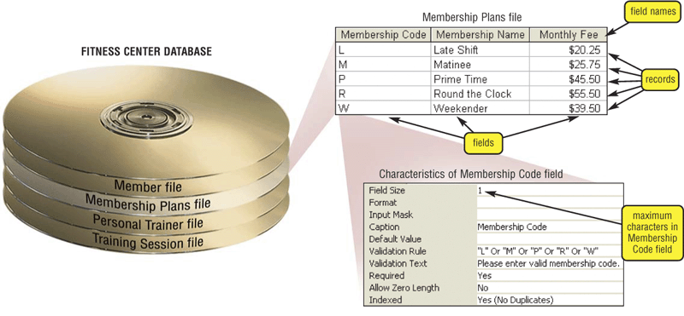
A Simple Example
primary key

Slide 6
Registrar Example
Which students are in which courses?
What do we need to know about the students?
first name, last name, email, department
What do we need to know about the courses?
course ID, description, enrolled students, grades

Slide 7
A “Flat File” Solution
Discussion Topic
Why is this a bad approach?

Slide 8
Goals of “Normalization”
Save space
Save each fact only once
More rapid updates
Every fact only needs to be updated once
More rapid search
Finding something once is good enough
Avoid inconsistency
Changing data once changes it everywhere

Slide 9
Relational Algebra
Tables represent “relations”
Course, course description
Name, email address, department
Named fields represent “attributes”
Each row in the table is called a “tuple”
The order of the rows is not important
Queries specify desired conditions
The DBMS then finds data that satisfies them

Slide 10
A Normalized Relational Database
Student Table
Department Table
Course Table
Enrollment Table

Slide 11
Approaches to Normalization
For simple problems
Start with “binary relationships”
Pairs of fields that are related
Group together wherever possible
Add keys where necessary
For more complicated problems
Entity relationship modeling

Slide 12
Example of Join
Student Table
Department Table
“Joined” Table

Slide 13
Problems with Join
Data modeling for join is complex
Useful to start with E-R modeling
Join are expensive to compute
Both in time and storage space
But it’s joins that make databases relational
Projection and restriction also used in flat files

Slide 14
Some Lingo
“Primary Key” uniquely identifies a record
e.g. student ID in the student table
“Compound” primary key
Synthesize a primary key with a combination of fields
e.g., Student ID + Course ID in the enrollment table
“Foreign Key” is primary key in the other table
Note: it need not be unique in this table

Slide 15
Project
New Table
SELECT Student ID, Department

Slide 16
Restrict
New Table
WHERE Department ID = “HIST”

Slide 17
Entity-Relationship Diagrams
Graphical visualization of the data model
Entities are captured in boxes
Relationships are captured using arrows

Slide 18
Registrar ER Diagram
Student
Student ID
First name
Last name
Department
E-mail
…
Enrollment
Student
Course
Grade
…
has
has
associated with
Course
Course ID
Course Name
…
Department
Department ID
Department Name
…

Slide 19
Getting Started with E-R Modeling
What questions must you answer?
What data is needed to generate the answers?
Entities
Attributes of those entities
Relationships
Nature of those relationships
How will the user interact with the system?
Relating the question to the available data
Expressing the answer in a useful form

Slide 20
“Project Team” E-R Example
manage-role
1
1
member-of
M
student
team
1
M
creates
human
implement-role
1
M
needs
1
client
project
d
php-project
ajax-project

Slide 21
Components of E-R Diagrams
Entities
Types
Subtypes (disjoint / overlapping)
Attributes
Mandatory / optional
Identifier
Relationships
Cardinality
Existence
Degree

Slide 22
Types of Relationships
Many-to-Many
1-to-Many
1-to-1

Slide 23
Making Tables from E-R Diagrams
Pick a primary key for each entity
Build the tables
One per entity
Plus one per M:M relationship
Choose terse but memorable table and field names
Check for parsimonious representation
Relational “normalization”
Redundant storage of computable values
Implement using a DBMS

Slide 24
1NF: Single-valued indivisible (atomic) attributes
Split “Doug Oard” to two attributes as (“Doug”, “Oard”)
Model M:M implement-role relationship with a table
2NF: Attributes depend on complete primary key
(id, impl-role, name)->(id, name)+(id, impl-role)
3NF: Attributes depend directly on primary key
(id, addr, city, state, zip)->(id, addr, zip)+(zip, city, state)
4NF: Divide independent M:M tables
(id, role, courses) -> (id, role) + (id, courses)
5NF: Don’t enumerate derivable combinations

Slide 25
Normalized Table Structure
Persons: id, fname, lname, userid, password
Contacts: id, ctype, cstring
Ctlabels: ctype, string
Students: id, team, mrole
Iroles: id, irole
Rlabels: role, string
Projects: team, client, pstring

Slide 26
Making Tables from E-R Diagrams
Pick a primary key for each entity
Build the tables
One per entity
Plus one per M:M relationship
Choose terse but memorable table and field names
Check for parsimonious representation
Relational “normalization”
Redundant storage of computable values
Implement using a DBMS

Slide 27
Database Integrity
Registrar database must be internally consistent
Enrolled students must have an entry in student table
Courses must have a name
What happens:
When a student withdraws from the university?
When a course is taken off the books?

Slide 28
Integrity Constraints
Conditions that must always be true
Specified when the database is designed
Checked when the database is modified
RDBMS ensures integrity constraints are respected
So database contents remain faithful to real world
Helps avoid data entry errors

Slide 29
Referential Integrity
Foreign key values must exist in other table
If not, those records cannot be joined
Can be enforced when data is added
Associate a primary key with each foreign key
Helps avoid erroneous data
Only need to ensure data quality for primary keys

Slide 30
Database “Programming”
Natural language
Goal is ease of use
e.g., Show me the last names of students in CLIS
Ambiguity sometimes results in errors
Structured Query Language (SQL)
Consistent, unambiguous interface to any DBMS
Simple command structure:
e.g., SELECT Last name FROM Students WHERE Dept=CLIS
Useful standard for inter-process communications
Visual programming (e.g., Microsoft Access)
Unambiguous, and easier to learn than SQL

Slide 31
Using Microsoft Access
Create a database called M:\rides.mdb
File->New->Blank Database
Specify the fields (columns)
“Create a Table in Design View”
Fill in the records (rows)
Double-click on the icon for the table

Slide 32
Creating Fields
Enter field name
Must be unique, but only within the same table
Select field type from a menu
Use date/time for times
Use text for phone numbers
Designate primary key (right mouse button)
Save the table
That’s when you get to assign a table name

Slide 33
Entering Data
Open the table
Double-click on the icon
Enter new data in the bottom row
A new (blank) bottom row will appear
Close the table
No need to “save” – data is stored automatically

Slide 34
Building Queries
Copy ride.mdb to your C:\ drive
“Create Query in Design View”
In “Queries”
Choose two tables, Flight and Company
Pick each field you need using the menus
Unclick “show” to not project
Enter a criterion to “restrict”
Save, exit, and reselect to run the query

Slide 35
Fun Facts about Queries
Joins are automatic if field names are same
Otherwise, drag a line between the fields
Sort order is easy to specify
Use the menu

Slide 36
The SQL SELECT Command
Project chooses columns
Based on their label
Restrict chooses rows
Based on their contents
e.g. department ID = “HIST”
These can be specified together
SELECT Student ID, Dept WHERE Dept = “History”

Slide 37
Restrict Operators
Each SELECT contains a single WHERE
Numeric comparison
<, >, =, <>, …
e.g., grade<80
Boolean operations
e.g., Name = “John” AND Dept <> “HIST”

Slide 38
Structured Query Language
DESCRIBE Flight;

Slide 39
Structured Query Language
SELECT * FROM Flight;

Slide 40
Structured Query Language
SELECT Company.CompanyName, Company.CompanyPhone, Flight.Origin, Flight.DepartureTime
FROM Flight,Company
WHERE Flight.CompanyName=Company.CompanyName
AND Flight.AvailableSeats>3;

Slide 41
field
select address
from employee
where employee.surname='Smith' and employee.forenames='Robert';
table
how you want to restrict the rows

Slide 42
field
tables to join
select dname
from employee, department where employee.depno=department.depno and surname='Smith' and forenames='Robert';
how to join
how you want to restrict the rows

Slide 43
Create a MySQL Database
“root” user creates database + grants permissions
Using the WAMP console (or mysql –u root –p)
root has no initial password; just hit <enter> when asked
By the system administrator account
CREATE DATABASE project;
GRANT SELECT, INSERT, UPDATE, DELETE, INDEX, ALTER, CREATE, DROP ON project.* TO ‘foo’@’localhost’ IDENTIFIED BY ‘bar’;
FLUSH PRIVILEGES;
Start mysql
MySQL console for WAMP: mysql –u foo –p bar
Connect to your database
USE project;

Slide 44
Creating Tables
CREATE TABLE contacts (
ckey MEDIUMINT UNSIGNED NOT NULL AUTO_INCREMENT,
id MEDIUMINT UNSIGNED NOT NULL,
ctype SMALLINT UNSIGNED NOT NULL,
cstring VARCHAR(40) NOT NULL,
FOREIGN KEY (id) REFERENCES persons(id) ON DELETE CASCADE,
FOREIGN KEY (ctype) REFERENCES ctlabels(ctype) ON DELETE RESTRICT,
PRIMARY KEY (ckey)
) ENGINE=INNODB;
To delete: DROP TABLE contacts;

Slide 45
Populating Tables
INSERT INTO ctlabels
(string) VALUES
('primary email'),
('alternate email'),
('home phone'),
('cell phone'),
('work phone'),
('AOL IM'),
('Yahoo Chat'),
('MSN Messenger'),
(‘other’);
To empty a table: DELETE FROM ctlabels;

Slide 46
“Looking Around” in MySQL
SHOW DATABASES;
SHOW TABLES;
DESCRIBE tablename;
SELECT * FROM tablename;

Slide 47
Databases in the Real World
Some typical database applications:
Banking (e.g., saving/checking accounts)
Trading (e.g., stocks)
Airline reservations
Characteristics:
Lots of data
Lots of concurrent access
Must have fast access
“Mission critical”

Slide 48
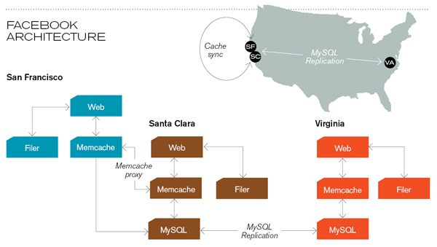
Caching servers: 15 million requests per second, 95% handled by memcache (15 TB of RAM)
Database layer: 800 eight-core Linux servers running MySQL (40 TB user data)
Source: Technology Review (July/August, 2008)

Slide 49
Concurrency
Thought experiment: You and your project partner are editing the same file…
Scenario 1: you both save it at the same time
Scenario 2: you save first, but before it’s done saving, your partner saves
Whose changes survive?
A) Yours B) Partner’s C) neither D) both E) ???
Notes:
4

Slide 50
Concurrency Example
Possible actions on a checking account
Deposit check (read balance, write new balance)
Cash check (read balance, write new balance)
Scenario:
Current balance: $500
You try to deposit a $50 check and someone tries to cash a $100 check at the same time
Possible sequences: (what happens in each case?)
Deposit: read balance
Deposit: write balance
Cash: read balance
Cash: write balance
Deposit: read balance
Cash: read balance
Cash: write balance
Deposit: write balance
Deposit: read balance
Cash: read balance
Deposit: write balance
Cash: write balance

Slide 51
Database Transactions
Transaction: sequence of grouped database actions
e.g., transfer $500 from checking to savings
“ACID” properties
Atomicity
All-or-nothing
Consistency
Each transaction must take the DB between consistent states.
Isolation:
Concurrent transactions must appear to run in isolation
Durability
Results of transactions must survive even if systems crash

Slide 52
Making Transactions
Idea: keep a log (history) of all actions carried out while executing transactions
Before a change is made to the database, the corresponding log entry is forced to a safe location
Recovering from a crash:
Effects of partially executed transactions are undone
Effects of committed transactions are redone
the log

Slide 53
Utility Service Desk Exercise
Design a database to keep track of service calls for a utility company:
Customers call to report problems
Call center manages “tickets” to assign workers to jobs
Must match skills and service location
Must balance number of assignments
Workers call in to ask where their next jobs are
In SQL, you can do the following operations:
Count the number of rows in a result set
Sort the result set according to a field
Find the maximum and minimum value of a field

Slide 54
Key Ideas
Databases are a good choice when you have
Lots of data
A problem that contains inherent relationships
Join is the most important concept
Project and restrict just remove undesired stuff
Design before you implement
Managing complexity is important

