Slide 1
Object Oriented Programming
Week 8
INFM 603

Slide 2
The Key Ideas
Structured Programming
Modular Programming
Data Structures
Object-Oriented Programming

Slide 3
Key Ideas
Protect the programmer from themselves
Model actions and attributes together
Object
Encapsulation of methods and data structures
Class
“Blueprint” for an object
Must be “instantiated” using a “constructor”

Slide 4
Some Conventions
CapsInitial skyline is used for a a class
lowerCaseInitial skyline is used for a
Variable (if not followed by parameters)
Method (if followed by parameters)
An object can be assigned to a variable

Slide 5
Object Instantiation
var n = new Array(5);
Creates an Array object using the Array class constructor (and specifying 5 elements)
var student = new Student(13205, “George”);
Creates a Student object using the Student class constructor (and specifying the student id and name)
Note that the variable name need not be different from (or the same as) the class name

Slide 6
Formalizing Object Interfaces
status = student.setHeightInches(74);
Invokes the setHeightInches() method for the object that is stored in the variable student and passes it 74 as a parameter; status=true indicates success
feet = student.getHeightFeet();
Invokes the getHeightFeet() method for the object that is stored in the variable student and then sets the variable feet to hold that result (in this case, 6); feet<0 indicates failure

Slide 7
Class Definition (private variable)
function Student(studentID, name) {
var totalInches = -1; // private variable
// private method
function inchesToFeet(i) {
return Math.floor(i/12);
}
// public methods
this.setHeightInches = function(n) {
if ((n>0) && (n<100)) {
totalInches = n;
return true;
} else {
return false;
}
}
this.getHeightFeet = function() {
if (totalInches>0) {
return inchesToFeet(totalInches);
} else {
return -1;
}
}
}
var student = new Student(13205, "George");
alert(student.setHeightInches(74));
alert(student.getHeightFeet());
alert(student.totalInches);

Slide 8
Class Definition (public variable)
function Student(studentID, name) {
this.totalInches = -1; // public variable
// private method
function inchesToFeet(i) {
return Math.floor(i/12);
}
// public methods
this.setHeightInches = function(n) {
if ((n>0) && (n<100)) {
this.totalInches = n;
return true;
} else {
return false;
}
}
this.getHeightFeet = function() {
if (this.totalInches>0) {
return inchesToFeet(this.totalInches);
} else {
return -1;
}
}
}
var student = new Student(13205, "George");
alert(student.setHeightInches(74));
alert(student.getHeightFeet());
alert(student.totalInches);

Slide 9
function Student(studentID, name) {
var inches = -1; // private variable
var feet = -1; // private variable
// private method
function inchesToFeet(i) {
return Math.floor(i/12);
}
// public methods
this.setHeightInches = function(n) {
if ((n>0) && (n<100)) {
feet = inchesToFeet(n);
inches = n-(feet*12);
return true;
} else {
return false;
}
}
this.getHeightFeet = function() {
if ((feet>0) || (inches>0)) {
return feet;
} else {
return -1;
}
}
}
Alternate
Method Definition (private variables)
var student = new Student(13205, "George");
alert(student.setHeightInches(74));
alert(student.getHeightFeet());
alert(student.feet);

Slide 10
String Objects
(Conceptually) an array of Unicode characters with some interfaces
var s = “Mr. Spock”
s.toLowerCase is “mr. spock”
s.substr(3,4) is “ Spo”
s.indexOf(“k”) is 8
s.split(“ ”) is [“Mr.”, “Spock”]
s.link(http://bit.ly.CUjV) is <a href=http://bit.ly.CUjV>Mr. Spock</a>
s + “Captain Kirk” is “Mr. SpockCaptainKirk”

Slide 11
Everything is an Object
var b = new Boolean(true);
var n = new Number(3.15);
var n = new Number(3); // same as 3.00
var a = new Array(5);

Slide 12
Some Handy Methods
document
document.writeln(“Test!”);
var e=document.getElementById(“goButton”);
document.cookie=“message=saveme”;
var c=document.cookie.split(“=“)[1];
window
window.prompt(“Input please”);
var w=window.open(“”, “New Window”, “”);

Slide 13
Why Use Objects?
A way of thinking about programming
Objects are nouns, methods are verbs
A form of defensive programming
Hides private variables and methods
Allows you to make behaviors explicit
Represent complex data structures
Airplanes have pilots, fuel, and destinations

Slide 14
Design Exercise
Design a class for email messages
Private internal representation should include:
Header (date, time, sender, recipients, subject, …)
Body
Attachments (which may be other emails!)
Public interfaces should include
Message creation
Access to specific header fields, the body, and specific attachments

Slide 15
A Tree

Slide 16
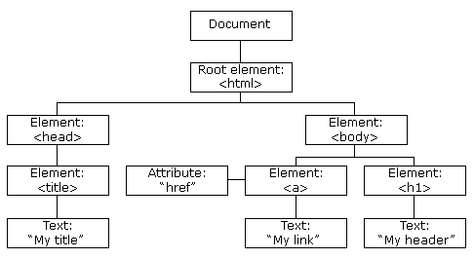
A DOM Tree

Slide 17
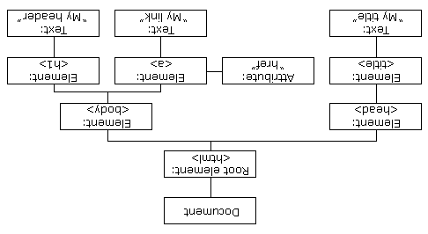
A DOM Tree

Slide 18
Document Object Model
Tree representation of HTML structure
Install firebug as a Firefox add-on
Activate firebug on http://ischool.umd.edu
Then browse the DOM

Slide 20
Getting to DOM Elements

Slide 21
Access to DOM Elements
Find a single element
element = document.getElementById(“input2”);
Find multiple elements
list = document.getElementsByTagName(input);
list = document.getElementsByName(“myInput”);
Move up in the DOM tree
element1 = element2.parentNode;
Move down in the DOM tree
list = element1.childNodes

Slide 22
Why Program?
Data manipulation
Simulation
Control
Interaction
Embedded

Slide 23
Term Project
Each team will have a Virtual Machine
Linux and Drupal
H4 includes teaming preferences
Due by 9 PM on Sunday March 25 (end of break)
P1 is project plan
P2 is project design
P3 is presentation slides

Slide 24
“Speed Dating”
Three 5-minute cycles
Find your partner
Describe your strengths
Listen to their strengths
Each name one project idea

