Slide 1
Engineering Undergraduate Competitions Website
-Heather Rodriguez,
Shilpa Reddy

Slide 2
Introduction
Goal
- One stop shop for Undergrad Competitions

Slide 3
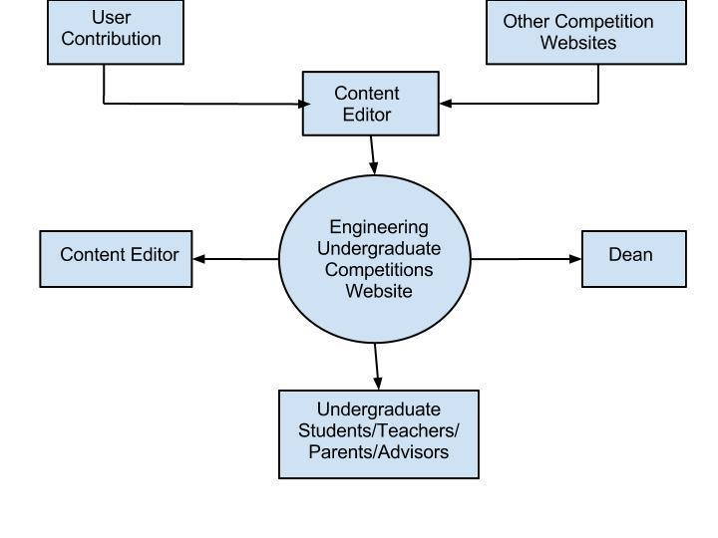
Work Context Diagram

Slide 4
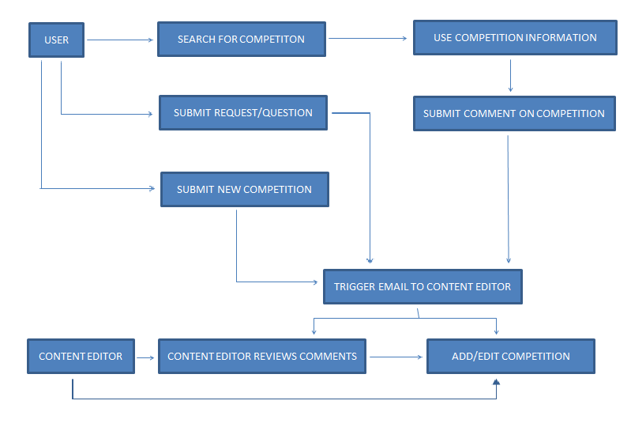
Sequence Diagram

Slide 5
WEBSITE DEMO

Slide 6
Implementation
1. Navigation
2. Design
3. Access
4. Notification
5. Web forms
5. Map
6. Social Network Plugin
7. Spam filter

Slide 7
Testing
Unit testing
Negative Testing for error messages
Access Testing
Load Testing result at http://loadimpact.com/load-test/undergrad-competitions.umd.edu-6a8d624f0a5b53ef87df0d28d9e704b8
Regression Testing
Multiple browsers
Multiple displays like laptops, mobiles
Usability testing

Slide 8
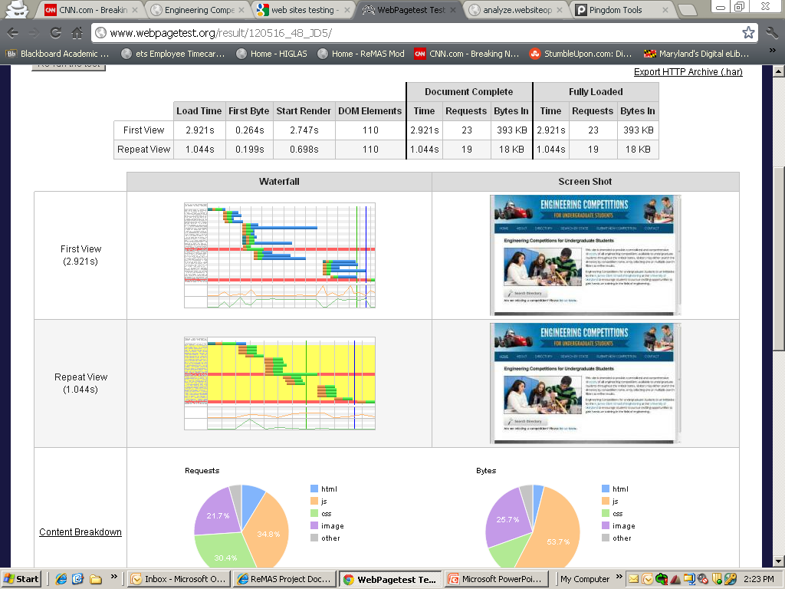
Web Page Performance Test
http://www.webpagetest.org/

Slide 9
Open Defects
Confirmation pages do not have Go back to Previous page links
Previous button on Directory’s pagination is not formatted correctly
Nothing happens when a state with no competitions are selected on the map
Text field are not validated for special characters and numbers

Slide 10
Limitations
1. Not validating identity of person submitting competitions
2. Will accept competitions based outside US but will not appear on Search By State
3. External Content will not be updated automatically

Slide 11
thank YOU

Slide 12
QUESTIONS AND DISCUSSION

