Slide 1

Physical Infrastructure
Week 1
INFM 603

Slide 2
Agenda
Computers
The Internet
The Web
About the course

Slide 3
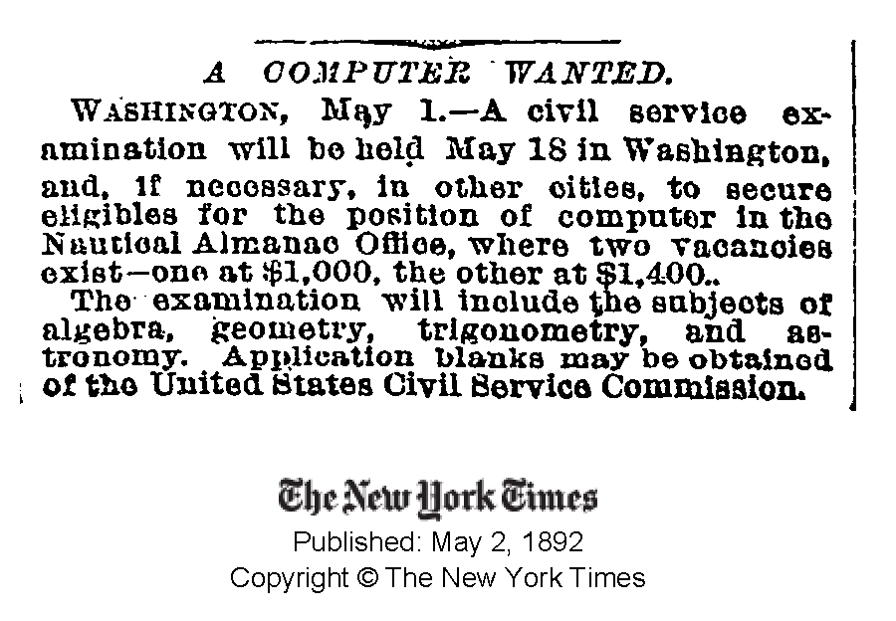

Slide 4
A Very Brief History of Computing
Hardware
  Mechanical: essentially a big adding machine
  Analog: designed for calculus, limited accuracy
  Digital: early machines filled a room
  Microchips: designed for missile guidance
Software
  Numeric: computing gun angles
  Symbolic: code-breaking

Slide 5
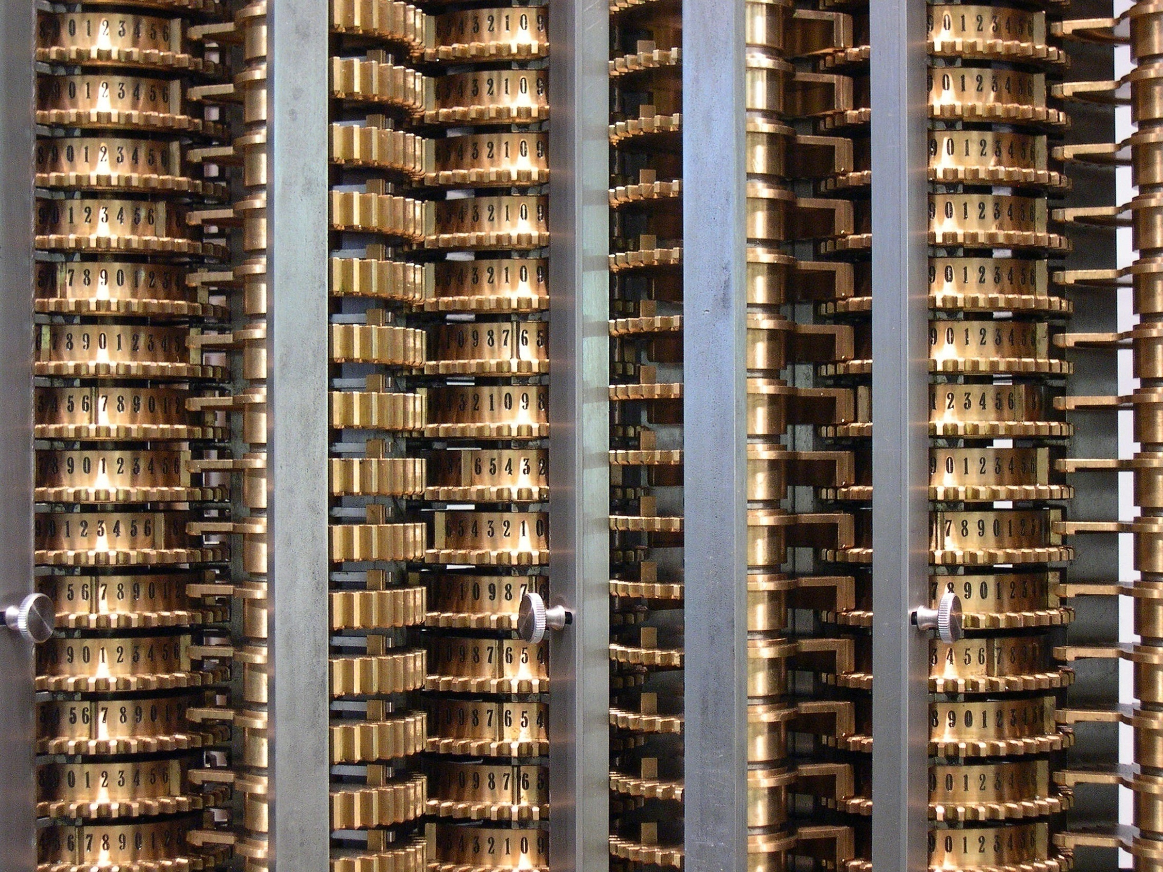
Source: Wikipedia

Slide 6

Source: Wikipedia

Slide 7
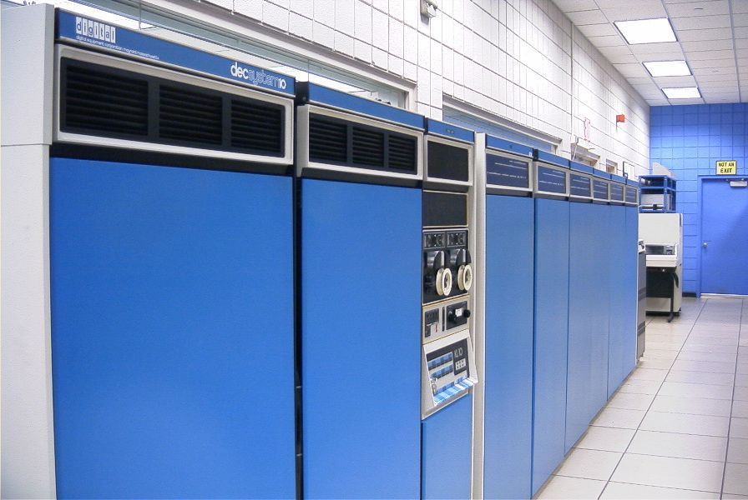
Source: Wikipedia

Slide 8
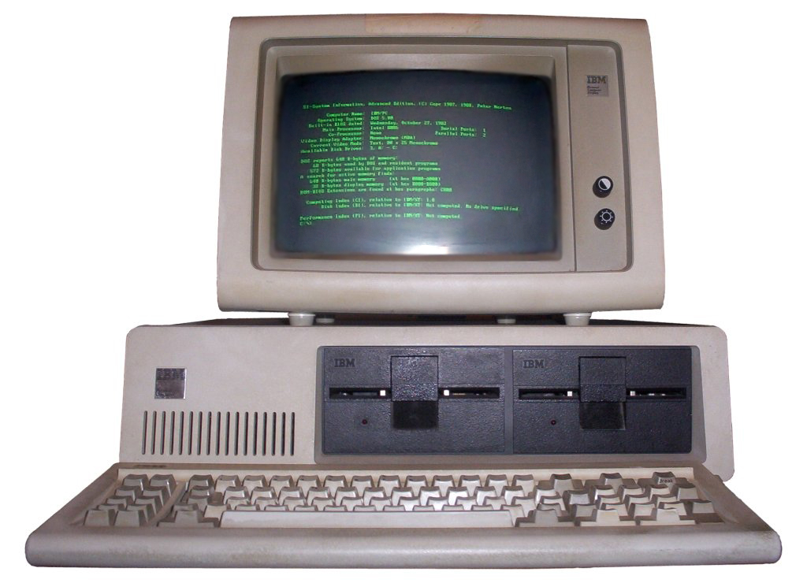
Source: Wikipedia

Slide 9
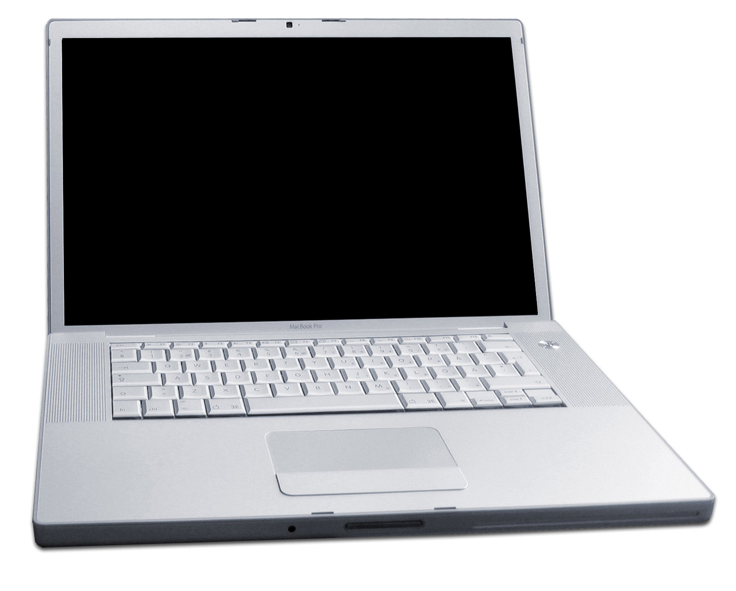
Source: Wikipedia

Slide 10
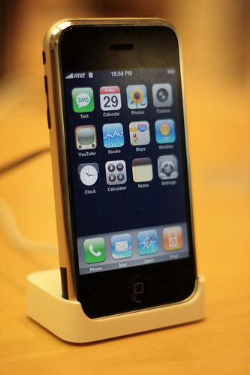
Source: Wikipedia

Slide 11
Input Devices
Text
  Keyboard, optical character recognition
  Speech recognition, handwriting recognition
Direct manipulation
  2-D: mouse, trackball, touchpad, touchscreen
  3-D: wand, data glove
Remote sensing
  Camera, speaker ID, head tracker, eye tracker

Slide 12
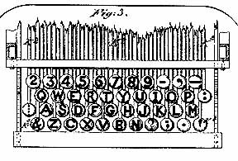
Input Example: QWERTY Keyboard
From http://home.earthlink.net/~dcrehr/whyqwert.html
Notes:
1878 patent image
The name "QWERTY" for our typewriter keyboard comes from the first six letters in the top alphabet row (the one just below the numbers). It is also called the "Universal" keyboard for rather obvious reasons. It was the work of inventor C. L. Sholes, who put together the prototypes of the first commercial typewriter in a Milwaukee machine shop back in the 1860's.

Slide 13
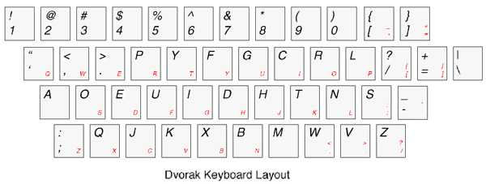
Dvorak Keyboard
From http://www.mwbrooks.com/dvorak/

Slide 14
Binary Data Representation
Example: American Standard Code for Information Interchange (ASCII)
01000001 = A
01000010 = B
01000011 = C
01000100 = D
01000101 = E
01000110 = F
01000111 = G
01001000 = H
01001001 = I
01001010 = J
01001011 = K
01001100 = L
01001101 = M
01001110 = N
01001111 = O
01010000 = P
01010001 = Q
…
01100001 = a
01100010 = b
01100011 = c
01100100 = d
01100101 = e
01100110 = f
01100111 = g
01101000 = h
01101001 = i
01101010 = j
01101011 = k
01101100 = l
01101101 = m
01101110 = n
01101111 = o
01110000 = p
01110001 = q
…

Slide 15
Output Devices
Visual
  Screen, projector, head-mounted display, CAVE
Acoustic
  Speakers, headphones
Physical
  Tactile (vibrotactile, pneumatic, piezoelectric)
  Force feedback (pen, joystick, exoskeleton)
  Thermal
Vestibular (motion-based simulators)
Locomotive (treadmill, stationary bicycle)
Olfactory

Slide 16
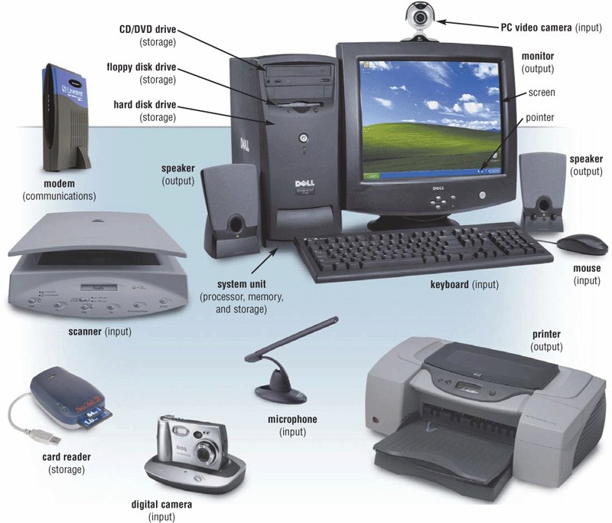
Extracted From Shelly Cashman Vermatt’s Discovering Computers 2004

Slide 17
The Big Picture
Memory
Processor
Network

Slide 18
Hardware Processing Cycle
Input comes from somewhere
  Keyboard, mouse, microphone, camera, …
The system does something with it
  Processor, memory, software, network, …
Output goes somewhere
  Monitor, speaker, robot controls, …

Slide 19
Computer Hardware
Central Processing Unit (CPU)
  Intel Xeon, Motorola Power PC, …
Communications “Bus”
  FSB, PCI, ISA, USB, Firewire, …
Storage devices
  Cache, RAM, hard drive, floppy disk, …
External communications
  Modem, Ethernet, GPRS, 802.11, …

Slide 20
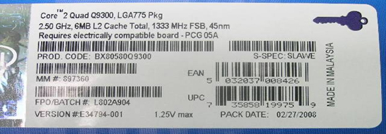
What’s that?

Slide 21
Units of Frequency
Unit | Abbreviation | Cycles per second
hertz | Hz | 1
kilohertz | KHz | 10³ = 1,000
megahertz | MHz | 10⁶ = 1,000,000
gigahertz | GHz | 10⁹ = 1,000,000,000

Slide 22
Units of Time
Unit | Abbreviation | Duration (seconds)
second | sec/s | 1
millisecond | ms | 10⁻³ = 1/1,000
microsecond | μs | 10⁻⁶ = 1/1,000,000
nanosecond | ns | 10⁻⁹ = 1/1,000,000,000
picosecond | ps | 10⁻¹² = 1/1,000,000,000,000
femtosecond | fs | 10⁻¹⁵ = 1/1,000,000,000,000,000

Slide 23
The Storage Hierarchy
Speed, cost, and size:
  You can easily get any 2, but not all 3
Fast memory is expensive
  So large memory is slow!
  But fast access to large memories is needed
Solution:
  Keep what you need often in small (fast) places
    Keep the rest in large (slow) places
  Get things to the fast place before you need them

Slide 24
Best of Both Worlds
Small, but fast…
=
+
Is Large and seems fast
Large, but slow…
Think about your bookshelf and the library…

Slide 25
Locality
Spatial locality:
  If the system fetched x, it is likely to fetch data located near x
Temporal locality:
  If the system fetched x, it is likely to fetch x again

Slide 26
System Architecture
Keyboard
Mouse
Sound
Card
Video
Card
Input
Controller
System Bus
Front Side Bus
Hard
Drive
CD/
DVD
L2
RAM
USB Port
CPU
L1
Cache
Motherboard

Slide 27
Everything is Relative
The CPU is the fastest part of a computer
  3 GHz Core 2 Duo = 6,000 MIPS
    3 operations per processor every nanosecond
Cache memory is fast enough to keep up
  128 kB L1 cache on chip (dedicated, CPU speed)
  4 MB L2 cache on chip (shared, CPU speed)
RAM is larger, but slower
  1 GB or more, ~6 ns

Slide 28
Units of Size
Unit | Abbreviation | Size (bytes)
bit | b | 1/8
byte | B | 1
kilobyte | KB | 2¹⁰ = 1024
megabyte | MB | 2²⁰ = 1,048,576
gigabyte | GB | 2³⁰ = 1,073,741,824
terabyte | TB | 2⁴⁰ = 1,099,511,627,776
petabyte | PB | 2⁵⁰ = 1,125,899,906,842,624

Slide 29
The Storage Hierarchy
Type | Speed | Size | Cost
Registers | ~300 ps | 256 B | Very expensive
Cache | ~1 ns | 4 MB | Expensive
RAM | ~10 ns | 1 GB | Cheap
Hard drive | ~10 ms | 100 GB | Very cheap

Slide 30
“Solid-State” Memory
ROM
  Does not require power to retain content
  Used for “Basic Input/Output System” (BIOS)
Cache (Fast low-power “Static” RAM)
  Level 1 (L1) cache: small, single-purpose
  Level 2 (L2) cache: larger, shared
(“Dynamic”) RAM (Slower, power hungry)
  Reached over the “Front-Side Bus” (FSB)
Flash memory (fast read, slow write EEPROM)
  Reached over USB bus or SD socket
  Used in memory sticks (“non-volatile” storage)

Slide 31
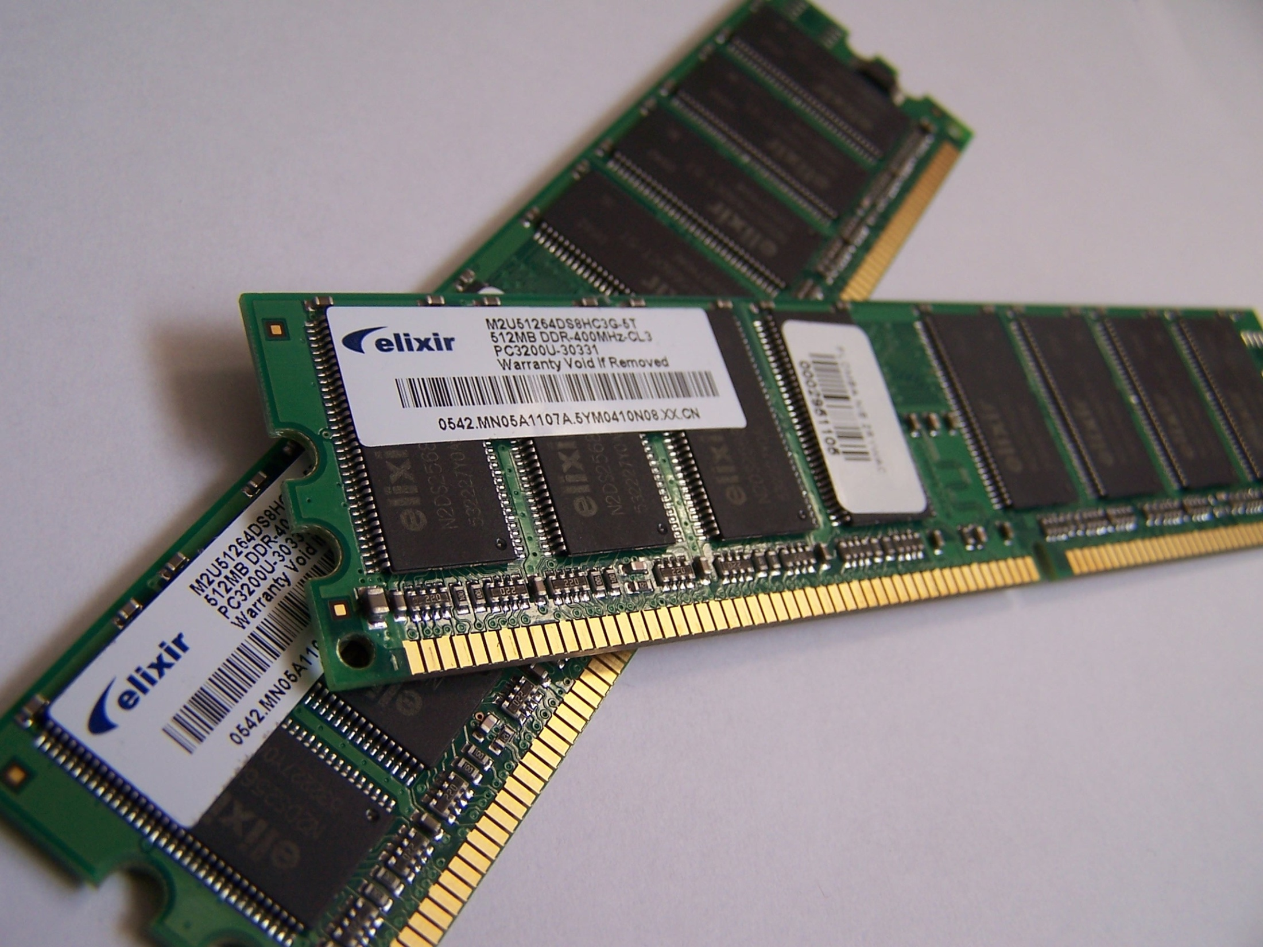
Source: Wikipedia

Slide 32
System Architecture
Keyboard
Mouse
Sound
Card
Video
Card
Input
Controller
System Bus
Front Side Bus
Hard
Drive
CD/
DVD
L2
RAM
USB Port
CPU
L1
Cache
Motherboard

Slide 33
“Rotating” Memory
Fixed magnetic disk (“hard drive”)
  May be partitioned into multiple volumes
    In Windows, referred to as C:, D:, E:, …
    In Unix, referred to as /software, /homes, /mail, …
Removable magnetic disk
  Floppy disk, zip drives, …
Removal optical disk
  CDROM, DVD, CD-R, CD-RW, DVD+RW, …

Slide 34
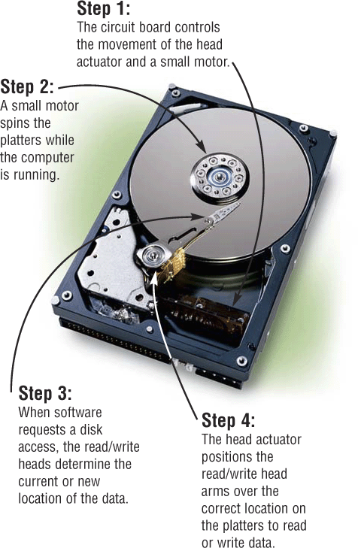
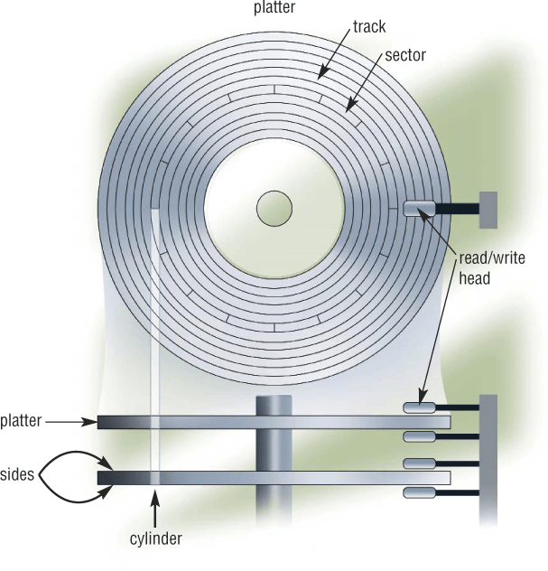
How Disks Work
Extracted From Shelly Cashman Vermatt’s Discovering Computers 2004

Slide 35
RAID-5
Disks can fail in two ways:
  Bad sectors (data sectors, directory sectors)
  Mechanical failure
RAID-5 arrays “stripe” blocks across disks
  “Parallel” data transfer is faster than “serial”
  ~30% “parity” allows reconstruction if one disk fails

Slide 36
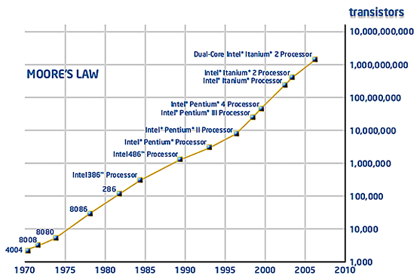

Slide 37
Moore’s Law
Processing speed doubles every 18 months
  Faster CPU, longer words, larger cache, more cores
Cost/bit for RAM drops 50% every 12 months
  Less need for “virtual memory”
Cost/bit for disk drops 50% every 12 months
  But transfer rates don’t improve much

Slide 38
More cores!

Slide 39
Agenda
Computers
The Internet
The Web
About the course

Slide 40
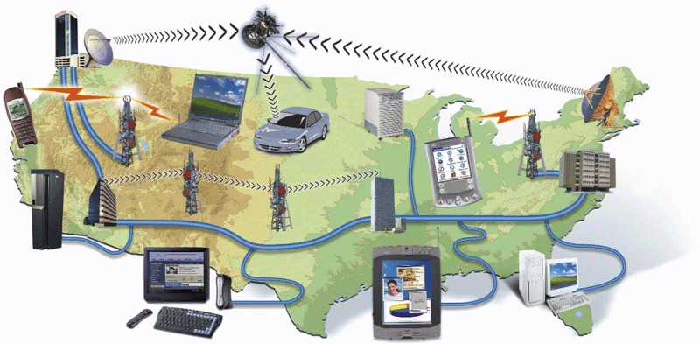
Network
Computers and devices connected via
  Communication devices
  Transmission media

Slide 41
Packet vs. Circuit Networks
Telephone system (“circuit-switched”)
  Fixed connection between caller and called
  High network load results in busy signals
Internet (“packet-switched”)
  Each transmission is routed separately
  High network load results in long delays

Slide 42
Packet Switching
Break long messages into short “packets”
  Keeps one user from hogging a line
Route each packet separately
  Number them for easy reconstruction
Request retransmission for lost packets
  Unless the first packet is lost!

Slide 43
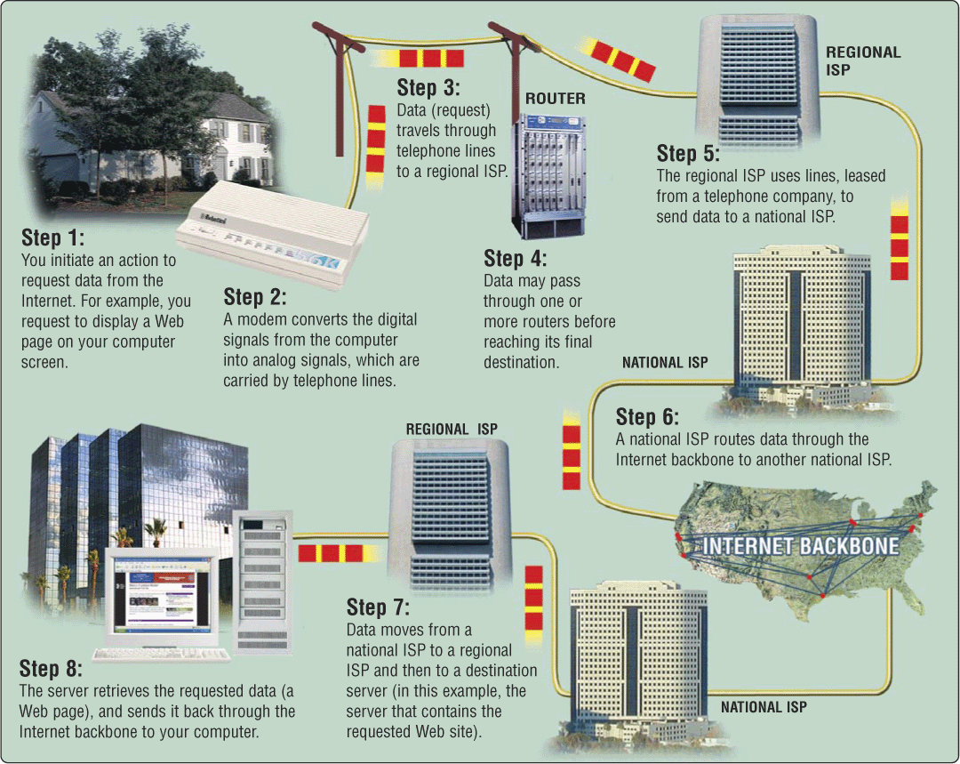
Overview

Slide 44
Networks of Networks
Local Area Networks (LAN)
  Connections within a room, or perhaps a building
Wide Area Networks (WAN)
  Provide connections between LANs
Internet
  Collection of WANs across multiple organizations

Slide 45
Local Area Networks
Within a campus or an office complex
  Short-distance lines are fast and cheap
  Fast communications makes routing simple
Ethernet is a common LAN technology
  All computers are connected to the same cable
    Ordinary phone lines can carry 10 Mb/sec
    100 Mb/s connections require special cables
    1 Gb/s connections require special switches
  Every host broadcasts everything to all others
    Collisions limit throughput to about 50% utilization

Slide 46
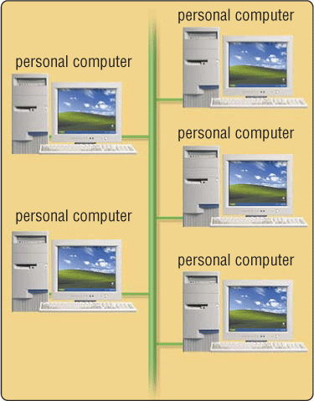
Shared Network
All attach to the same cable
  Ethernet and “cable modems”
Transmit anytime
  Collision detection
  Automatic retransmission
Inexpensive and flexible
  Easy to add new machines
  Robust to computer failure
Practical for short distances
  Half the bandwidth is wasted

Slide 47
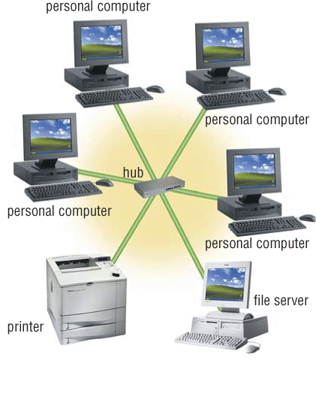
Switched (“Star”) Network
All attach directly to a hub
  Switched Ethernet
  Digital Subscriber Lines (DSL)
Higher cost
  Line from hub to each machine
  Hub must handle every packet
  Hub requires backup power
Much higher bandwidth
  No sharing, no collisions
  Allows disks to be centralized

Slide 48
Wireless Networks
Radio-based Ethernet
  Effective for a few rooms within buildings
“Access Point” gateways to wired networks
  Available throughout most of the Maryland campus
  Commercial providers offer “hot spots” in airports, etc.
“WiFi WLAN” is available in several speeds
  IEEE 802.11b: 10Mb/s (good enough for most uses)
  IEEE 802.11g: 54Mb/s (required for wireless video)
  IEEE 802.11n: 248Mb/s (and longer range)
Computer-to-computer networks are also possible
  “Bluetooth” is the most common (very short range)

Slide 49
Wide Area Networks
Campus, regional, national, or global scale
Expensive communications must be used well
  Limiting to two hosts allows 100% utilization
Routing is complex with point-to-point circuits
  Which path is shortest? Which is least busy? …

Slide 50
Types of Digital Channels
“Backbone”
  Microwave
  Satellite
  Fiber
“Last mile” wired
  Telephone modem
  ADSL
  Cable modem
  Fiber
“Last mile” wireless
  Wi-Fi (IEEE 802.11)
  GSM

Slide 51
Thinking About Speed
Two parts of moving data from here to there:
  Getting the first bit there
  Getting everything there
Fundamentally, there’s no difference:
  Moving data from the processor to RAM
  Saving a file to disk
  Downloading music from a server in China

Slide 52
Some Definitions
Latency
  The amount of time it takes data to travel from source to destination
Bandwidth
  The amount of data that can be transmitted in a fixed amount of time

Slide 53
The Internet
Global collection of public “IP” networks
  Private networks are often called “intranets”
Independent
  Each organization maintains its own network
Cooperating
  Internet Protocol (IP) address blocks
  Domain names
  World-Wide Web Consortium (W3C)
  Computer Emergency Response Team (CERT)

Slide 54
A Short History of the Internet
1969: Origins in government research
  Advanced Research Projects Agency (ARPAnet)
  Key standards: UDP, TCP, DNS
1983: Design adopted by other agencies
  Created a need for inter-network connections
  Key standards: IP
1991: World-Wide Web added point-and-click
  Now 571 million Internet “hosts” (August 2008)
  Key standards: HTTP, URL, HTML, XML
Notes:
Moore’s law make shift from large time sharing computer facilities to individual, small but powerful computer systems, and

Slide 55
What Changed in 1994?

Slide 56
Types of Internet “Nodes”
Hosts
  Computers that use the network to do something
Routers
  Specialized computers that route packets
Gateway
  Routers that connect two networks
Firewall
  Gateways that pass packets selectively

Slide 57
IP Address
Every host (and every router) is identified by an “Internet Protocol” (IP) address
32 bit number, divided into four “octets”
128.8.11.33
216.239.39.99
199.181.132.250
Example: point your browser at “http://66.249.93.99/”

Slide 58
An Internet Protocol (IP) Address
Identifies a LAN
IP address: 216.183.103.150
Identifies a specific computer

Slide 59
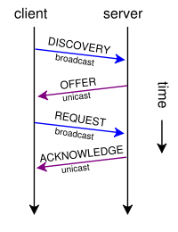
Dynamic IP Addresses
Dynamic Host Configuration Protocol (DHCP)

Slide 60
Hands-on:
Learn About Your IP Address
Find your IP address
  Select “start” on the taskbar, then “Run”
  Type in “cmd” and click “OK”
  Type “ipconfig /all” (and press enter)
See who “owns” that address
  Use http://remote.12dt.com/
See where in the world it (probably) is
  http://www.geobytes.com/ipLocator.htm

Slide 61
Routing Tables
IP Prefix | Next Router | Estimated Delay
216.141.xxx.xxx | 120.0.0.0 | 18 ms
216.xxx.xxx.xxx | 121.0.0.0 | 34 ms
101.42.224.xxx | 120.0.0.0 | 21 ms
xxx.xxx.xxx.xxx | 121.0.0.0 | 250 ms
120.0.0.0
45.0.2.10
121.0.0.0

Slide 62
Hands On: TraceRoute
See how packets get from South Africa to you
  Use http://utl-lnx1.puk.ac.za/cgi-bin/webutil
Look at the same data visually
  http://visualroute.visualware.com/

Slide 63
Domain Name Service (DNS)
“Domain names” improve usability
  Easier to remember than IP addresses
  Written like a postal address: specific-to-general
Each “name server” knows one level of names
  “Top level” name servers know .edu, .com, .mil, …
  .edu name server knows umd, umbc, stanford, …
  .umd.edu name server knows wam, ischool, ttclass, …
  .wam.umd.edu name server knows rac1, rac2, …

Slide 64
IP Addresses and Domain Names
IP address: 128.8.10.142
Domain Name: wam.umd.edu

Slide 65
Uniform Resource Locator (URL)
Uniquely identify Web pages
Domain name
File name
http://www.glue.umd.edu:80/~oard/teaching.html
Protocol
Port
Path

Slide 66
Ports
Well-known ports
  22 Secure Shell (for SSH and SFTP)
  25 Simple Mail Transfer Protocol (SMTP)
  53 Domain Name System (DNS)
  68 Dynamic Host Configuration Protocol (DHCP)
  80 Hypertext Transfer Protocol (HTTP)
  143 Internet Message Access Protocol (IMAP)
  554 Real-Time Streaming Protolol (RTSP)
Registered Ports
  8080 HTTP server run by ordinary users
Ephemeral Ports

Slide 67
Port Mapping
Internet Service providers lease one IP address
  But home networks may contain many machines
Network Address Translation (NAT)
  Each internal machine gets a private IP address
  Ports on internal machines are mapped both ways
Port forwarding
  Permits public server to run in the local network

Slide 68
Paths
Specify location of files on a hard drive
Folder metaphor
  Hierarchically nested directories
  Absolute vs. relative paths
/afs/wam.umd.edu/home/wam/j/i/jimmylin/home
C:\Documents and Settings\Jimmy Lin\My Documents
../pub
..\Desktop
~/oard

Slide 69
Hands On:
The Directory Tree
First, use Windows Explorer to visually explore the directory tree
Now launch a “shell” with Start->Run->cmd
  “c:” takes you to Drive C
  “dir” lists the present “directory”
  “cd WINDOWS” takes you “down” to the WINDOWS directory
  cd .. takes you “up” in the tree

Slide 70
The TCP/IP “Protocol Stack”
Link layer moves bits
  Ethernet, cable modem, DSL
Network layer moves packets
  IP
Transport layer provides services to applications
  UDP, TCP
Application layer uses those services
  DNS, SFTP, SSH, …

Slide 71
TCP/IP layer architecture
Application
Application
Virtual network service
Transport
Transport
Virtual link for end to end packets
Network
Network
Network
Network
Virtual link for packets
Link
Link
Link
Link
Link
Link
Link for bits
Link for bits
Link for bits

Slide 72
Transmission Control Protocol (TCP)
Built on the network-layer version of UDP
Guarantees delivery all data
  Retransmits missing data
Guarantees data will be delivered in order
  “Buffers” subsequent packets if necessary
No guarantee of delivery time
  Long delays may occur without warning

Slide 73
User Datagram Protocol (UDP)
The Internet’s basic transport service
  Sends every packet immediately
  Passes received packets to the application
No delivery guarantee
  Collisions can result in packet loss
Example: sending clicks on web browser
Notes:
No connection establishment. As we shall discuss in Section 3.5, TCP uses a three-way handshake before it starts to transfer data. UDP just blasts away without any formal preliminaries. Thus UDP does not introduce any delay to establish a connection. This is probably the principle reason why DNS runs over UDP rather than TCP -- DNS would be much slower if it ran over TCP. HTTP uses TCP rather than UDP, since reliability is critical for Web pages with text. But, as we briefly discussed in Section 2.2, the TCP connection establishment delay in HTTP is an important contributor to the "world wide wait".
No connection state. TCP maintains connection state in the end systems. This connection state includes receive and send buffers, congestion control parameters, and sequence and acknowledgment number parameters. We will see in Section 3.5 that this state information is needed to implement TCP's reliable data transfer service and to provide congestion control. UDP, on the other hand, does not maintain connection state and does not track any of these parameters. For this reason, a server devoted to a particular application can typically support many more active clients when the application runs over UDP rather than TCP.
Small segment header overhead. The TCP segment has 20 bytes of header overhead in every segment, whereas UDP only has 8 bytes of overhead.
Unregulated send rate. TCP has a congestion control mechanism that throttles the sender when one or more links between sender and receiver becomes excessively congested. This throttling can have a severe impact on real-time applications, which can tolerate some packet loss but require a minimum send rate. On the other hand, the speed at which UDP sends data is only constrained by the rate at which the application generates data, the capabilities of the source (CPU, clock rate, etc.) and the access bandwidth to the Internet. We should keep in mind, however, that the receiving host does not necessarily receive all the data - when the network is congested, a significant fraction of the UDP-transmitted data could be lost due to router buffer overflow. Thus, the receive rate is limited by network congestion even if the sending rate is not constrained.

Slide 74
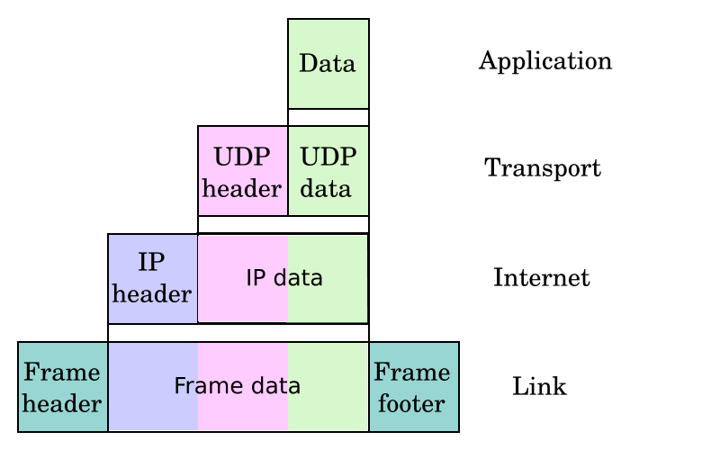
UDP/IP Protocol Stack

Slide 75
File Transfer Program (FTP)
Used to move files between machines
  Upload (put) moves from client to server
  Download (get) moves files from server to client
Both visual and command line interfaces available
Normally requires an account on the server
  Userid “anonymous” provides public access

Slide 76
Hands On:
Graphical Secure FTP
SFTP to “terpconnect.umd.edu”
Change directory to “/pub/USERID”
Upload or download files
You can see these files at:
http://www.wam.umd.edu/~USERID/

Slide 77
Hands On:
Unsecure Command Line FTP
  Start->Run->cmd
  “ftp umiacs.umd.edu”
  Login in as user “anonymous”
  Download a file
    “cd pub/gina/lbsc690/”
    “binary”
    “get hwOne.ppt”
  Exit
    “quit”

Slide 78
Agenda
Computers
The Internet
The Web
About the course

Slide 79
Internet ≠ Web
Internet: collection of global networks
Web: way of managing information exchange
There are many other uses for the Internet
  File transfer (FTP)
  Email (SMTP, POP, IMAP)

Slide 80
The World-Wide Web
My Browser
Local copy of
Page requested
Requested Page
Proxy Server
Fetch Page
Remote Sever
Send Request
Internet
Notes:
A server that sits between a client application, such as a Web browser, and a real server. It intercepts all requests to the real server to see if it can fulfill the requests itself. If not, it forwards the request to the real server. Proxy servers have two main purposes:
Improve Performance: Proxy servers can dramatically improve performance for groups of users. This is because it saves the results of all requests for a certain amount of time. Consider the case where both user X and user Y access the World Wide Web through a proxy server. First user X requests a certain Web page, which we'll call Page 1. Sometime later, user Y requests the same page. Instead of forwarding the request to the Web server where Page 1 resides, which can be a time-consuming operation, the proxy server simply returns the Page 1 that it already fetched for user X. Since the proxy server is often on the same network as the user, this is a much faster operation. Real proxy servers support hundreds or thousands of users. The major online services such as Compuserve and America Online, for example, employ an array of proxy servers.
Filter Requests: Proxy servers can also be used to filter requests. For example, a company might use a proxy server to prevent its employees from accessing a specific set of Web sites.

Slide 81
“The Web”
HTML
HTTP
Email
FTP
RTSP
URL
URL
(e.g.,http://www.foo.org/snarf.html)
Web
Server
File System
Internet
communication
protocols
HTML
(data/display)
HTTP
(transfer)

Slide 82
HyperText Transfer Protocol (HTTP)
Send request
  GET /path/file.html HTTP/1.0
  From: someuser@jmarshall.com
  User-Agent: HTTPTool/1.0
Server response
  HTTP/1.0 200 OK
  Date: Fri, 31 Dec 1999 23:59:59 GMT
  Content-Type: text/html
  Content-Length: 1354
  <html><body> <h1>Happy New Millennium!</h1> … </body> </html>
Notes:
The Difference Between FTP and HTTP File Transfer Protocol, or FTP, is a protocol used to upload files from a workstation to a FTP server or download files from a FTP server to a workstation. It is the way that files get transferred from one device to another in order for the files to be available on the Internet. When ftp appears in a URL it means that the user is connecting to a file server and not a Web server and that some form of file transfer is going to take place. Most FTP servers require the user to log on to the server in order to transfer files. In contrast, Hyper Text Transfer Protocol, or HTTP, is a protocol used to transfer files from a Web server onto a browser in order to view a Web page that is on the Internet. Unlike FTP, where entire files are transferred from one device to another and copied into memory, HTTP only transfers the contents of a web page into a browser for viewing. FTP is a two-way system as files are transferred back and forth between server and workstation. HTTP is a one-way system as files are transported only from the server onto the workstation's browser. When http appears in a URL it means that the user is connecting to a Web server and not a file server. The files are transferred but not downloaded, therefore not copied into the memory of the receiving device.

Slide 83
HyperText Markup Language (HTML)
Simple document structure language for Web
Advantages
  Adapts easily to different display capabilities
  Widely available display software (browsers)
Disadvantages
  Does not directly control layout

Slide 84
“Hello World” HTML
This is the header
<html>
<head>
<title>Hello World!</title>
</head>
<body>
<p>Hello world! This is my first webpage!</p>
</body>
</html>
This is the actual content of the HTML document

Slide 85
Hands On:
Learning HTML From Examples
Use Internet Explorer to find a page you like
  http://terpconnect.umd.edu/~oard
On the “Page” menu select “View Source” (in IE)
  Opens a notepad window with the source
Compare HTML source with the Web page
  Observe how each effect is achieved

Slide 86
Hands On: “Adopt” a Web Page
Modify the HTML source using notepad
  For example, change the page to yours
Save the HTML source on your “M:” drive
  In the “File” menu, select “Save As”
  Select “All Files” and name it “test.html”
FTP it to your ../pub directory on terpconnect
View it
  http://www.wam.umd.edu/~(yourlogin)/test.html

Slide 87
Tips
Edit files on your own machine
  Upload when you’re happy
Save early, save often, just save!
Reload browser to see changes
File naming
  Don’t use spaces
  Punctuation matters

Slide 88
HTML Document Structure
“Tags” mark structure
  <html>a document</html>
  <ol>an ordered list</ol>
  <i>something in italics</i>
Tag name in angle brackets <>
  Not case sensitive
Open/Close pairs
  Close tag is sometimes optional (if unambiguous)

Slide 89
Logical Structure Tags
Head
  Title
Body
  Headers: <h1> <h2> <h3> <h4> <h5>
  Lists: <ol>, <ul> (can be nested)
  Paragraphs:<p>
  Definitions: <dt><dd>
  Tables: <table> <tr> <td> </td> </tr> </table>
  Role: <cite>, <address>, <strong>, …

Slide 90
Physical Structure Tags
Font
  Typeface: <font face=“Arial”></font>
  Size: <font size=“+1”></font>
  Color: <font color=“990000”></font>
    http://webmonkey.wired.com/webmonkey/reference/color_codes/Emphasis
  Bold: <b></b>
  Italics: <i></i>

Slide 91
(Hyper)Links
index.html
<html>
<head>
<title>Hello World!</title>
</head>
<body>
<p>Hello world! This is my first webpage!</p>
<p>Click <a href="test.html">here</a> for another page.</p>
</body>
</html>
test.html
<html>
<head>
<title>Another page</title>
</head>
<body>
<p>This is another page.</p>
</body>
</html>

Slide 92
Hypertext “Anchors”
Internal anchors: somewhere on the same page
  <a href=“#students”> Students</a>
    Links to: <a name=“students”>Student Information</a>
External anchors: to another page
  <a href=“http://www.clis.umd.edu”>CLIS</a>
  <a href=“http://www.clis.umd.edu#students”>CLIS students</a>
URL may be complete, or relative to current page
  <a href=“video/week2.rm”>2</a>
File name part of URL is case sensitive (on Unix servers)
  Protocol and domain name are not case sensitive

Slide 93
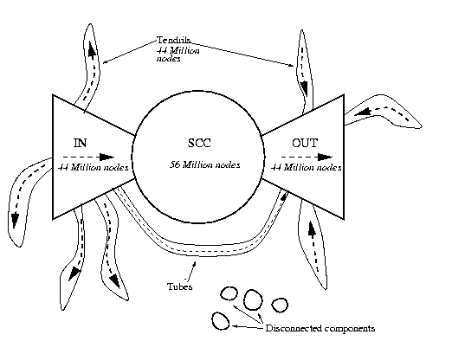
Link Structure of the Web

Slide 94
Images
<img src=“URL”> or <img src=“path/file”>
  <img src=“http://www.clis.umd.edu/IMAGES/head.gif”>
  SRC: can be url or path/file
  ALT: a text string
  ALIGN: position of the image
  WIDTH and HEIGHT: size of the image
Can use as anchor:
  <a href=URL><img src=URL2></a>
Example:
  http://www.umiacs.umd.edu/~daqingd/Image-Alignment.html

Slide 95
Tables
<table>
eenie | mennie | miney
mo | catch | a tiger
by | the | toe
<tr>
<td>
</td>
<td>
</td>
<td>
</td>
</tr>
<tr>
<td>
</td>
<td>
</td>
<td>
</td>
</tr>
<tr>
<td>
</td>
<td>
</td>
<td>
</td>
</tr>
</table>

Slide 96
Table Example
<table align=“center”>
<caption align=“right”>The caption</caption>
< tr align=“LEFT”>
<th> Header1 </th>
<th> Header2</th>
</tr>
<tr><td>first row, first item </td>
<td>first row, second item</td></tr>
< tr><td>second row, first item</td>
<td>second row, second item</td></tr>
</table>
See also: http://www.umiacs.umd.edu/~daqingd/Simple-Table.html
Notes:
Table can basically put all the html into it
Better keep with basic table elements so that you have wider auidence
Use indent to help you to read the table source data

Slide 97
Hands on:
The Internet Archive
alexa.com Web crawls since 1997
  http://archive.org
Check out the CLIS Web site from 1998!
  http://www.clis.umd.edu

Slide 98
Agenda
Computers
The Internet
The Web
About the course

Slide 99
A Personal Approach to Learning
Work ahead, so that you are never behind
Find new questions everywhere
  Then find the answers somewhere
Enrich your practical skills relentlessly
Pick topics you want to learn more about
Start thinking about your project soon
  Pick partners with complementary skills

Slide 100
The Fine Print
Group work is encouraged on homework
  But you must personally write what you turn in
Deadlines are firm and sharp
  Allowances for individual circumstances are included in the grading computation
Academic integrity is a serious matter
  No group work during the exam!
  Scrupulously respect time limits

Slide 101
Before You Go
On a sheet of paper, answer the following (ungraded) question (no names, please):
What was the muddiest point in today’s class?

