Slide 1
Software Engineering
Session 14
INFM 603

Slide 2
Software
Software represents an aspect of reality
Input and output represent the state of the world
Software describes how the two are related
Programming languages specify the model
Data structures model things
Structured programming models actions
Object-oriented programming links the two
A development process organizes the effort

Slide 3
Software Engineering
Systematic
Repeatable
Disciplined
Transferable
Quantifiable
Managable

Slide 4
Tradition
Heroic age of software development: small teams of programming demigods wrestle with many-limbed chaos to bring project to success, or die in the attempt
Kind of fun for programmers ...
… not so fun for project stakeholders!

Slide 5
The Waterfall Model
Key insight: invest in the design stage
An hour of design can save a week of debugging!
Three key documents
Requirements
Specifies what the software is supposed to do
Specification
Specifies the design of the software
Test plan
Specifies how you will know that it did it

Slide 6
The Waterfall Model
Requirements
Specification
Software
Test Plan

Slide 7
Bug Hunting
Bugs are your code not behaving as you designed it
Many can be found by testing for expected behavior
But some are not found until operational use!
Users can report bugs
And in the mean time, they need workarounds

Slide 8
Bug Tracking
Even with good processes, (alleged) bugs will still turn up in system-level products, both in development and in deployment
Tools for managing, tracking, performing statistics on such bugs and vulnerabilities essential, particularly on large projects.
A core tool is the bug tracker
e.g., Bugzilla

Slide 9
Bug Counting
How good a metric of software quality is “number of oustanding bugs”?
Are there other reasons you (as a manager) might want to introduce it as a metric?
What would you expect to be the most immediate effect if you introduced it as a metric (and tied programmer appraisal to it)?

Slide 10
Design!
Bad design leads to messy workarounds; messy workarounds lead to bugs and vulnerabilities
Catch mistakes early!
The later in the development process you find bugs, the more difficult and expensive they are to fix

Slide 11
Coding
Coding standards
Layout: readable code is easier to debug
Design Patterns: avoid common pitfalls, build code in the expected manner
Verification: code checkers
Code review
Computers don't criticize; other coders do!
Formalized in pair programming
(Proofs of correctness)
Code less
Bugs per 100 lines surprisingly invariant
Libraries: maximise re-use of code, yours and others

Slide 12
Debugging is harder than coding!
“Debugging is twice as hard as writing the code in the first place. Therefore, if you write the code as cleverly as possible, you are, by definition, not smart enough to debug it”
– Brian W. Kernighan and P. J. Plauger, The Elements of Programming

Slide 13
Testing
Manual vs. automated testing
How can you design to facilitate automation?
Unit, integration, and system testing
Test: components separately; integrated subsystems; then full system for implementation of requirements
How to design for this model of testing?
Regression testing, and test-driven development
Keep bugs fixed; keep non-bugs absent
Test, then code

Slide 14
The Spiral Model
Build what you think you need
Perhaps using the waterfall model
Get a few users to help you debug it
First an “alpha” release, then a “beta” release
Release it as a product (version 1.0)
Make small changes as needed (1.1, 1.2, ….)
Save big changes for a major new release
Often based on a total redesign (2.0, 3.0, …)

Slide 15
The Spiral Model
2.3
1.2
0.5
1.1
2.2
1.0
2.1
2.0
3.0

Slide 16
Unpleasant Realities
The waterfall model doesn’t work well
Requirements usually incomplete or incorrect
The spiral model is expensive
Rule of thumb: 3 iterations to get it right
Redesign leads to recoding and retesting

Slide 17
The Rapid Prototyping Model
Goal: explore requirements
Without building the complete product
Start with part of the functionality
That will (hopefully) yield significant insight
Build a prototype
Focus on core functionality, not in efficiency
Use the prototype to refine the requirements
Repeat the process, expanding functionality

Slide 18
Rapid Prototyping + Waterfall
Update
Requirements
Write
Specification
Initial
Requirements
Choose
Functionality
Create
Software
Build
Prototype
Write
Test Plan

Slide 19
Objectives of Rapid Prototyping
Quality
Build systems that satisfy the real requirements by focusing on requirements discovery
Affordability
Minimize development costs by building the right thing the first time
Schedule
Minimize schedule risk by reducing the chance of requirements discovery during coding

Slide 20
The Specification
Formal representation of the requirements
Represent objects and their relationships
Using a constrained entity-relationship model
Specify how the behavior is controlled
Activity diagrams, etc.

Slide 21
Characteristics of Good Prototypes
Easily built (about a week’s work)
Requires powerful prototyping tools
Intentionally incomplete
Insightful
Basis for gaining experience
Well-chosen focus (DON’T built it all at once!)
Easily modified
Facilitates incremental exploration

Slide 22
Prototype Demonstration
Choose a scenario based on the task
Develop a one-hour script
Focus on newly implemented requirements
See if it behaves as desired
The user’s view of correctness
Solicit suggestions for additional capabilities
And capabilities that should be removed

Slide 23
A Disciplined Process
Agree on a project plan
To establish shared expectations
Start with a requirements document
That specifies only bedrock requirements
Build a prototype and try it out
Informal, focused on users -- not developers
Document the new requirements
Repeat, expanding functionality in small steps

Slide 24
What is NOT Rapid Prototyping?
Focusing only on appearance
Behavior is a key aspect of requirements
Just building capabilities one at a time
User involvement is the reason for prototyping
Building a bulletproof prototype
Which may do the wrong thing very well
Discovering requirements you can’t directly use
More efficient to align prototyping with coding

Slide 25
Agile Methods
Prototypes that are “built to last”
Planned incremental development
For functionality, not just requirements elictitation
Privileges time and cost
Functionality becomes the variable

Slide 26
Agile Methods
Return to the heroic age of software development: small teams of programming demigods wrestle with many-limbed chaos to bring project to success, or die in the attempt
Kind of fun for programmers ...
… and for project stakeholders!

Slide 27
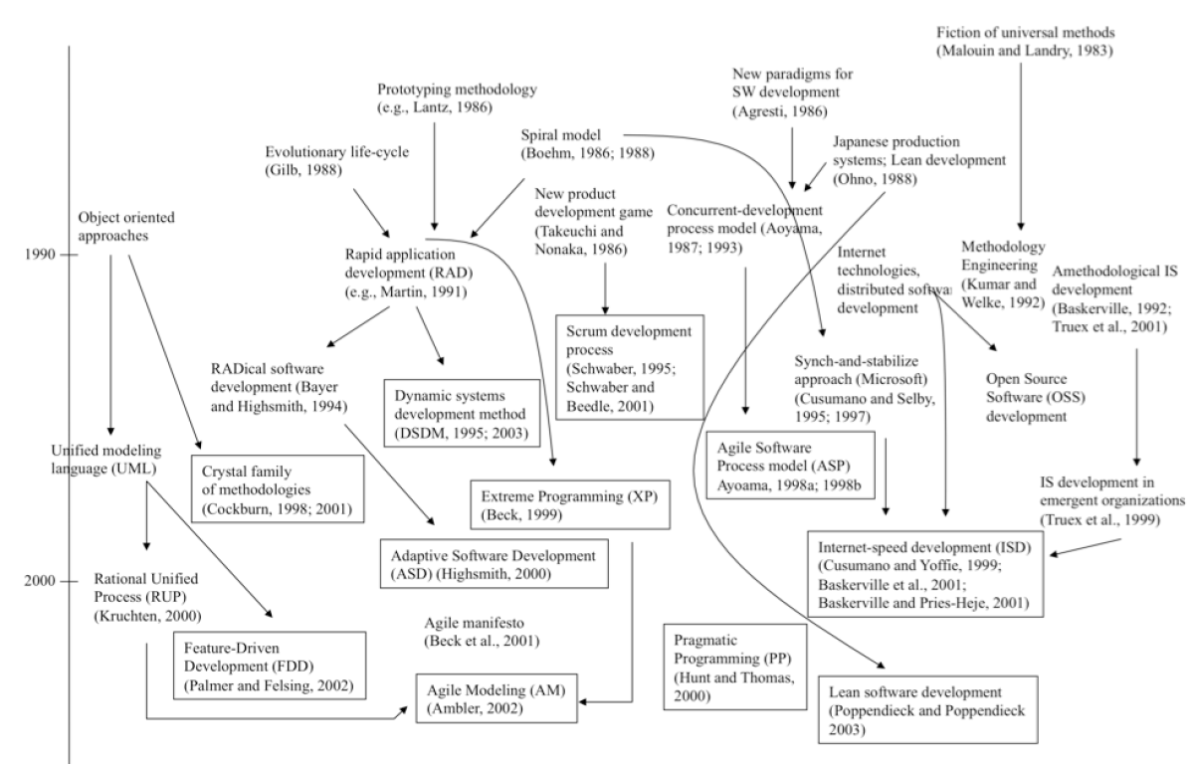
Agile Methods

Slide 28
Comparing Agile Methods

