Slide 1

XML + Ajax
Week 13
INFM 603

Slide 2
Agenda
Questions
XML
Web Services
Ajax
CSS?
Drupalcon
Project discussion

Slide 3
History of Structured Documents
Early standards were “typesetting languages”
  NROFF, TeX, LaTeX, SGML
HTML was developed for the Web
Specialized standards met other needs
  Change tracking in Word, annotating manuscripts, …
XML seeks to unify these threads
  One standard format for printing, viewing, processing

Slide 4
eXtensible Markup Language (XML)
SGML was too complex
HTML was too simple
Goals for XML
  Easily adapted to specific tasks
    Rendering Web pages
    Encoding metadata
    “Semantic Web”
  Easily created
  Easily processed
  Easily read
  Concise

Slide 5
The XML Family Tree
SMIL
VoiceXML
RSS
XHTML
MathML
RDF
HTML
TEI
. . .
. . .
XML
SGML

Slide 6
Some XML Applications
Text Encoding Initiative
  For adding annotation to historical manuscripts
  http://www.tei-c.org/
Encoded Archival Description
  To enhance automated processing of finding aids
  http://www.loc.gov/ead/
Metadata Encoding and Transmission Standard
  Bundles descriptive and administrative metadata
  http://www.loc.gov/standards/mets/

Slide 7
XHTML: Cleaning up HTML
<?xml version="1.0" encoding="iso-8859-1"?>
<html xmlns="http://www.w3.org/TR/xhtml1" >
<head>
<title> Title of text XHTML Document </title>
</head>
<body>
<div class="myDiv">
<h1> Heading of Page </h1>
<p> here is a paragraph of text. I will include inside this paragraph
a bunch of wonky text so that it looks fancy. </p>
<p>Here is another paragraph with <em>inline emphasized</em>
text, and <b> absolutely no</b> sense of humor. </p>
<p>And another paragraph, this one with an <img src="image.gif"
alt="waste of time" /> image, and a <br /> line break. </p>
</div>
</body></html>

Slide 8

Really Simple Syndication (RSS)
<?xml version="1.0"?>
<rss version="2.0">
<channel>
<title>Lift Off News</title>
<link>http://liftoff.msfc.nasa.gov/</link>
<description>Liftoff to Space Exploration.</description>
<language>en-us</language>
<pubDate>Tue, 10 Jun 2003 04:00:00 GMT</pubDate>
<lastBuildDate>Tue, 10 Jun 2003 09:41:01 GMT</lastBuildDate>
<docs>http://blogs.law.harvard.edu/tech/rss</docs>
<generator>Weblog Editor 2.0</generator>
<managingEditor>editor@example.com</managingEditor>
<webMaster>webmaster@example.com</webMaster>
<ttl>5</ttl>
<item>
<title>Star City</title>
<link>http://liftoff.msfc.nasa.gov/news/2003/news-starcity.asp</link>
<description>How do Americans get ready to work with Russians aboard the International Space Station? They take
a crash course in culture, language and protocol at Russia's Star City.</description>
<pubDate>Tue, 03 Jun 2003 09:39:21 GMT</pubDate>
<guid>http://liftoff.msfc.nasa.gov/2003/06/03.html#item573</guid>
</item>
</channel>
</rss>
See example at http://www.nytimes.com/services/xml/rss/

Slide 9
Atom Feeds
<?xml version="1.0" encoding="utf-8"?>
<feed xmlns="http://www.w3.org/2005/Atom">
<title>Example Feed</title>
<subtitle>A subtitle.</subtitle>
<link href="http://example.org/feed/" rel="self"/>
<link href="http://example.org/"/>
<updated>2003-12-13T18:30:02Z</updated>
<author>
<name>John Doe</name>
<email>johndoe@example.com</email>
</author>
<id>urn:uuid:60a76c80-d399-11d9-b91C-0003939e0af6</id>
<entry>
<title>Atom-Powered Robots Run Amok</title>
<link href="http://example.org/2003/12/13/atom03"/>
<id>urn:uuid:1225c695-cfb8-4ebb-aaaa-80da344efa6a</id>
<updated>2003-12-13T18:30:02Z</updated>
<summary>Some text.</summary>
</entry>
</feed>

Slide 10
Synchronized Multimedia Integration Language (SMIL)
Window controls (in <head>)
  Controlling layout: <region>, <root-layout>
Timeline controls (in <body>)
  Sequence control: <seq>, <excl>, <par>
  Timing control: <begin>, <end>, <dur>
Content types (in <body>)
  <audio>, <video>, <img>, <ref>

Slide 11
XML: A Family of Standards
Definition: DTD or Schema
  Known types of entities with “labels”
  Defines part-whole and is-a relationships
Markup: XML
  “Tags” regions of text with labels
Presentation: XSLT
  Specifies how each type of entity should be rendered

Slide 12
Some Basic Rules for All XML
XML is case sensitive
XML declaration is the first statement
  <?xml version="1.0"?>
An XML document is a “tree”
  Must contain one root element
  Other elements must be properly nested
All start tags must have end tags
Attribute values must have quotation marks
  <item id=“33905”>
Certain characters are “reserved”
  For example: &lt; is used to represent <

Slide 13
XML Example
View “The Song of the Wandering Aengus”
  See related materials with this week’s slides
Built from three files
  yeats01.xml
  poem01.dtd
  poem01.xsl
Notes:
What is XML? What

Slide 14
XML Example
<?xml version="1.0"?>
<!DOCTYPE POEM SYSTEM "poem01.dtd">
<?xml-stylesheet type="text/xsl" href="poem01.xsl"?>
<POEM>
<TITLE>The Song of Wandering Aengus</TITLE>
<AUTHOR> <FIRSTNAME>W.B.</FIRSTNAME>
<LASTNAME>Yeats</LASTNAME>
</AUTHOR>
<STANZA>
<LINE>I went on to the hazel wood,</LINE>
<LINEIN>Because a fire was in my head,</LINEIN>
<LINE>And cut and peeled a hazel wand,</LINE>
</STANZA>
</POEM>

Slide 15
Document Type Definition (DTD)
<!ELEMENT poem ( (title, author, stanza)* )>
<!ELEMENT title (#PCDATA) >
<!ELEMENT author (firstname, lastname) >
<!ELEMENT firstname (#PCDATA) >
<!ELEMENT lastname (#PCDATA) >
<!ELEMENT stanza (line+ | linein+) >
<!ELEMENT line (#PCDATA) >
<!ELEMENT linein (#PCDATA) >
#PCDATA span of text
a,b a followed by b
a|b either a or b
a* 0 or more a’s
a+ 1 or more a’s
Notes:
DTD defines a document type in
1. Its vocabulary, what kind of elements are allowed in the document type.
2. It defines a content model for each element. A content model is a pattern that tells what elements or data can go inside an element, in what order, in what number, and whether they are required or optional. Think of this as the “grammar” of the attribute.
#PCDATA => parsed character data. The characters will be checked by an XML parser for entity reference, which will then be replaced with their entity values

Slide 16
Specifying Appearance: XSL(T)
<xsl:template match="POEM">
<HTML>
<BODY BGCOLOR="#FFFFCC">
<xsl:apply-templates/>
</BODY>
</HTML>
</xsl:template>
<xsl:template match="TITLE">
<H1>
<FONT COLOR="Green">
<xsl:value-of/>
</FONT>
</H1>
</xsl:template>
Notes:
Extensible Stylesheet language XSL
http://www.w3.org/Style/CSS-vs-XSL

Slide 17
Multiple XML Namespaces
<?xml version="1.0"?>
<rdf:RDF
xmlns:rdf="http://www.w3.org/1999/02/22-rdf-syntax-ns#"
xmlns:rss="http://purl.org/rss/1.0/"
xmlns:dc="http://purl.org/dc/elements/1.1/">
<rss:channel rdf:about="http://www.xml.com/xml/news.rss">
<rss:title>XML.com</rss:title>
<rss:link>http://xml.com/pub</rss:link>
<dc:description>
XML.com features a rich mix of
information and services for the XML community.
</dc:description>
<dc:subject>XML, RDF, metadata, information
syndication services</dc:subject>
<dc:identifier>http://www.xml.com</dc:identifier>
<dc:publisher>O'Reilly & Associates, Inc.</dc:publisher>
<dc:rights>Copyright 2000, O'Reilly &
Associates, Inc.</dc:rights>
</rss:channel>
</rdf:RDF>
Example from http://www.xml.com/pub/a/2000/10/25/dublincore/

Slide 18
XML DOM Parser (IE)
doc = new ActiveXObject(“Msxml2.DOMDocument.6.0”);
doc.async = false;
doc.load(“sports.xml”);
result = doc.selectNodes (“/sports/game/name”);
for (i in result) {
document.writeln(result.item(i).text + “<br />”);
}

Slide 19
Resource Description Framework
<http://dbpedia.org/resource/Ayn_Rand> <http://dbpedia.org/ontology/deathDate>
"1982-0306"^^<http://www.w3.org/2001/XMLSchema#date> . <http://dbpedia.org/resource/Ayn_Rand> <http://dbpedia.org/ontology/birthPlace> <http://dbpedia.org/resource/Russian_Empire> .
<http://dbpedia.org/resource/Ayn_Rand> <http://dbpedia.org/ontology/birthPlace>
<http://dbpedia.org/resource/Saint_Petersburg,_Russia> . <http://dbpedia.org/resource/Ayn_Rand> <http://dbpedia.org/ontology/birthDate>
"1905-02-02"^^<http://www.w3.org/2001/XMLSchema#date> . <http://dbpedia.org/resource/Ayn_Rand> <http://purl.org/dc/elements/1.1/description>
"novelist, philosopher, playwright, screenwriter"@en . <http://dbpedia.org/resource/Ayn_Rand> <http://www.w3.org/1999/02/22-rdf-syntax-ns#type>
<http://xmlns.com/foaf/0.1/Person> .
<http://dbpedia.org/resource/Ayn_Rand> <http://xmlns.com/foaf/0.1/givenName>
"Ayn"@en .
<http://dbpedia.org/resource/Ayn_Rand> <http://xmlns.com/foaf/0.1/surname>
"Rand"@en .
<http://dbpedia.org/resource/Ayn_Rand> <http://xmlns.com/foaf/0.1/name>
"Ayn Rand"@en .

Slide 20
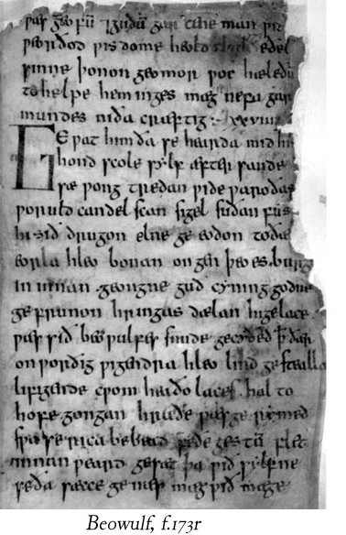
Representing Complex Structures
Concurrent hierarchies
Standoff annotation

Slide 21
Networked Data Exchange
Service-Oriented
  Network of Workstations
  Web API
  Web services
  Service Oriented Architecture
Content-oriented
  Web scraping
  Microformats
  Data repositories
  Linked data
Mashups

Slide 22
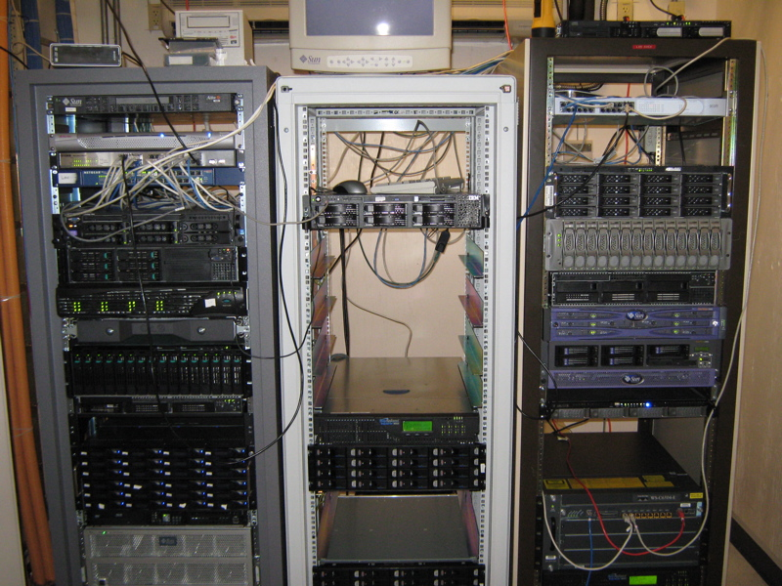
The World’s Largest Supercomputer

Slide 23
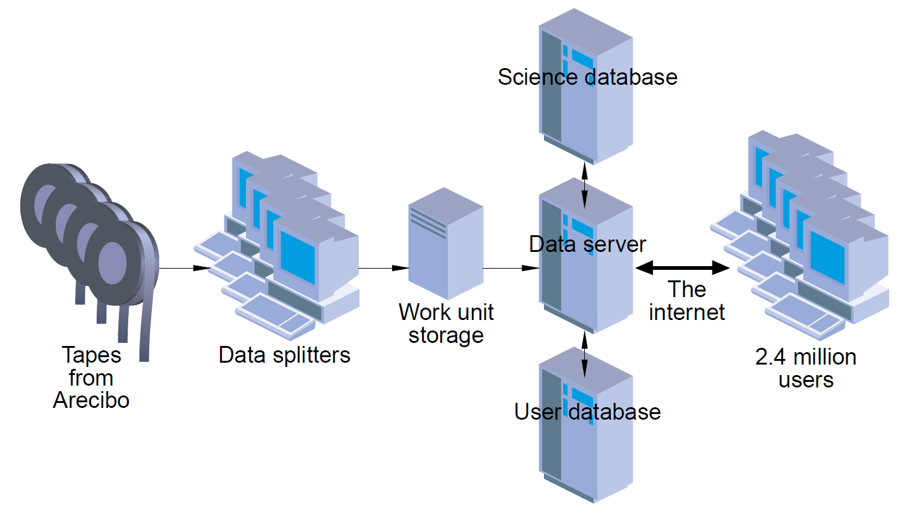
SETI@Home:
Network of Workstations

Slide 24
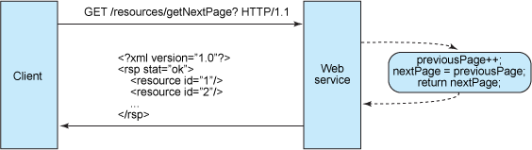
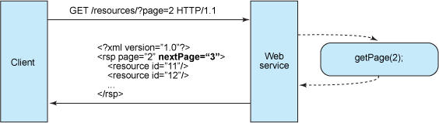
Web Services
Stateful:
RESTful:

Slide 25
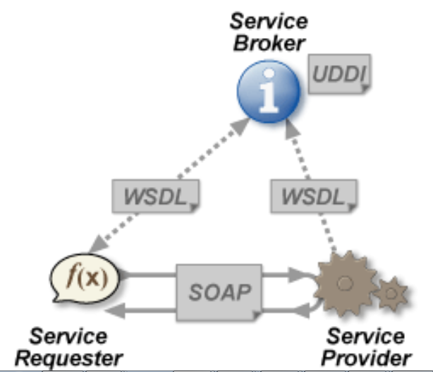
Web Services

Slide 26
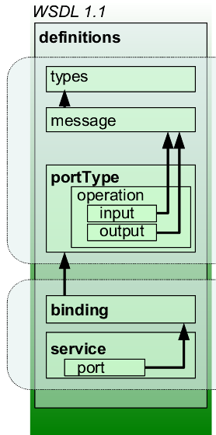
WSDL
<?xml version="1.0" encoding="UTF-8"?>
<definitions name="HugeIntegerService"
targetNamespace="http://hugeinteger.ch28.iw3htp4.deitel.com/"
xmlns:soap="http://schemas.xmlsoap.org/wsdl/soap/"
xmlns:xsd="http://www.w3.org/2001/XMLSchema"
xmlns:tns="http://hugeinteger.ch28.iw3htp4.deitel.com/"
xmlns="http://schemas.xmlsoap.org/wsdl/">
<types><xsd:schema>
<xsd:import xmlns:soap12="http://schemas.xmlsoap.org/wsdl/soap12/"
xmlns:wsdl="http://schemas.xmlsoap.org/wsdl/"
schemaLocation="http://pjd:8080/HugeInteger/HugeIntegerService/
__container$publishing$subctx/WEB-INF/wsdl/HugeIntegerService_schema1.xsd"
namespace="http://hugeinteger.ch28.iw3htp4.deitel.com/"/>
</xsd:schema>
</types>
<message name="add"><part name="parameters" element="tns:add"/></message>
<message name="addResponse"><part name="parameters" element="tns:addResponse"/>
</message>
“ …
<soap:binding style="document" transport="http://schemas.xmlsoap.org/soap/http"/>
<operation name="add"><soap:operation soapAction=""/>
<input><soap:body use="literal"/></input>
<output><soap:body use="literal"/></output></operation>
<operation name="equals"><soap:operation soapAction=""/>
<input><soap:body use="literal"/></input><output>
<soap:body use="literal"/></output>
</operation>
…
<service name="HugeIntegerService">
<port name="HugeIntegerPort" binding="tns:HugeIntegerPortBinding">
<soap:address xmlns:soap12="http://schemas.xmlsoap.org/wsdl/soap12/" xmlns:wsdl="http://schemas.xmlsoap.org/wsdl/" location="http://pjd:8080/HugeInteger/HugeIntegerService"/>
</port>
</service>
</definitions>

Slide 27
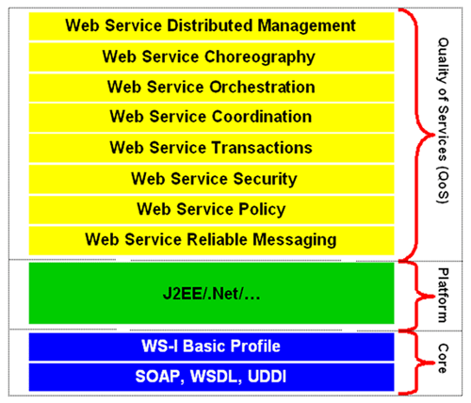
Services Oriented Architecture

Slide 28
Networked Data Exchange
Service-Oriented
  Network of Workstations
  Web API
  Web services
  Service Oriented Architecture
Content-oriented
  Web scraping
  Microformats
  Data repositories
  Linked data
Mashups

Slide 29
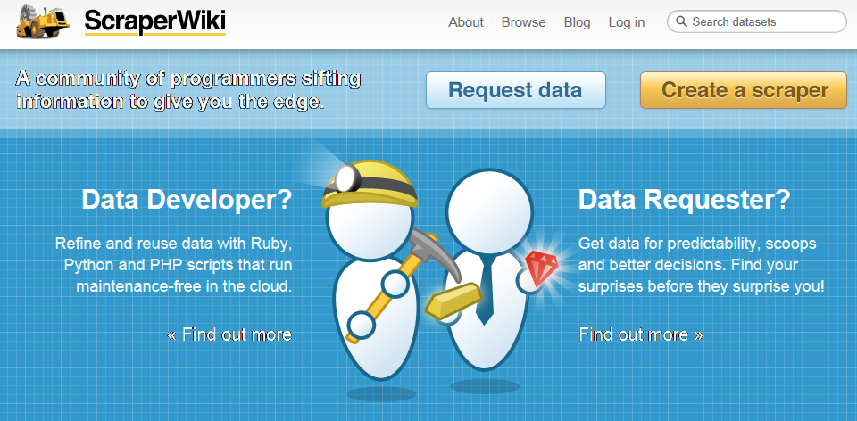
Web Scraping

Slide 30
Microformats
Human-Readable
Human- and Machine-Readable
<div id="contact">
<h2>Contact Me</h2>
<p> You can contact me via email to <a href="mailto:jane@example.com">jane@example.com</a>, or send stuff to me at the following address:</p>
<p>255 Some Street,<br />
Some Place,<br />
Some Town</p>
</div>
<div id="contact" class="vcard">
<h2>Contact Me</h2>
<h3 class="fn">Jane Doe</h3>
<p> You can contact me via email to <a class="email" href="mailto:jane@example.com">jane@example.com</a>, or reach me at the following address:</p>
<div class="adr">
<div class="street-address">255 Some Street</div>
<div class="locality">Some Town</div>
<div class="region">Some Place</div>
</div> </div>

Slide 31
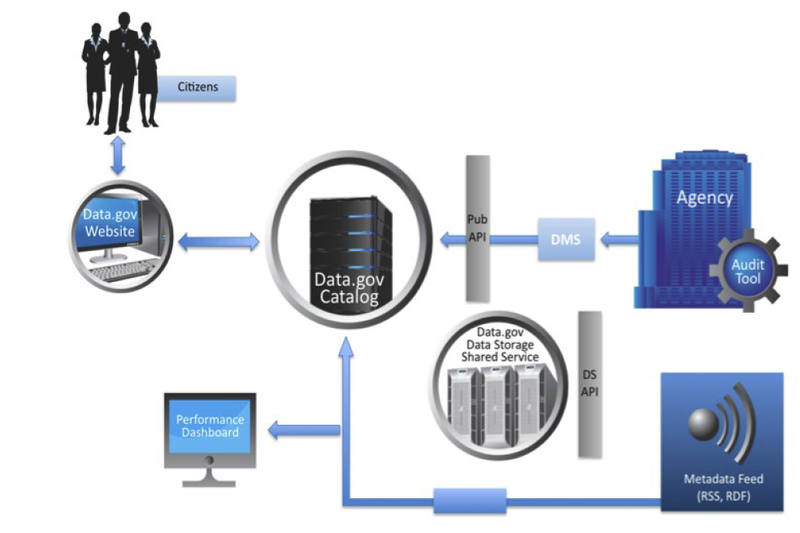
Data.gov

Slide 32
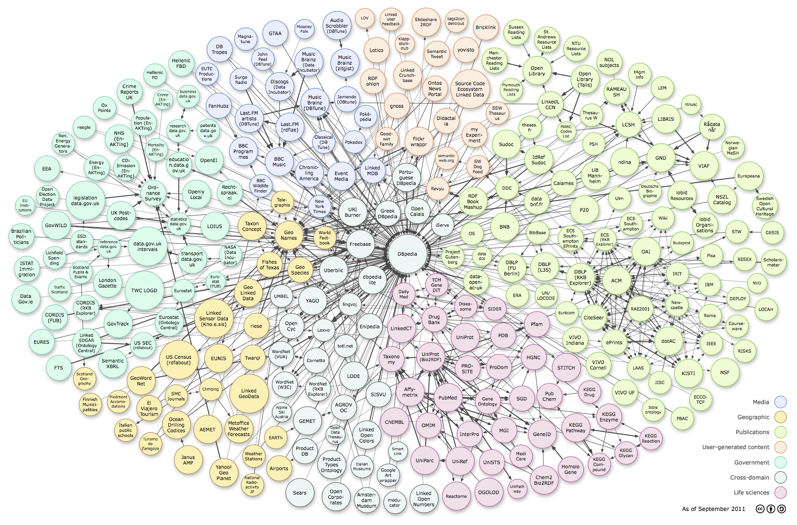
Linked Open Data

Slide 33
Networked Data Exchange
Service-Oriented
  Network of Workstations
  Web API
  Web services
  Service Oriented Architecture
Content-oriented
  Web scraping
  Microformats
  Data repositories
  Linked data
Mashups

Slide 34
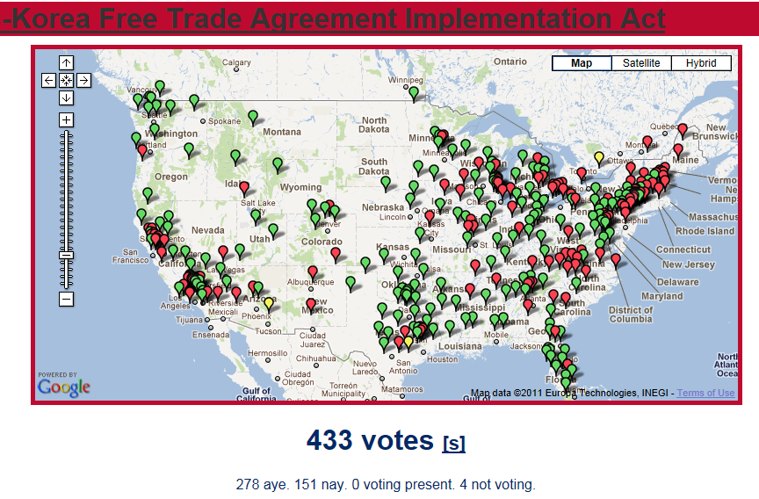
Mashups

Slide 35
Relational normalization
Structured programming
Software patterns
Object-oriented design
Functional decomposition
Client Hardware
(PC)
Interface
Design
Web Browser
(IE, Firefox)
Client-side Programming
(JavaScript)
Interaction
Design
Interchange Language
(HTML, XML)
Server-side Programming
(PHP)
Business
rules
Database
(MySQL)
Server Hardware
(PC, Unix)

Slide 36
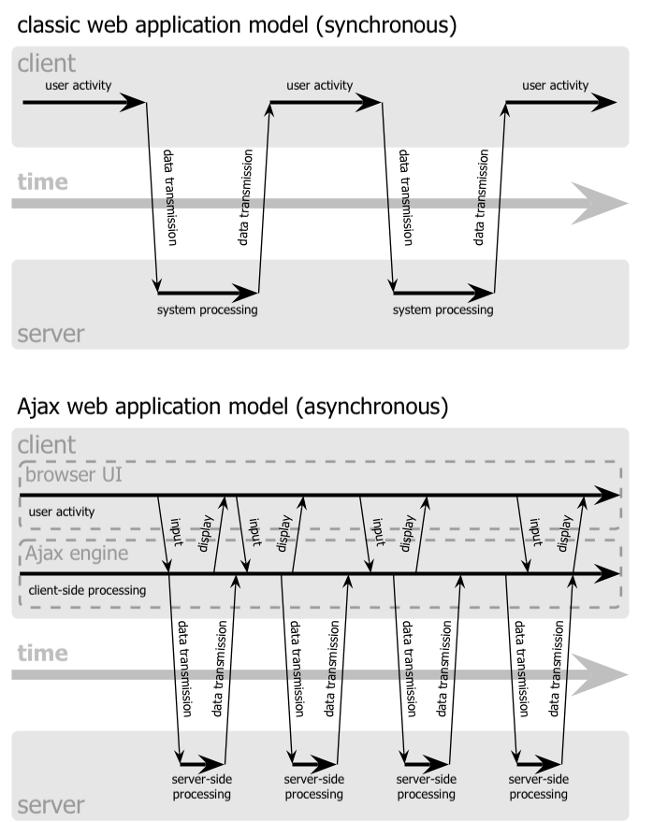

Slide 38
Sajax: Simple Ajax for PHP http://www.modernmethod.com/sajax/
<?
require("Sajax.php");
function multiply($x, $y) {
return $x * $y;
}
sajax_init();
// $sajax_debug_mode = 1;
sajax_export("multiply");
sajax_handle_client_request();
?>

Slide 39
<html><head>
<title>Multiplier</title>
<script>
<?
sajax_show_javascript();
?>
function do_multiply_cb(z) {
document.getElementById("z").value = z;
}
function do_multiply() {
// get the folder name
var x, y;
x = document.getElementById("x").value;
y = document.getElementById("y").value;
x_multiply(x, y, do_multiply_cb);
}
</script>
</head>
<body>
<input type="text" name="x" id="x" value="2" size="3">
*
<input type="text" name="y" id="y" value="3" size="3">
=
<input type="text" name="z" id="z" value="" size="3">
<input type="button" name="check" value="Calculate"
onclick="do_multiply(); return false;">
</body></html>

Slide 40
Communication methods
GET/POST (client to server) – simple data
XML (the “X” in AJAX)
  Structured data between client and server.
  Client responsible for updating page
JSON – a light-weight alternative to XML
HTML (server to client) – server sends rendered result
Widget – GUI library hiding (some) AJAX details (e.g. DoJo)

Slide 41
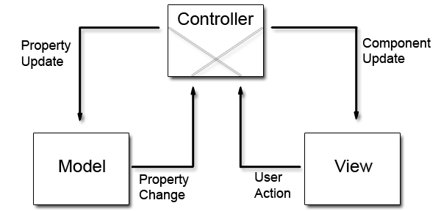
Model-View-Controller

Slide 42
Object-relational model (ORM)
In naïve webapp, data has three lives:
  Row in database
  Variable in program (field of object)
  Parameter in request (HTTP POST)
ORM wraps database in object-oriented code (table rows look like objects)
MVC allows near-transparent extension to Web forms, parameters.

Slide 43
CSS
Separating content and structure from appearance
Rules for defining styles “cascade” from broad to narrow:
  Browser default
  External style sheet
  Internal style sheet
  Inline style

Slide 44
Basics of CSS
Basic syntax:
Example:
Causes
  Font to be center-aligned
  Font to be Arial and black
selector {property: value}
HTML tag you want to modify…
The property you want to change…
The value you want the property to take
p { text-align: center;
color: black;
font-family: arial }

Slide 45
Different Ways of Using CSS
Inline style:
  Causes only this tag to have the desired properties
Internal stylesheet:
  Causes all tags to have the desired properties
<p style="font-family:arial; color:blue“>…</p>
…
<head>…
<style type="text/css" >
p { font-family:arial; color:blue}
</style>
</head>
<body>
<p>…</p>
…

Slide 46
Customizing Classes
Ability to define customized styles for standard HTML tags:
…
<head>…
<style type="text/css">
p.style1 { font-family:arial; color:blue}
p.style2 { font-family:serif; color:red}
</style>
</head>
<body>
<p class=“style1“>…</p>
<p class=“style2“>…</p>
…

Slide 47
External Style Sheets
Store formatting metadata in a separate file
mystyle.css
p.style1 { font-family:arial; color:blue}
p.style2 { font-family:serif; color:red}
…
<head>…
<link rel="stylesheet" href="mystyle.css" type="text/css" />
</head>
<body>
<p class=“style1">…</p>
<p class=“style2">…</p>
…

