Slide 1
Requirements Analysis
Session 12
INFM 603

Slide 2
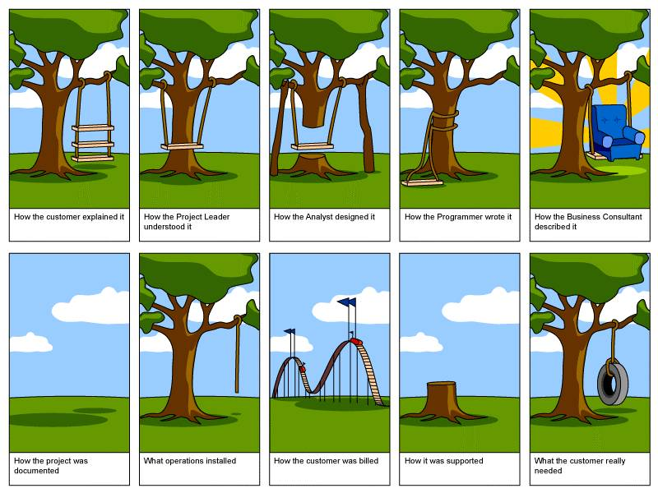
Different Perspectives on Design
Thanks to Satish Mishra

Slide 3
The System Life Cycle
Systems analysis
  How do we know what kind of system to build?
User-centered design
  How do we discern and satisfy user needs?
Implementation
  How do we build it?
Management
  How do we use it?
Notes:
3

Slide 4
Systems Analysis
First steps:
  Understand the task
    Limitations of existing approaches
  Understand the environment
    Structure of the industry, feasibility study
Then identify the information flows
  e.g., Serials use impacts cancellation policy
Then design a solution
  And test it against the real need
Notes:
4

Slide 5
What are Requirements?
Attributes
  Appearance
  Concepts (represented by data)
Behavior
  What it does
  How you control it
  How you observe the results

Slide 6
Types of Requirements
User-centered
  Functionality
System-centered
  Availability
    Mean Time Between Failures (MTBF)
    Mean Time To Repair (MTTR)
  Capacity
    Number of users for each application
    Response time
  Flexibility
    Upgrade path
Notes:
9

Slide 7
Who Sets the Requirements?
People who need the task done (customers)
People that will operate the system (users)
People who use the system’s outputs
People who provide the system’s inputs
Whoever pays for it (sponsor)

Slide 8

The Waterfall Model
Requirements
Specification
Software
Test Plan

Slide 9
Agile Methods
Specification
Release
Implementation
Requirements
Establishment
Experience

Slide 10
The Requirements Interview
Focus the discussion on the task
  Look for objects that are mentioned
Discuss the system’s most important effects
  Displays, reports, data storage, device control, …
Learn where the system’s inputs come from
  People, stored data, devices, …
Note any data that is mentioned
  Try to understand the structure of the data
Shoot for the big picture, not every detail

Slide 11
Analyze the Information Flows
Where does information originate?
  Might come from multiple sources
  Feedback loops may have no identifiable source
Which parts should be automated?
  Some things are easier to do without computers
Which automated parts should be integrated?
What existing systems are involved?
  What information do they contain?
  Which systems should be retained?
  What data will require “retrospective conversion”?
Notes:
7

Slide 12
Interaction Modality Choices
Interactive
  Do it while the user is present
Batch processing
  Save it up and do it all at once

Slide 13
Unified Modeling Language
Real systems are more complex than anyone can comprehend
Key idea: Progressive refinement
  Carve the problem into pieces
  Carve each piece into smaller pieces
  When the pieces are small enough, code them
UML provides a formalism for doing this
  But it does not provide the process

Slide 14
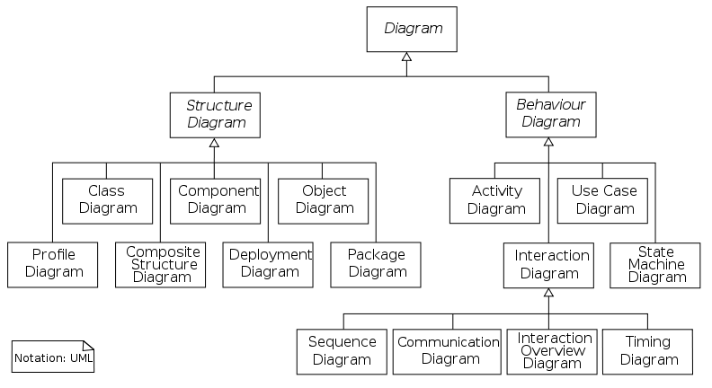
Unified Modeling Language

Slide 15
Specifying Structure
Capturing the big picture
  Use case diagram (interactions with the world)
  Narrative
  Scenarios (examples to provoke thinking)
Designing the object structure
  Class diagram (“entity-relationship” diagram)
  Object diagram (used to show examples)

Slide 16
Specifying Behavior
Represent a candidate workflow
  Activity diagram (a “flowchart”)
Represent object interactions for a scenario
  Collaboration diagram (object-based depiction)
  Sequence diagram (time-based depiction)
Represent event-object interactions
  Statechart diagram (a “finite state machine”)

Slide 17
Use Case Design
Use Case Diagram
  Input-output behavior
Use Case Narrative
  Explains each use case
Use Case Scenario
  Activity diagram shows how the use cases are used together

Slide 18
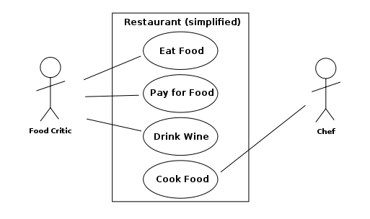
Use Case Diagram

Slide 19
Use Case Diagram
External “actors”
  Roles of people
  Types of systems
Use cases
  Top-level functions (solid arrows to/from actors)
Relationships among use cases
  Always-depends-on (dashed <<include>>)
  Sometimes-is-depended-on (dashed <<extend>>)
  Inherits-from (solid triangle-arrow)

Slide 20
Activity Diagram: Modeling Decisions

Slide 21
Sequence Diagram
Activation
Message
Thanks to Satish Mishra

Slide 22
Good Uses for UML
Focusing your attention
  Design from the outside in
Representing partial understanding
  Says what you know, silent otherwise
Validate that understanding
  Structuring communication with stakeholders

Slide 23
Avoiding UML Pitfalls
Don’t sweat the notation too much
  The key is to be clear about what you mean!
Don’t try to make massive conceptual leaps
  Leverage abstraction encapsulation
Don’t get to attached to your first design
  Goal is to find weaknesses in your understanding

Slide 24
Total Cost of Ownership
Planning
Installation
  Facilities, hardware, software, integration, migration, disruption
Training
  System staff, operations staff, end users
Operations
  System staff, support contracts, outages, recovery, …
Notes:
24
13

Slide 25
Management Issues
Policy
  Privacy, access control, appropriate use, …
Training
  System staff, organization staff, “end users”
Operations
  Fault detection and response
  Backup and disaster recovery
  Audit
  Cost control (system staff, periodic upgrades, …)
Planning
  Capacity assessment, predictive reliability, …
Notes:
13

Slide 26
Strategic Choices
Acquisition
  Proprietary (“COTS”)
  Open source
Implementation
  Integrate “Best-of-breed” systems
  “One-off” custom solution
Notes:
26
4

Slide 27
Open Source “Pros”
More eyes ⇒ fewer bugs
Iterative releases ⇒ rapid bug fixes
Rich community ⇒ more ideas
  Coders, testers, debuggers, users
Distributed by developers ⇒ truth in advertising
Open data formats ⇒ Easier integration
Standardized licenses

Slide 28
Open Source “Cons”
Communities require incentives
  Much open source development is underwritten
Developers are calling the shots
  Can result in feature explosion
Proliferation of “orphans”
Diffused accountability
  Who would you sue?
Fragmentation
  “Forking” may lead to competing versions
Little control over schedule

Slide 29
Open Source Business Models
Support Sellers
Loss Leader
Widget Frosting
Accessorizing
Sell distribution, branding, and after-sale services.
Give away the software to make a market for proprietary software.
If you’re in the hardware business, giving away software doesn’t hurt.
Sell accessories:
books, compatible hardware, complete systems with pre-installed software

Slide 30
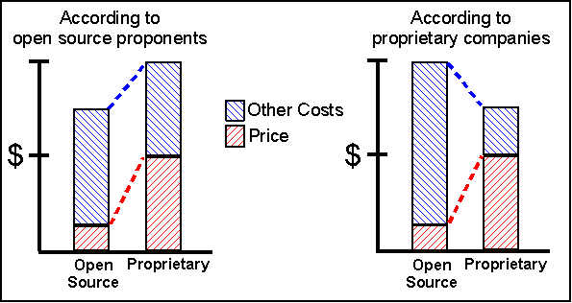
Total Cost of Ownership

Slide 31
Summary
Systems analysis
  Required for complex multi-person tasks
User-centered design
  Multiple stakeholders complicate the process
Implementation
  Architecture, open standards, …
Management
  Typically the biggest cost driver
Notes:
14

