Slide 1

Virtualization
Session 8
INST 346

Slide 2
Software Stack
Application Program (“App”)
API
Runtime environment
Operating System
BIOS
Hardware drivers
Microcode

Slide 3
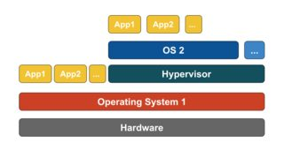
Emulation

Slide 4
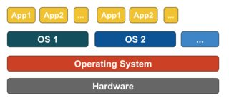
Paravirtualization

Slide 5
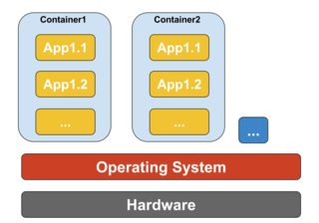
Containerization

Slide 6
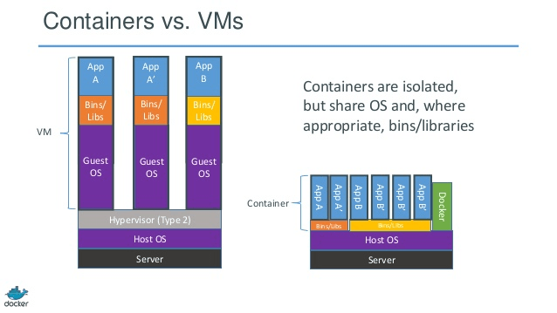

Slide 7
Other “Virtualizations”
Data Virtualization
  Session 34
Network Virtualization
  Not this semester

Slide 8
Getahead: Encryption

Slide 9



The language of cryptography
Alice’s
encryption
key
Bob’s
decryption
key
K
K
A
B
plaintext
encryption
algorithm
ciphertext
decryption
algorithm
plaintext
m plaintext message
K_{A}(m) ciphertext, encrypted with key K_{A}
m = K_{B}(K_{A}(m))

Slide 10
Symmetric key cryptography
K
K
S
S
plaintext
message, m
encryption
algorithm
ciphertext
decryption
algorithm
plaintext
K (m)
m = K_{S}(K_{S}(m))
S
symmetric key crypto: Bob and Alice share same (symmetric) key: K
e.g., key is knowing substitution pattern in mono alphabetic substitution cipher
S

Slide 11
Simple encryption scheme
substitution cipher: substituting one thing for another
  monoalphabetic cipher: substitute one letter for another
plaintext: abcdefghijklmnopqrstuvwxyz
ciphertext: mnbvcxzasdfghjklpoiuytrewq
e.g.:
Plaintext: bob. i love you. alice
ciphertext: nkn. s gktc wky. mgsbc
Encryption key: mapping from set of 26 letters
to set of 26 letters

Slide 12
Stream and Block Ciphers
n substitution ciphers, M₁,M₂,…,M_{n}
cycling pattern:
  e.g., n=4: M₁,M₃,M₄,M₃,M₂; M₁,M₃,M₄,M₃,M₂; ..
  random initialization
for each new plaintext symbol, use subsequent substitution pattern in cyclic pattern
  dog: d from M₁, o from M₃, g from M₄
  Encryption key: n substitution ciphers, and cyclic pattern

Slide 13
AES: Advanced Encryption Standard
symmetric-key NIST standard, replaced DES (Nov 2001)
processes data in 128 bit blocks
128, 192, or 256 bit keys
brute force decryption (try each key) taking 1 sec on DES, takes 149 trillion years for AES

Slide 14
Before You Go
On a sheet of paper, answer the following (ungraded) question (no names, please):
What was the muddiest point in today’s class?

